Slide 1

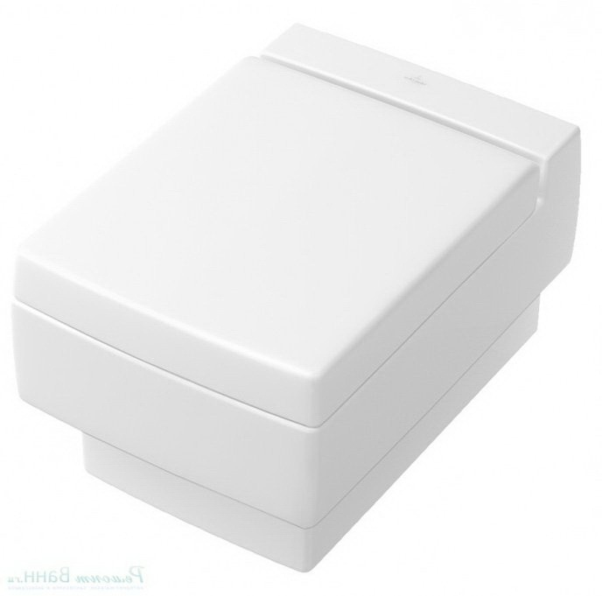
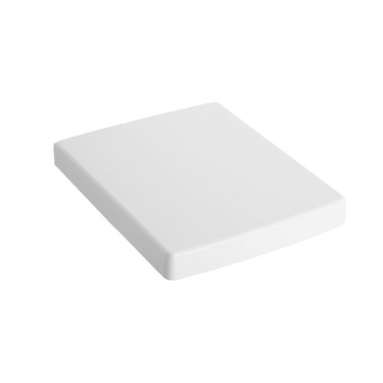
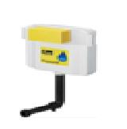
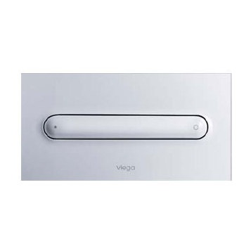
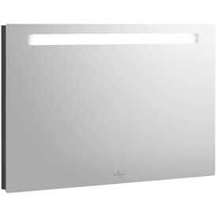
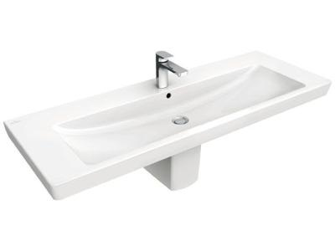
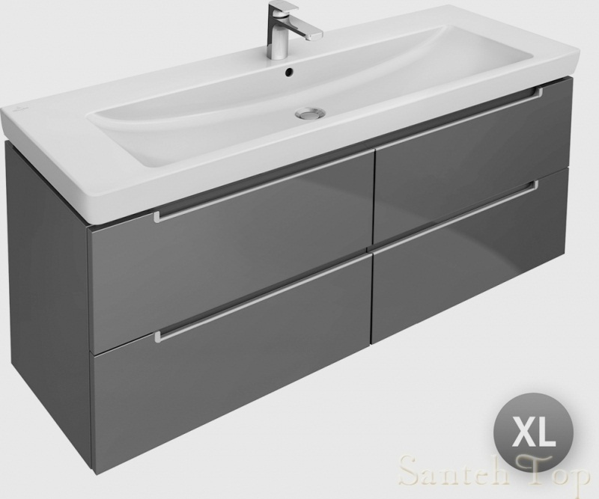
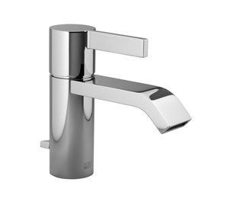

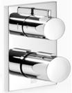
MBR
Brand | Item Name | Description | Color | Quantity | Unit Price | Special Price | Total
MEMENTO | 562810R1 | Memento Wall Hung WC with hinges and black bush | White Alpin cermaicplus | 1 | 48045.00 | 48045.00 | 48045.00
MEMENTO | 9M17S1R1 | Memento Soft Closing Seat and Cover | White Alpin cermaicplus | 1 | 19833.00 | 19833.00 | 19833.00
- | 8864.4-622220 | Concealed Cistern with connector pipe and rubber bush | N-A | 1 | 6500.00 | 6500.00 | 6500.00
Style 11 | 8331.1-597115 | Vision for Style 11 flush plate with rods | Chrome | 1 | 10950.00 | 10950.00 | 10950.00
Subway 2.0 | A373D000 | Subway 2.0 Mirror.Size: 300 x 600 x 50 | N-A | 1 | 84321.00 | 84321.00 | 84321.00
Subway-2 1tap | 7176D001 | VanityWashbasin With 1Tap Hole, Over Flow Size: 1300x 470 mm. | White Alpin | 1 | 61148.00 | 61148.00 | 61148.00
Subway 2.0 | A69800DH | Vanity Unit.Size: 1287x524x449mm. | Glossy White | 1 | 120750.00 | 120750.00 | 120750.00
IMO | 3350067000 | Single-lever Basin Mixer | Chrome | 1 | 40860.00 | 40860.00 | 40860.00
Dornbracht | 2854967000 | Rain Shower W/Wall Fixing | Chrome | 1 | 61978.00 | 61978.00 | 61978.00
Dornbracht | 3642667000 | Con.Thermostat With Two Function Vol.Control | Chrome | 1 | 42028.00 | 42028.00 | 42028.00

Slide 2
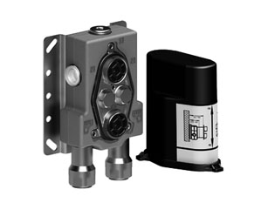
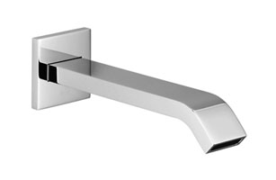
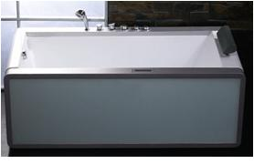
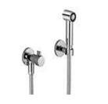


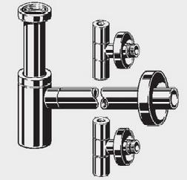
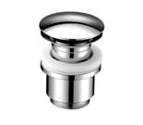
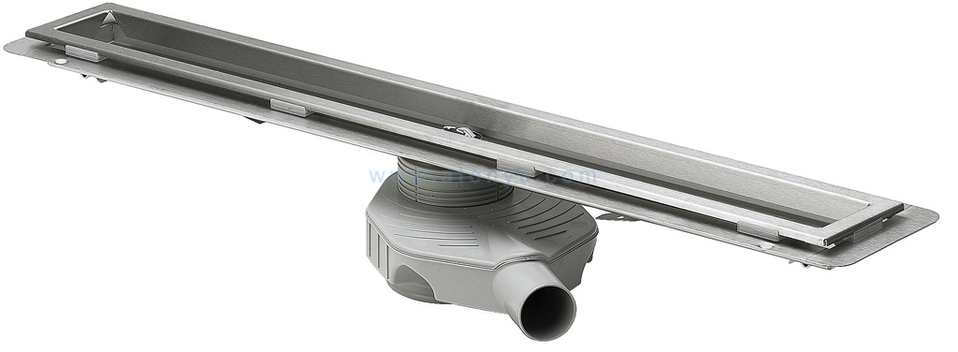
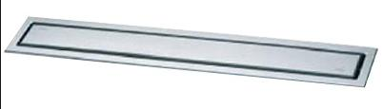
MBR
Brand | Item Name | Description | Color | Quantity | Unit Price | Special Price | Total
IMO | 35426970-90 | Thermostat with Two Function volume control- .Concealed Part. | Chrome | 1 | 40385.00 | 40385.00 | 40385.00
IMO | 1380167000 | Bath spout for wall mounting 1/2inc | Chrome | 1 | 39653.00 | 39653.00 | 39653.00
SIRIUS | SAT1510J-L | Left Hand Side Whirlpool Bath tub with TS Control system | White | 1 | 233000.00 | 233000.00 | 233000.00
Generic | 27700970-00 | Bidet spray | Chrome | 1 | 34352.00 | 34352.00 | 34352.00
Essentials | Fischer Bolt | Fischer Bolt for WC | N-A | 1 | 1200.00 | 1200.00 | 1200.00
Slip In Connector | TX215C | Slip In Connector For WC | N-A | 1 | 660.00 | 660.00 | 660.00
Eleganta 1 | 5788.4-492489 | Eleganta Set.1 Bottle Trap and 2 Angle Valves. | Chrome | 1 | 30000.00 | 30000.00 | 30000.00
- | 91029279 | pop-up waste | Chrome | 1 | 4400.00 | 4400.00 | 4400.00
ER9 1200 Con. | 4964.80-618049 | Shower Channel Con.part.with Drains 1200 mm | Chrome | 1 | 42250.00 | 42250.00 | 42250.00
ER3 1200 -Ext | 4971.11-589554 | ER3 Shower Channel 1200 MM -External Piece. | Shiny Chrome | 1 | 21500.00 | 21500.00 | 21500.00

Slide 3

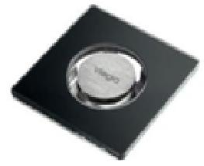
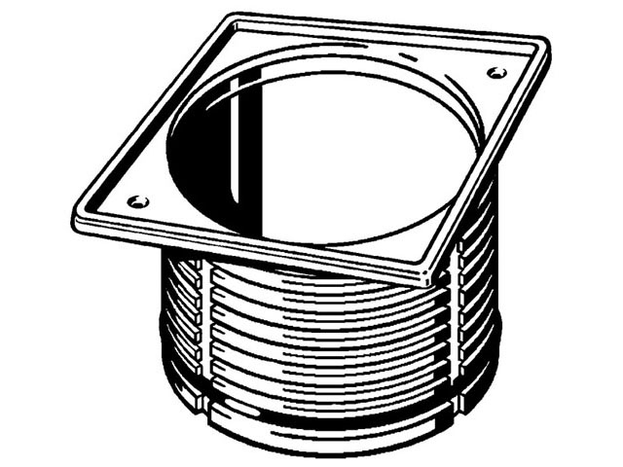
MBR
Brand | Item Name | Description | Color | Quantity | Unit Price | Special Price | Total
Advantix DN70 Con. | 4921.66-284626 | Advantix Bathroom Drain DN 70 | N-A | 1 | 2851.00 | 2851.00 | 2851.00
ER5 | 4976.20-617134 | Visign ER5 Floor Drain | Clear-Grey | 1 | 36749.00 | 36749.00 | 36749.00
Top Frame | 4949.3-489038 | Advantix-Top frame,.with stainless steel 1.4404 frame,.150 x 150 | Chrome | 1 | 7000.00 | 7000.00 | 7000.00

