Slide 1
Customer:
G V Chowdary
Mobile:
8978721232
Address:
East Point colony,visakhapatnam

Slide 2
Google AdSense Online Terms of Service
1. Welcome to AdSense!
Thanks Eloi for your interest in our search and advertising services (the “Services”)!
By using our Services, you agree to these terms (the “AdSense Terms”), the AdSense Program Policies and the Google Branding Guidelines (collectively, the “Agreement”). If ever in conflict, to the extent of such conflict, the AdSense Terms will take precedence over any other terms of the Agreement. Please read the Agreement carefully.
As used in the Agreement, “you” or “publisher” means the individual or entity using the Services (and/or any individual, entity or successor entity, agency or network acting on your behalf), “we,” “us” or “Google” means Google Inc., and the “parties” means you and Google.
2. Access to the Services; AdSense Accounts
Your use of the Services is subject to your creation and our approval of an AdSense account (an “Account”). We have the right to refuse or limit your access to the Services. By submitting an application to use the Services, if you are an individual, you represent that you are at least 18 years of age. You may only have one Account.
By enrolling in AdSense, you permit Google to serve, as applicable, (i) advertisements and other content (“Ads”), (ii) Google search boxes and search results, and (iii) related search queries and other links to your websites, mobile applications, media players, mobile content, and/or other properties approved by Google (each individually a “Property”). In addition, you grant Google the right to access, index and cache the Properties, or any portion thereof, including by automated means. Google may refuse to provide the Services to any Property.
Any Property that is a software application and accesses our Services (a) may require preapproval by Google in writing, and (b) must comply with Google’s Software Principles.

Slide 3

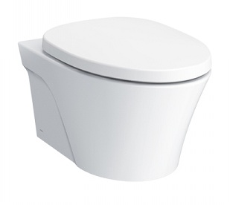
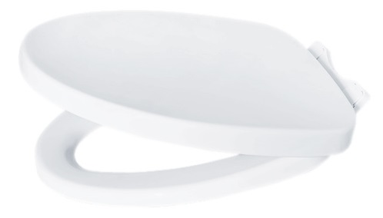
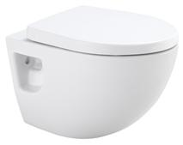

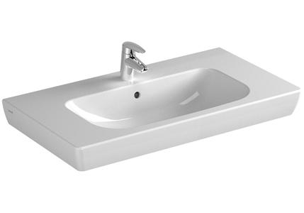
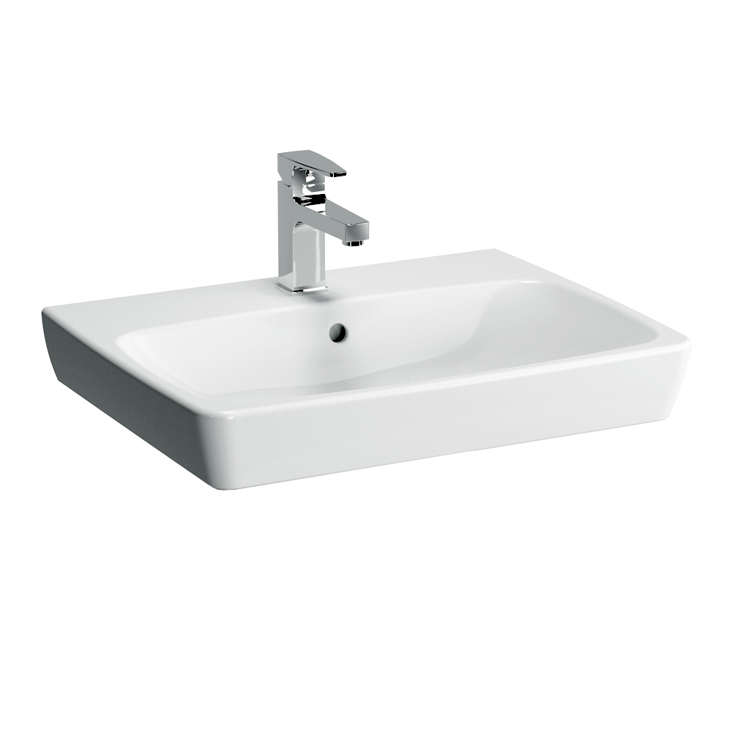
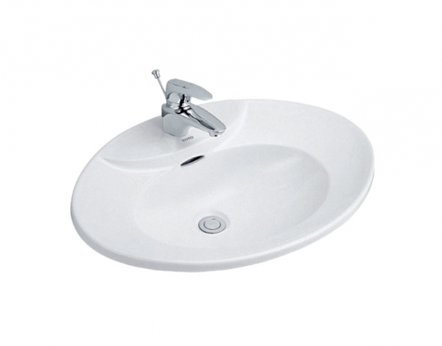
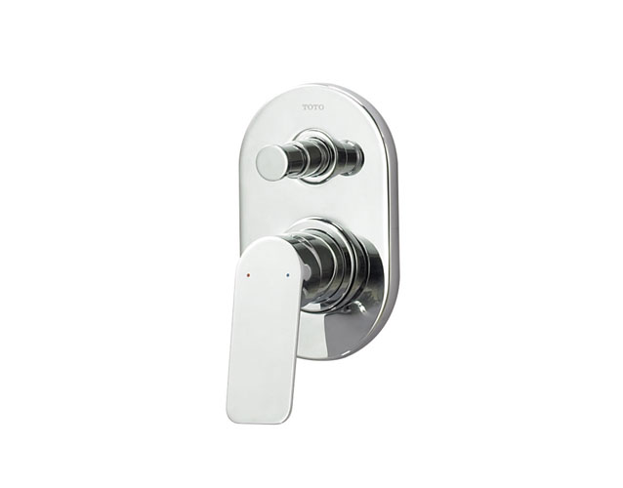

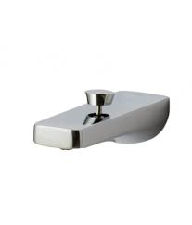
-
Brand | Item Name | Description | Color | Quantity | Unit Price | Special Price | Total
AVANTE | CW822RA | Rimless Wall Hung WC | White | 3 | 26000.00 | 26000.00 | 78000.00
- | TC385VS | Soft Closing Seat Cover With Hinges | White | 3 | 6600.00 | 6600.00 | 19800.00
REI | CW580M | Wall Hung WC | White | 1 | 10300.00 | 10300.00 | 10300.00
TOTO | TC300 | Soft closing Seat Cover with Hinges | White | 1 | 5940.00 | 5940.00 | 5940.00
S20 85 | 5523B003H0973/5523B003-0973 | S20 counter top Wash Basin with Tap Hole, and Overflow Hole.Size 85cm. | White | 1 | 13200.00 | 13200.00 | 13200.00
Metropole | 5662B003H0973/5662B003-0973 | Metropole Wash Basin Size 60cm For Countertop use.One tap hole with overflow hole | White | 1 | 14660.00 | 14660.00 | 14660.00
Pacifica | LW909CKS | Self rimming Lavatory 1 tap hole.Size: 650 x 455 mm | White | 2 | 8910.00 | 8910.00 | 17820.00
REI S | TTBR302 | Concealed Single Lever Mixer With Diverter - Ext.Part (Plate, Lever, Rings) | Chrome | 4 | 6100.00 | 6100.00 | 24400.00
REI S | TTBB301 | REI-s Bath and Shower Mixer - Concealed part | Chrome | 4 | 6200.00 | 6200.00 | 24800.00
REI S | TTBR102 | Bath Spout With Button Attachment | Chrome | 4 | 6500.00 | 6500.00 | 26000.00

Slide 4
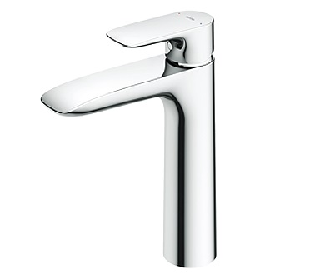
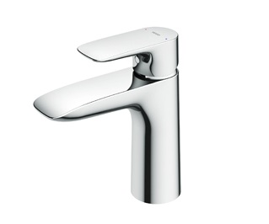
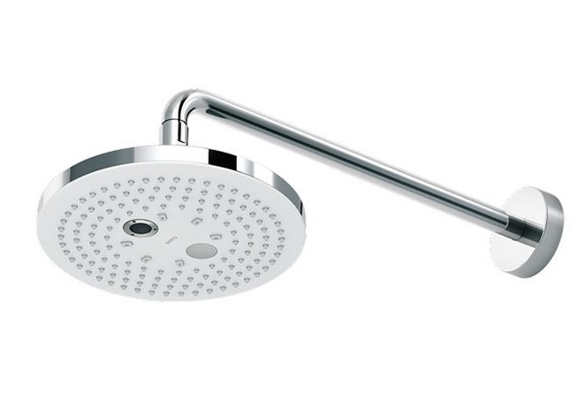
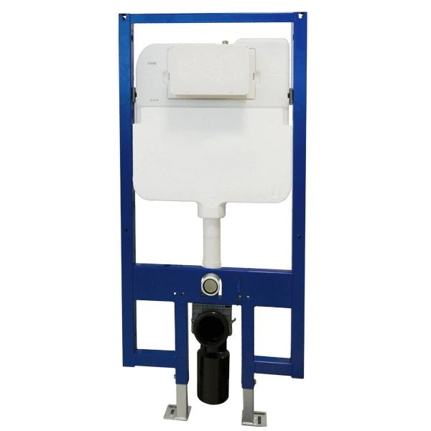

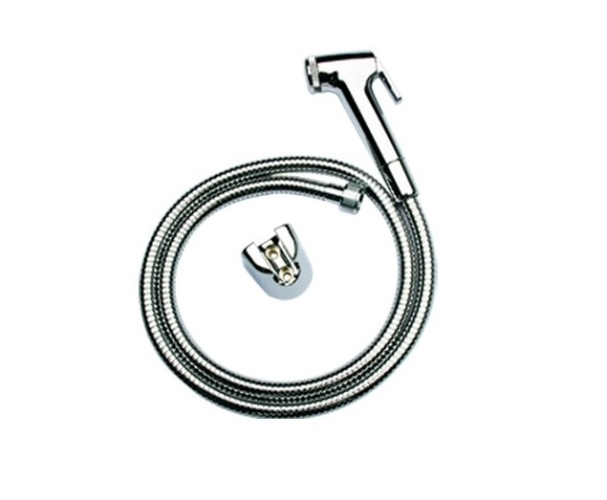
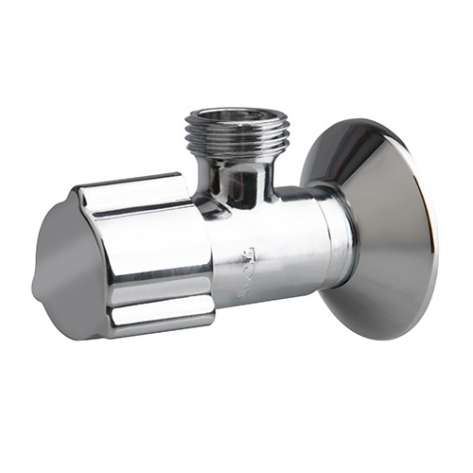
-
Brand | Item Name | Description | Color | Quantity | Unit Price | Special Price | Total
GA | TLG04306B | Single Lever Lavatory Faucet.(Semi-tall Vessel).(w/o pop-up) | Chrome | 2 | 13210.00 | 13210.00 | 26420.00
GA | TLG04303B | Single Lever Lavatory Faucet without pop-up | Chrome | 2 | 10400.00 | 10400.00 | 20800.00
G | TBW01004A/B | Over Head Shower.2 mode, round, 220mm, with pipe | Chrome | 4 | 19200.00 | 19200.00 | 76800.00
Concealed Tank | WH172A | Concealed Tank with Full Frame with Slip in connector.4.8L/3L | N-A | 4 | 29300.00 | 29300.00 | 117200.00
Flush Plate | MB174PSS | Dual Flush Plate Round Button | Chrome | 4 | 3100.00 | 3100.00 | 12400.00
TOTO | THX20MCRB | Health Faucet (Faucet, Hosepipe, Hook) | Chrome | 4 | 4000.00 | 4000.00 | 16000.00
- | TX277SV1 | Angle Valve | Chrome | 12 | 2900.00 | 2900.00 | 34800.00

