Slide 1
Customer:
MAK Ravinder
Mobile:
9963846688
Address:
Hyderabad

Slide 2
Google AdSense Online Terms of Service
1. Welcome to AdSense!
Thanks Eloi for your interest in our search and advertising services (the “Services”)!
By using our Services, you agree to these terms (the “AdSense Terms”), the AdSense Program Policies and the Google Branding Guidelines (collectively, the “Agreement”). If ever in conflict, to the extent of such conflict, the AdSense Terms will take precedence over any other terms of the Agreement. Please read the Agreement carefully.
As used in the Agreement, “you” or “publisher” means the individual or entity using the Services (and/or any individual, entity or successor entity, agency or network acting on your behalf), “we,” “us” or “Google” means Google Inc., and the “parties” means you and Google.
2. Access to the Services; AdSense Accounts
Your use of the Services is subject to your creation and our approval of an AdSense account (an “Account”). We have the right to refuse or limit your access to the Services. By submitting an application to use the Services, if you are an individual, you represent that you are at least 18 years of age. You may only have one Account.
By enrolling in AdSense, you permit Google to serve, as applicable, (i) advertisements and other content (“Ads”), (ii) Google search boxes and search results, and (iii) related search queries and other links to your websites, mobile applications, media players, mobile content, and/or other properties approved by Google (each individually a “Property”). In addition, you grant Google the right to access, index and cache the Properties, or any portion thereof, including by automated means. Google may refuse to provide the Services to any Property.
Any Property that is a software application and accesses our Services (a) may require preapproval by Google in writing, and (b) must comply with Google’s Software Principles.

Slide 3

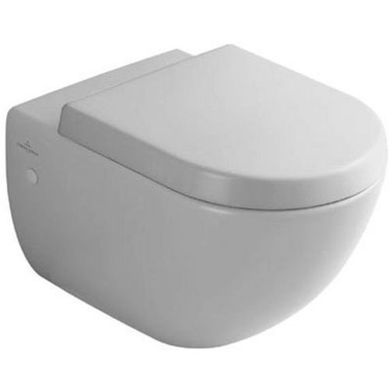
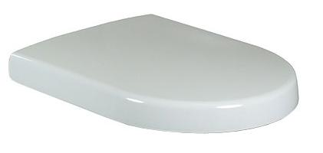
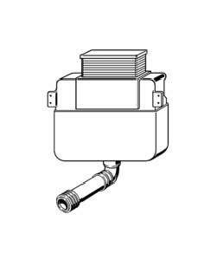
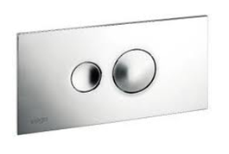
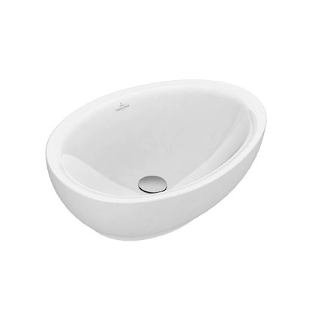
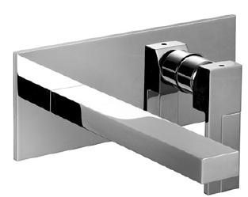
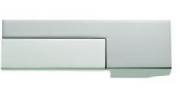
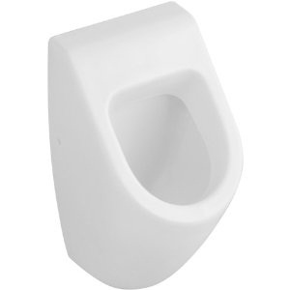
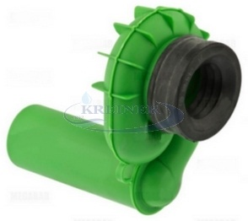
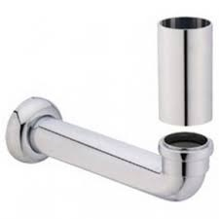
-
Brand | Item Name | Description | Color | Quantity | Unit Price | Special Price | Total
Subway | 66001001 | Subway Wall Hung WC With Hinges and Black Bushes | White Alpin | 6 | 21900.00 | 21900.00 | 131400.00
Subway | 9955C101 | Subway Soft Closing Seat Cover with Hinges. | White Alpin | 6 | 6300.00 | 6300.00 | 37800.00
VIEGA | 8864.6-622244 | Concealed flush cistern | N-A | 7 | 8465.00 | 8465.00 | 59255.00
Style 10 | 8315.1-596323 | Visign for Style 10 Actuating Plate with rods | Chrome | 7 | 3175.00 | 3175.00 | 22225.00
Aveo New | 413260R1 | Surface-Mounted Wash Basin with Brakets.Size 595x440mm | White Alpin cermaicplus | 1 | 51500.00 | 51500.00 | 51500.00
Plano | 3802E213SB | Wall Mounted Basin Mixer with out waste. | Chrome | 1 | 43670.00 | 43670.00 | 43670.00
- | 3802334802 | Handle | Chrome | 1 | 12320.00 | 12320.00 | 12320.00
Subway | 75130001 | Siphoni Urinal .Size 285 x 535 x 315 mm | White Alpin | 2 | 39259.00 | 39259.00 | 78518.00
Waste Unit | 93260000 | Concealed Waste Unit for Urinal | N-A | 2 | 6306.00 | 6306.00 | 12612.00
Waste Pipe | 93190000 | Connection Pieces | Chrome | 2 | 10069.00 | 10069.00 | 20138.00

Slide 4
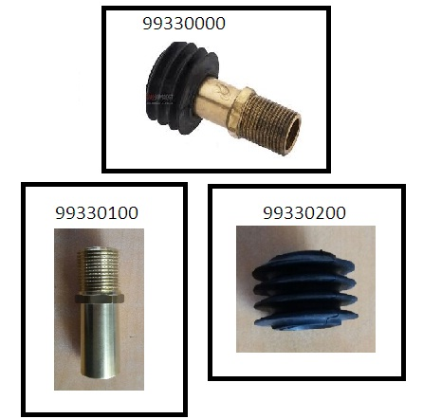
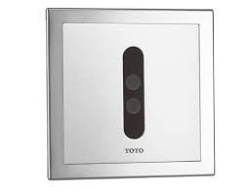
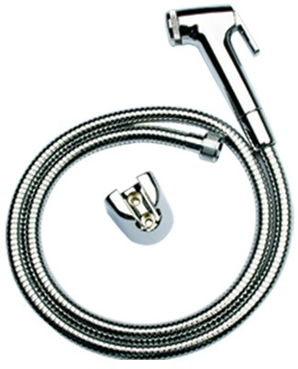
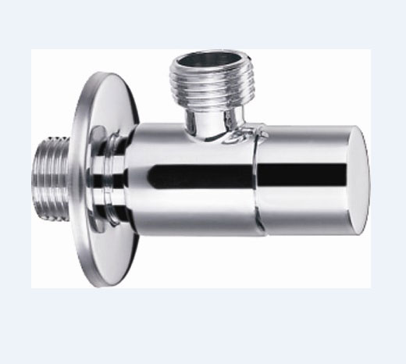
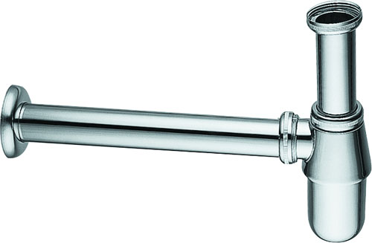
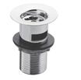

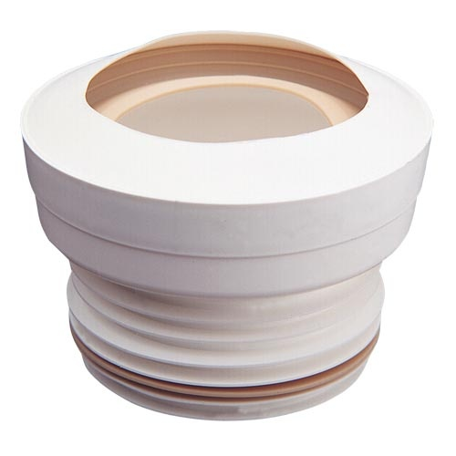
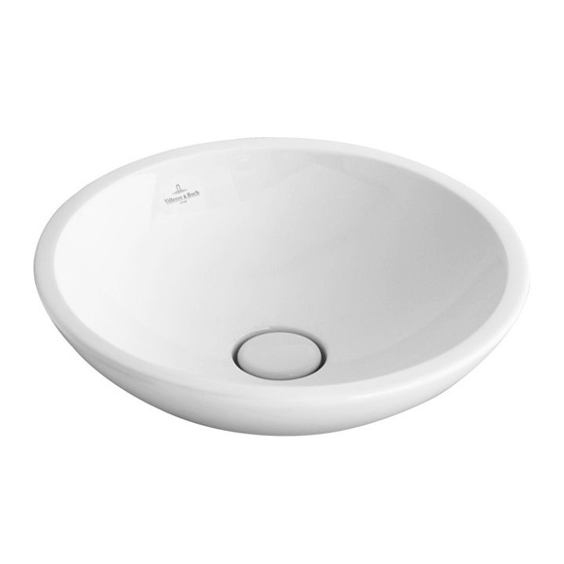
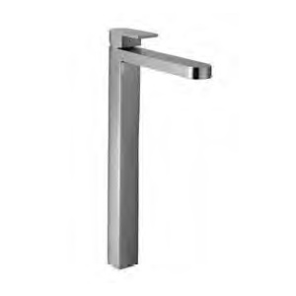
-
Brand | Item Name | Description | Color | Quantity | Unit Price | Special Price | Total
- | 99330000 | Water Inlet Connector for Urinal .99330100 - Rod.99330200- Rubber Bush | N-A | 2 | 3966.00 | 3966.00 | 7932.00
Automation | DUE106UPA | Automatic Urinal Sensor Battery Oprated -full set (Control Box, Battery Box, Sensor Plate, With Screws). | Chrome | 2 | 26810.00 | 26810.00 | 53620.00
TOTO | THX20MCRB | Health Faucet (Faucet, Hosepipe, Hook) | Chrome | 7 | 3780.00 | 3780.00 | 26460.00
Essentials | E0014 | Angle Valve w/Flange | Chrome | 21 | 1242.00 | 1242.00 | 26082.00
SIRIUS | E8502.97 | Bottle Trap | Chrome | 7 | 3689.00 | 3689.00 | 25823.00
Essentials | Waste Coupling H/T | - | Chrome | 7 | 550.00 | 550.00 | 3850.00
Essentials | Fischer Bolt | Fischer Bolt for WC | N-A | 7 | 1200.00 | 1200.00 | 8400.00
- | TX215C | Slip In Connector For WC | N-A | 7 | 830.00 | 830.00 | 5810.00
Loop AND Friends | 514401R1 | Surface Mounted Wash Basin Without Overflow.Size.430mm Dia | White | 2 | 47900.00 | 47900.00 | 95800.00
Mare | 51021006WF | HIGH Single-lever washb. Mixer.in- let flexible pipes.without pop- up waste, .with handle | Chrome | 2 | 42680.00 | 42680.00 | 85360.00

Slide 5
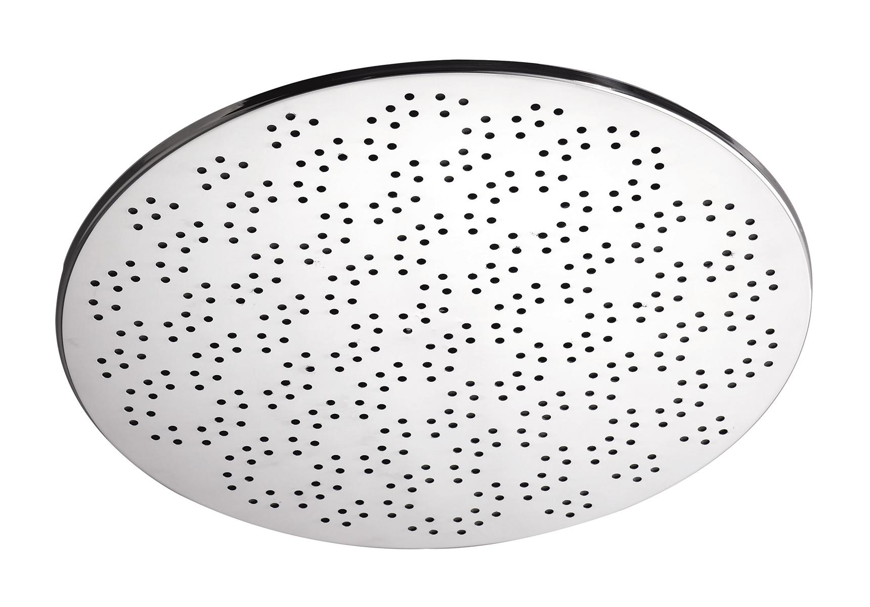
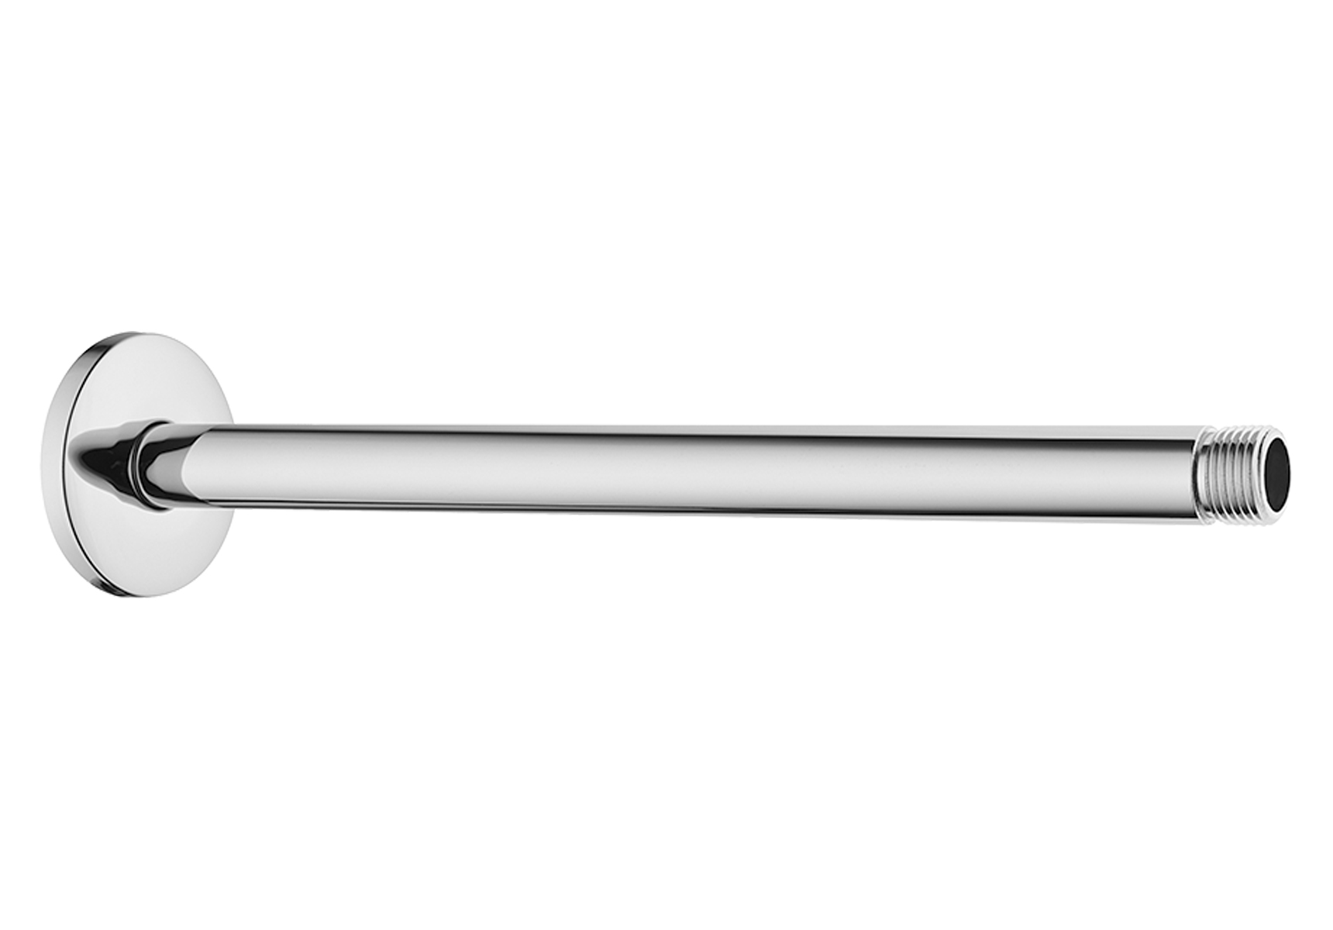
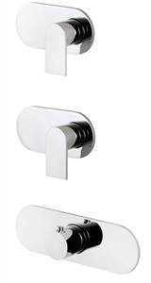
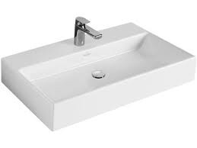
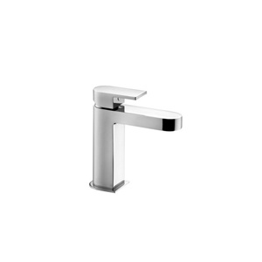
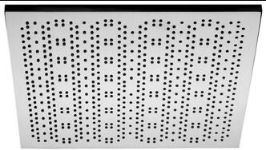
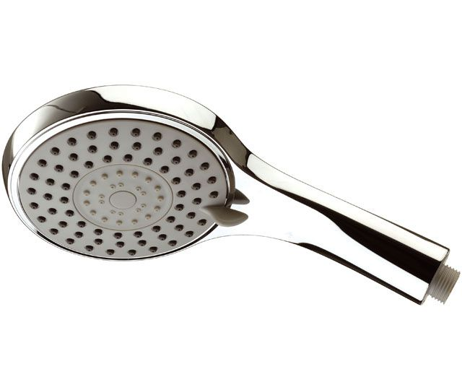
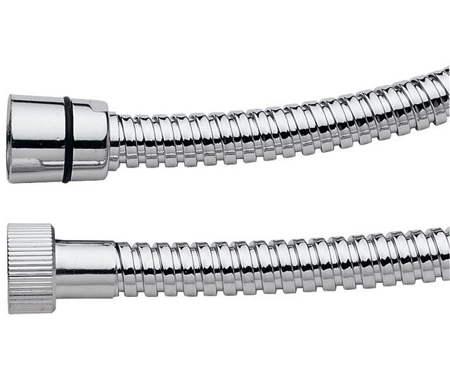
-
Brand | Item Name | Description | Color | Quantity | Unit Price | Special Price | Total
Istanbul Dia 350 mm | A48021IND | Shower Head (ceiling mounted) Dia 350 mm | Chrome | 1 | 37500.00 | 37500.00 | 37500.00
- | A45650IND | Ceiling Mounted Shower Arm 308mm | Chrome | 1 | 2600.00 | 2600.00 | 2600.00
Mare | 51022002B | Thermostatic Built In Shower mixer with 2 Out lets | Chrome | 1 | 51370.00 | 51370.00 | 51370.00
MARE | 19003902A | BUILT IN PIECE.for Thermostat Mixer with 2 Outlets. | Chrome | 1 | 63470.00 | 63470.00 | 63470.00
Memento | 51338LMD | Memento Wash basin .Size: 800 x 470 MM | White Alpin | 3 | 118200.00 | 118200.00 | 354600.00
Mare | 51021004WF | Single-lever Basin Mixer Without Pop up. | Chrome | 1 | 21450.00 | 21450.00 | 21450.00
Showers 350x350mm | A48022IND | Celing Shower Head Size:350x350mm | Chrome | 3 | 41300.00 | 41300.00 | 123900.00
- | A45650IND | Ceiling Mounted Shower Arm 308mm | Chrome | 3 | 2600.00 | 2600.00 | 7800.00
Colonne Showers | A448CR/A448SCR | Douchette a disque 5 jets. | Chrome | 3 | 3696.00 | 3696.00 | 11088.00
DOCCE | A505200CM | Hose | Chrome | 3 | 1342.00 | 1342.00 | 4026.00

Slide 6
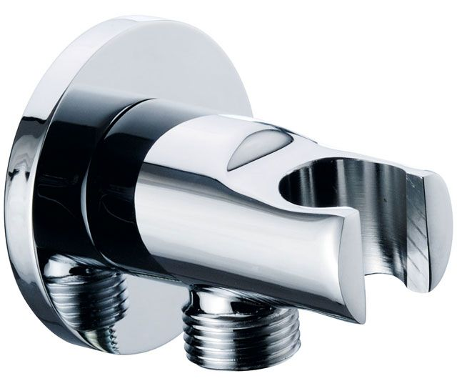
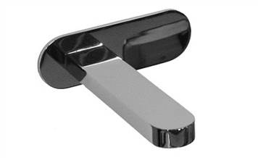
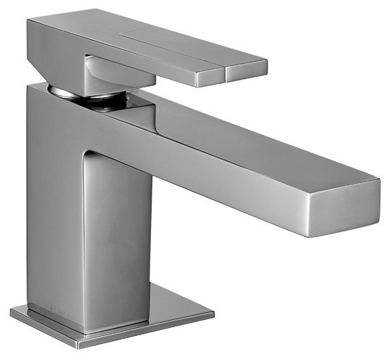
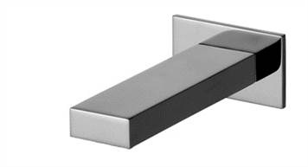
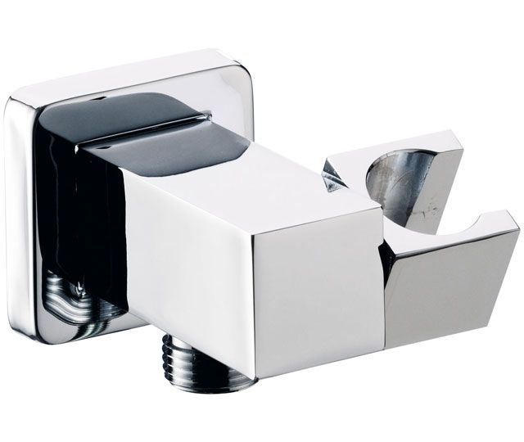
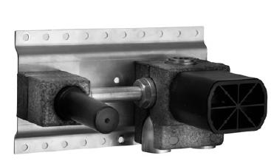
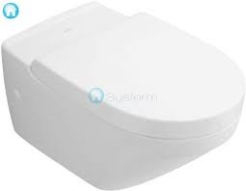
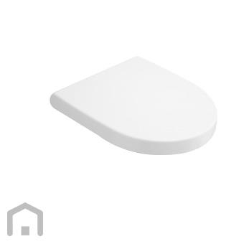
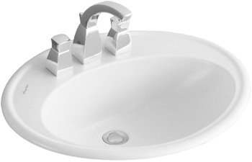
-
Brand | Item Name | Description | Color | Quantity | Unit Price | Special Price | Total
Docce | A546CR | Adjustable Shower Holder With wall out let | Chrome | 1 | 3872.00 | 3872.00 | 3872.00
- | 51021041 | Bath Spout | Chrome | 2 | 20240.00 | 20240.00 | 40480.00
Plano | 38023303SWF | Single-lever washbasin mixer.14.5 CM Spout | Chrome | 2 | 38610.00 | 38610.00 | 77220.00
- | 3802334802 | Handle | Chrome | 2 | 12320.00 | 12320.00 | 24640.00
- | 38023345 | Bath Spout | Chrome | 2 | 24530.00 | 24530.00 | 49060.00
Docce | A547CR | Adjustable Shower Holder with Wall outlet | Chrome | 2 | 6985.00 | 6985.00 | 13970.00
- | 2200D013A | Built in Piece(for wall mounted washbasin mixer) | N-A | 1 | 20350.00 | 20350.00 | 20350.00
LifeTime | 56721001 | Wall hung WC with hinges and black bush | White Alpin | 1 | 38600.00 | 38600.00 | 38600.00
Lifetime | 9M02S101 | Life Time Soft Closing Seat Cover with Hinges | White Alpin | 1 | 22800.00 | 22800.00 | 22800.00
AMADEA | 6198A1R1 | Built in Wash Basin 3 tap Hole.Size: 635 x 525 mm, 14 kg. | White Alpin cermaicplus | 1 | 81900.00 | 81900.00 | 81900.00

Slide 7
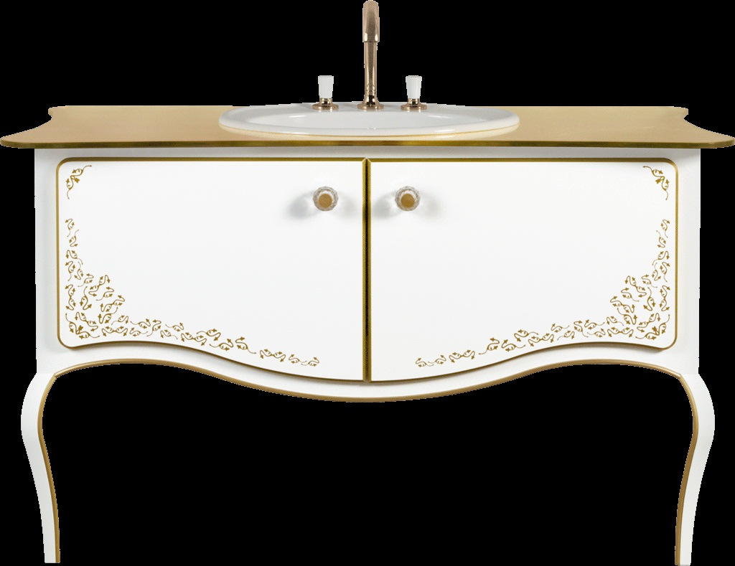
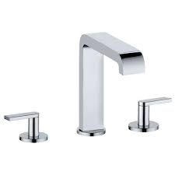
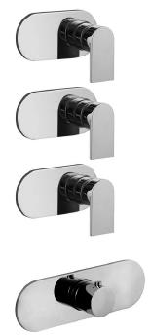
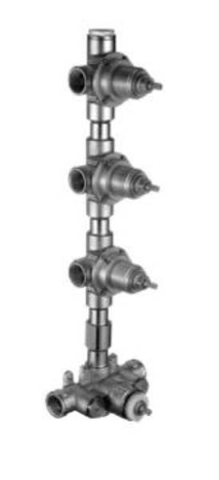
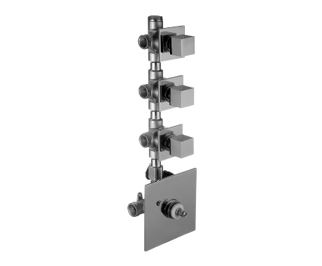
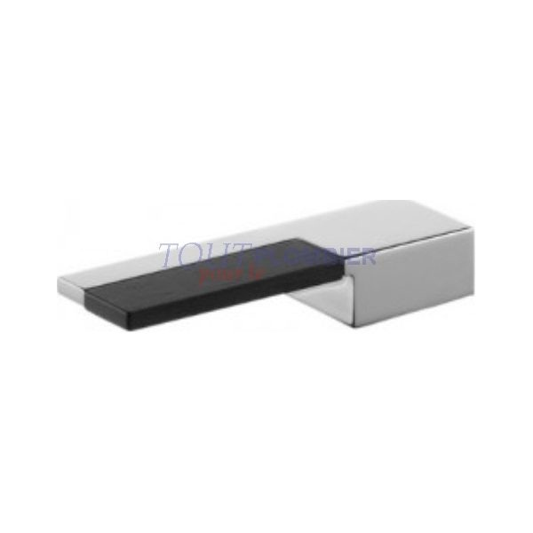
-
Brand | Item Name | Description | Color | Quantity | Unit Price | Special Price | Total
Amadea | B65000GL | Amadea Royal vanity unit | N-A | 1 | 645800.00 | 645800.00 | 645800.00
Edition 300 | 53015010000 | Three-hole basin mixer with rosettes .and pop-up waste chrome-plated | Chrome | 1 | 50634.00 | 50634.00 | 50634.00
Mare | 51022003B | Built in thermostatic shower mixer with 3 outlets | Chrome | 1 | 66000.00 | 66000.00 | 66000.00
- | 19003903A | Built In Piece - For Thermostatic Built in Shower Mixer With 3 Out Lets | N-A | 1 | 77220.00 | 77220.00 | 77220.00
Ar/38 | 38023903SB | Thermostatic built-in shower mixer, .With 3 out-lets. | Chrome | 2 | 65780.00 | 65780.00 | 131560.00
- | 19003903A | Built In Piece - For Thermostatic Built in Shower Mixer With 3 Out Lets | N-A | 2 | 77220.00 | 77220.00 | 154440.00
Plano | 3802394902 | Handle for Thermostatic | Chrome | 2 | 15400.00 | 15400.00 | 30800.00
Ar/38 | 38023903SB | Thermostatic built-in shower mixer, .With 3 out-lets. | Chrome | 1 | 65780.00 | 65780.00 | 65780.00
- | 19003903A | Built In Piece - For Thermostatic Built in Shower Mixer With 3 Out Lets | N-A | 1 | 77220.00 | 77220.00 | 77220.00
Plano | 3802394902 | Handle for Thermostatic | Chrome | 1 | 15400.00 | 15400.00 | 15400.00

Slide 8
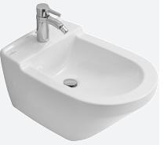

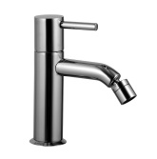
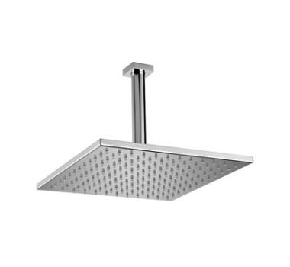
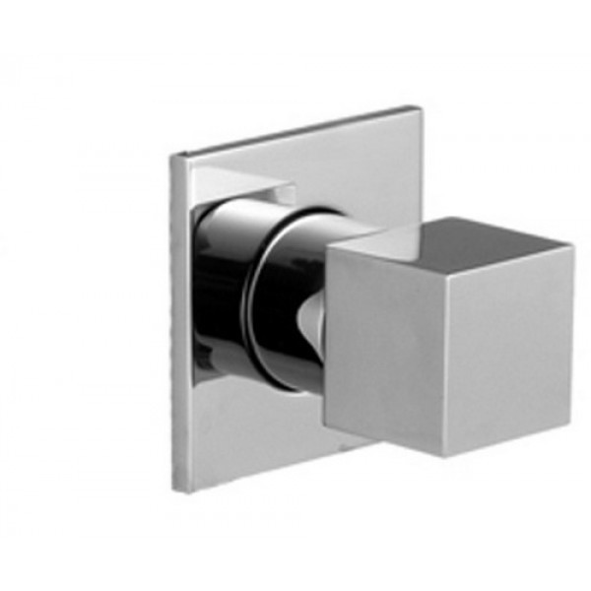
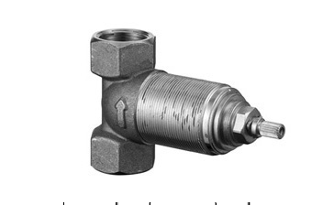
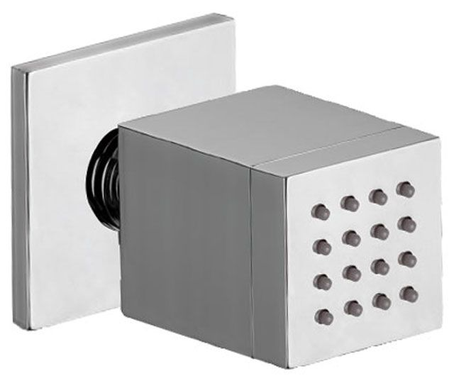
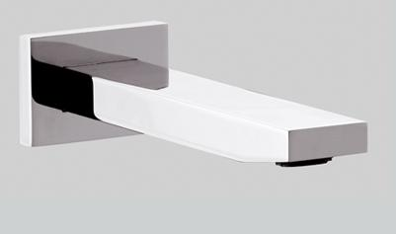
-
Brand | Item Name | Description | Color | Quantity | Unit Price | Special Price | Total
LIFETIME | 54750001 | Bidet with overflow.400 x 605 mm, 23 kg | White Alpin | 1 | 44500.00 | 44500.00 | 44500.00
Fastening set | 99610000 | Fastening set | N-A | 1 | 3100.00 | 3100.00 | 3100.00
Single Hole Bidet Mixer | 50932708WF | Single Hole Bidet Mixer With Handle without Waste | Chrome | 1 | 45650.00 | 45650.00 | 45650.00
X Change -R Ceiling Shower 300 mm | 6510CC | Ceiling Shower 300 mm (Round) | Chrome | 1 | 82026.00 | 82026.00 | 82026.00
- | 38023990B | Stop Valve | Chrome | 1 | 13200.00 | 13200.00 | 13200.00
- | 19003970A | Concealed Part for Wall Valve | Chrome | 1 | 10010.00 | 10010.00 | 10010.00
Docce | OX JET CR | Body jet w/anti lime stone nozzles | Chrome | 6 | 8338.00 | 8338.00 | 50028.00
Sky Line | SK4704CR | Bath Spout | Chrome | 1 | 14652.00 | 14652.00 | 14652.00
Colonne Showers | A448CR/A448SCR | Douchette a disque 5 jets. | Chrome | 1 | 3696.00 | 3696.00 | 3696.00
DOCCE | A505200CM | Hose | Chrome | 1 | 1342.00 | 1342.00 | 1342.00

Slide 9
-
Brand | Item Name | Description | Color | Quantity | Unit Price | Special Price | Total
Docce | A546CR | Adjustable Shower Holder With wall out let | Chrome | 1 | 3872.00 | 3872.00 | 3872.00

