Slide 1
Customer:
Prime Earthworks Private Limited
Mobile:
9703959818
Address:
IT Towers, Rushikonda,
Visakhapatnam.

Slide 2
Google AdSense Online Terms of Service
1. Welcome to AdSense!
Thanks Eloi for your interest in our search and advertising services (the “Services”)!
By using our Services, you agree to these terms (the “AdSense Terms”), the AdSense Program Policies and the Google Branding Guidelines (collectively, the “Agreement”). If ever in conflict, to the extent of such conflict, the AdSense Terms will take precedence over any other terms of the Agreement. Please read the Agreement carefully.
As used in the Agreement, “you” or “publisher” means the individual or entity using the Services (and/or any individual, entity or successor entity, agency or network acting on your behalf), “we,” “us” or “Google” means Google Inc., and the “parties” means you and Google.
2. Access to the Services; AdSense Accounts
Your use of the Services is subject to your creation and our approval of an AdSense account (an “Account”). We have the right to refuse or limit your access to the Services. By submitting an application to use the Services, if you are an individual, you represent that you are at least 18 years of age. You may only have one Account.
By enrolling in AdSense, you permit Google to serve, as applicable, (i) advertisements and other content (“Ads”), (ii) Google search boxes and search results, and (iii) related search queries and other links to your websites, mobile applications, media players, mobile content, and/or other properties approved by Google (each individually a “Property”). In addition, you grant Google the right to access, index and cache the Properties, or any portion thereof, including by automated means. Google may refuse to provide the Services to any Property.
Any Property that is a software application and accesses our Services (a) may require preapproval by Google in writing, and (b) must comply with Google’s Software Principles.

Slide 3

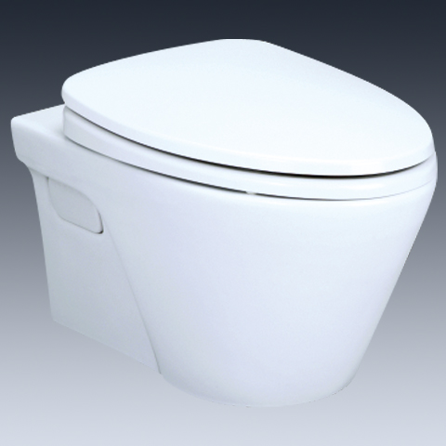

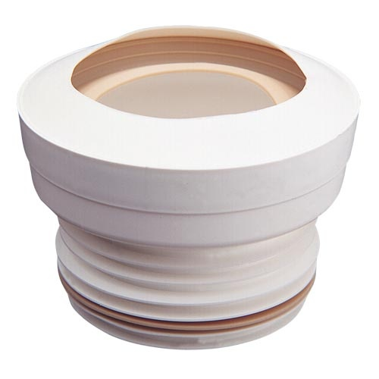
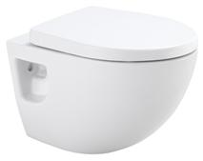
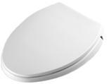
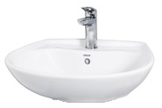
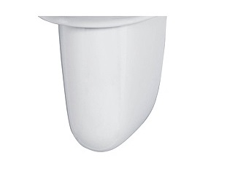
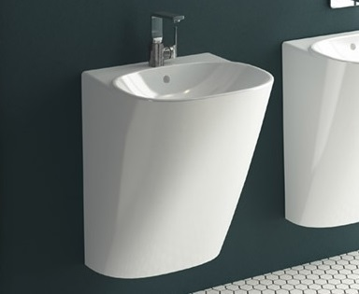
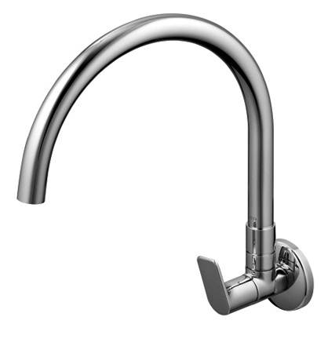
-
Brand | Item Name | Description | Color | Quantity | Unit Price | Special Price | Total
AVANTE | CW822J/CW822M | Avante -Wall Hung WC | White | 1 | 13900.00 | 13900.00 | 13900.00
- | TC394CVK | Soft Closing Seat Cover with Hinges | White | 1 | 7500.00 | 7500.00 | 7500.00
- | TX215C | Slip In Connector For WC | N-A | 1 | 1200.00 | 1200.00 | 1200.00
REI | CW580M | Wall Hung WC | White | 1 | 10600.00 | 10600.00 | 10600.00
TOTO | TC300 | Soft closing Seat Cover with Hinges | White | 1 | 6400.00 | 6400.00 | 6400.00
- | TX215C | Slip In Connector For WC | N-A | 1 | 1200.00 | 1200.00 | 1200.00
500wx430d | LW300CM/L300CE | Wall hung Wash Basin .Size: 500w x 430d mm | White | 1 | 4200.00 | 4200.00 | 4200.00
- | LW300HFM | Half Pedestal for Lavatory | White | 1 | 3000.00 | 3000.00 | 3000.00
FRAME | 5798B403H0012 / 0001 | Half monoblock basin, with faucet area. | White | 1 | 31350.00 | 31350.00 | 31350.00
REI-R | TTKR101 | Rei Wall Mounted Kitchen Faucet | Chrome | 1 | 7200.00 | 7200.00 | 7200.00

Slide 4
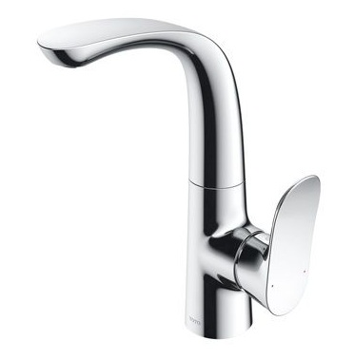
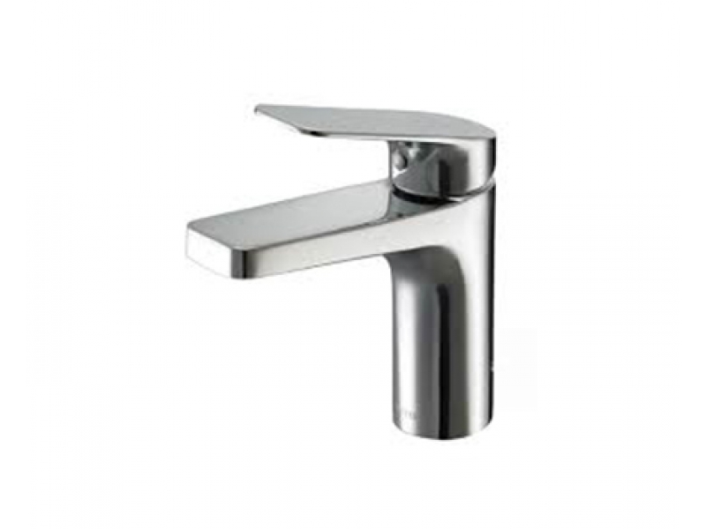
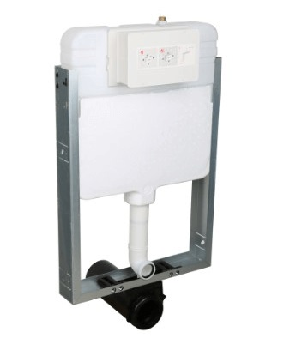
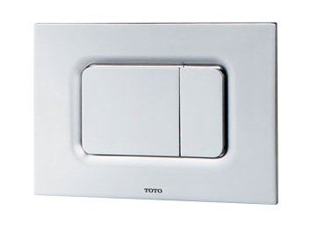
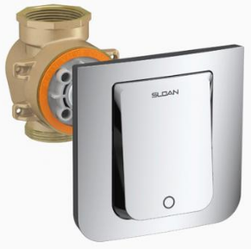
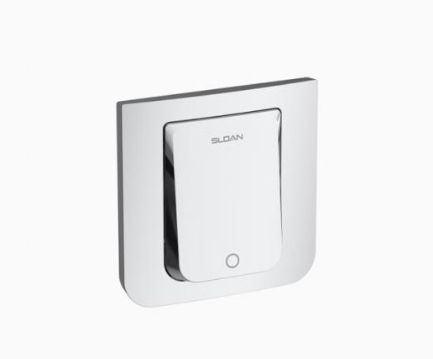
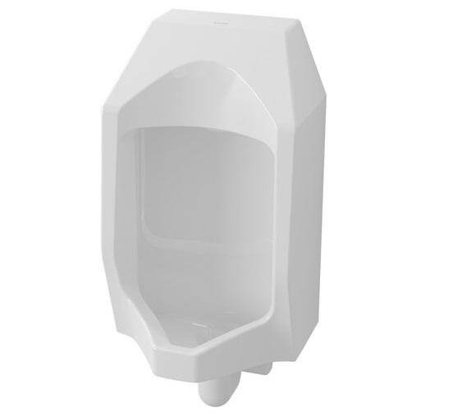
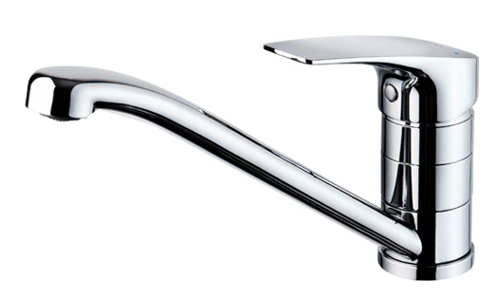

-
Brand | Item Name | Description | Color | Quantity | Unit Price | Special Price | Total
GO | TLG01309B | Single Lever Washbasin Faucet Side Handle | Chrome | 1 | 32300.00 | 32300.00 | 32300.00
REI-S | TTLR102 | Single Lever Pillar Cock | Chrome | 1 | 5400.00 | 5400.00 | 5400.00
Tank | WH131MHFR | Concealed Tank With Half Frame, Inlet Outlet Connection Pipes, Washer, Fixing Bolts And Nuts, Full Set. | N-A | 1 | 10600.00 | 10600.00 | 10600.00
Flush Plate | MB170P#SS | Dual Flush Plate | Chrome | 1 | 3800.00 | 3800.00 | 3800.00
3400005IN | TRF-156-1.6 | WashDown Valve Less Plate for WC | NA | 1 | 10350.00 | 10350.00 | 10350.00
0340215IN | GBL-200-A CP | Activation Plate | CHROME | 1 | 4450.00 | 4450.00 | 4450.00
URINAL | U57K | Wall Hung Urinal -Back Inlet.Size: 330 x 310 x 737 MM. | White | 1 | 17780.00 | 17780.00 | 17780.00
Cress | TTKC301F | Cress Kitchen Faucet | Chrome | 1 | 14800.00 | 14800.00 | 14800.00
Sensor FV - For Urinal(DC) | DUE114UPK | In-Wall Urinal Sensor Flush Valve (DC)2-3 (Control Box, Battery Box, Batteries, Upper Plate, Screws) | Chrome | 1 | 26200.00 | 26200.00 | 26200.00
Sensor FV - For Urinal(AC) | DUE114UPE | In Wall Sensor Urinal Flush Valve with Control Box, Sensor Plate, Adaptor and Screws Full Set (AC) 1.2-1.9 L | Chrome | 1 | 31000.00 | 31000.00 | 31000.00

Slide 5
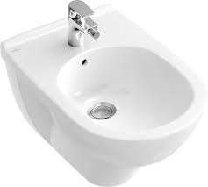
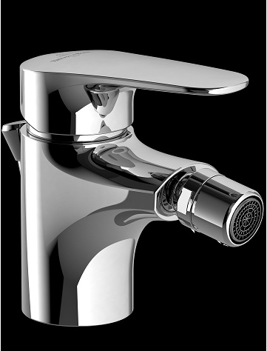
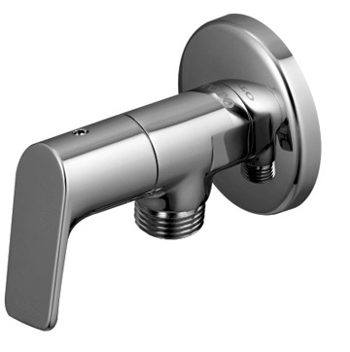
-
Brand | Item Name | Description | Color | Quantity | Unit Price | Special Price | Total
O Novo | 54600001 | O.novo Bidet.360 x 560 mm. | White Alpin | 1 | 25668.00 | 25668.00 | 25668.00
O novo Start | TVB10520111061 | O novo Start Single Lever Bidet Mixer | Chrome | 1 | 10488.00 | 10488.00 | 10488.00
SUPPLEMENTARY ITEM | TTWR103 | Angular Stop Cock .(1/2) with CP Cap | Chrome | 1 | 2200.00 | 2200.00 | 2200.00

