Slide 1
Customer:
Samvit Gupta
Mobile:
9000333719
Address:
Mr.Samvit Gupta,Near Spring pet School, Road no:11, Banjara Hills, Hyd.

Slide 2
Google AdSense Online Terms of Service
1. Welcome to AdSense!
Thanks Eloi for your interest in our search and advertising services (the “Services”)!
By using our Services, you agree to these terms (the “AdSense Terms”), the AdSense Program Policies and the Google Branding Guidelines (collectively, the “Agreement”). If ever in conflict, to the extent of such conflict, the AdSense Terms will take precedence over any other terms of the Agreement. Please read the Agreement carefully.
As used in the Agreement, “you” or “publisher” means the individual or entity using the Services (and/or any individual, entity or successor entity, agency or network acting on your behalf), “we,” “us” or “Google” means Google Inc., and the “parties” means you and Google.
2. Access to the Services; AdSense Accounts
Your use of the Services is subject to your creation and our approval of an AdSense account (an “Account”). We have the right to refuse or limit your access to the Services. By submitting an application to use the Services, if you are an individual, you represent that you are at least 18 years of age. You may only have one Account.
By enrolling in AdSense, you permit Google to serve, as applicable, (i) advertisements and other content (“Ads”), (ii) Google search boxes and search results, and (iii) related search queries and other links to your websites, mobile applications, media players, mobile content, and/or other properties approved by Google (each individually a “Property”). In addition, you grant Google the right to access, index and cache the Properties, or any portion thereof, including by automated means. Google may refuse to provide the Services to any Property.
Any Property that is a software application and accesses our Services (a) may require preapproval by Google in writing, and (b) must comply with Google’s Software Principles.

Slide 3

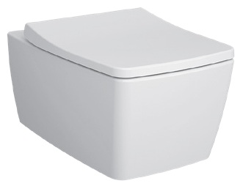
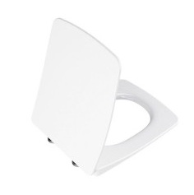
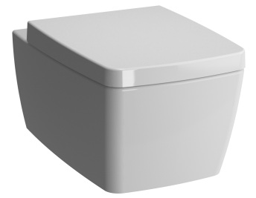
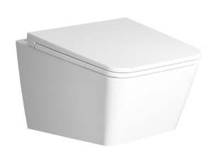
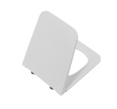
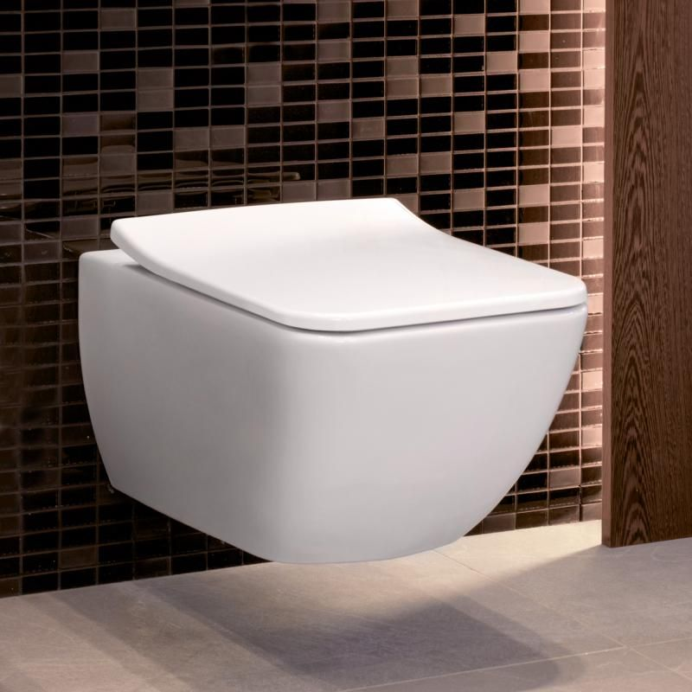
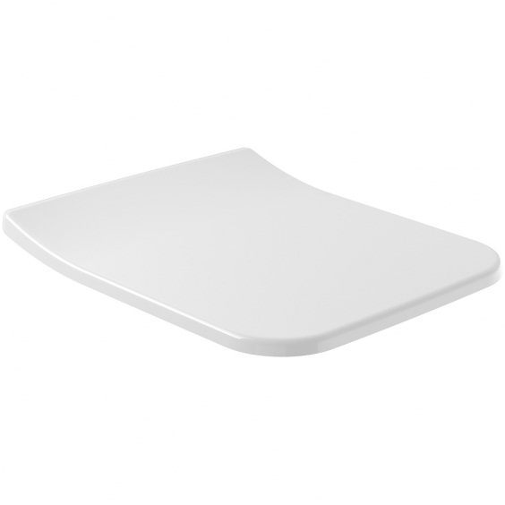
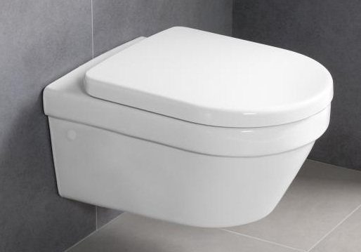
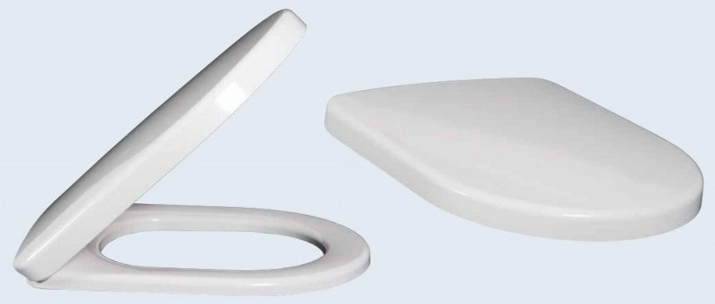
-
Brand | Item Name | Description | Color | Quantity | Unit Price | Special Price | Total
Metropole Rim-ex | 7672B003H1686 | Metropole Rim-ex Wall Hung WC with Fresh Liquid cleaner | White | 1 | 44230.00 | 44230.00 | 44230.00
Metropole | 122-003H209 | Soft Closing Seat Cover | White | 1 | 10750.00 | 10750.00 | 10750.00
Metrople Rimless | 7672B003H0101 | Wall Hung Rimless WC | White | 1 | 36890.00 | 36890.00 | 36890.00
Metropole | 122-003H209 | Soft Closing Seat Cover | White | 1 | 10750.00 | 10750.00 | 10750.00
Equal | 7245B403H0075 | Rim-ex Wall Hung WC | White | 1 | 35580.00 | 35580.00 | 35580.00
Equal | 119-003H209 | Slim Seat Cover | White | 1 | 10750.00 | 10750.00 | 10750.00
Venticello | 4611R001 | Venticello Wall Hung WC With Hinges And Black Bushes | White Alpin | 1 | 40697.00 | 40697.00 | 40697.00
Venticello | 9M79S101 | Slim Soft Closing seat cover with Hinges | White Alpin | 1 | 15206.00 | 15206.00 | 15206.00
Architectura | 4694HR01 | Architectura Wall Hung WC with Seat Cover | White Alpin | 1 | 51030.00 | 51030.00 | 51030.00
Omnia Archetectura | 98M9C101 | Omnia Architectura Soft Closing Seat And Cover w/Hinges | White Alpin | 1 | 7603.00 | 7603.00 | 7603.00

Slide 4
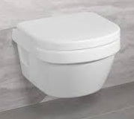
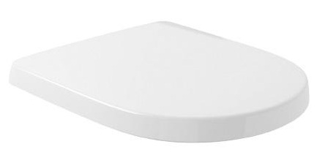
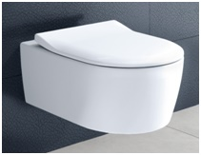
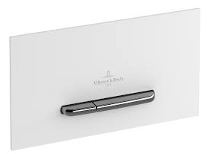
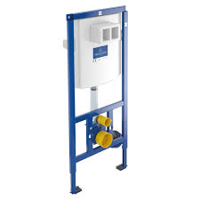
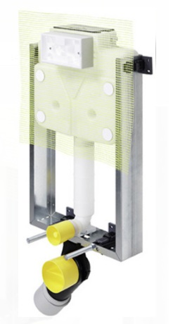
-
Brand | Item Name | Description | Color | Quantity | Unit Price | Special Price | Total
ARCHITECTURA | 4688R001 | Wall hung WC | White Alpin | 1 | 40530.00 | 40530.00 | 40530.00
Seat Cover | 9M83S101 | Seat Cover | White Alpin | 1 | 23205.00 | 23205.00 | 23205.00
Avento | 5656RS01 | Avento Wall Hung WC With Soft Closing Seat Cover, Hinges and WC Fixing Set | White | 1 | 33298.00 | 33298.00 | 33298.00
Flush Plate | 922169N5 | Flush Plate | WHITE MATT | 1 | 10815.00 | 10815.00 | 10815.00
Viconnect | 92246100 | Concealed Flush Cistern With Full Frame, Inlet And Outlet Connector Pipes, Washers, Bolts And Nuts Full Set | N-A | 1 | 28080.00 | 28080.00 | 28080.00
MONO TEC NEW | 792428-K85103 | Mono Tech Concealed cistern w/Connector pipe and Rubber bush w/Frame and bolts | N-A | 1 | 12170.00 | 12170.00 | 12170.00

