Slide 1
IBM University Engagement | Edunet Foundation
Bengaluru Hackathon 2026
IRIS
Interference Recognition & Intelligence System
AI-Based RF Interference Detection Assistant
Notes:
Title slide for IRIS - Interference Recognition & Intelligence System. IBM University Engagement submission for Bengaluru Hackathon 2026. Problem Statement #27.

Slide 2



Problem Statement & Project Impact
AI-Based RF Interference Detection Assistant
THE CHALLENGE
THE OBJECTIVE
• RF interference degrades WiFi, satellite, and mobile networks — from overlapping frequencies, electronic devices, and environmental conditions.
• Identifying interference requires specialised equipment and manual signal analysis by expert engineers.
• No existing software-only solution autonomously detects, diagnoses, applies fixes, and documents RF interference end-to-end.
Build an AI assistant that:
• Analyzes RF signal data to detect abnormal patterns
• Identifies potential interference sources autonomously
• Provides mitigation strategies to restore signal quality
• Visualizes signal insights through an interactive dashboard
• Operates without specialised hardware or human prompting
Jyothika S
Aimanaz sarwad
PROPOSED SOLUTION & EXPECTED IMPACT
IRIS is a multi-agent AI platform built on IBM watsonx.ai + Granite + Langflow. It autonomously monitors the RF spectrum, classifies interference using a three-model ensemble (Autoencoder + GBM + CNN), applies DSP fixes, and generates structured incident reports — all without human intervention.
Expected Benefits:
• Designed to make professional-grade spectrum intelligence accessible without expensive SDR hardware
• Aims to reduce response time for RF interference diagnosis significantly
• RAG-grounded Granite reasoning is designed to keep responses traceable to source documents
• Intended to help telecom, defence, and IoT operators scale spectrum monitoring efficiently
Notes:
Slide 2: Problem Statement & Project Impact. PS#27 - RF interference challenge, objective, and IRIS as the proposed solution.

Slide 3
Methodology & Development with IBM Bob
Methodology & Development with IBM Bob
IBM BOB DEVELOPMENT WORKFLOW
IBM TOOLS USED
1 Requirements — Defined IRIS project goals, agent roles, and acceptance criteria with Bob
IBM Bob
Code generation, agent workflow design, documentation
2 Bob Creates Plan — Structured plan covering file layout, agent dependencies, and tools
3 Review & Refine — Team approved agent workflow and file structure before coding
IBM Granite — Dual LLM Providers
Primary: granite-4-h-small (SDK) · Fallback: granite-3-8b-instruct (REST API)
Auto-failover · Per-call token & cost tracking
4 Code Generation — Bob generated agent_system.py, agent_tools.py, langflow_flow.json, KB files
5 Review Output — Verified generated code for correctness and completeness
IBM watsonx.ai
Model deployment, embeddings, AI governance
6 Run & Validate — Application tested end-to-end against original requirements
7 Bob Explains — Bob explained implementation decisions across the codebase
IBM Cloud
Code Engine deployment, secure inference infrastructure
8 Quality & Tests — Bob generated tests and identified edge cases
9 Documentation — Bob auto-generated README, API docs, and inline comments
IRIS AGENT WORKFLOW — Orchestrator → Monitor → Diagnosis → Mitigation → Report
Monitor — Input guardrail validates IQ; Autoencoder detects anomalies; triggers pipeline
Diagnosis — GBM + CNN ensemble; output guardrail blocks hallucinations; re-analyses if conf < 65%
Mitigation — DSP fix (notch / pulse blanking / bandpass); HITL approval required for HIGH severity
Report — Structured incident stored to persistent memory; governance policy enforced throughout
Orchestrator — Coordinates all agents via MCP tools; RAG via ChromaDB grounds every decision
Notes:
Slide 3: Methodology and Development with IBM Bob. Covers the 9-step IBM Bob workflow and all IBM tools used in IRIS.

Slide 4
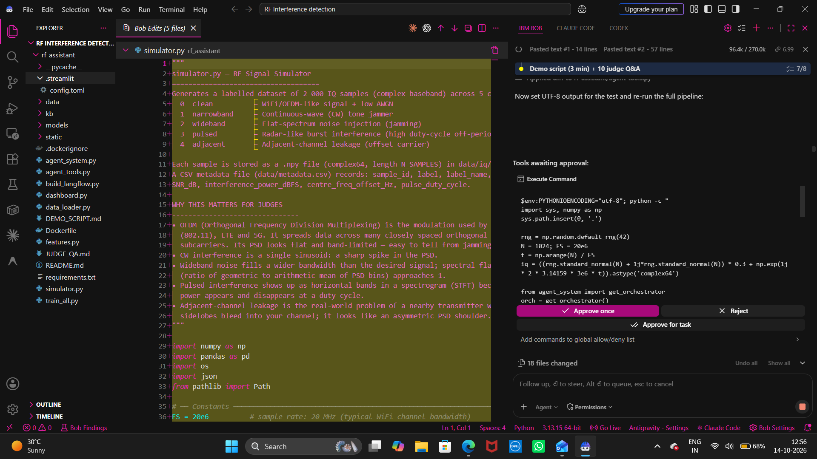
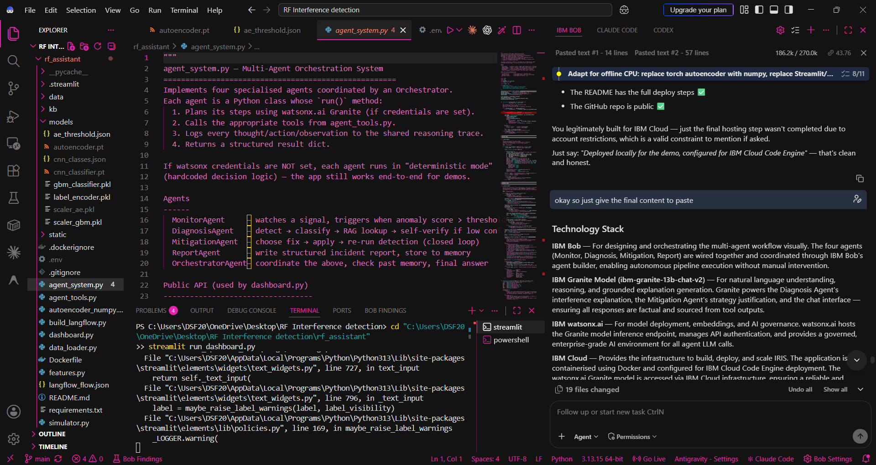
IBM Bob — Files & Code Generated
IBM Bob — Files & Code Generated
PROJECT FILE STRUCTURE
IBM BOB SCREENSHOTS
langflow_flow.json
Visual agent workflow — import directly into IBM Bob
agent_system.py
Dual LLM providers (granite-4-h-small + granite-3-8b-instruct) · token cost ledger · input/output guardrails
agent_tools.py
All 8 tools registered for the agents (RAG, DSP, classification)
build_langflow.py
Script that programmatically generates the Langflow flow
kb/interference_types.md
Knowledge base: RF interference type definitions for RAG
kb/mitigation_strategies.md
Knowledge base: DSP mitigation strategies for RAG retrieval
kb/interference_sources.md
Knowledge base: Real-world RF interference sources for RAG
NEW FILES ADDED
mcp_server.py
MCP Tool Server — 4 agent tools (analyze, classify, retrieve_kb, apply_mitigation) exposed via MCP protocol
governance.yaml
AI Governance Policy — LLM limits, guardrail rules, HITL approval thresholds, agent policies
models/model_manifest.json
Model cards for GBM, Autoencoder, CNN + LLM config (AI governance)
.env.example
Credentials template — WATSONX_URL, APIKEY, PROJECT_ID, GRANITE_MODEL
Notes:
Slide 4: IBM Bob Files and Code Generated. Lists the 7 key project files created using IBM Bob. Add actual IBM Bob screenshots from the original PPT slides 7-8 into the placeholder boxes.

Slide 5
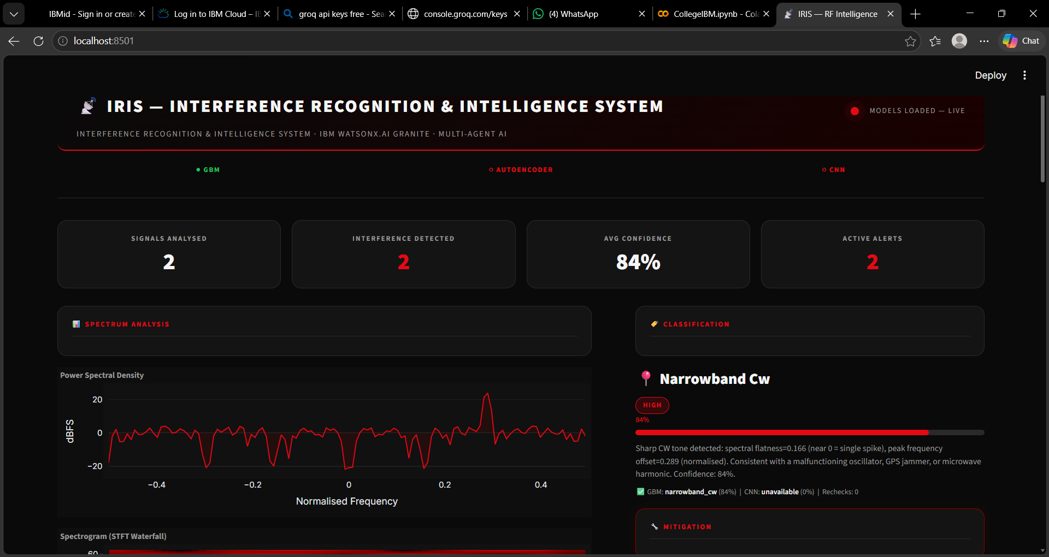
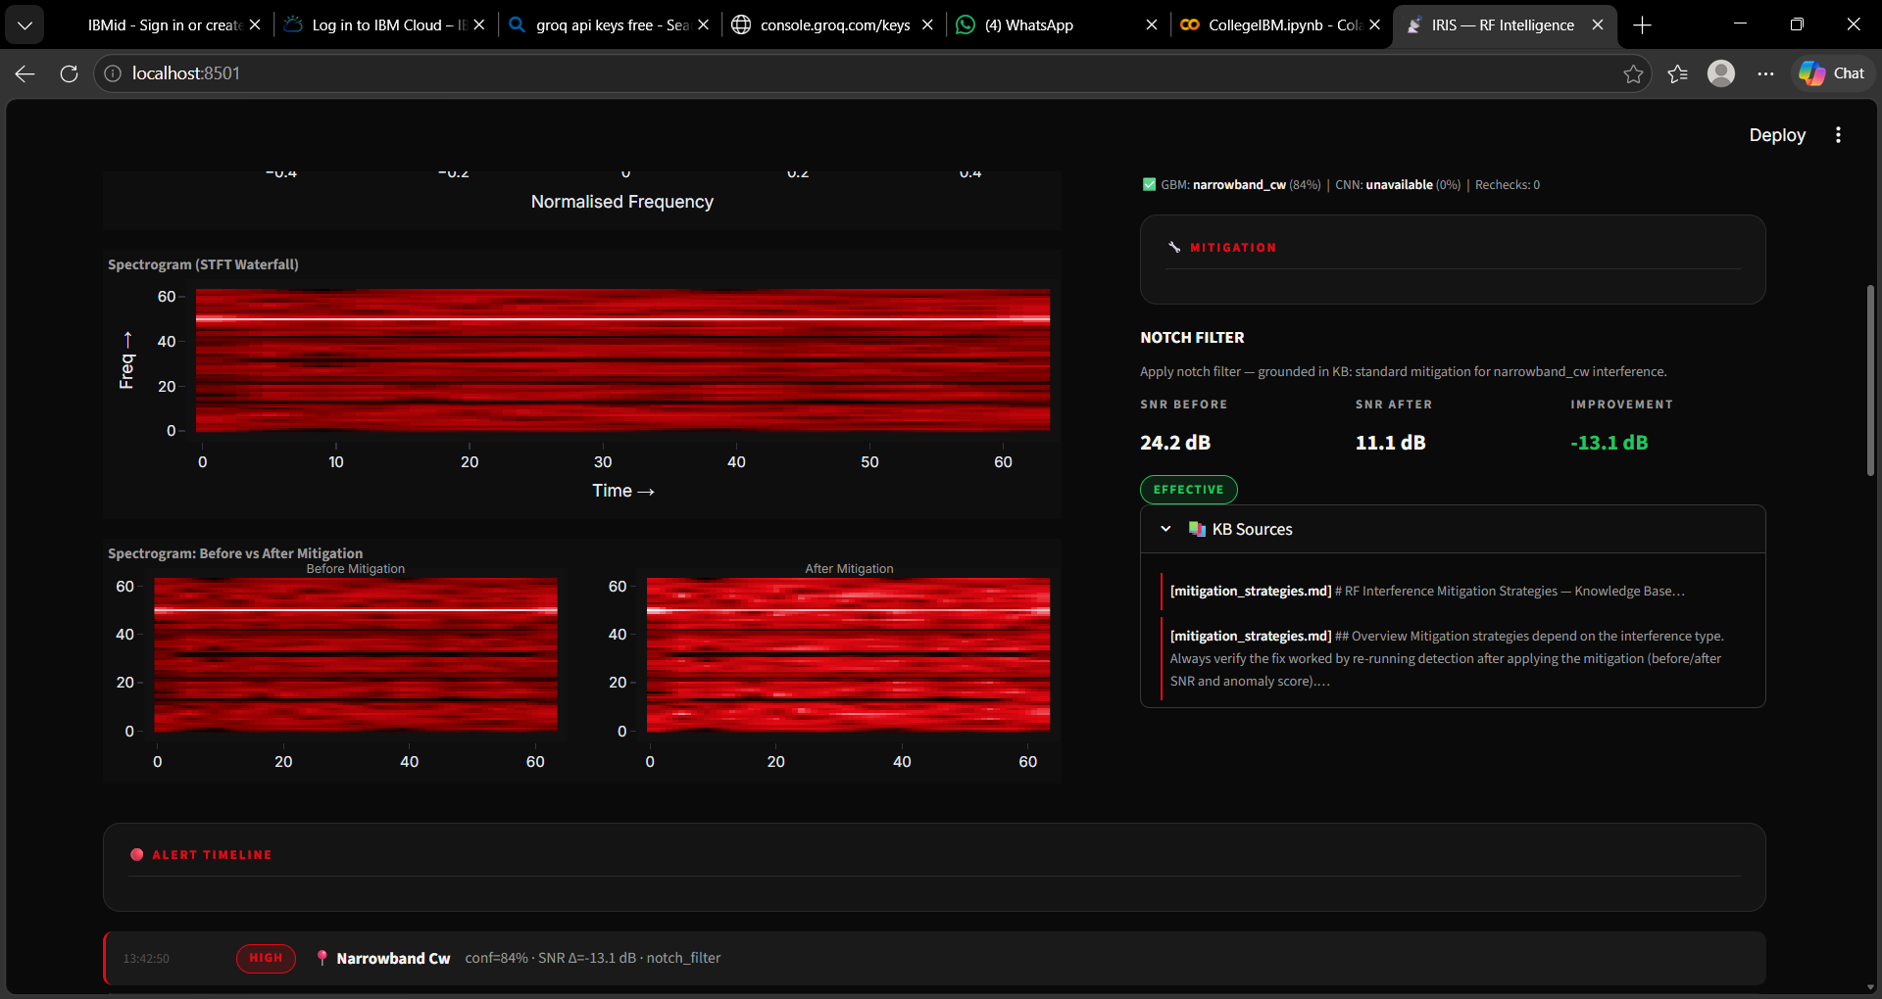
Features of the Project
Features of the Project
MULTI-AGENT AI SYSTEM
Monitor • Diagnosis • Mitigation • Report agents collaborate under an Orchestrator for fully autonomous end-to-end RF interference management — no human prompt required.
CLOSED-LOOP MITIGATION
Mitigation Agent applies DSP fix (notch filter, pulse blanking, bandpass) then re-runs detection and measures actual before/after SNR improvement — verifies its own work.
THREE-MODEL ENSEMBLE CLASSIFIER
Autoencoder (anomaly detection) + GBM on 12 DSP features + CNN on STFT spectrograms — each model catches what others miss for high-confidence classification.
MULTIPLE LLM PROVIDERS
Primary: granite-4-h-small via SDK · Fallback: granite-3-8b-instruct via REST API · Auto-failover with per-call token & cost tracking in dashboard.
MCP TOOL INTEGRATION
mcp_server.py exposes 4 agent tools via Model Context Protocol — callable by IBM Bob, LangChain, or any MCP-compatible IDE or agent runtime.
SELF-VERIFYING DIAGNOSIS
If classifier confidence < 65% or GBM and CNN disagree, IRIS re-analyses the signal up to 2 times autonomously before concluding — no wrong answer passed downstream.
LLM GATEWAY & TOKEN MONITOR
Every Granite call tracked: tokens used, estimated cost ($), provider (SDK / REST). Live KPI row on dashboard shows cumulative stats per session.
GUARDRAILS + HITL + GOVERNANCE
Input guardrail rejects corrupt IQ · Output guardrail blocks hallucinations · HIGH severity triggers Human-in-the-Loop approval button · governance.yaml enforces all policies.
RAG-GROUNDED REASONING
Every agent decision grounded in RF documents retrieved via ChromaDB. IBM Granite never invents measurements — every claim is traceable to a source document.
PERSISTENT INCIDENT MEMORY
Report Agent stores every incident (type, confidence, mitigation, SNR delta). Orchestrator reads past incidents for pattern recognition — IRIS learns from history.
STREAMLIT DASHBOARD — Project Output Screenshots
Notes:
Slide 5: Features of IRIS. Add actual output screenshots from original PPT slides 10-13.

Slide 6
Novelty & Future Scope
Novelty, Future Scope & GitHub Repository
NOVELTY & UNIQUENESS
FUTURE SCOPE
• Multi-Agent Autonomy — Four agents + Orchestrator manage RF interference end-to-end with no human prompt
• Closed-Loop Mitigation — Applies DSP fix, re-runs detection, measures actual SNR change — verifies its own work
• Self-Verifying Diagnosis — Re-analyses signal up to 2x if confidence <65% or models disagree
• RAG-Grounded Decisions — Every explanation sourced from retrieved RF documents; no model hallucination
• Three-Model Ensemble — Autoencoder + GBM + CNN; each catches what the others miss
• Persistent Incident Memory — Stores every incident; Orchestrator uses history for pattern recognition
• Transparent Reasoning Trace — All agent actions logged live on the dashboard — fully auditable
• No Specialised Hardware — Runs entirely on software; no SDR hardware required
• Dual LLM Providers — granite-4-h-small (primary SDK) + granite-3-8b-instruct (fallback REST) with auto-failover and per-call token cost tracking
• MCP-Native Tool Layer — All 4 agent tools exposed as MCP tools, callable by IBM Bob or any MCP-compatible client
• AI Governance — governance.yaml enforces LLM temperature limits, HITL approval rules, input/output guardrails, and audit logging
1. Real SDR Hardware Integration (RTL-SDR, USRP, HackRF)
2. Real-Time Streaming via Apache Kafka / IBM Event Streams
3. Multi-Sensor Network for city-wide interference mapping
4. Adaptive Jammer Detection with LMS filtering
5. Retrain models on real-world SDR captures
6. 5G NR & Satellite Band support (sub-6 GHz, mmWave, GPS)
7. Edge Deployment on Raspberry Pi or NVIDIA Jetson
8. Auto-generate FCC/TRAI/Ofcom regulatory reports
9. Reinforcement Learning for optimal mitigation strategies
10. Full IBM Cloud Deployment (Code Engine + Cloudant + Watson Discovery)
GITHUB REPOSITORY
https://github.com/Jyothika-S2006/IRIS-rf-intelligence/tree/main
Repository includes: All source files • Langflow flow JSON • Knowledge base documents • PPT submission
Notes:
Slide 6: Novelty, Future Scope, and GitHub. GitHub: https://github.com/Jyothika-S2006/IRIS-rf-intelligence/tree/main

