Slide 1

MOVIE RECOMMENDATION SYSTEM
Ms. Suyeba Anjum
Mr. Rakesh M K
Mr. Kaushik V
Ms. Sophiya Joseph Thundathil
Mrs. Jyothika K S
Mr. Ramdarsh M S

Slide 2
TABLE OF CONTENTS
Introduction
EDA
Model Building
Model Evaluation
Deployment
Conclusion

Slide 3
INTRODUCTION
Objective:
Build a system that suggests movies to users based on their preferences
Input Data:
Data was collected by web scraping; it was scraped from IMDb, resulting in a dataset of 10,000 entries.
ML Technique Used:
Cosine Similarity is used to match movies based on their descriptions.
Predictive Outcomes:
The model will suggest movies that are similar to the one provided by the user.

Slide 4


EDA
Data Collected from IMDB using BeautifulSoup
Data Shape: (10100, 12)
Datatypes: Contains values of type Object, float and integer.
Corrected the datatypes for each feature
Checked for null values and replaced it with mean of the particular column

Slide 5
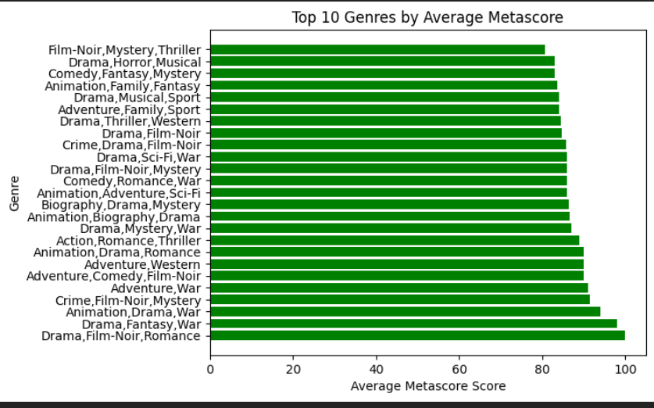
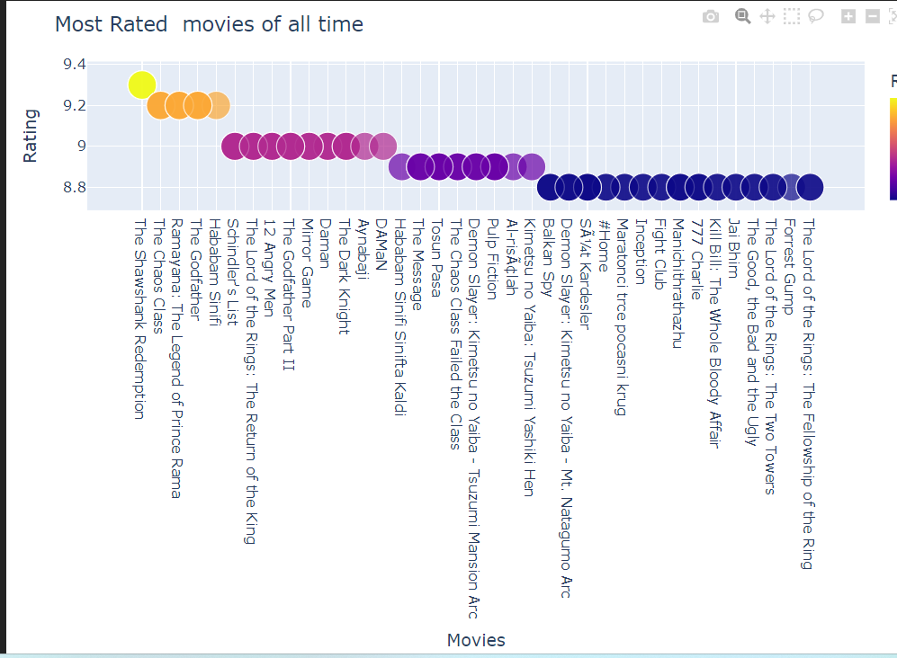
DATA VISUALIZATION
Drama, Romance is the top Genre with an average Metascore of 100
Movies with highest rating of all time

Slide 6
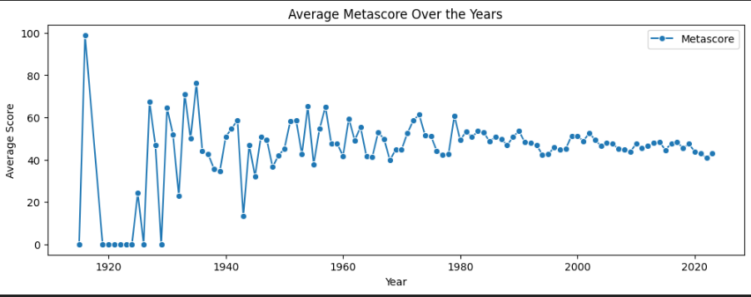
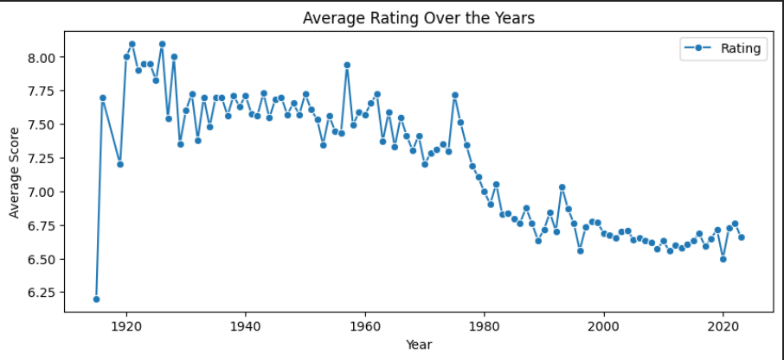
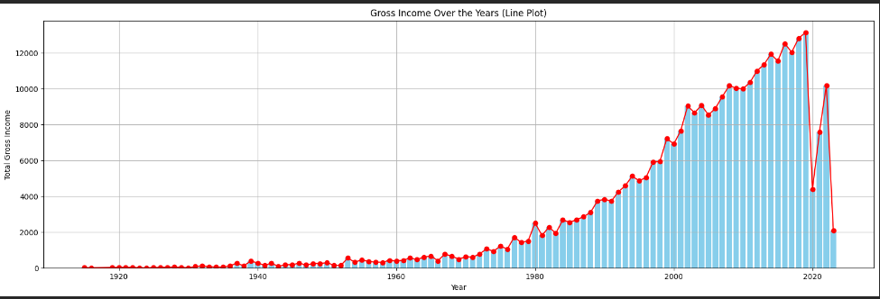
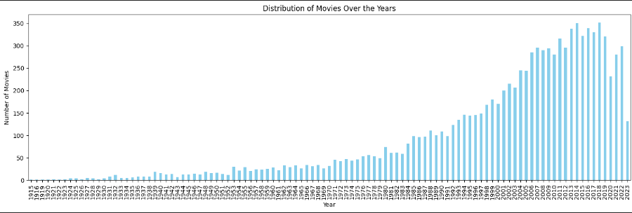

Slide 7
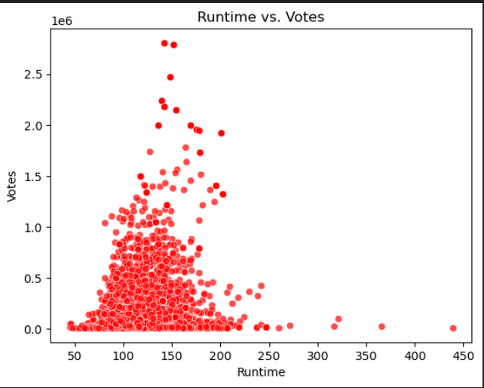
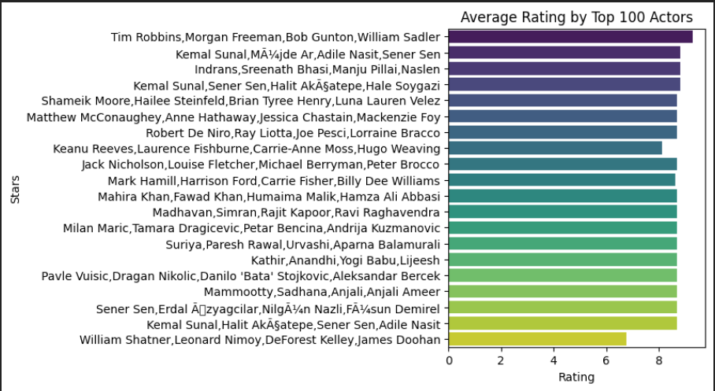
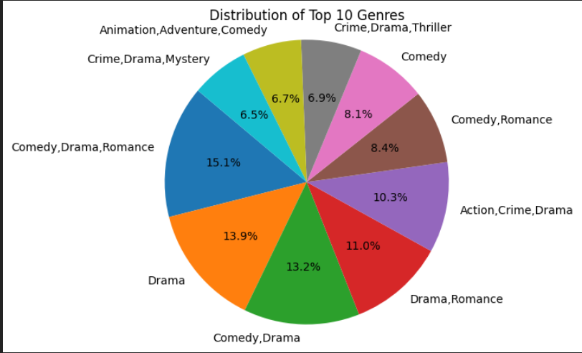
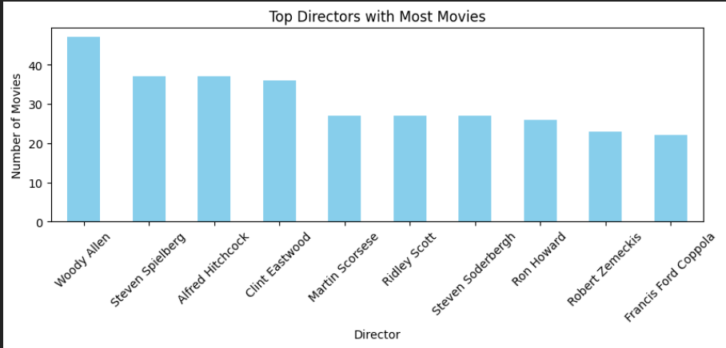

Slide 8
MODEL BUILDING
EXTRACTION:
Taking the required textual features from a featureset and using them to build a corpus for further analysis or training
VECTORIZATION:
By using TextVectorization layer from tensorflow.keras.layers converted textual data into numerical representations that can be used for analysis
NORMALIZATION:
Performing L2 normalization, or Euclidean normalization, to scales individual vectors to have a Euclidean norm of 1 using the tf.math.l2_normalize function from TensorFlow.
COSINESIMILARITY:
Performed cosineSimilarity to determine how similar two movies are, it ranges from -1 (completely dissimilar) to 1 (completely similar), with 0 indicating orthogonality (no similarity).

Slide 9
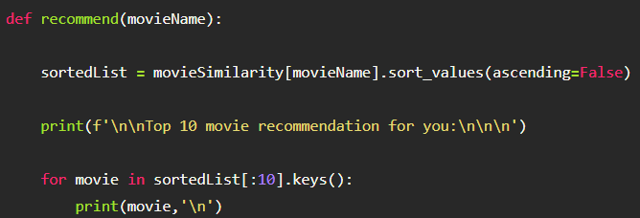
MODEL EVALUATION
Defining a function – recommend
when you call the recommend function with the name of a movie, it retrieves the similarity scores for that movie from the precomputed movieSimilarity matrix, sorts them in descending order, and then prints the movies along with a header indicating the input movie.

Slide 10
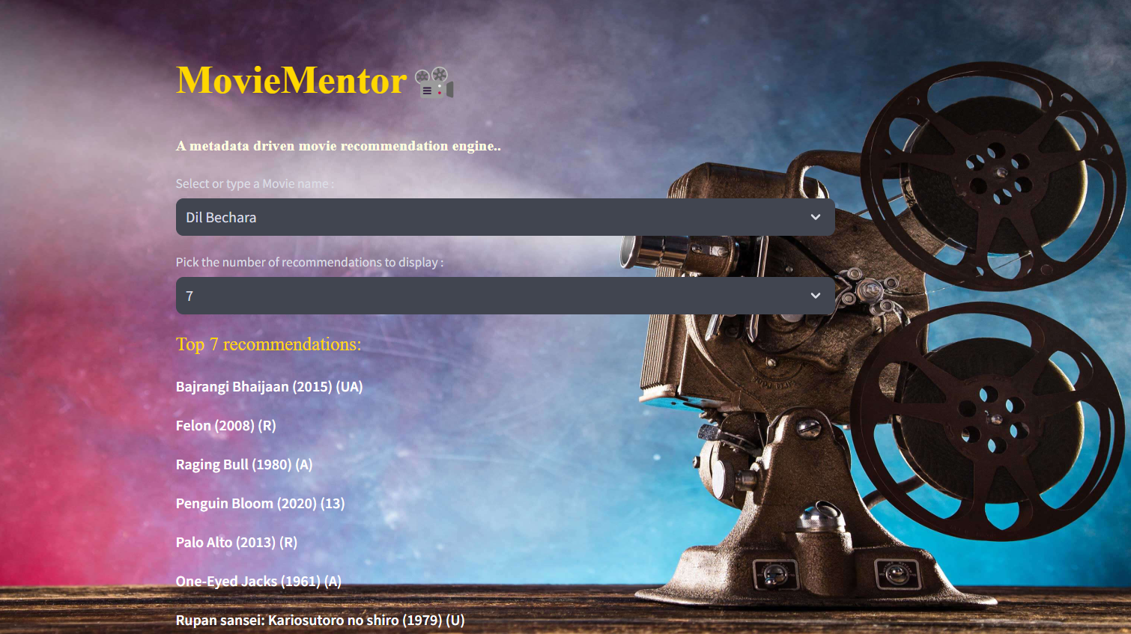
DEPLOYMENT
The model has been deployed using streamlit.io. It takes the movie name and the number of recommendations required from the user, provides movies similar to the one specified by the user.
https://movierecomsystems-wckwpia3zs4pmphrcmiaat.streamlit.app/

Slide 11
THANK YOU

