Slide 1

Project Title - Seasonal Agriculture Performance Analysis

Slide 2

PROBLEM STATEMENT
Agricultural performance varies across seasons due to changes in environmental conditions, farming practices, resource availability, and market conditions.
However, raw agricultural data does not clearly show how performance changes across seasons.
This project analyzes agricultural data to identify seasonal differences, patterns, trends, relationships, and variations in yield, production, resource usage, and economic performance.

Slide 3
Project Description
Seasonal Agriculture Performance Analysis is a data analysis project that studies agricultural performance across different seasons, crops, and regions.
The project uses a dataset containing 4,000 farm records and 28 variables covering environmental conditions, soil characteristics, farming practices, resource usage, crop yield, production, revenue, cost, profit, water efficiency, and disease/pest risk.
The data was cleaned and analyzed using Python, Pandas, NumPy, Matplotlib, and Seaborn. Seasonal, crop-wise, state-wise, and state-season comparisons were performed along with correlation analysis, statistical testing, visualization, and outlier detection.
The analysis helps identify seasonal patterns, high-performing combinations, resource-use differences, and areas that require better agricultural planning.

Slide 4

WHO ARE THE END USERS?
👨‍🌾 Farmers – To select suitable crops and seasons.
🌾 Agricultural Planners – To plan crops and manage resources effectively.
🏛️ Government Agriculture Departments – To support agricultural policies and decisions.
💼 Agribusiness & Market Planners – To understand production and profitability trends.
🔬 Researchers & Students – To study agricultural patterns and performance.

Slide 5

Technology Used
Python – Data analysis and processing
Jupyter Notebook – Project development and analysis
Pandas – Data cleaning and manipulation
NumPy – Numerical analysis
Matplotlib – Data visualization
Seaborn – Statistical visualizations
SciPy – Statistical testing
CSV Dataset – Agricultural data source

Slide 6
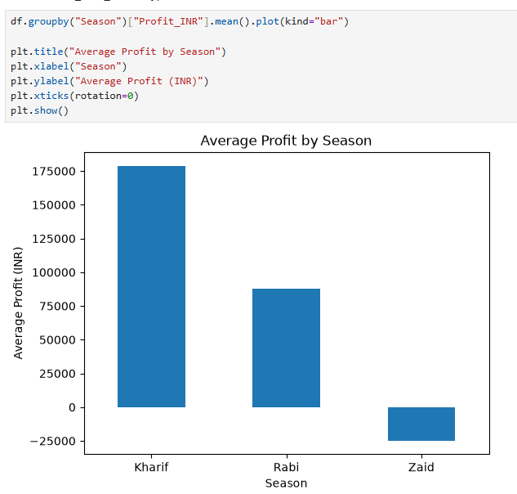
RESULTS
Overall Seasonal Results
Kharif had the highest average yield: 5.63 tonnes/ha
Rabi had an average yield of 5.04 tonnes/ha
Zaid had the lowest average yield: 4.64 tonnes/ha
Kharif had the highest average profit: ₹178,915
Zaid recorded an average loss of approximately ₹24,805
Sugarcane had the highest average yield across all seasons
Kharif had the highest water efficiency: 5.89 t/1000 m³
Punjab–Rabi recorded the highest state-season yield: 8.61 tonnes/ha

Slide 7
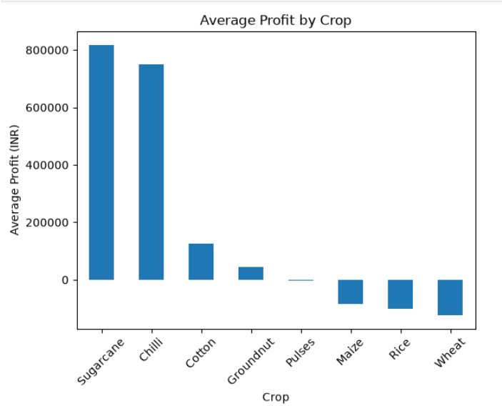
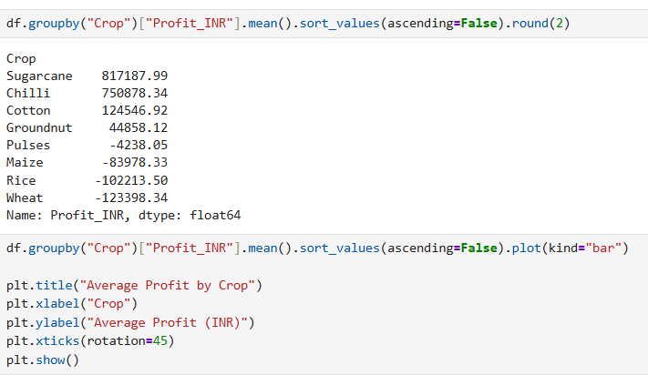
RESULTS
Crop-wise Results
Sugarcane had the highest average yield across all seasons.
Sugarcane: ₹817,188 average profit
Chilli: ₹750,878 average profit
Sugarcane and Chilli were the strongest-performing crops.

Slide 8
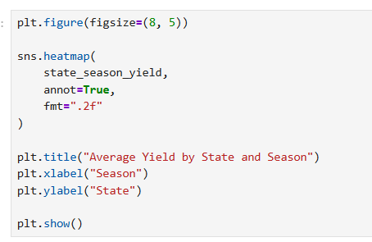
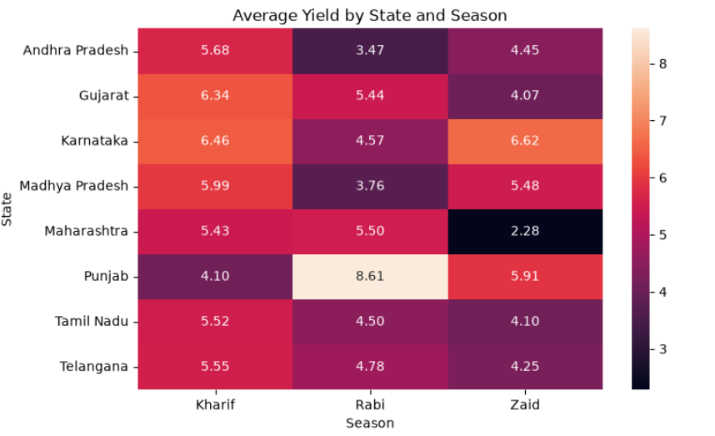
RESULTS
State & Season Results
Punjab – Rabi recorded the highest yield: 8.61 tonnes/ha
Karnataka – Zaid recorded 6.62 tonnes/ha
Maharashtra – Zaid recorded the lowest yield: 2.28 tonnes/ha
Punjab showed the highest seasonal variation: 4.51 tonnes/ha
Telangana showed the lowest seasonal variation: 1.30 tonnes/ha

Slide 9
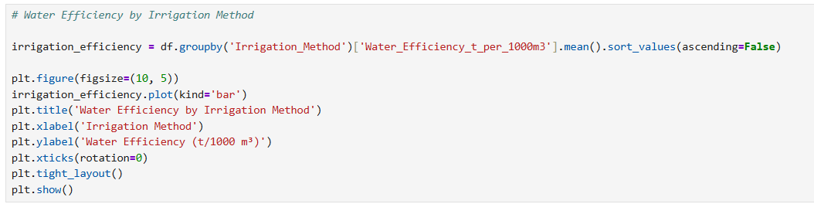
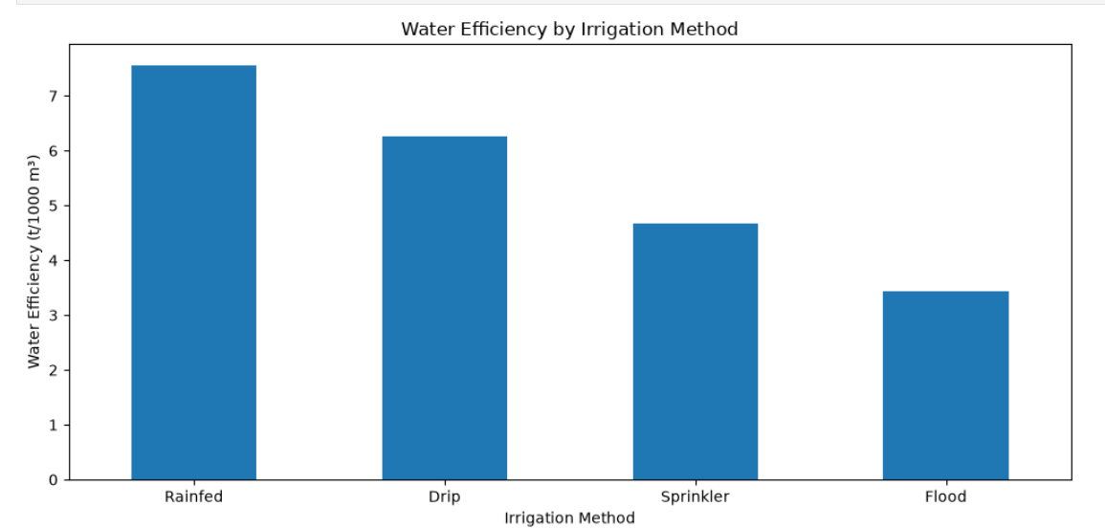
RESULTS
Water & Environmental Results
Zaid used the highest average water: 6419.89 m³
Zaid had the lowest water efficiency: 4.41 t/1000 m³
Kharif had the highest water efficiency: 5.89 t/1000 m³
Rainfed irrigation showed the highest water efficiency: 7.56 t/1000 m³
Kharif had the highest rainfall: 849.20 mm
Zaid had the highest temperature: 31.04°C

Slide 10
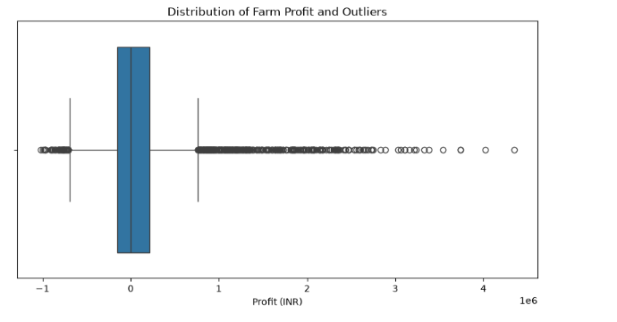
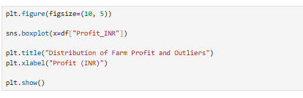
RESULTS
STATISTICAL & OUTLIER RESULTS
Kruskal-Wallis test showed a significant difference in yield across seasons.
P-value = 1.20 × 10⁻¹⁵ (< 0.05).
Profit outlier analysis identified 404 unusual observations.
Profit was strongly associated with Revenue (0.89).
Yield was strongly associated with Water Efficiency (0.91).
Outliers included both unusually high profits and large losses.

Slide 11
Future scope
Develop machine learning models to predict crop yield and profit.
Build crop recommendation systems based on season and environmental conditions.
Use weather forecasting data for better seasonal planning.
Create an interactive dashboard for farmers and agricultural planners.
Integrate real-time agricultural and market data.
Perform deeper analysis of crop costs, prices, and profitability.
Provide personalized recommendations for crop and resource management.

Slide 12
GitHub Link
https://github.com/Jyothirmai-09/Seasonal-Agriculture-Performance-Analysis

Slide 13
Thank you
.
.

