Slide 1



Smart Garbage Classifier Using Deep Learning
By
Ch.Jyothirmai
CSE-4th year
RGUKT Nuzvid

Slide 2

Learning Objectives
Understand how to build and train a deep learning model for image classification.
Learn how to use ResNet50 (transfer learning) effectively.
Gain hands-on experience with image preprocessing and dataset augmentation.
Build a user-friendly web interface using Streamlit.
Integrate multiple input methods: upload, URL, and webcam.
Interpret model outputs using confidence scores and class probabilities.
GOAL

Slide 3
Tools and Technology used
Category | Technology
Language | Python
Deep Learning | Pytorch, Torchvision
Model | Resnet50
Data Handling | PIL, Requests
Web App UI | Streamlit
Visualisation | Pandas
Dataset | Images

Slide 4
Methodology
Data Preparation
Model Selection
Training
Used a labeled garbage image dataset with 6 classes
Applied data augmentation (rotation, flipping, color jitter)
Used pretrained ResNet50
Replaced the final layer with a 6-class classifier
Fine-tuned only final layers (layer4 and fc)
Loss: CrossEntropy with Label Smoothing
Optimizer: AdamW
Achieved ~93% test accuracy
User Interface
Prediction logic
Input options: Upload file, Paste URL, Use Webcam
Shows image, prediction, confidence, and probability table
Applies softmax to model output
Shows top class and class-wise confidence

Slide 5
Problem Statement:
Improper segregation of garbage leads to inefficient recycling, environmental hazards, and health risks.
Manual waste sorting is time-consuming, error-prone, and often unhygienic.
There is a need for an automated, scalable solution to classify waste types accurately and in real time.
Develop an image classification mdoel that sorts waste images into their correct categories. the dataset contains labelled images of garbage in six classes (cardboard, glass, metal, paper, trash).
The goal is to take a photo of waste item and correctly classify it.

Slide 6
Solution:
Developed a deep learning-based classifier using ResNet50 for high-accuracy garbage classification.
Implemented data augmentation techniques to improve generalization on real-world images.
Integrated a clean and interactive Streamlit-based web app to accept images via:
📁 File upload
🌐 URL input
📷 Webcam capture
Displayed prediction results with:
🎯 Top predicted class
📊 Confidence percentage
🔢 Probability distribution across all classes
Notes:
Developed a deep learning-based classifier using ResNet50 for high-accuracy garbage classification.
Implemented data augmentation techniques to improve generalization on real-world images.
Integrated a clean and interactive Streamlit-based web app to accept images via:
📁 File upload
🌐 URL input
📷 Webcam capture
Displayed prediction results with:
🎯 Top predicted class
📊 Confidence percentage
🔢 Probability distribution across all classes

Slide 7
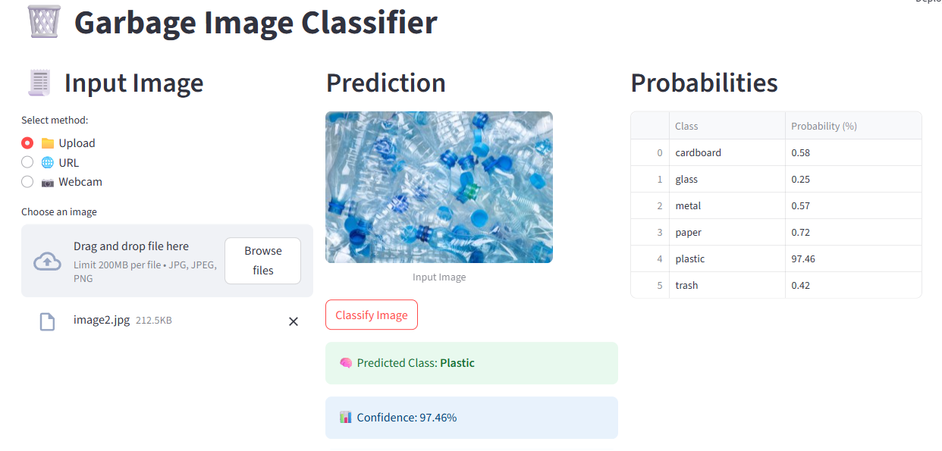
Screenshot of Output:

Slide 8
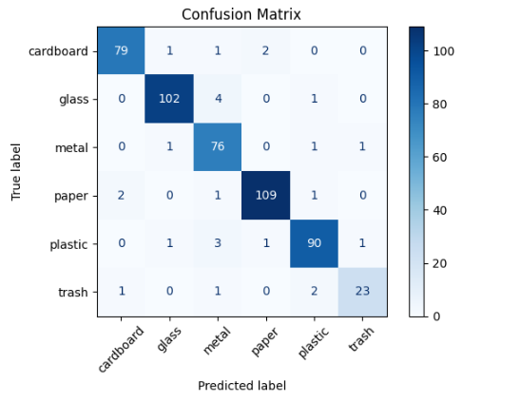
Conclusion:
This project demonstrates how AI can contribute to solving real-world environmental issues by automating waste classification.
Leveraged the power of transfer learning and human-centered UI design to make the model accessible and intuitive for users.

Slide 9
Thank You..

