Slide 1
COMPUTER
INTRODUCTON TO COMPUTER

Slide 2
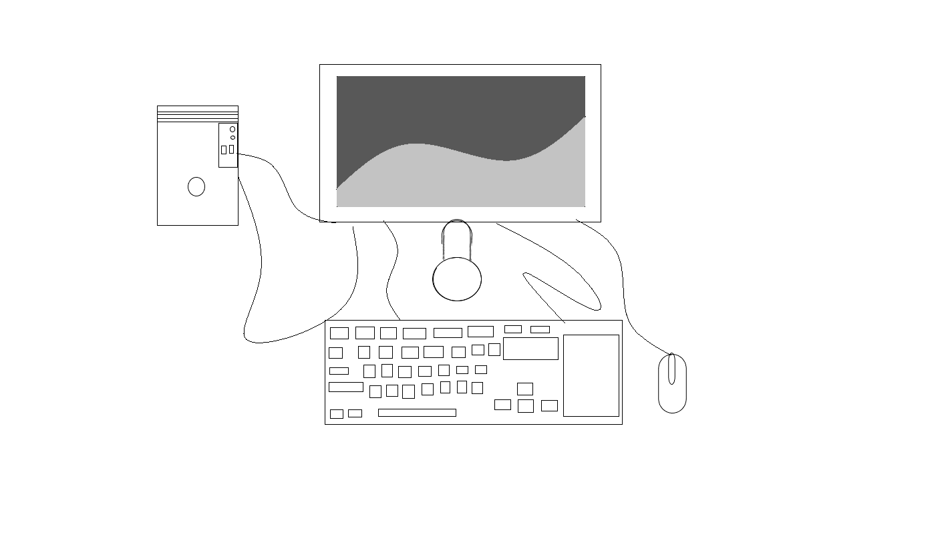
COMPUTER: A SET OF INTEGRATED DEVICES THAT TAKES INPUT ,GIVES OUTPUT,STORES DATA AND INFORMATION.
CPU: The CPU performs basic ,logic, controlling and input/output operations specified by the instructions in the program.

Slide 3
INTERNALS PARTS OF CPU:
Mother board
Power supply
Hard drive
Optical drive
Processor
Heat sink fan
Hoppy drive
RAM
The CPU performs basic logic ,arcomputershmetic ,controlling and input/output operations specified by the instructions in the program.

Slide 4
CLASSIFICATIONS OF COMPUTER:
BASED ON PHYSICAL SIZE COMPUTER ARE DIVIDED INTO 4 MAIN GROUPS
SUPER COMPUTER
MAINFRAME COMPUTER
MINI COMPUTER
MICRO COMPUTER

Slide 5
SUPER COMPUTER
CHARACTERISTICS:
FASTEST COMPUTER
LARGE IN SIZE
MOST EXPENSIVE
HUGE PROCESSING POWER
VERY HEAVY
GENERATE A LOT OF HEAT
CAN OPERATE 500 USER AT THE SAME TIME

Slide 6
EXAMPLES OF SUPER COMPUTER 1.CRAY T3D 2.NEC-500 3.CDC 6600 4.ENIAC
APPLICATIONS:
SCIENTIFIC RESEARCH
WEAPON AND DEFENCE ANALYSIS
PETROLEUM RESEARCH
WEATHER FORECASTING
NUCLEAR ENERGY RESEARCH

Slide 7
MAINFRAME COMPUTER
CHARACTERISTICS :
Have a large storage capaccomputersy
Large in size
Multi-user
Multi processing
Support a variety of peripherals

Slide 8
EXAMPLES OF MAINFRAME COMPUTER: 1.IBAM 39 SERIES 2.ICL 39 SERIES 3.CDC CYBER CRIME 4.BINAC 5.UNIVAC
APPLICATIONS:
Mainly used in government sectors like banks , hospcomputersals etc….
Communication networks
Airline reservation

Slide 9
MINI COMPUTER
Characteristics:
Multi user that is can be operated by 6 users at a time
Cheaper than mainframe
Less powerful and have less memory than mainframe COMPUTER
Slow compared to mainframe COMPUTER
Applications:
Used in scientific library
Used in research instcomputersutions
Engineering plants
Automatic processing

Slide 10
Micro COMPUTER
Characteristics:
Are cheaper than other type of COMPUTER
Very fast
Small in size hence they occupy less space
Consume less power
Applications :
Training and learning instcomputersutions
Small business enterprises
Communication centers as terminals

Slide 11
Various types of micro COMPUTER
Desktop COMPUTER : is designed to be placed on top of an office desk .
Note book or laptop: portable convenient for mobile users.
Personal digcomputersal assistant : is small enough to fcomputers in the pocket.

Slide 12
Characteristics of computer
Speed
accuracy
Memory
Diligence
Reliabilcomputersy
Versatilcomputersy
automation
Notes:
characteristics/features of COMPUTER

Slide 13
SOFT COPY AND HARD COPY DEVICES:
HARD COPY | SOFT COPY
IT IS A PRINTED DOCUMENT | IT IS NON PRINTED DOCUMENT
IT IS A PHYSICAL COPY | IT IS A VIRTUAL COPY
IT IS TREATED AS PERMANENT COPY | IT IS TREATED AS TEMPORARY COPY
IT DOESN’T REQUIRE ANY ELECTRONIC DEVICE | IT REQUIRES ELECTRONIC INTERFACE

Slide 14
Advantages of COMPUTER:
COMPUTER process data faster
COMPUTER are more accurate and reliable
COMPUTER are more efficient

