Slide 1


Summer Online internship web development using Django
Topic: Online Library Management System
Meda Jyothsna
2401600149 KLU

Slide 2
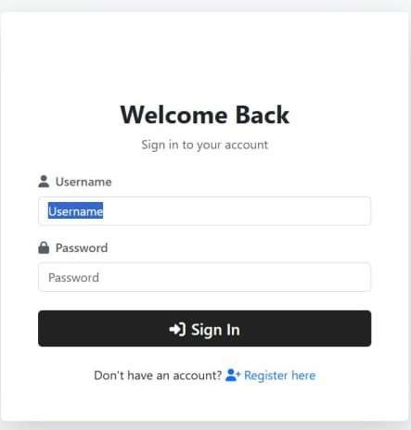
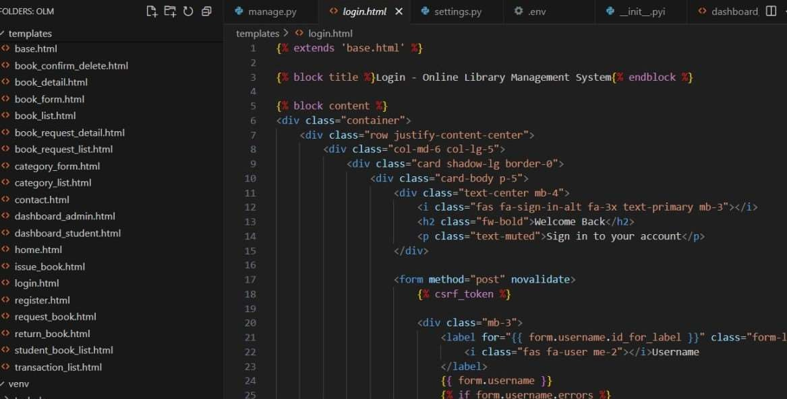
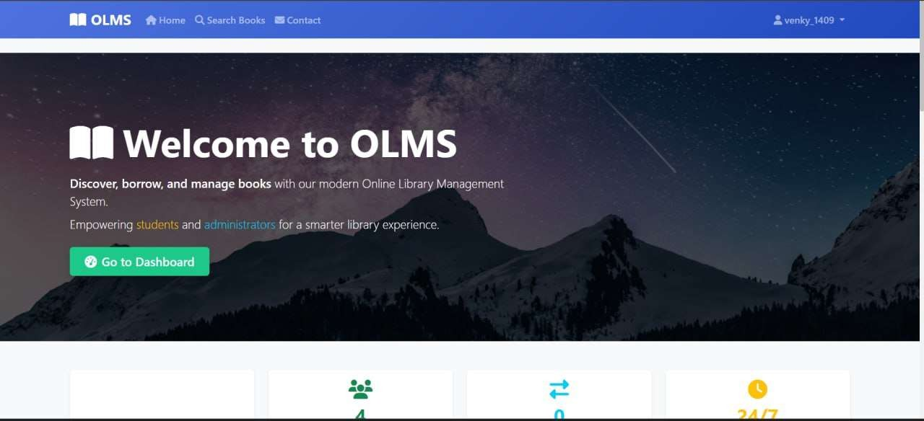
contains
Home Page
Login Page
Admin Administration
Views Books
Site Administration
Code

Slide 3
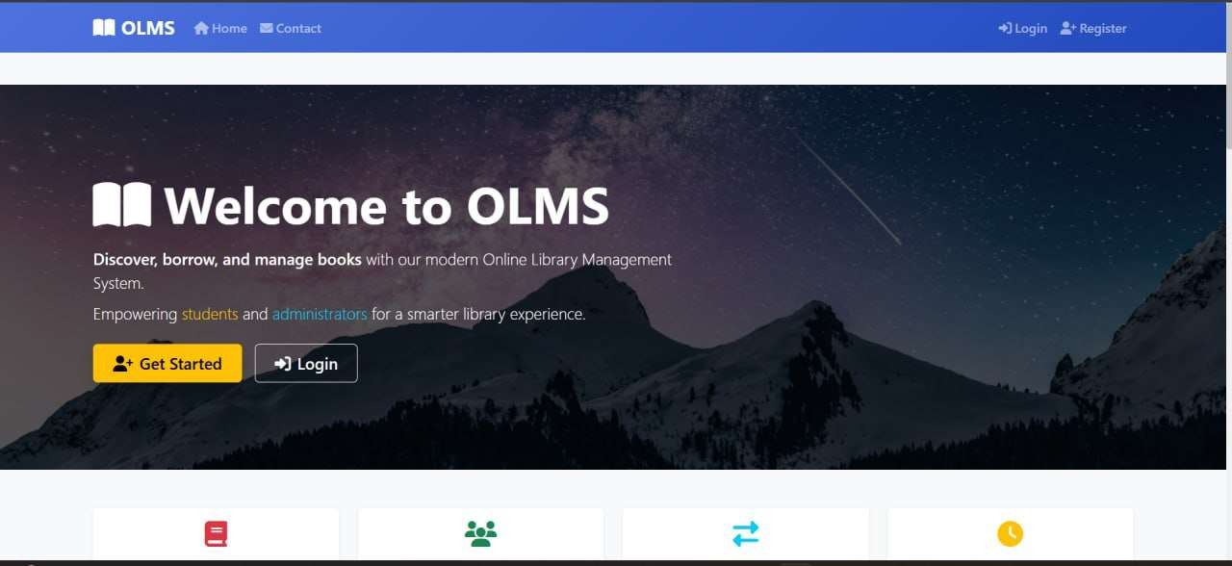
Home Page
User-Friendly Interface:
The homepage features a clean layout with clear navigation options like Home, Contact, Login, and
Register
for easy access.
Call to Action Buttons:
Prominent buttons like "Get Started" and "Login" guide users to take immediate actions, improving user engagement.
Modern Visual Appeal:
The background with a night sky and mountains, paired with bold text and icons, creates a visually appealing and welcoming experience for users.

Slide 4

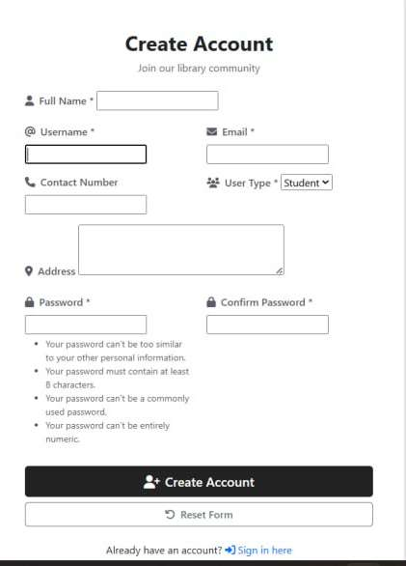
Login Page
Don’t have an account yet? Register now to join our library community and unlock full access to our catalog and services.
Welcome back! Sign in with your username and password to access your library dashboard and view your borrowed books, holds, and reading history.
Forgot your password? Click the “Forgot Password” link to securely reset it via your registered email address.

Slide 5
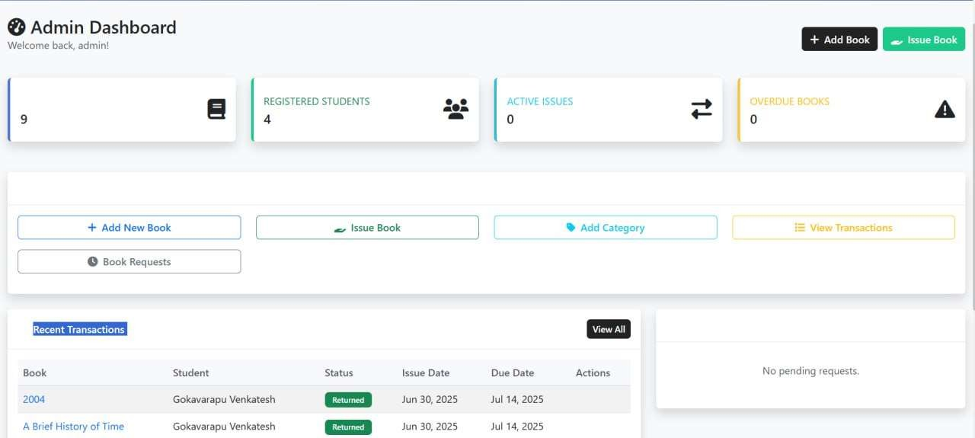
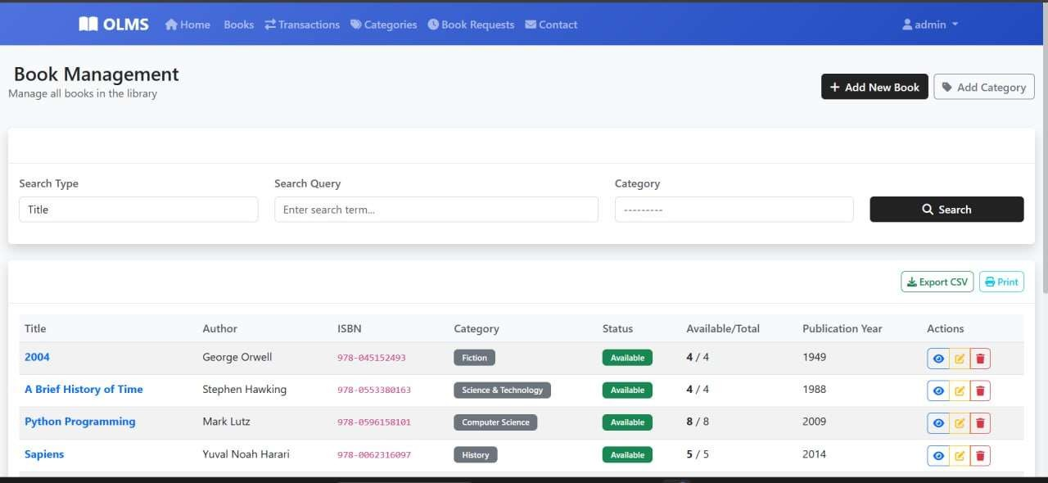
Admin Administration
Combine powerful filters (Title, Author, ISBN, Category) with top-bar actions—add/edit books, issue items, and manage categories—all from a single, intuitive interface.
Instantly see live “Available/Total” counts alongside key summary cards (total books, registered students, active issues, overdue items) to gauge library status at a glance.
With one-click buttons you can view, edit or delete records, export CSV, print lists, and review recent transactions—then drill into a full history with “View All.”

Slide 6
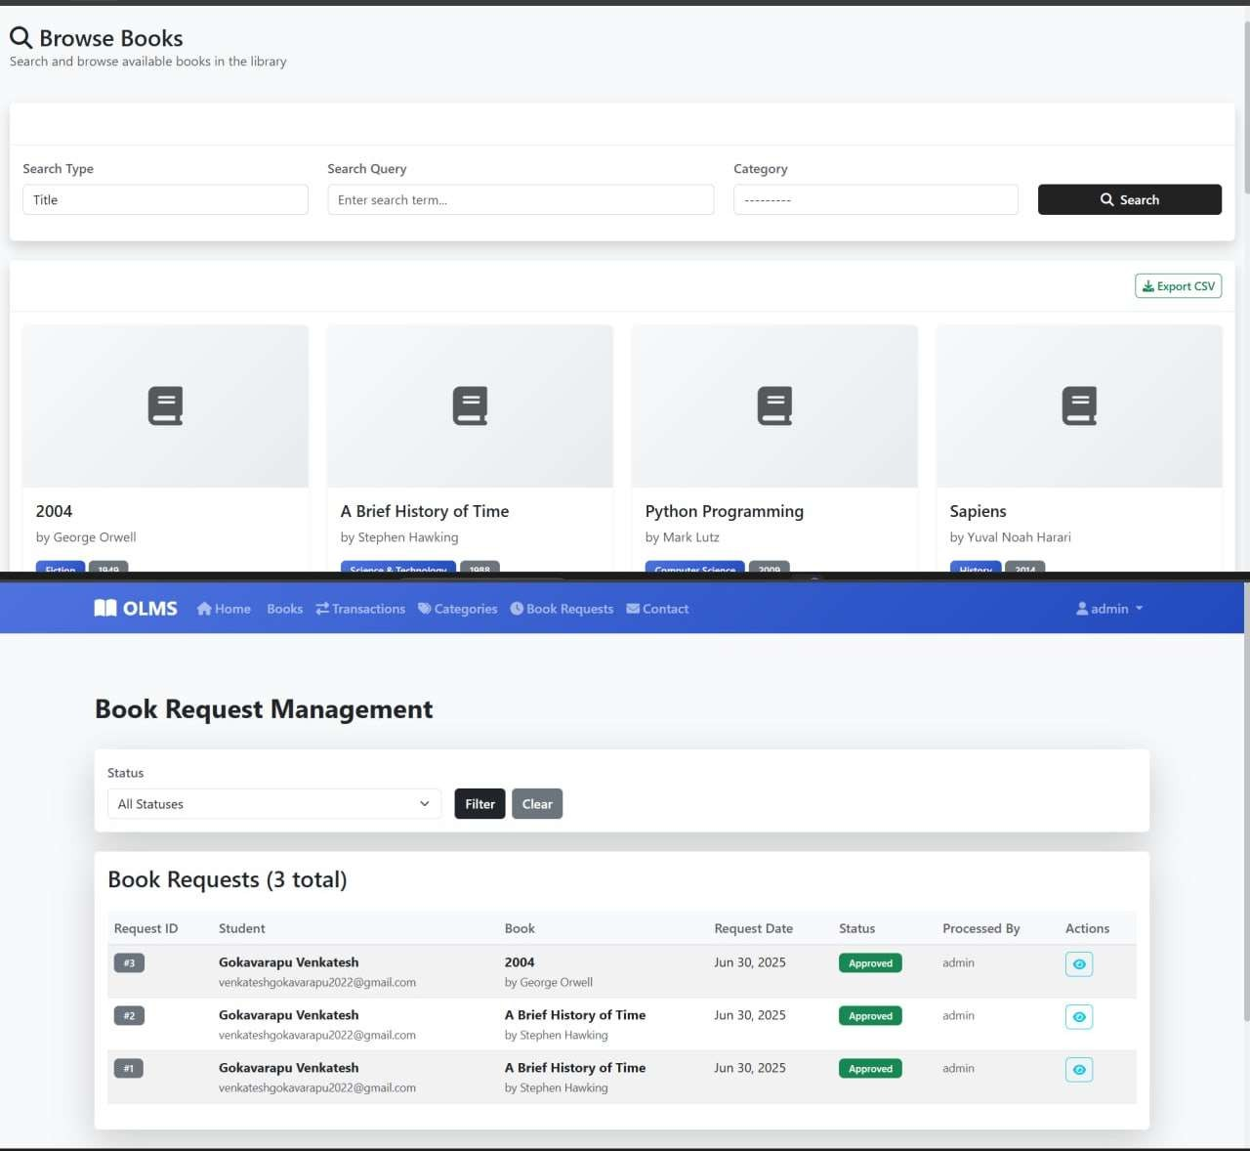
View Books
Displays all book requests with student details and status.
Allows admin to monitor and process requests efficiently.
Provides status-based filtering to quickly view requests
Ensure easy management of approved, pending, or rejected books.
Actions can be performed by the admin with secure access.
Request status updates and detailed views are available.

Slide 7
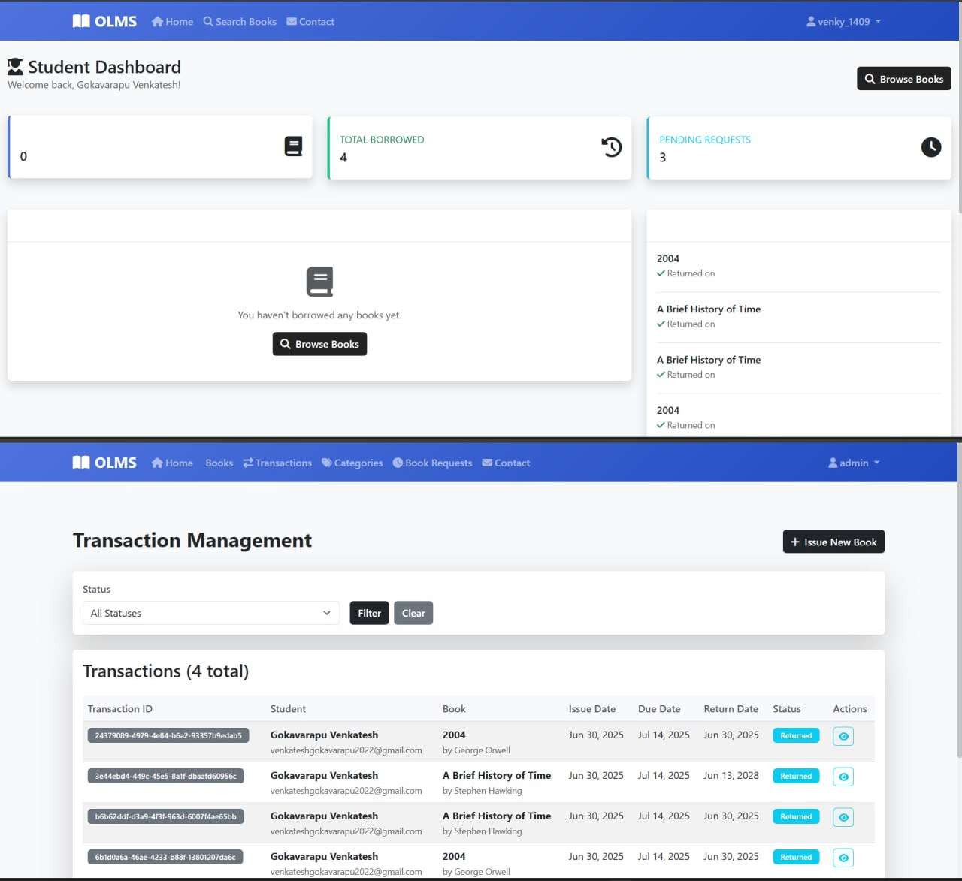
Site Administration
Displays borrowed books, pending requests, and borrowing history with quick access to browse books.
Shows borrowed books, pending requests, and borrowing history in a clean view.
Admin can view, filter, and manage all book transactions with student and book details.
Allows admin to issue new books quickly and track borrowing status efficiently.
Admin can track, filter, and manage all book transactions easily.

Slide 8
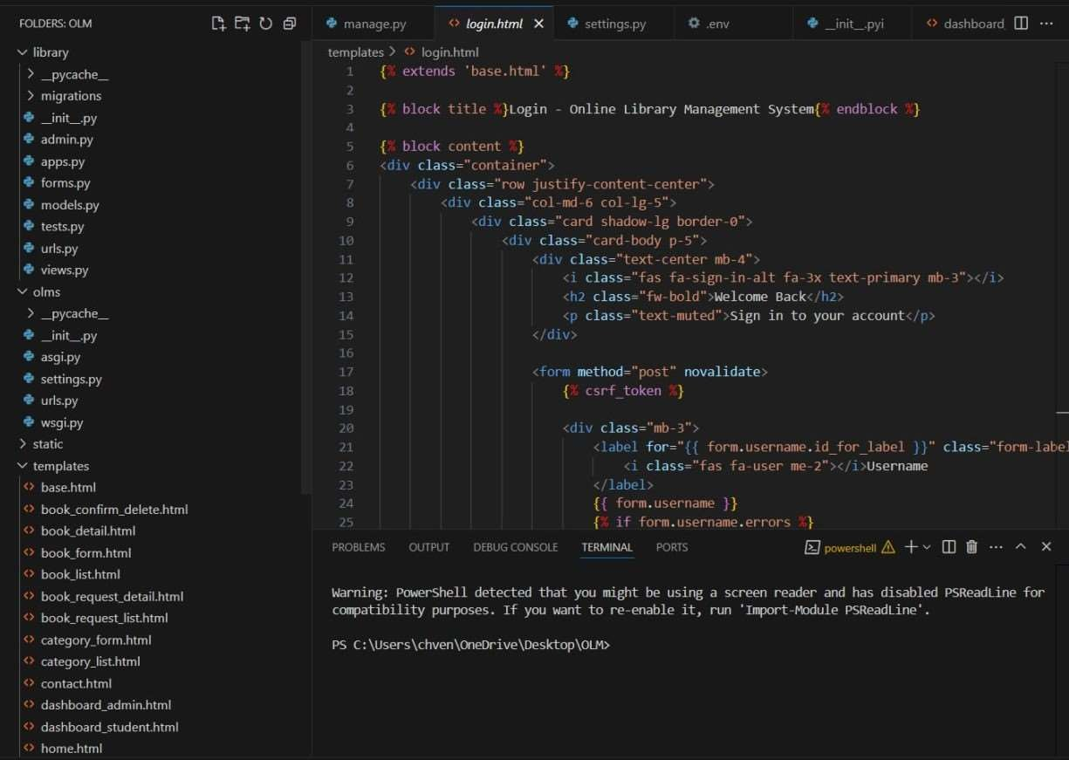
Code
Designed a clean, mobile-friendly login page using Bootstrap.
Provides a smooth and simple user experience.
CSRF token included for secure form submissions.
Validates username and password with error display.
Used Django’s template inheritance from base.html
Ensures layout consistency across all project pages.

Slide 9


