Slide 2
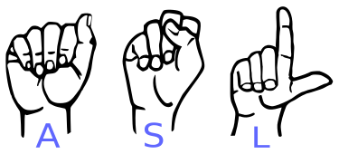
American Alphabet Sign Languages Detection (MIS-64061-003)
Presented by
Jyothsna Peddireddigari
Pranay Kumar Kodeboyina
Ramya Krishna Singavarapu
Venkateswara Rao Jammula

Slide 3
Introduction to American Sign Language
​Visual language used by American deaf and hard hearing communities. ​
Combination of handshapes, facial expressions, body movements, and spatial grammar ​
Not merely a series of gestures​
Language rich in nuances​
Expression of complex thoughts, emotions, and concepts​
Distinctive from English grammar. ​
It has a subject-comment structure, in which the topic is presented first, followed by comments or additional details ​
Emphasizes space and movement usage, making it a unique and powerful mode of communication.​

Slide 4
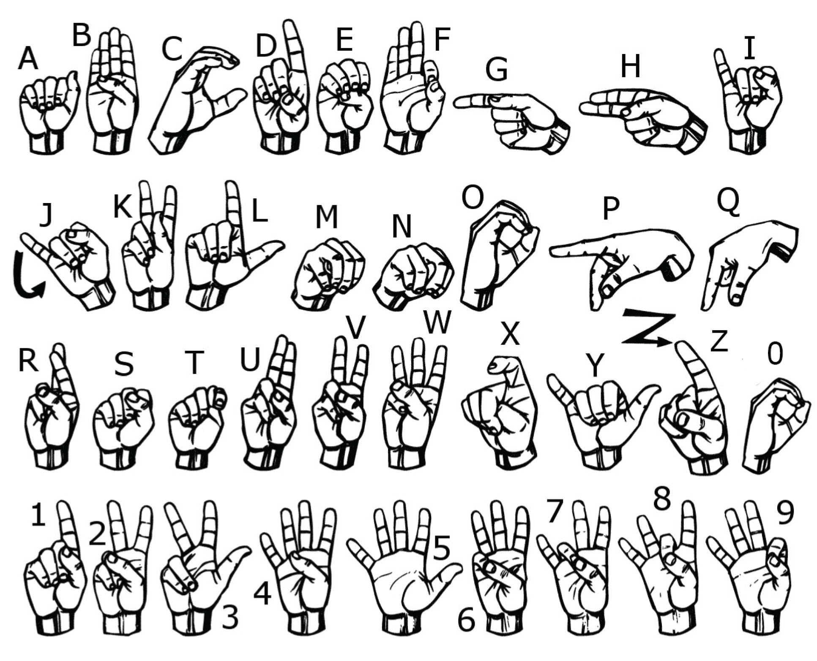

Slide 5
Problem Statement​
This project aims to create a tool that assists children with varying degrees of hearing impairment in recognizing alphabets through American Sign Language gestures.
Leveraging convolutional neural networks for accurate and efficient gesture identification.
The overarching goal is to provide a user-friendly and accessible solution that enhances communication for children with hearing impairment.

Slide 6
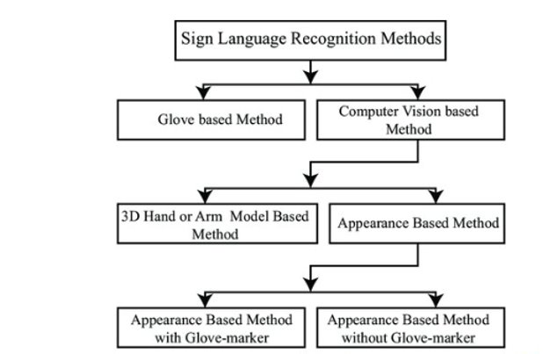
Sign Language Recognition Models​

Slide 7
Assumptions
The training dataset is representative of the real-world scenarios the model will encounter
Sufficiently captures the diversity of objects, backgrounds, and conditions.
Annotations provided in the training data are accurate, consistent, and properly align with the objects.

Slide 8
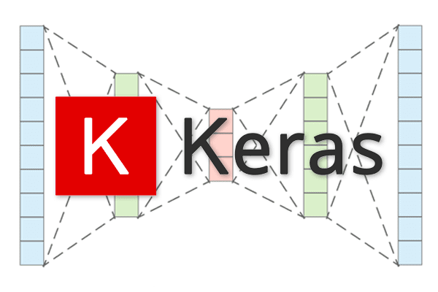
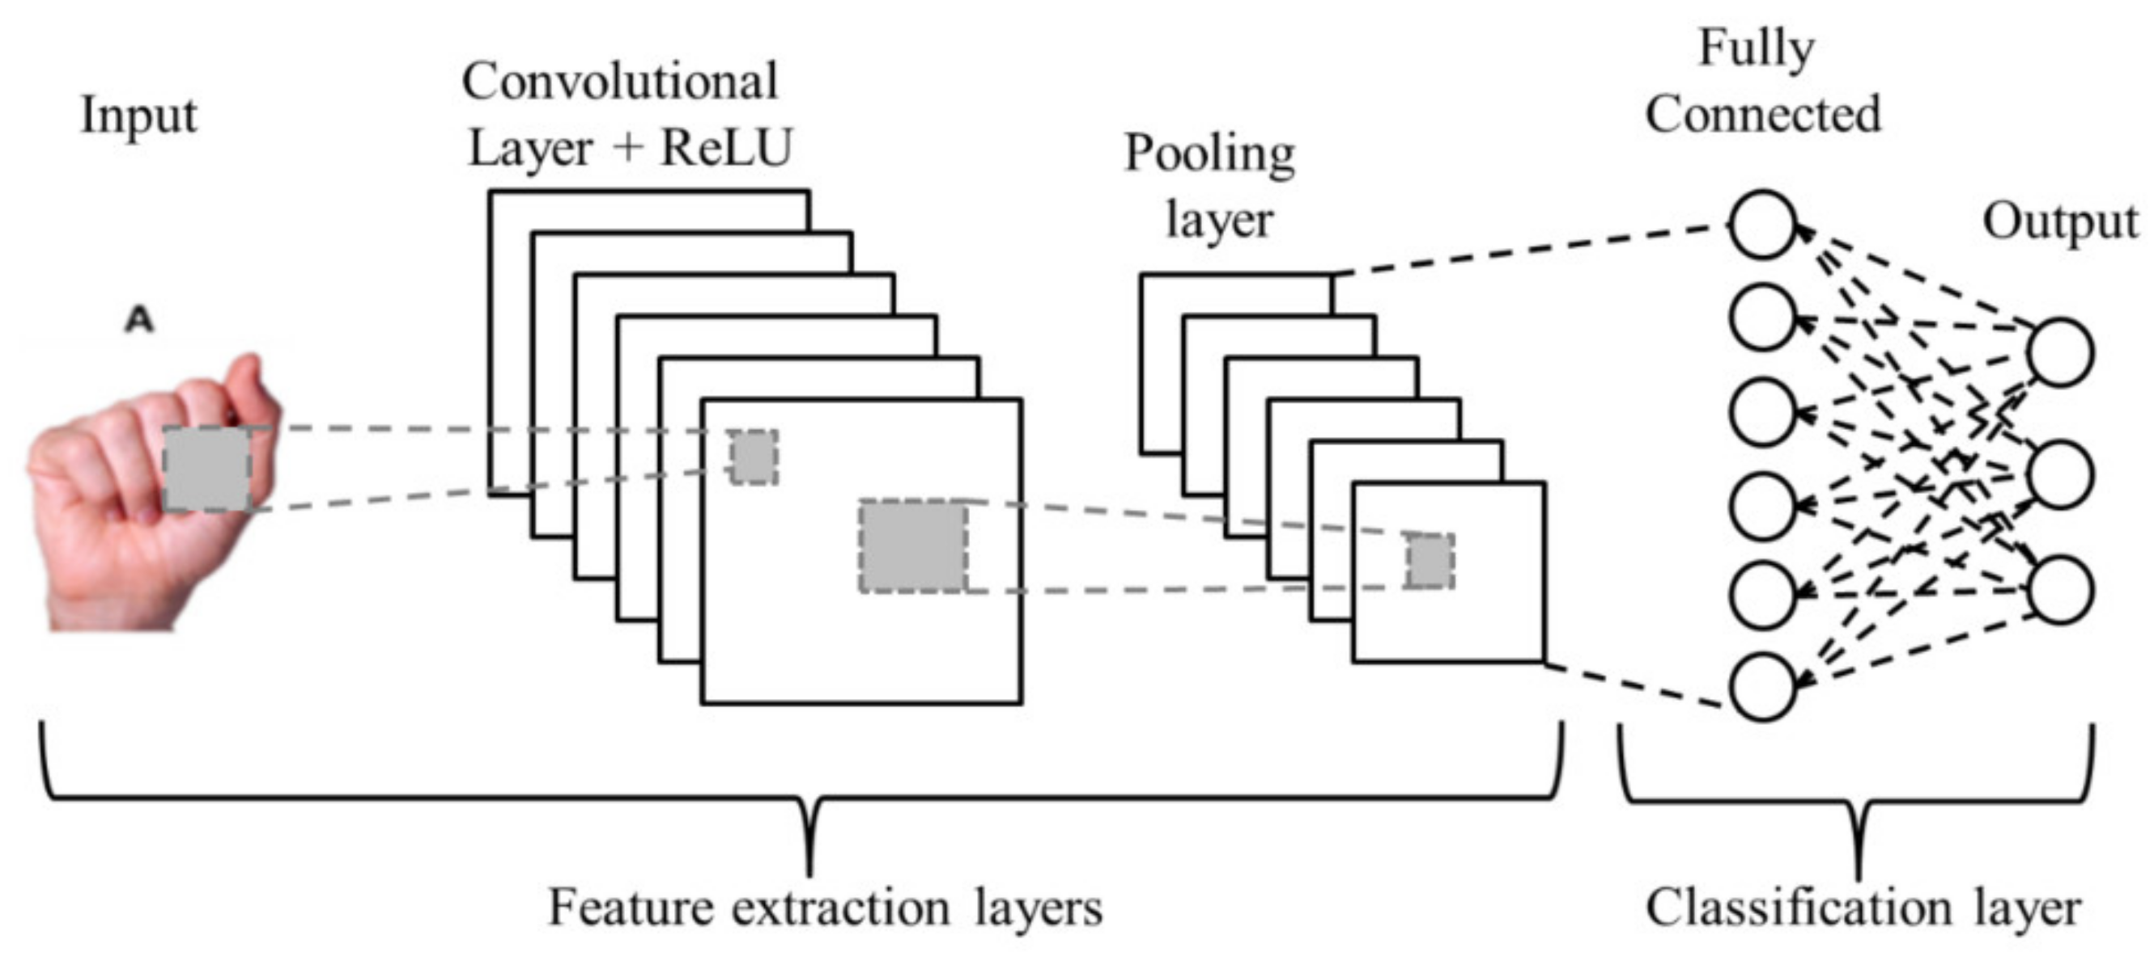
Tools and Dependencies - Keras
Keras is an Open source software library that provides a Python interface for artificial neural networks.
Keras is a popular deep learning framework widely used for various machine learning tasks, including sign language recognition.
Reasons for choosing library - Interface, support for convolutional neural networks, and extensive optimization algorithms.

Slide 9
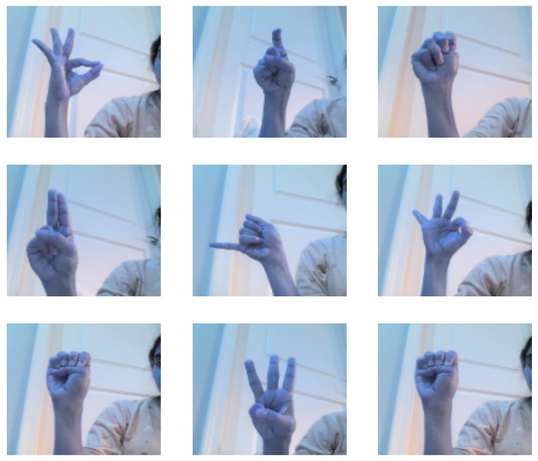
Tools and Dependencies - Opencv
OpenCV is a library of programming functions mainly for real-time computer vision.
Python library to perform image processing and computer vision tasks.
Offers a rich set of functionalities
extract and interpret relevant features from video frames
accurate recognition of sign language gestures.

Slide 10
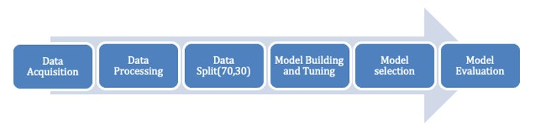
Project Implementation​ Stages

Slide 11
Data Creation
Manually Capture Process​
Help of TeachableMachine
Google Drive
Each Alphabet images stored in Each folder in Google Drive
Data Creation

Slide 12
Data Processing And Split
Project Hosting and Dataset Access​
A custom function employed to read, label and resize the images
One Hot Encoding to convert Images to binary format of 0 & 1​
The dataset is split into training and testing sets, ensuring a balanced distribution of classes.​
Dataset shape : (12974, 120, 120, 3)
Total Images used for Training - 9081
Data Creation
Data Processing
Dataplit(70,30)

Slide 13
Model Building
Convolutional Neural Networks(CNN)
CNN with Image Augmentation
Pretrained Model - ResNET
Data Creation
Data Processing
Dataplit(70,30)
Model Building and Tuning

Slide 14
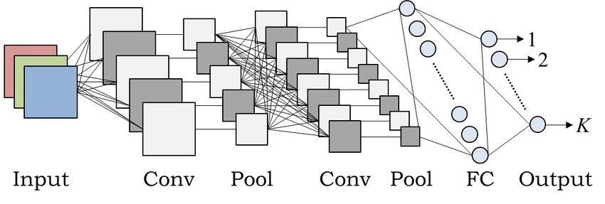
CNN Architecture
﻿A labelled dataset of sign language images is required for training.
﻿CNN learns to extract relevant features that distinguish different signs.
﻿During training, the model adjusts its parameters using optimization techniques like backpropagation to minimize the difference between predicted and actual labels

Slide 15
Model Building – CNN Design Architecture
model = Sequential() model.add(Conv2D(16, (3,3), input_shape=(120, 120, 3)))
model.add(Activation('relu'))
model.add(MaxPoling2D((2, 2)))
model.add(Conv2D(32, (3, 3)))
model.add(Activation('relu'))
model.add(MaxPooling2D((2, 2)))
model.add(Conv2D(64, (3, 3)))
model.add(Activation('relu'))
model.add(MaxPooling2D((2, 2)))
model.add(Conv2D(128, (3, 3)))
model.add(Activation('relu'))
model.add(MaxPooling2D((2, 2)))
model.add(Conv2D(256, (3, 3)))
model.add(Activation('relu'))
model.add(MaxPooling2D((2, 2)))

Slide 16
model.add(Flatten())
model.add(Dense(64, activation='relu'))
model.add(Dropout(0.2)) # Added a dropout layer for regularization
model.add(Dense(128, activation='relu'))
model.add(Dropout(0.2))
model.add(Dense(256, activation='relu'))
model.add(Dropout(0.2))
model.add(Dense(26, activation='softmax’))
from tensorflow.keras.callbacks import EarlyStopping
early_stop = EarlyStopping(monitor='val_loss',patience=2)

Slide 17
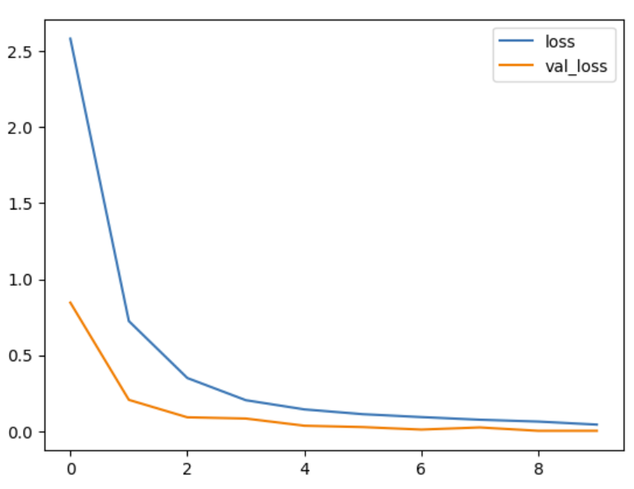
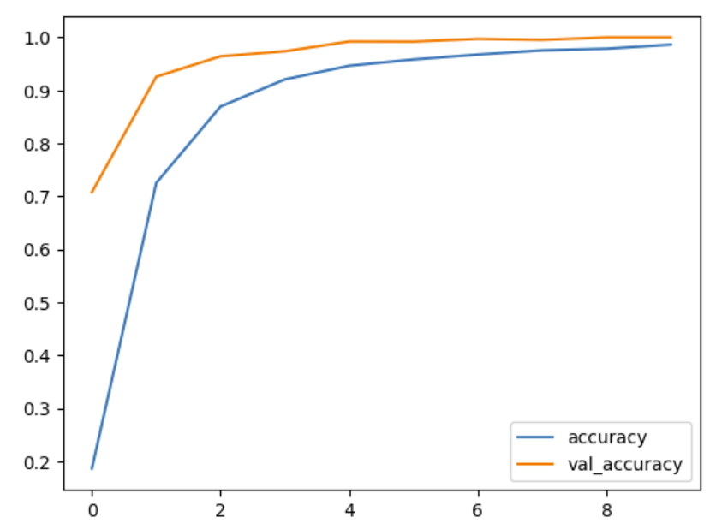
Results

Slide 18
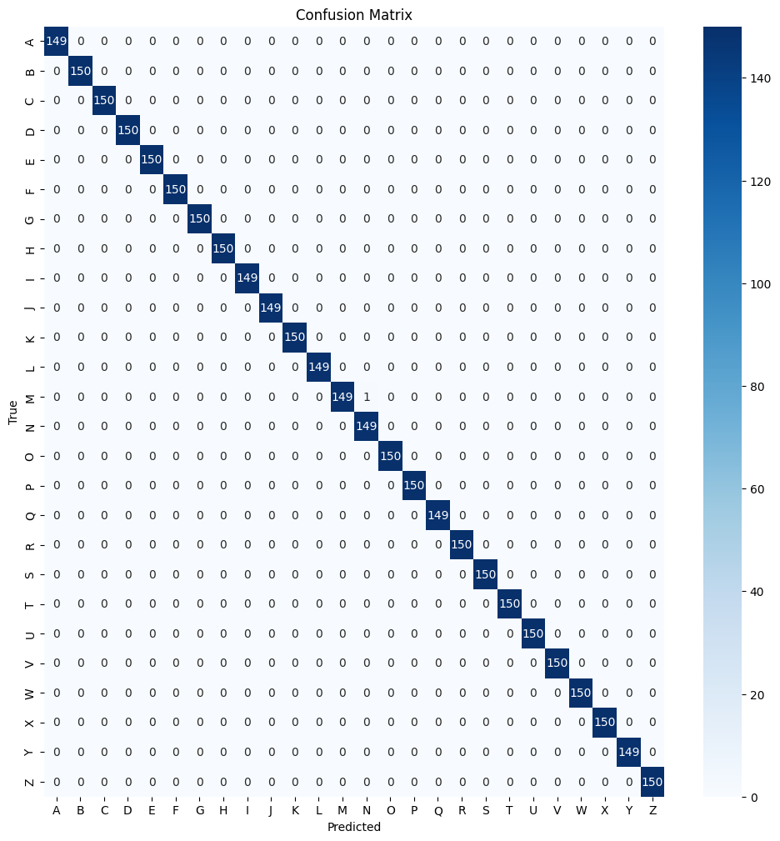

Results –Confusion matrix

Slide 19
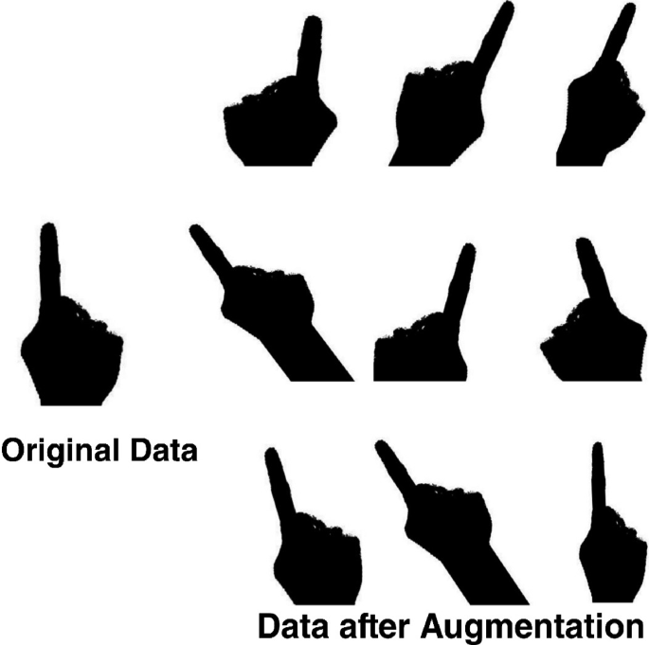
Model Building – CNN with Image Augmentation
ImageDataGenerator(rotation_range=20, width_shift_range=0.2,height_shift_range=0.2, shear_range=0.2, zoom_range=0.2, horizontal_flip=True,
fill_mode='nearest’ )
Similar settings of Model 1 followed in addition to
L2 Regularization
Batch Normalization
Dropout
Notes:
.

Slide 20
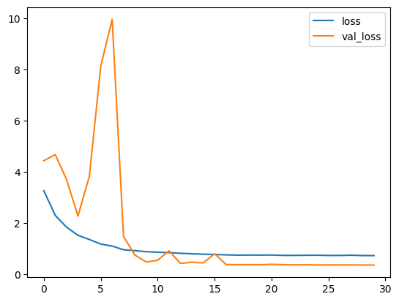
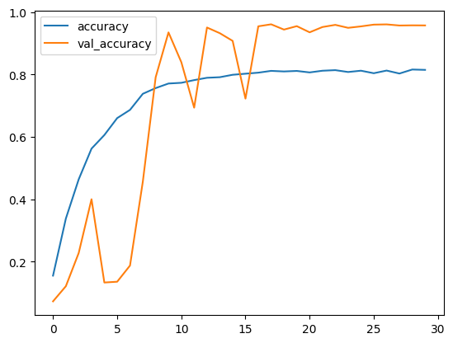
Results

Slide 21
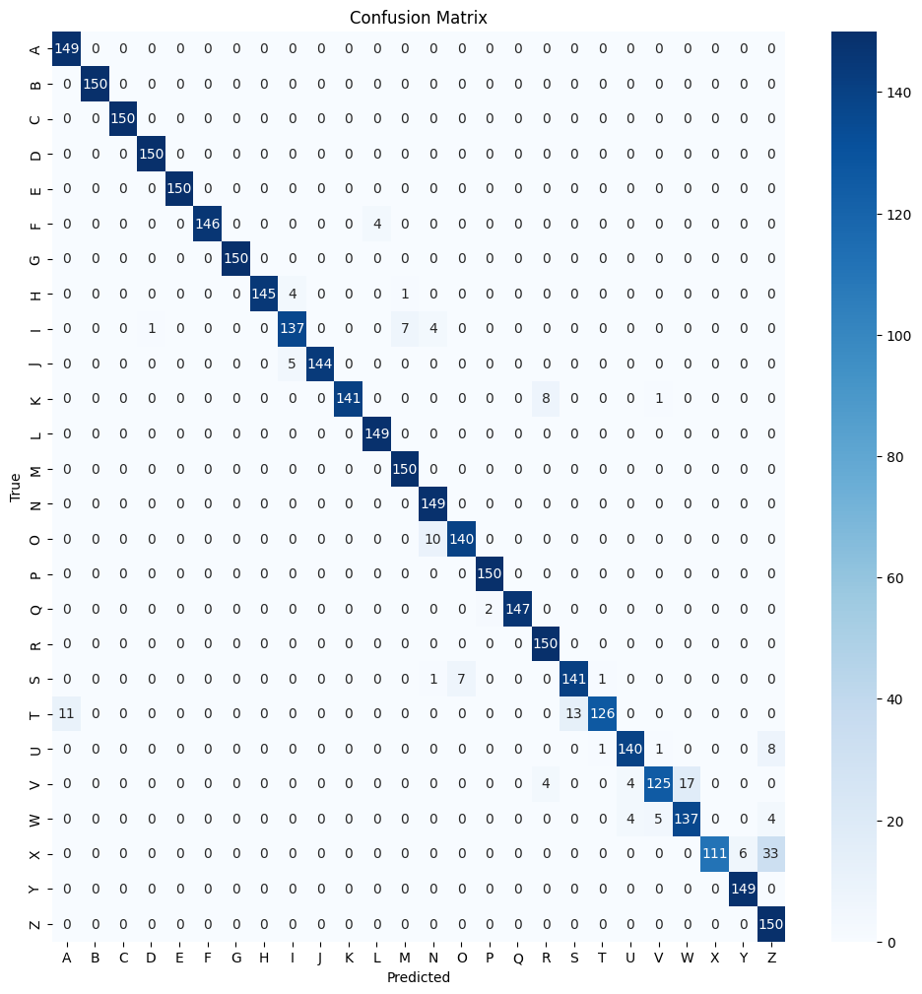
Results –Confusion matrix

Slide 22
Pre-trained model: ResNet
ResNet solves the problem of Vanishing gradient in CNN using skip connections
Transfer Learning: ResNet's pretrained models generalize well, enhancing performance with less labeled data.
Pretrained Models: Resnet50 and ResNet101V2
Second version of ResNet with 101 layers performed the best
Prominent model trained on Imagenet(14 million images)

Slide 23
Model Building – ResNet Architecture
base_model = ResNet101V2(weights='imagenet',pooling='avg',classes=26, include_top=False, input_shape=(120, 120, 3))
# Freeze the layers in the base model
for layer in base_model.layers:
layer.trainable = False

Slide 24
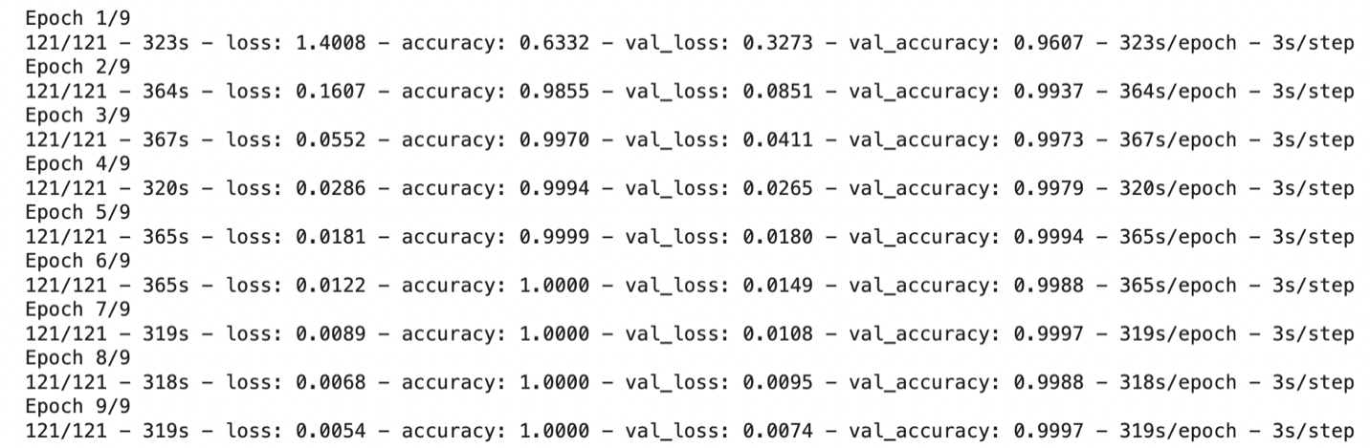
Model Performance

Slide 25
Recommendations
Experiment with Hyperparameters
Transfer Learning
Model Deployment And Feedback loop

Slide 26
Conclusions
Data Creation
Data Processing
Data Split(70,30)
Model Building and Tuning
Model selection
Model Evaluation
Model Name | Train Accuracy (%) | Validation Accuracy (%)
Convolutional Neural Networks | 90.6 | 97.8
Convolutional Neural Networks with Image Augmentation | 81.5 | 95.7
Pretrained model – ResNET 101v2 | 100 | 99.96

Slide 27
Thank You!

