Slide 1

CryptoX: BLOCKCHAIN-BASED CRYPTOCURRENCY

Slide 2
ABSTRACT
This project involves building a new cryptocurrency using blockchain technology
The goal is to create a decentralized, secure, and efficient currency that can be used for various purposes such as payments and investments
The project will begin by defining the specifications for the new cryptocurrency, such as the total supply, transaction fees, and consensus mechanism

Slide 3
PROBLEM STATEMENT
The current financial system is centralized, with governments and financial institutions having significant control over the flow of money. Cryptocurrencies have the potential to offer a decentralized, secure, and efficient alternative to traditional currencies. This project aims to address these challenges by building a new cryptocurrency using blockchain technology

Slide 4

SOFTWARE REQUIREMENTS
REMIX- ETHEREUM IDE
METAMASK
SOLIDITY PROGRAMMING LANGUAGE

Slide 5
hardware REQUIREMENTS
Device: Laptop, Smart Phones or Desktop Computer
Processor: CORE i3 (3rd Gen minimum) and above
RAM: 4GB (minimum) and above
Hard disk: 100 GB (minimum) and above

Slide 6
OBJECTIVES
Decentralization: One of the primary goals of cryptocurrencies is to create a decentralized system that is not controlled by any central authority, such as a government or a bank
Transparency: Cryptocurrencies are built on blockchain technology, which allows for transparent and secure transactions
Faster transactions: Cryptocurrencies can offer faster transaction speeds than traditional financial systems, which can be particularly useful for international transactions
Privacy: Cryptocurrencies can offer a high degree of privacy and anonymity, which can be important for users who want to protect their financial information

Slide 7
Scope and Limitations
Scope
Limitations
CryptoX has a broad scope, as it can be used as a digital currency for a wide range of transactions.
It can be used to buy goods and services, make international payments, and even as a store of value.
CryptoX operates independently of any government or financial institution, it is not backed by any physical assets, which may limit its adoption in certain industries and regions.
The mining process used to create new CryptoX units requires significant computational resources, which may limit its scalability and accessibility to a wider audience.

Slide 8
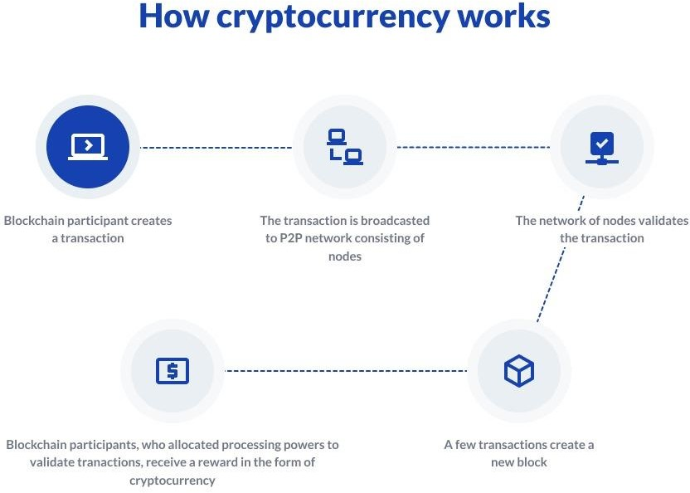

Slide 9

Conclusion
In conclusion, the use of blockchain technology and cryptocurrencies is rapidly growing and has the potential to revolutionize various industries. Overall, the CryptoX project is an example of the potential of blockchain technology and cryptocurrencies to transform the way we conduct transactions and interact with financial systems. With ongoing development and innovation in the blockchain space, we can expect to see even more exciting applications of this technology soon.

