Slide 1
Wireless Audio Amplifier with Multiple Receiver
Arman Hossain Jyoti Chakma
ID: 18702012 ID: 18702044
Session: 2017-18 Session 2017-18

Slide 2
Wireless audio amplifier with multiple receiver
Table of Contents
Introduction
Motivation
How FM Works
Live of Project
Transmitter Analysis
Receiver Analysis
Role of Antenna
Advantages
Disadvantages
Application
Conclusion

Slide 3
Wireless audio amplifier with multiple receiver
MOTIVATION
In our 1st year class room, the students of back bench can’t hear the lecture of the standing teacher. Have you ever think, how to solve this problem?
Lets Start

Slide 4
Wireless audio amplifier with multiple receiver
INTRODUCTION
The main purpose of our system is to make acoustic system easy with wireless communication. The project also focuses to make sure about sound equity in a big room. We make a project with microphone and amplifier. To make it more user friendly, we made it wireless by FM technology. The project is mainly consist of 3 parts i.e., Transmitter, Receiver and Amplifier. In order to getting clear sound quality from sound recording, we use multiple receiver for multiple devices.

Slide 5
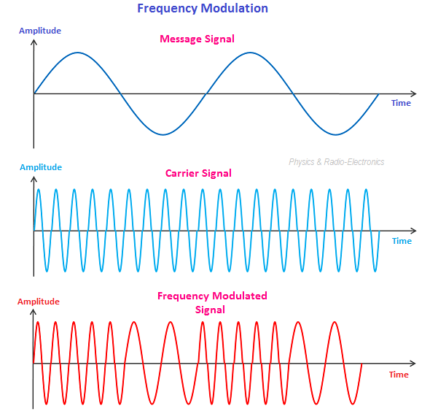
Wireless audio amplifier with multiple receiver
How FM Works
FM stands for Frequency Modulation. In this wireless communication system, sound is transmitted by the changes in frequency. Frequency modulation (FM) is the process of transmitting information.

Slide 6



Live of the Project
TRANSMITTER
RECEIVER
AMPLIFIER
A transmitter is an electronic device used in telecommunications to produce radio waves in order to transmit or send data
A radio or FM receiver is an electronic device that receives radio waves and converts the information carried by them to a usable form.
An amplifier or simply amp is an electronic device that can increase the power of a signal.

Slide 7
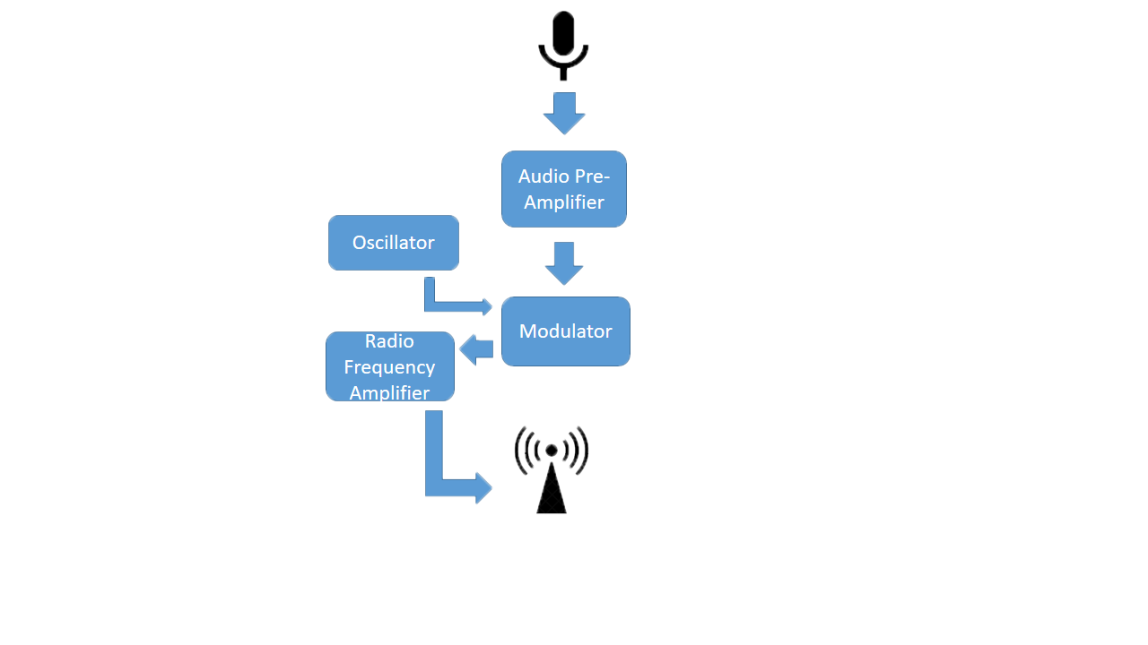
Wireless audio amplifier with multiple receiver
Transmitter Analysis
Transmitter is the sender of signal. It transmits data wirelessly. A FM transmitter uses the principles of frequency modulation to transmit sound supplied at its input.

Slide 8
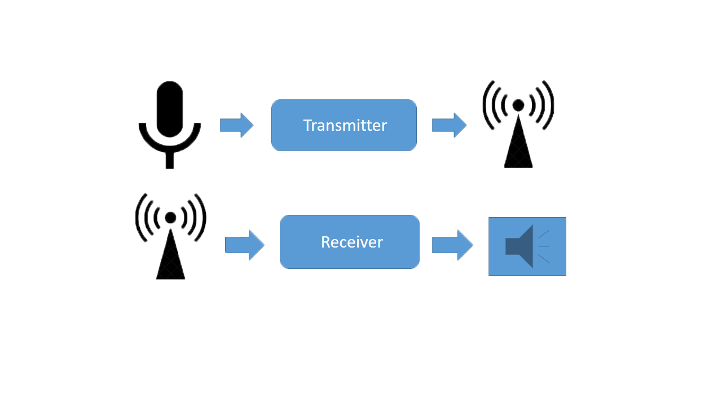
Wireless audio amplifier with multiple receiver
Receiver Analysis
A FM receiver is an electronic device that receives radio waves and converts the information. An antenna is used to catch the desired frequency waves

Slide 9
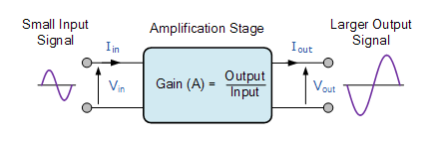
Wireless audio amplifier with multiple receiver
Amplifier Analysis
Amplifier is a device which increase the input signal from receiver and give amplified output.

Slide 10
Wireless audio amplifier with multiple receiver
Roles of Antenna
Antenna is used to transmit modulated signal from transmitter. And also an antenna is used to receive modulated signal for future use.

Slide 11
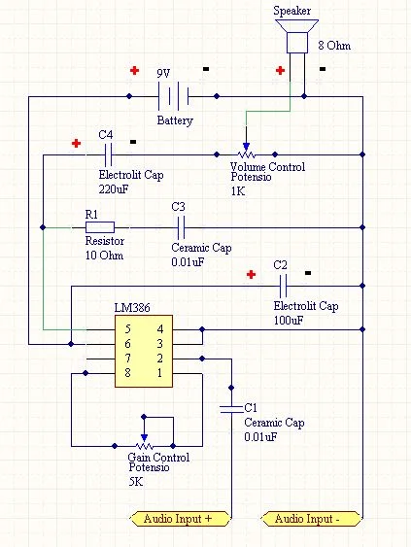
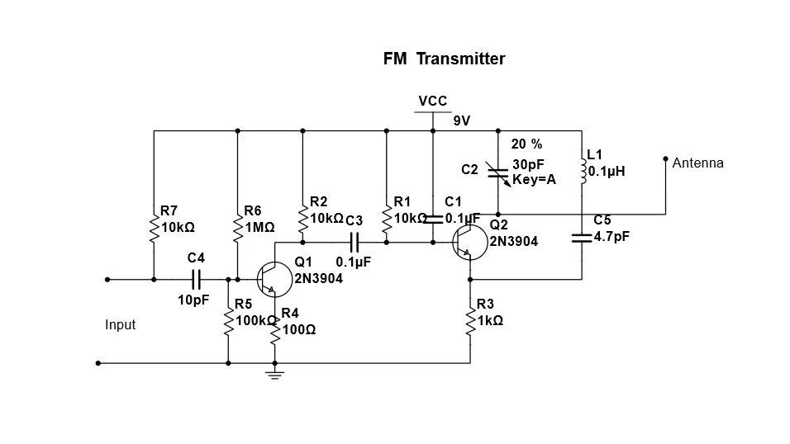
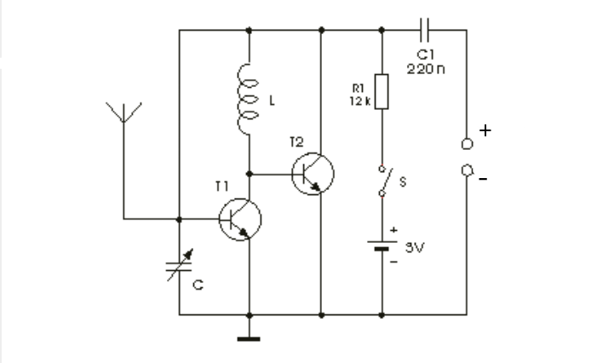
Wireless audio amplifier with multiple receiver
Circuit Diagram
Fig: Transmitter
Fig: Receiver
Fig: Amplifier

Slide 12
Wireless audio amplifier with multiple receiver
ADVANTAGES of FM
Transmitted Power Remains Constant
Resilience to Noise
Easy to Apply Modulation at a Low Power Stage of the Transmitter
The Efficiency of Transmission is very High
The Operating Range is Quite Large
Easy Installment

Slide 13
Wireless audio amplifier with multiple receiver
DISADVANTAGES of FM
A much Wider Channel is Required by FM
Requires more Complicated Demodulator
It is Easier to Apply Modulation at a Low Level Power Stage of a Transmitter.
FM has poorer spectral efficiency than some other modulation formats
Under extremely weak signal conditions, FM receivers have poorer signal-to-noise ratio
If two transmitters are on the same frequency, the receiver will only be able to pick out the stronger one

Slide 14
Wireless audio amplifier with multiple receiver
APPLICATION
Radio Broadcasting
Two way Mobile Radio
Recording Seminar/ Conference/ Class Room
Getting Real Audio for Audio/ Video
To Ensure Sound Equity in a Big Room

Slide 15
Wireless audio amplifier with multiple receiver
Thank You

