Slide 1

ADALINE – A Perceptron variant implementation in Spark
CS 777 – Big Data Analytics Final Project
Jyoti Sharma

Slide 2
Project Overview
The objective of this project is to implement ADALINE (~ Adaptive Linear Neuron ) from scratch in spark using SGD on Wikipedia documents dataset.
The dataset contains two document categories
1.) Wikipedia Documents
2.) Australian court Documents
The goal of the project is to classify the Documents as Australian court document(Class label : 1) or Wikipedia Document(Class label: -1)

Slide 3
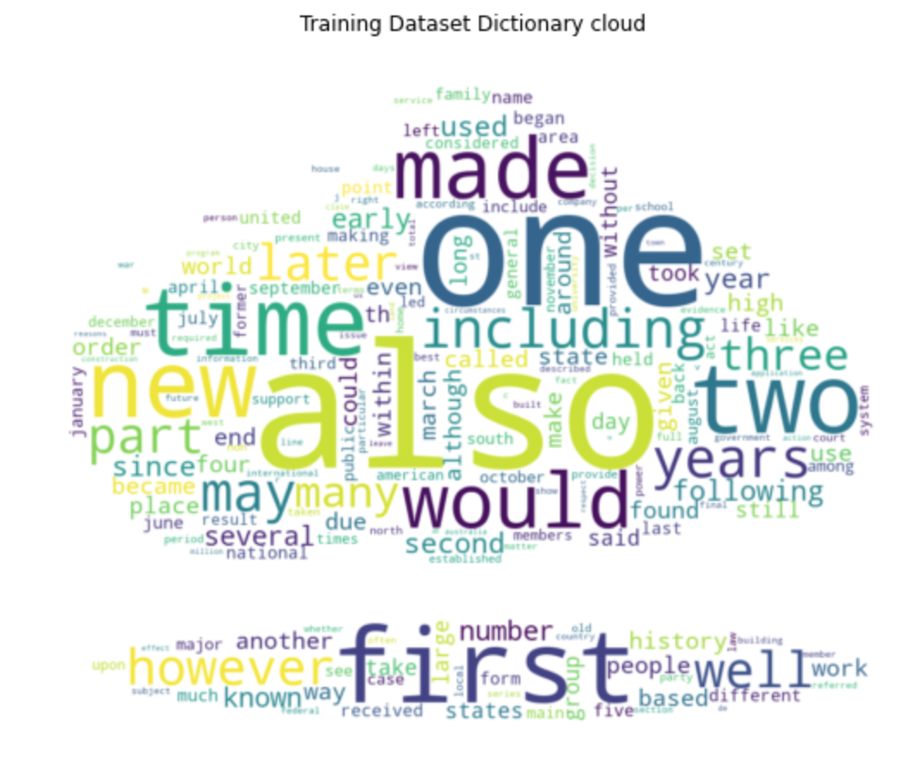
Data Preparation
For Data preparation phase includes generating generation of TF-IDF matrix from text document.
TF = (Number of time the word occurs in the text) / (Total number of words in text)
IDF = (Total number of documents / Number of documents with word ‘t’ in it)
Tf-Idf = TF * IDF

Slide 4
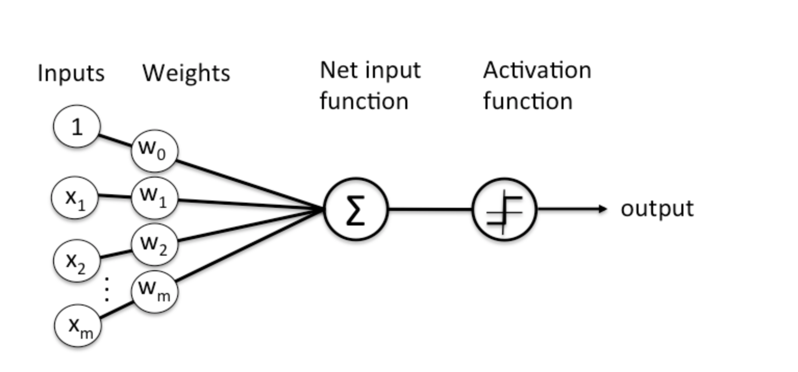
ADAPTIVE LINEAR NEURON -Overview
Perceptron is the first neural network to exist. The functioning of perceptron is pretty similar to biological neurons.
The ADALINE (Adaptive Linear Neuron) is a variant of perceptron and was introduced in 1959, shortly after Rosenblatt’s perceptron, by Bernard Widrow and Ted Hoff (one of the inventors of the microprocessor) at Stanford.
The main difference between the perceptron and the ADALINE is that the later works by minimizing the mean squared error of the predictions of a linear function. This means that the learning procedure is based on the outcome of a linear function rather than on the outcome of a threshold function as in the perceptron.

Slide 5
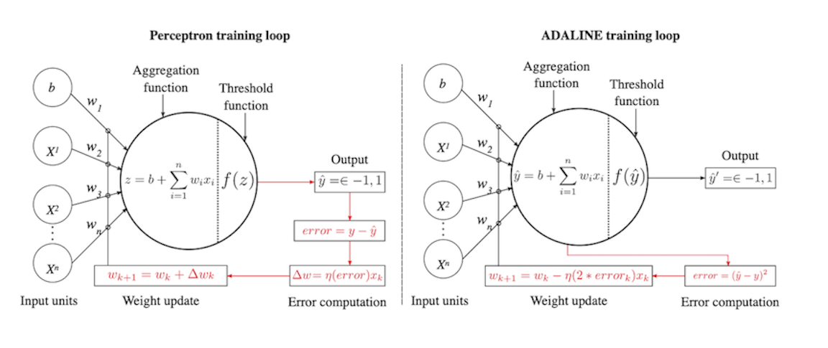
ADAPTIVE LINEAR NEURON –Learning
ADALINE computes the difference between the expected class value 𝑦 (+1 or -1), and the continuous output value 𝑦̂ from the linear function, which can be any real number.
This is crucial because it means the ADALINE can learn even when no classification mistake has been made. This is a consequence of the fact that predicted class values 𝑦̂ ′ do not influence the error computation. Since the ADALINE learns all the time and the perceptron only after errors, the ADALINE will find a solution faster than the perceptron for the same problem.

Slide 6
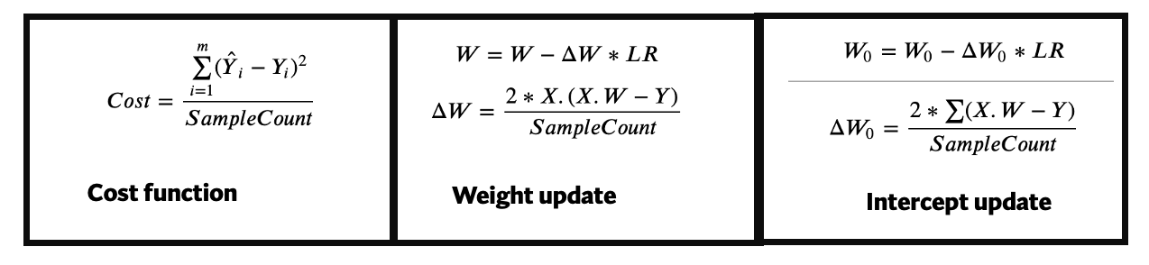
ADAPTIVE LINEAR NEURON - Learning
In ADALINE (Adaptive Linear Neuron) the learning is carried out using mean squared error as the cost function. The derivatives of cost function are used for adjusting weights and intercepts. Below are the mathematical equations used:
X : Input feature matrix W : Intercept matrix (𝑊1...𝑊𝑚) W_0 : Bias for network LR : Learning rate used for network SampleCount: Count of no of samples used for training the network
Y^ : Weighted sum (WX +W_0)

Slide 7
ADAPTIVE LINEAR NEURON - Learning
Spark Code:
Predictions = samples.map(lambda x : (x[0] ,x[1] ,np.dot(x[1] ,Weights) + intercept , ((np.dot(x[1] ,Weights) + intercept) -x[0] ))).\
map(lambda x: (x[0] , x[2] , np.multiply(x[1] , x[3] ) )).\
map(lambda x: ( np.square( x[1] - x[0] ) , x[1] - x[0] ,x[2] ) ).\
reduce(lambda x, y : (x[0] +y[0], x[1]+y[1] ,x[2]+y[2] ))
w_grad = 2/Sample_size * Predictions[2]
b_grad = 2/Sample_size * Predictions[1]
cost= 1/Sample_size * Predictions[0]

Slide 8
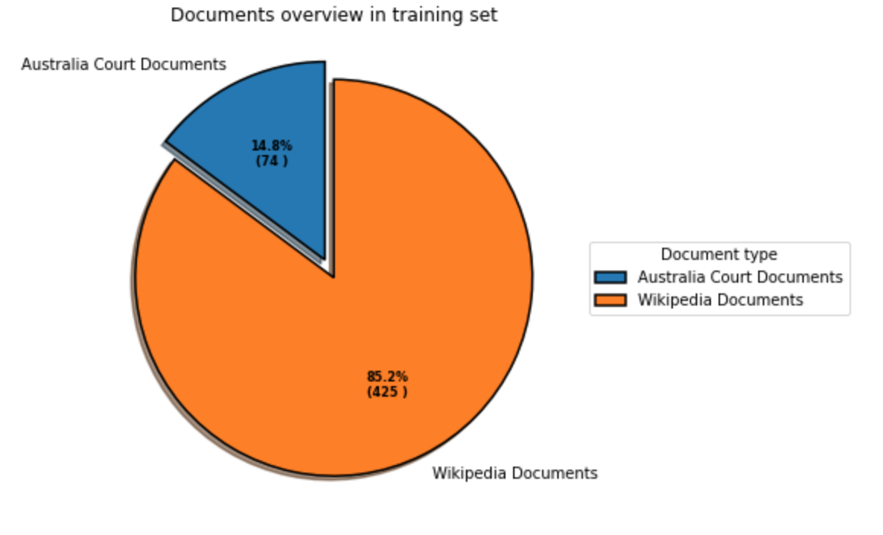
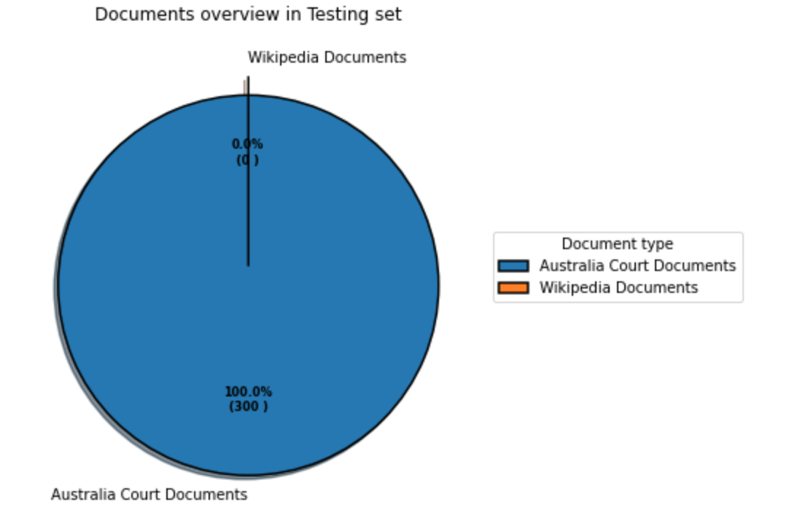
Training Data set
For training the network we have used below configurations:
# of training documents = 500
# of testing documents = 300
Dictionary size = 500
Epoch =1000
Learning rates=[0.001,0.005, 0.009,0.0009]

Slide 9
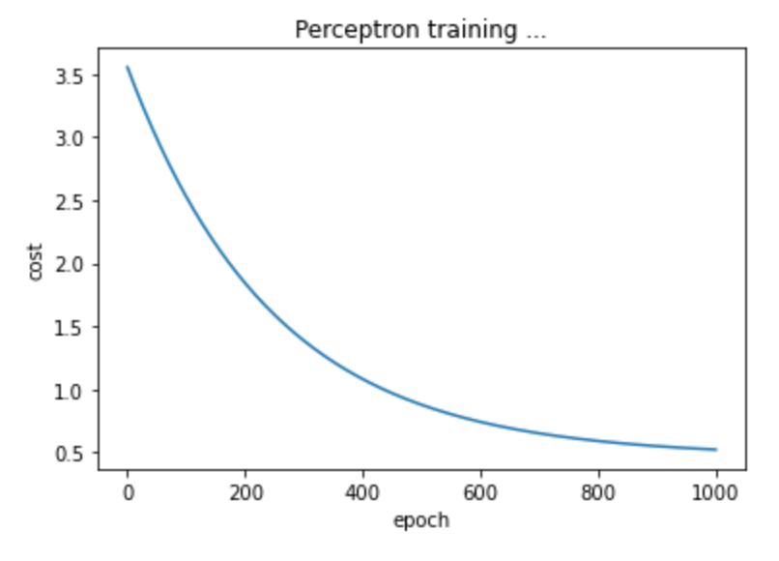
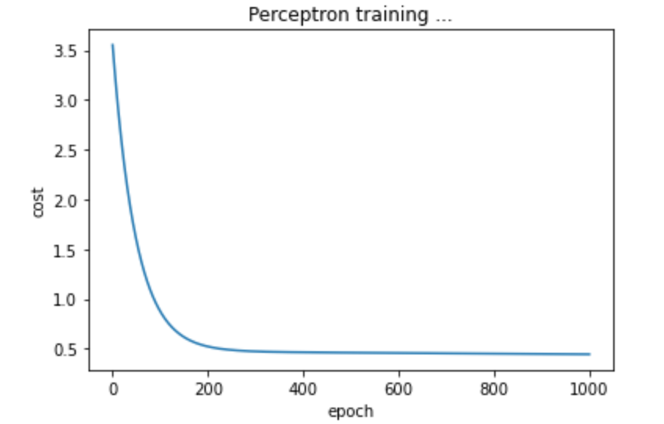
Results
True Positive : 277
False Positive : 0
True Negative : 0
False Negative : 23
Precision is : 0.9999999963898917 Recall is : 0.9233333302555555
F1 score is : 0.960138145646929
True Positive : 299
False Positive : 0
True Negative : 0
False Negative : 1
Precision is : 0.9999999966555184
Recall is : 0.9966666633444444
F1 score is : 0.9983300475865169
Learning Rate : 0.001
Learning Rate : 0.005

Slide 10
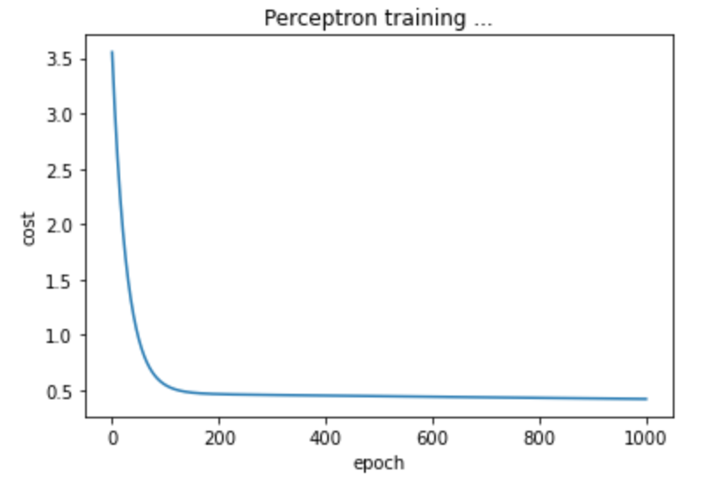
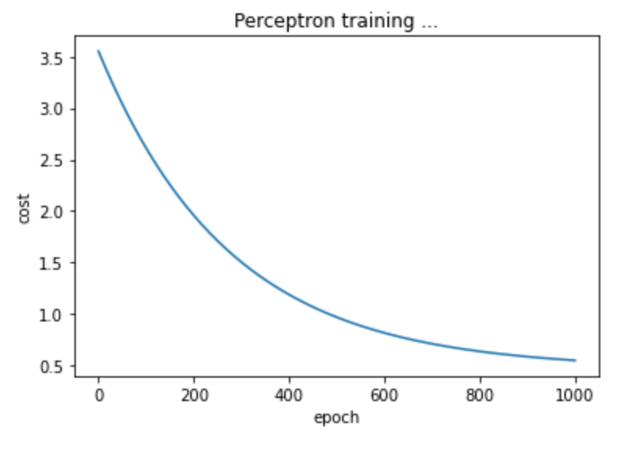
Results
True Positive : 299
False Positive : 0
True Negative : 0
False Negative : 1
Precision is : 0.9999999966555184 Recall is : 0.9966666633444444
F1 score is : 0.9983300475865169
True Positive : 265
False Positive : 0
True Negative : 0
False Negative : 35
Precision is : 0.9999999962264151 Recall is : 0.883333330388889
F1 score is : 0.9380525959435647
Learning Rate : 0.009
Learning Rate : 0.0009

Slide 11
References:
https://com-cog-book.github.io//com-cog-book/features/adaline.html

