Slide 1

Data Modeling in
CS779 A1 Advanced Database Management (2020 Fall)
Jyoti Sharma

Slide 2
Agenda
Project Goal
Overview of Dataset
Tools used
Data modeling practices in MongoDb
Data preprocessing/cleaning
Application Analysis for NOSQL implementation
Entities and relationships
Loading of data
Querying data in MongoDB
Constraints

Slide 3
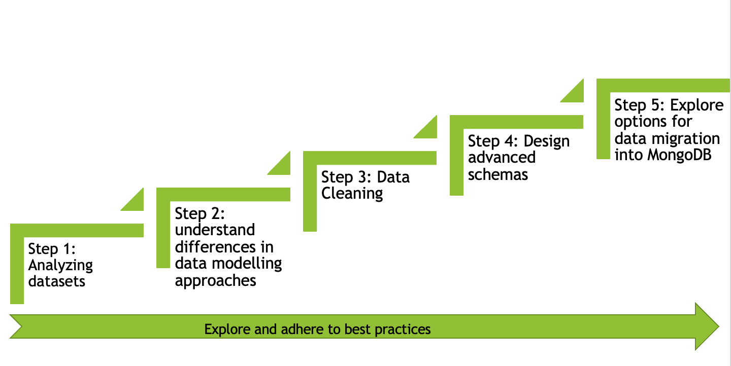
Goal of the project
This project aims to explore the best methods and operational practices to import data from flat file or relation DB systems to NoSql MongoDB.

Slide 4
Overview of Dataset
For this project two different datasets downloaded from Kaggle.com. The datasets contain information about different job postings.
Data Source 1: moster_com-job_sample.csv
This data is an extract of job postings on monster.com- a job search website.
Data Source 2: data_scientist_united_states_job_postings_jobspikr.csv
This data contains information about multiple job postings for data scientist profiles across the United States and collections for different platforms like indeed, dice, monster, career builder, etc.

Slide 5
Overview of Dataset
Fields | Description | Available in both datasets
crawl_timestamp | The timestamp of extracting data from the job portal | N
URL | URL of job posting | Y
job_title | Job position title | Y
category | Job category, describing if it's in accounting or biotech or banking | Y
company_name | Name of the company | N
city | city area for the job position | N
state | State for the job position | N
country | Abbreviation of Country name for the job opening | Y
inferred_city | the city for the job position | N
inferred_state | State in which job is offered | N
inferred_country | The country in which job is open | Y
post_date | Date of job posting | Y
job_description | Description of the job profile | Y
job_type | Type of job contract Full/Part-time | N
salary_offered | Salary offered | Y
job_board | The site from which job post is fetched | Y
geo | Country name | N
cursor | Longitude and latitude of job location | N
contact_email | Contact person email | N
contact_phone_number | Contact person Phone | N
uniq_id | Unique id for the job posting | N
html_job_description | HTML code for Job description | N
Fields | Description | Available in both datasets
country | The country name for a job opening | N
country_code | Abbreviation of Country name for the job opening | Y
date_added | The date of job posting | Y
has_expired | Is the job still open | N
job_board | The platform posting the job opening | Y
job_description | Description of the job profile | Y
job_title | Job position title | Y
job_type | Type of Job | N
location | Location | N
organization | Job category, describing if it's in accounting or biotech or banking | Y
page_url | URL of job posting | Y
salary | Salary Range | N
sector | The experience type for the job. | N
uniq_id | Uniquely identifying the job posting | N
moster_com-job_sample.csv
data_scientist_united_states_job_postings_jobspikr.csv

Slide 6
Tools used
For this project three tools are used : MongoDB Compass, Spyder, Hackolade.
MongoDb Compass
MongoDB compass is the Gui developed by MongoDB helping end users to analyzes your documents and displays rich structures within end-user’s collections through an intuitive GUI.
Operations Performed:
Loading the data
Querying the data
Spyder
Spyder is an open-source development environment for programming in python.
Operations Performed:
Cleaning data
Creating json document for bulk insert
Hackolade
Hackolade is tool for data modeling for NoSQL and multi-model databases with its unique ability to represent deeply nested JSON objects in Entity Relationship diagrams.
Operations Performed:
Designing the Er diagram
Json Data insert formats

Slide 7
Data modeling practices in MongoDb
One of the critical differences between relational and MongoDB is the idea based on which cluster/table structure is defined. Where relation DBMS focuses on how data is stored, NoSql focuses on data retrieval pattern by applications. Unlike in relational DBMS in MongoDB, the documents are designed keeping in mind how it is retrieved, paying a little or no attention towards normalization.
Advantages of NoSQL
Flexible Schema: MongoDB’s collection by default doesn’t require its document to have a schema
Documents of a single collection need not have the same set of fields.
To change the documents' structure in a collection like adding a new field, remove an existing field, or change field values to a new type, update the documents to a new structure.
The flexibility helps in mapping a document to an object or entity.

Slide 8
Data modeling practices in MongoDb
However, the latest version of MongoDB also gives the option of enforcing schema/document validation rules. The schema validation can be implemented using a JSON schema validator supported by MongoDB.
db.runCommand( {
collMod: "JobInfo",
"validator": {"$jsonSchema": {
"bsonType": "object",
"title": "JobInfo",
"additionalProperties": true,
"properties": {
"_id": {"bsonType": "objectId"},
"job_title": {"bsonType": "string"}
}}
},
"validationAction": "warn"
});
Controlling scope of validation implementation
validationLevel option: Determines how strictly MongoDB applies validation rules to existing documents during an update.
strict (the default) MongoDB applies validation rules to all inserts and updates.
moderate applies validation rules to inserts and to updates to existing documents that already fulfill the validation criteria.
validationAction option: which determines whether MongoDB should error and reject documents that violate the validation rules or warn about the log's violations but allow invalid documents. [3]
error (the default), MongoDB rejects any insert or update that violates the validation criteria.
warn, MongoDB logs any violations but allows the insertion or update to proceed.

Slide 9
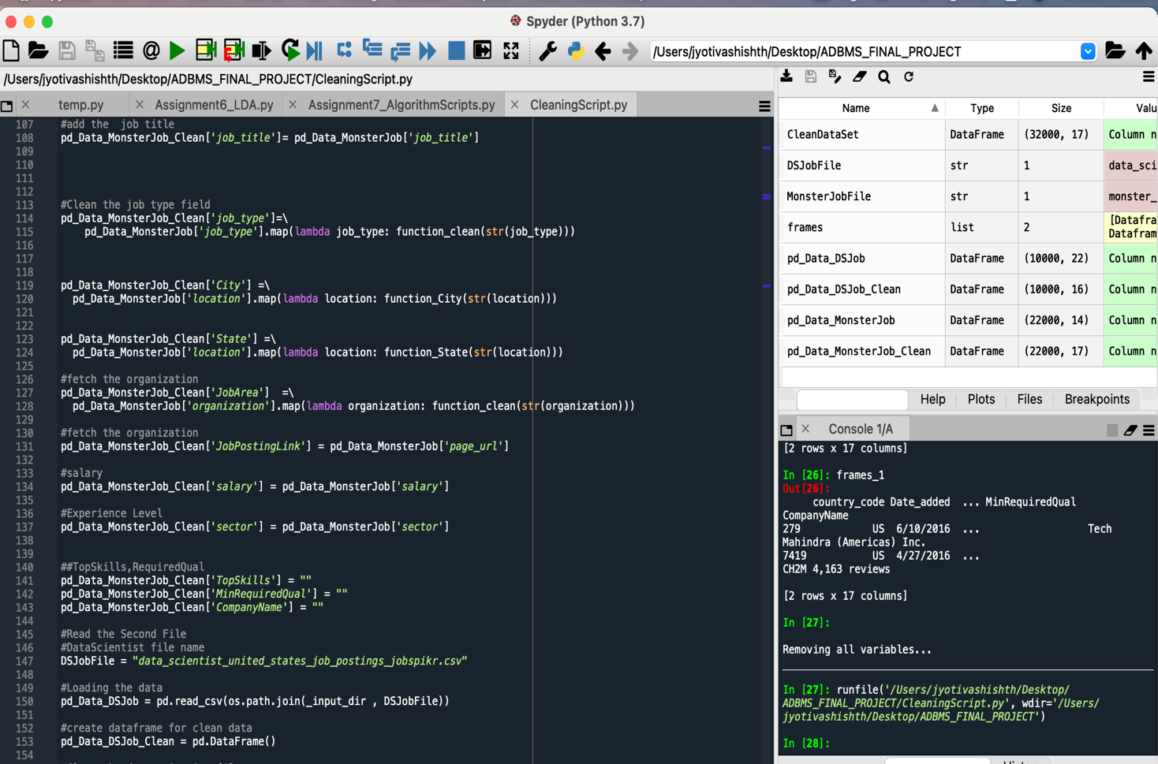
Data preprocessing/cleaning
Spyder is the tool used for cleaning the dataset and merging it into a single data frame.
Step 1: Decide on final fields
Step 2: remove junk characters
Step 3: extract data in desired format, i.e. in one of the dataset city, state and zip code values are stored in a single string.
Step4: merge data frame
Screenshot of script execution

Slide 10
Data preprocessing/cleaning
Fields | Description
country_code | Abbreviation of Country name for the job opening
Date_added | Date in which job is posted
has_expired | Is the job still open
job_board | The site on which job is posted
job_description_Abstract | Trimmed description of the job profile
job_description | Description of the job profile
job_title | Job position title
job_type | Type of job contract Full/Part-time/contract
City | City in which job is offered
State | State in which job is offered
sector | Which field the job belongs to Medical or IT Or Marketing
JobPostingLink | Link of job posted
salary | Salary range offered
TopSkills* | The top skill required for the job
MinRequiredQual* | Minimum qualification required to apply for the job
CompanyName | Company name
Final Data Frame
* Newly added field

Slide 11
Application Analysis for NOSQL implementation
Name of System: One-Click Job Search
Benefits: The main goal of developing this system is to have a centralized job search platform. They are helping end-users to save time in the tedious job hunt process. The schema designing process will begin with describing the workload, look for the most frequent operations which will be performed by the application.
To implement MongoDB schema the ideal methodology should follow below steps
Step 1: Describing the workload
Step 2: Identify the entities and relationship
Step 3: Design model and apply patterns

Slide 12
Application Analysis for NOSQL implementation Step 1: Describing the workload
For describing the workload, One should create the list of frequent operations followed by the step of quantification and qualification of operations.
Query | Operation | Description
1. Search the job postings based on job title or a substring of job title. | Read | Lookup for jobs with keywords or full job title.
2. Search the job posting based on the company name. | Read | Look for jobs based on the name of the company in which the position is open.
3. Search the job posting based on State name. | Read | Look for jobs based on the state name in which the job position is opened.
4. Read the full job description. | Read | Look up the full job description for the job post of interest.
5. Updating the jobs | Write | Update a job posting in the system, adding a new job posting, or marking a job posting a closed.
6. Search the job posting based on skills required | Read | Lookup for a job-based on the skills job requires.
Query | Quantification | Qualification
1. Search the job postings based on job title or a substring of job title. | Retrieval time < 1 s | No stale data <Critical Operation>
2. Search the job posting based on the company name. | Retrieval time < 1 s | No stale data <Critical Operation>
3. Search the job posting based on State name. | Retrieval time < 1 s | No stale data <Critical Operation>
4. Read the full job description. | Retrieval time < 3 s | No stale data
5. Updating the jobs | Write time < 0.05s per transaction | critical write
6. Search the job posting based on skills required | Retrieval time < 3 s | No stale data
List of operation
Quantification & qualification of operation

Slide 13
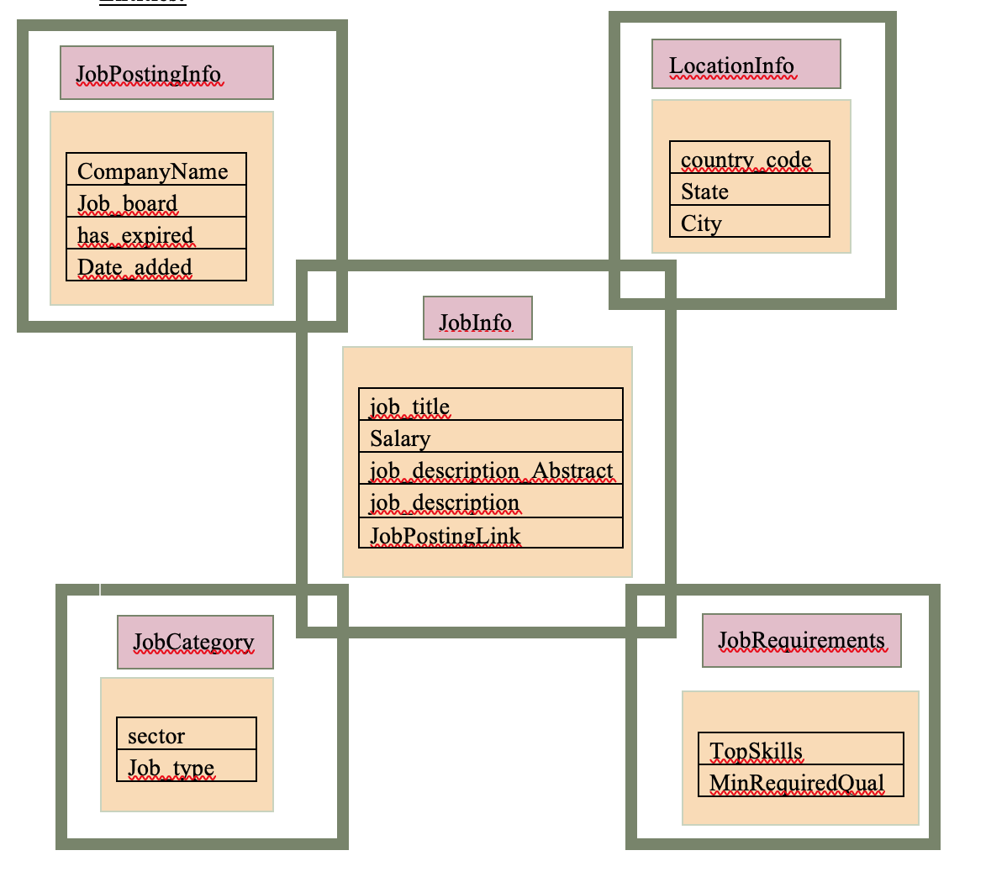
Entities and relationships
After analysis the data can be categorized into 5 entities
JobInfo: This entity will consist of information that helps describe the job or give details about the job.
JobPostingInfo: This entity will consist of information that helps describe which website the job posting came from and what date it will be available.
LocationInfo: This entity will consist of information that helps describe the location of job openings like the city, state, and country.
JobCategory: This entity will consist of information that helps describe the job posting's domain type.
JobRequirements: This entity will consist of information that helps describe the job posting's skill and minimum education requirements.
All entities have one-to-one relationship with job info.

Slide 14
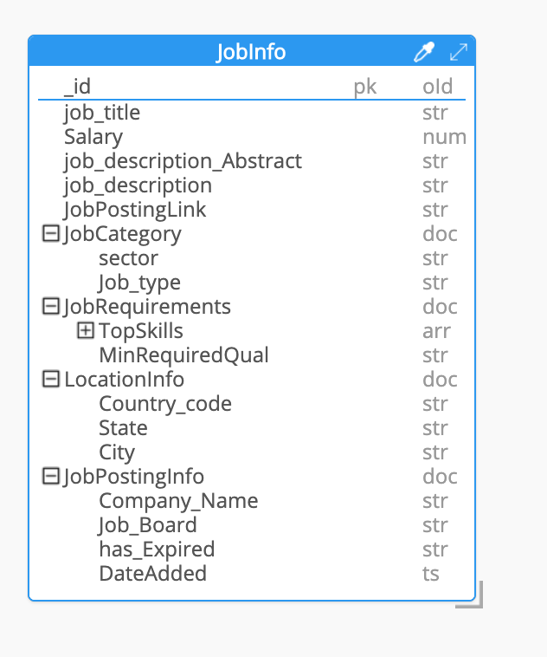
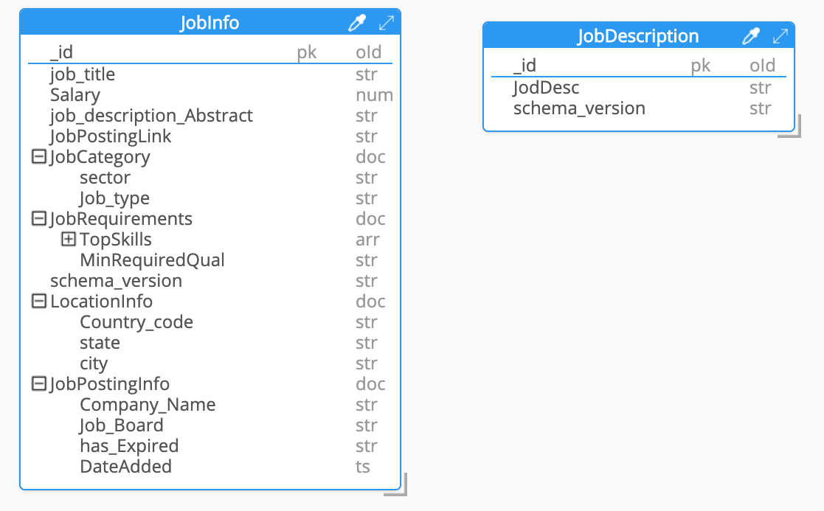

Entities and relationships : ER diagrams
Fig: ER design for Version 1_0
Fig: ER design for Version 1_1
Reason for version upgrade:
Job description field: This field contains vary long strings and one of the constraints in MongoDB is its document limit. So, it will make sense to move the job_description field into another document and link it to the existing one
Schema Versioning pattern: To control the future upgrades
JobInfo MongoDB Script
JobInfo JSON Data syntax
MongoDB Script
JobDescription JSON Data syntax
JobDescription MongoDB Script
JobInfo JSON Data syntax
Note: ER diagrams and Scripts are autogenerated by hackolade tool

Slide 15
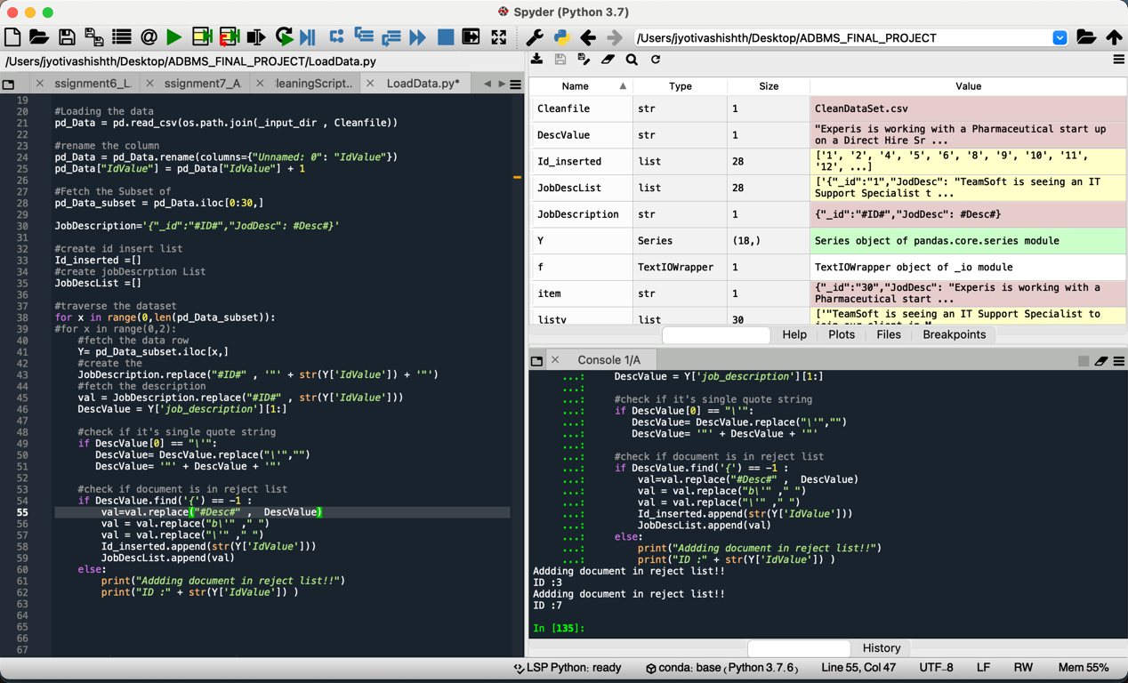
Loading of data
Creating JSON files:
For transforming data into NoSQL model python script is used. Script is generating two files
﻿JobDescription_new_insert.json
﻿JobinfoList_new_insert.json

Slide 16
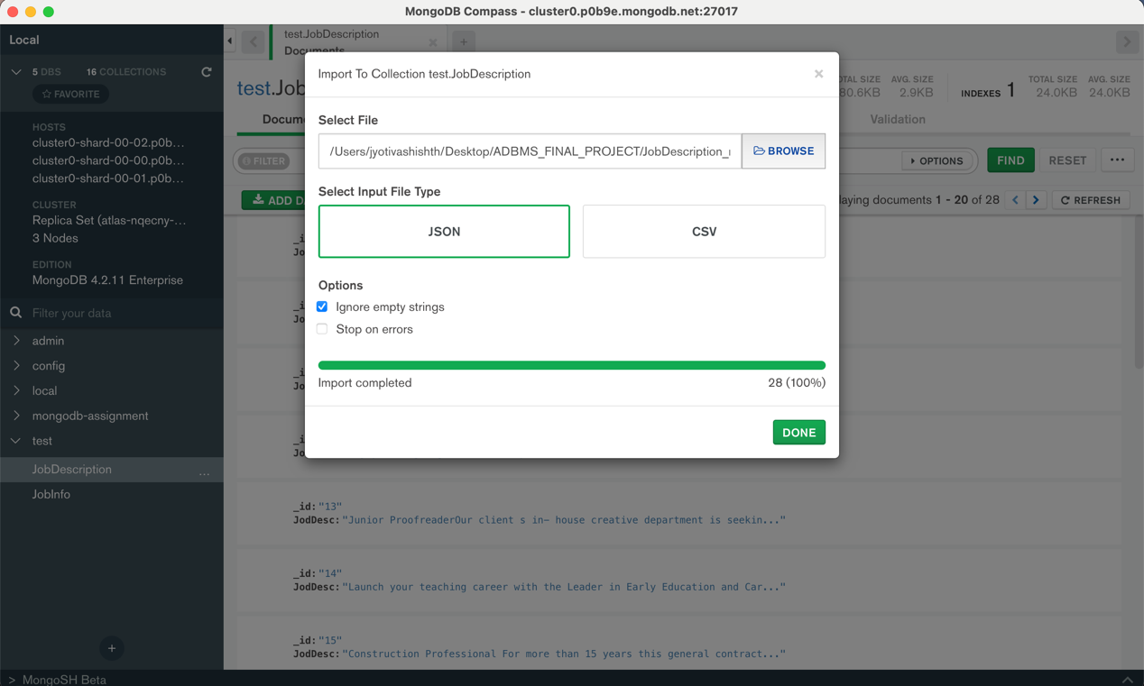
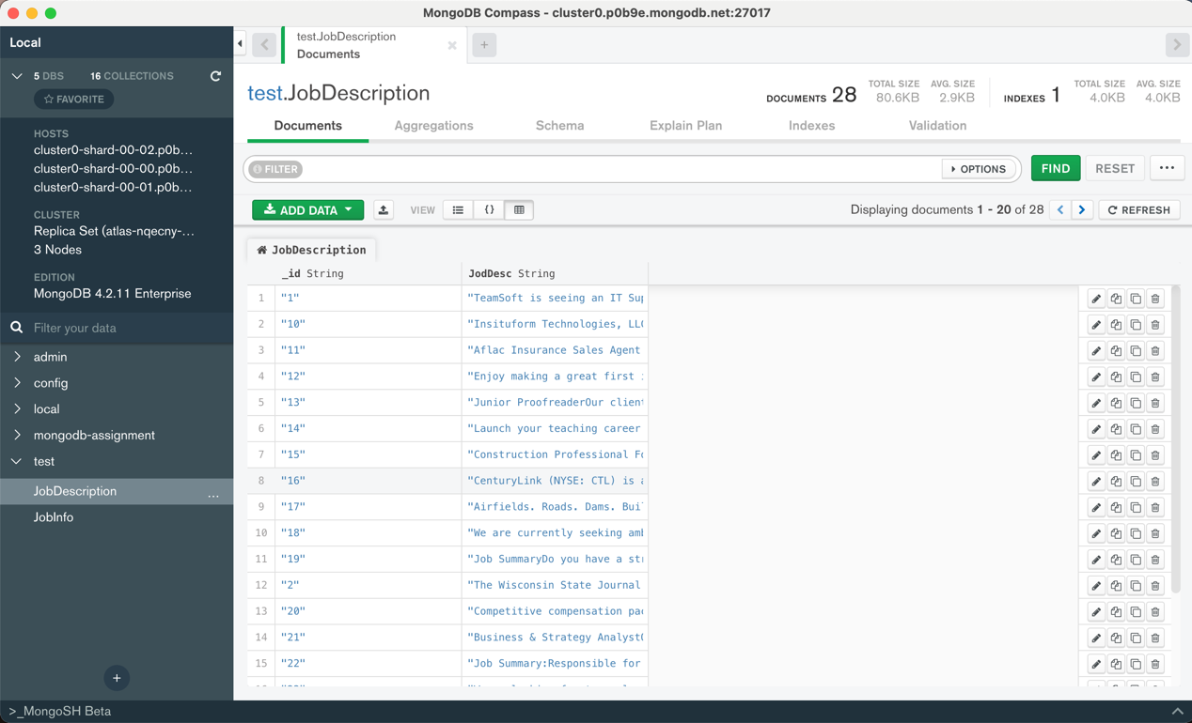
Loading of Data – JobDescription collection

Slide 17
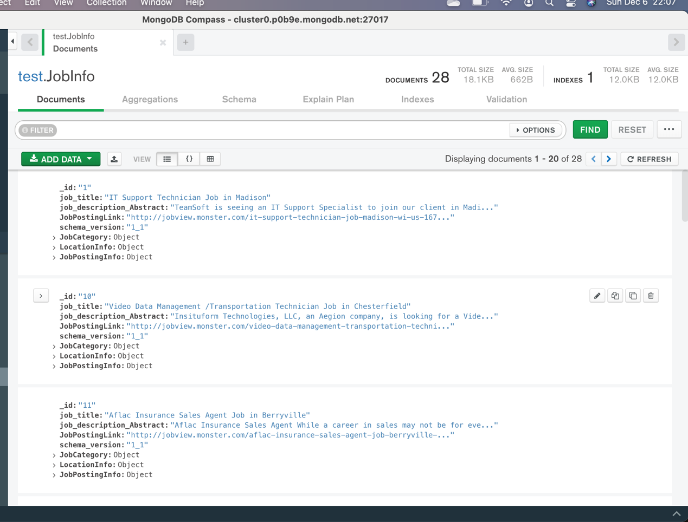
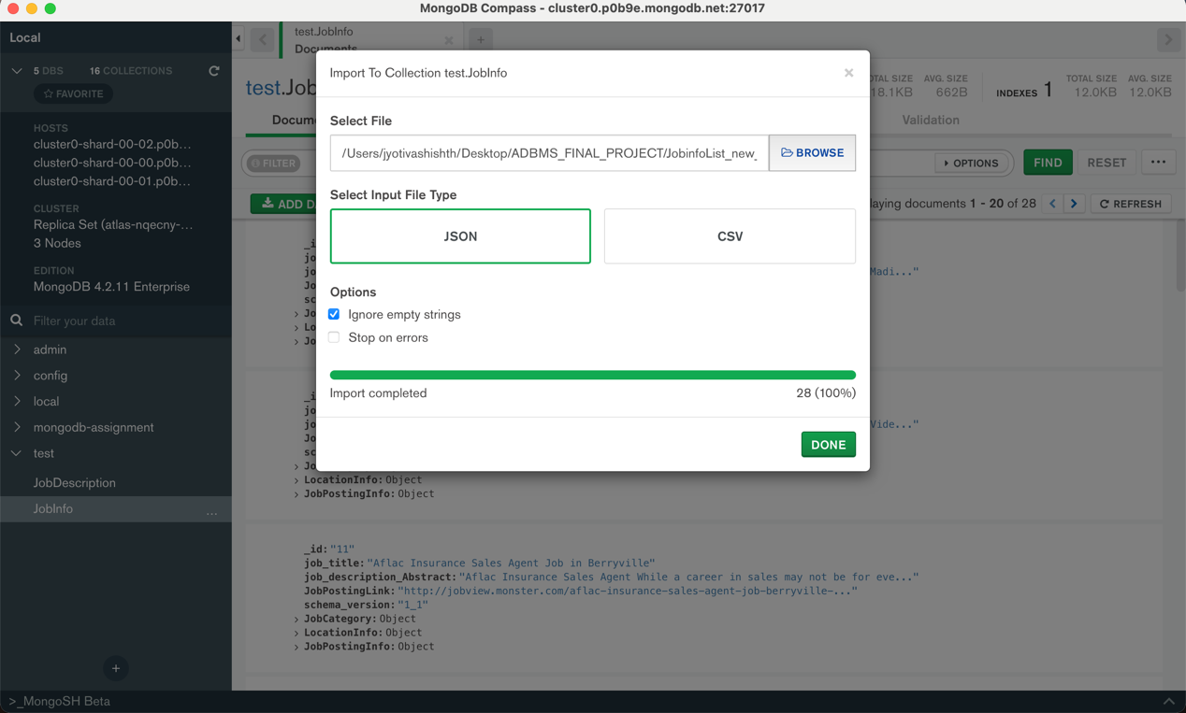
Loading of Data – JobInfo collection

Slide 18
Querying data in MongoDB
[ { _id: '1', job_title: 'IT Support Technician Job in Madison', job_description_Abstract: 'TeamSoft is seeing an IT Support Specialist to join our client in Madison, WI. The ideal candidate must have at least 6 years of experience in the fie...', JobPostingLink: 'http://jobview.monster.com/it-support-technician-job-madison-wi-us-167855963.aspx?mescoid=1500134001001&jobPosition=20', schema_version: '1_1', JobCategory:{ sector: 'IT/Software Development', Job_type: 'Full Time Employee' }, LocationInfo: { Country_code: 'US', state: 'WI', city: 'Madison' }, JobPostingInfo: { Job_Board: 'monster', has_Expired: 'No' }, studentUnits: [ { _id: '1', JodDesc: 'TeamSoft is seeing an IT Support Specialist to join our client in Madison, WI. The ideal candidate must have at least 6 years of experience in the field. They need to be familiar with a variety of the field s concepts, practices, and procedures as this position relies on extensive experience and judgment to plan and accomplish goals. Required Skills: Call tracking software Phone based technical support Problem documentation and communication Remote Desktop Management Tools Respond to customer requests General understanding of LANDesk Microsoft Office 2007 SuiteFind out why TeamSoft is the Madison area s technology leader with over 200 IT consultants. Owned, operated, and managed by IT consultants, TeamSoft is the clear choice for your career. Join the TeamSoft family today!Did you know? TeamSoft offers salaried options for many positions that include 5 weeks PTO and great benefits! TeamSoft has been in business since 1996 TeamSoft s owners are local IT professionals who possess a wealth of experience in application development, business analysis, and project management TeamSoft s Recruiters are knowledgeable, friendly, and ready to help you make your next great career move TeamSoft offers a full benefits suite to all of our W2 consultants, including a 401k plan with a 100% vested 4% dollar for dollar match Our targeted selection process is designed to get to know your strengths and career interests and provide you with the best chance for success in your new position Our longest running consultant has been with us for 16 years Consultants can participate in our charitable giving committee. To date, TeamSoft s charitable giving committee has donated over $100,000!TeamSoft is owned by local IT professionals. Our team also has deep experience with IT staffing. Our clients understand this and rely on our expertise. That is why TeamSoft is the Madison Area s largest privately owned IT consulting firm, with more than 200 current consultants! With over 50 active clients, TeamSoft will give you the greatest exposure to the widest range of IT careers.Our owners possess a combined 60+ years of IT consulting experience. Our recruiting and Account Management staff are very well-versed in our client markets. We get you. We know you. We know what you do every day. And we know what you deal with on the job.You take your career seriously and so do we. At TeamSoft you are not just a resume or number. Our goal is to create long-term partnerships with each of our consultants, and according to feedback from many of them, we are very good at this. Click HERE to see what our consultants have to say about working with TeamSoft.TeamSoft -- Promote yourself!TeamSoft is an equal employment opportunity employer functioning under an Affirmative Action Plan.', schema_version: '1_1' } ] }
MongoDB compass along with it’s interactive GUI also gives us option of interacting with it via shell.
Example 1: Joining jobInfo and JobDescription based on _id
db.getCollection('JobInfo').aggregate([{
$lookup:
{
from: "JobDescription",
localField: "_id",
foreignField : "_id",
as: "studentUnits"
}
}])

Slide 19
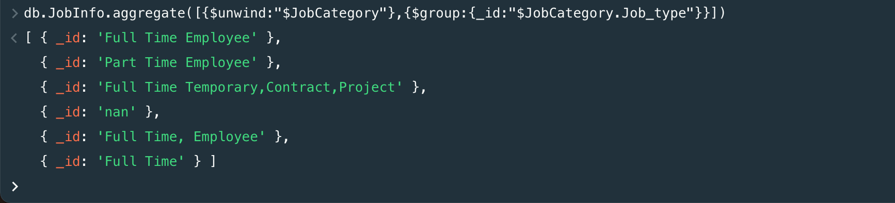
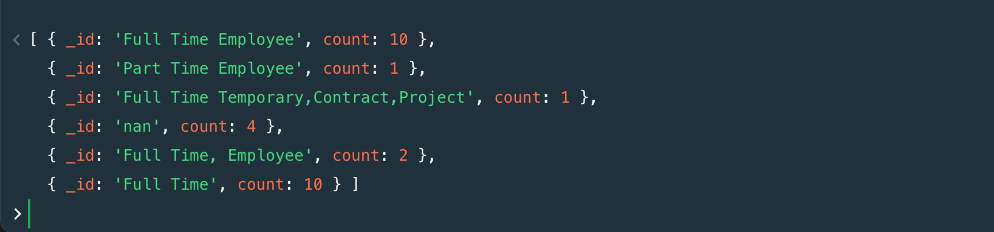
Querying data in MongoDB
Example 2: Fetching the unique Job_type and fetch the count of no of positions opened in each Job_type
db.JobInfo.aggregate([{$unwind:"$JobCategory"},{$group:{_id:"$JobCategory. Job_type"}}])
db.JobInfo.aggregate([
{ "$unwind": "$JobCategory" },
{ "$group": { "_id": "$JobCategory.Job_type ",
"count": { "$sum": 1 } }} ])

Slide 20
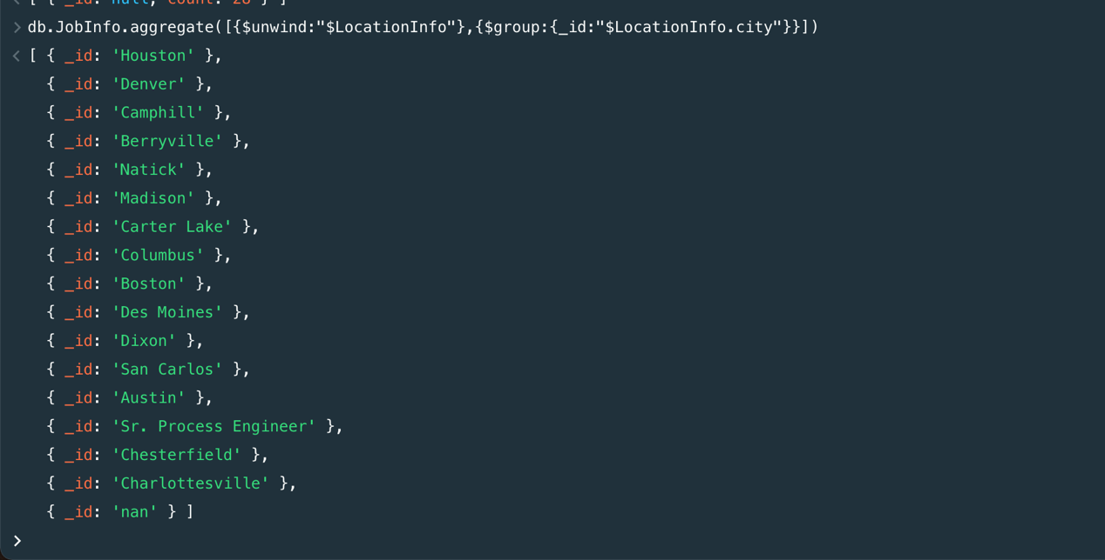
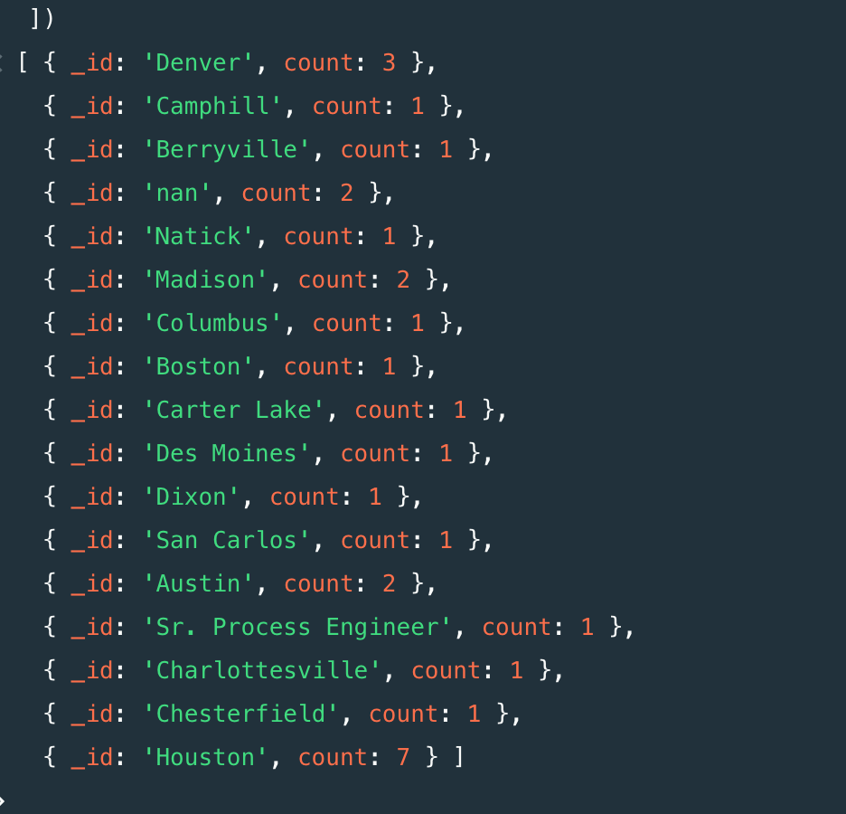
Querying data in MongoDB
Example 2: Fetching the unique cities and fetch the count of no of positions opened in each city
db.JobInfo.aggregate([{$unwind:"$LocationInfo"},
{$group:{_id:"$LocationInfo.city"}}])
db.JobInfo.aggregate([
{ "$unwind": "$LocationInfo" },
{ "$group": { "_id": "$LocationInfo.city",
"count": { "$sum": 1 } }} ])

Slide 21
Constraints
By default, MongoDB will automatically abort any multi-document transaction that runs for more than 60 seconds.
There are no hard limits to the number of documents that can be read within a transaction. As a best practice, no more than 1,000 documents should be modified within a transaction.
In MongoDB 4.0, a transaction is represented in a single oplog entry, therefore must be within the 16MB document size limit. If this limit is exceeded, the transaction will be aborted and fully rolled back. The transaction should therefore be decomposed into a smaller set of operations that can be represented in 16MB or less.

Slide 22

Thank you

