Slide 1
Credit Card Fraud Detection
Jyoti Sahu
DSC 680
07-July-2022

Slide 2
1. Introduction
The use of credit card to commit fraud is known as credit card fraud. Cybersecurity is becoming increasingly significant in our daily lives. When addressing digital life security, the main issue is identifying anomalous behavior. Many consumers prefer using credit cards when they make purchases or do online transactions. Occasionally, we can make purchases even when we don't have the cash on hand thanks to credit card credit limitations. However, cyber thieves take use of these advantages.

Slide 3
2. Business Problem
My objective for this project is to assist in preventing, reducing, or avoiding credit card fraud. fraud is typically only discovered after it has already occurred, it is crucial for me to evaluate and visualize the Credit Card Transactions datasets. However, fraud detection is the best option for eliminating it from the environment and averting a recurrence in the event that they are unable to prevent it in time.

Slide 4
3. Problem statements
Best Fit Model for Fraud Detection
Recommendation

Slide 5
4. Scope
The scope of the project is based on dataset with 20 variables
Identify relevant attributes
Data Preparation
Feature Selection/Feature Engineering
Exploratory Data Analysis
Data Visualization
Model Selection
Model Evaluation
Expected Results / Outcome

Slide 6
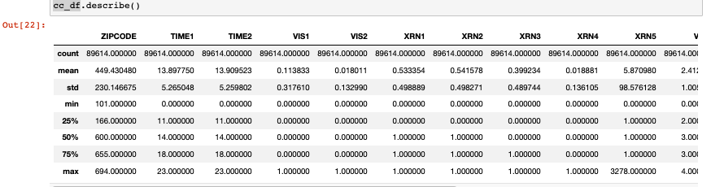
5.1. Exploratory Data Analysis (EDA)
I examined the data. The total dataset's Total Transaction Amount count is 89614.
For the entire dataset, 25% of the Total Transaction Amount is equal to $12.95.
For the entire dataset, the total transaction amount's standard deviation is 14.17.

Slide 7
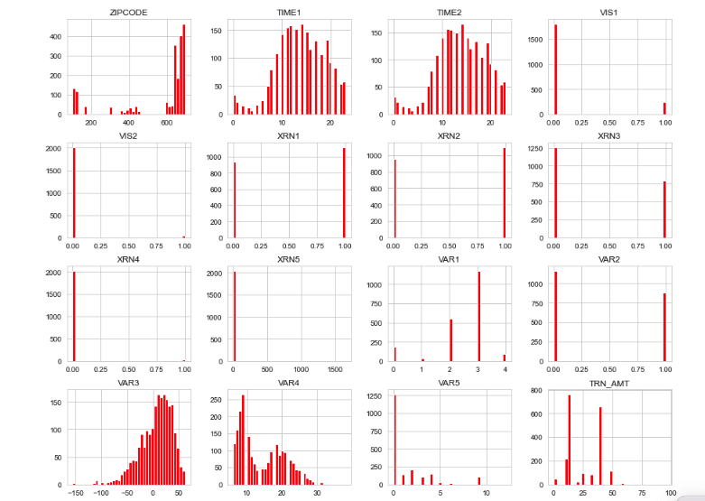
5.2. Exploratory Data Analysis (EDA)
After plotting the distribution of the variable using the Kernel density plot it was observed that for legitimate and fraud transactions var 1 and var 2, time1 and time2 are the variables which can be considered to detect the fraud or legit transaction.

Slide 8
Feature Engineering/Dimension Reduction
We are going to employ three different methods here to select features.
Spearman Method
Pearson coefficient
Probability Density function

Slide 9
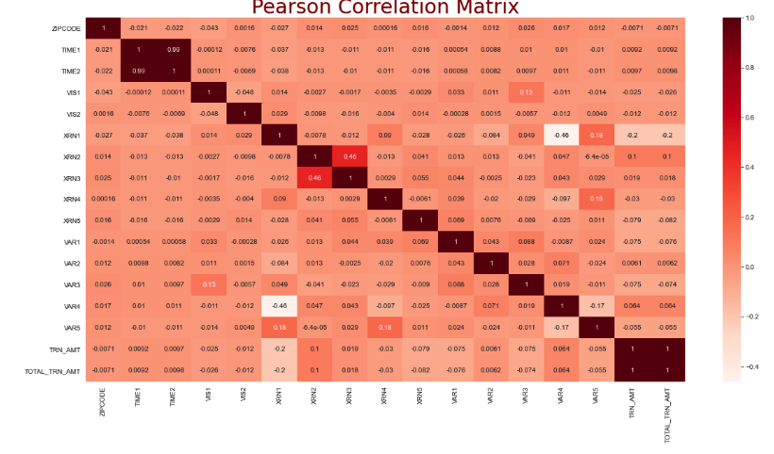
Pearson Coefficient
TIME1 and TIME2 have a strong correlation of 0.99, which is close to 1, indicating a significant positive link.
- The correlation between XRN2 and XRN3 is 0.46, which is quite close to 1, indicating a favorable link.

Slide 10
7. Model Accuracy
Accuracy is a ratio of correct predictions to the total predictions. Its formula is (𝑇𝑃+𝑇𝑁)/(𝑇𝑃+𝐹𝑃+𝐹𝑁+𝑇𝑁) According to that,

Slide 11
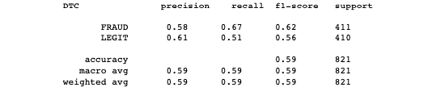
7.1 Model Accuracy-Precision
I have used decision tree model to detect the fraud. I have taken the fraud data into consideration and splited the data in 80-20 ratio test and train data. The accuracy of my model came as 60%

Slide 12
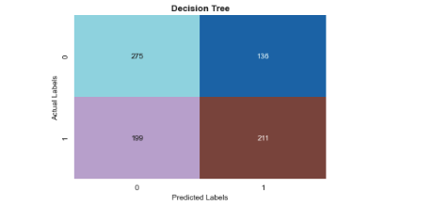
Model Accuracy-Confusion Matrix
In the confusion matrix the first row stands for positive, while the second row for negative. I therefore have 275 real positives and 136 erroneous positives. Accordingly, out of 411, I have 275 transactions that are successfully classed as normal, and 136 transactions that were fraudulently classified as normal.

Slide 13
Conclusion/Recommendation
I have looked into the data, ensuring that it is balanced, visualizing the features, and understanding how they relate to one another. Our recent results for detecting credit card theft showed a 60% accuracy rate. Given that our data was weighted in favor of one class, this number shouldn't come as a surprise. Our model is not overfitted, which is a positive finding from the confusion matrix

