Slide 1
Assignment-1
Design a mashup
To fetch part details (4-5 attributes) and display in the table based on the ufid or criteria and type
On selecting the part in the 1st table it should display the LifeCycle History details in 2nd Table
On selecting the 1st part details in 1st table, mashup should contain the option for Checkin and checkout(Radio-Button) and display its details

Slide 2
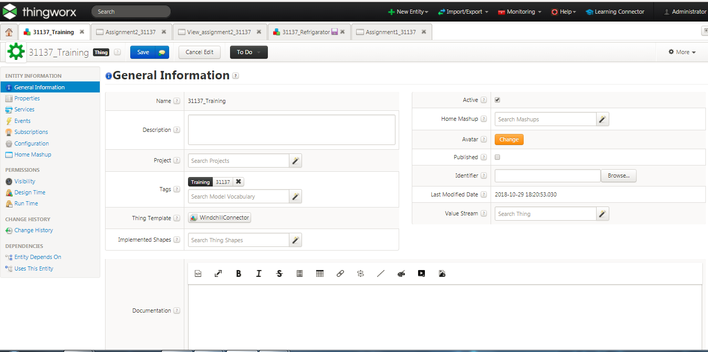
Create the thing which follows thing template-WindchillConnector

Slide 3
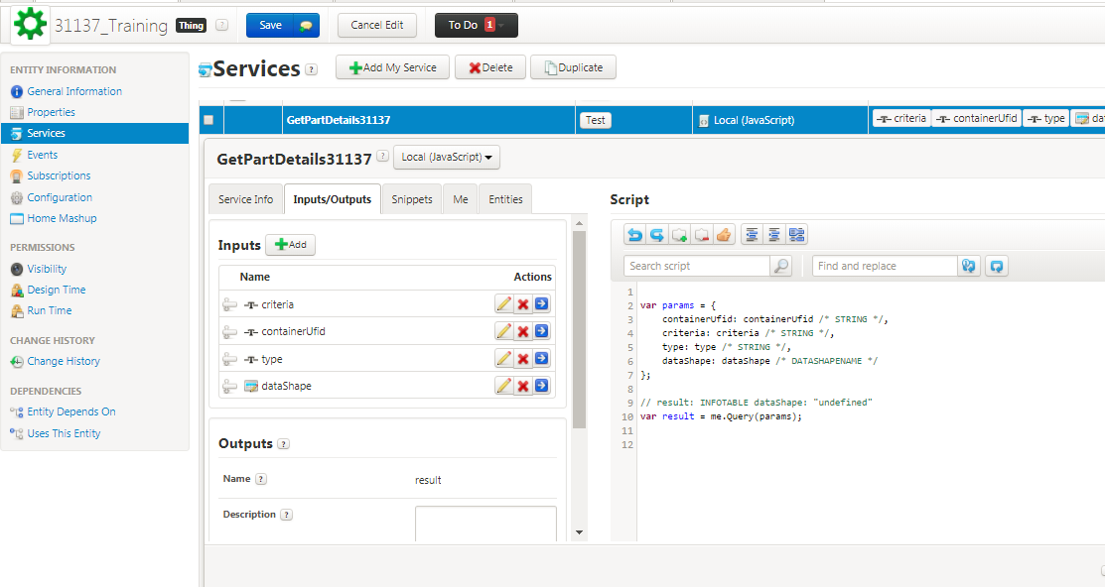
GetPartDetails services should be taken as Querry Serrvice from the windchillConnector(from ME tab after ip/op tab)

Slide 4
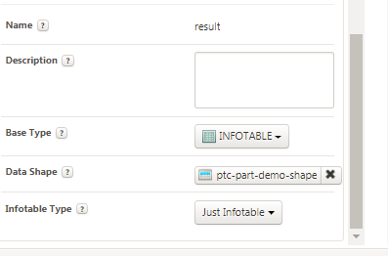
Output for tat service should be (infotable-basetype which follows –ptc-part-demo-shape)

Slide 5
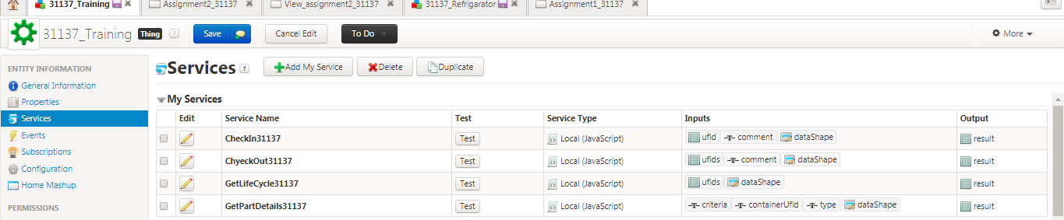
Similarly create other services GetPartDetails-Querry GetLifeCycle31137-GetLifeCycleHistory Checkin31137-CheckIn CheckOut31137-CheckOut

Slide 6
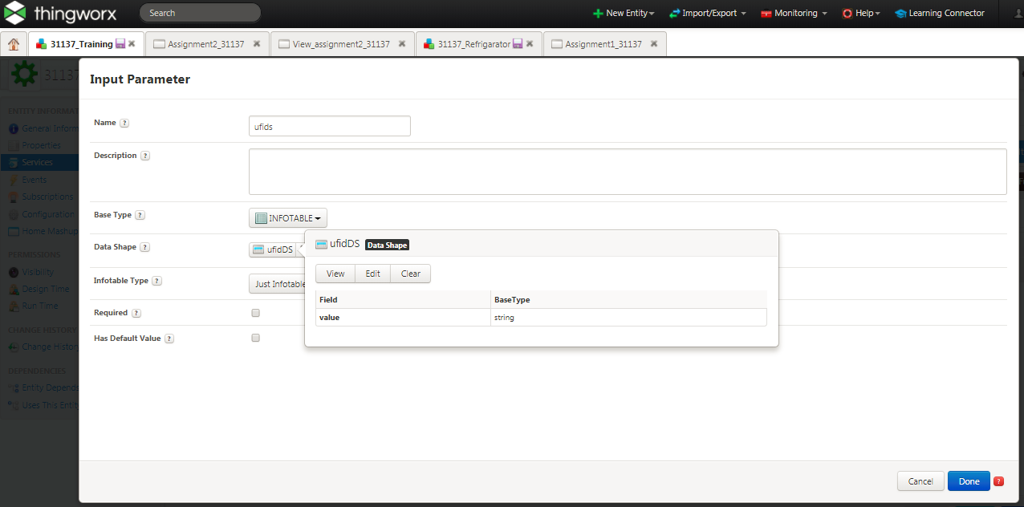
To get the lifecycle history – input ufid so create one parameter for tat service which have base type as infotable and create one Datashape UFIDDS which accepts oly one string value and other input is datatype name

Slide 7
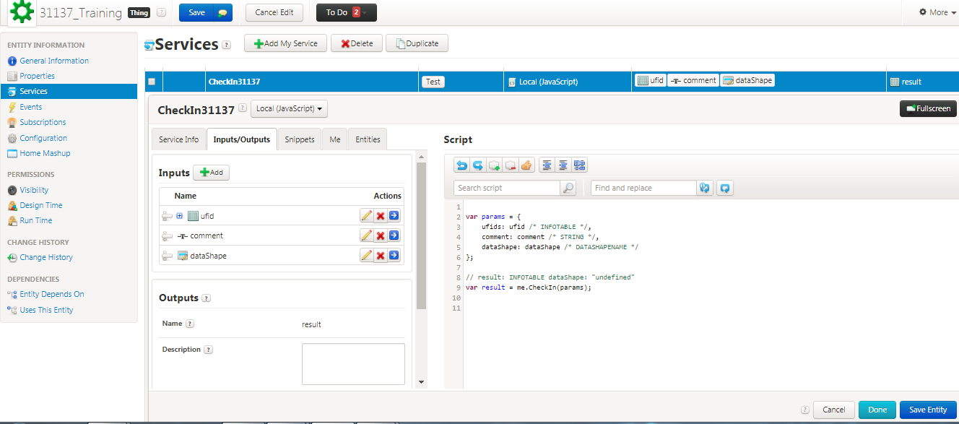
inputs=-ufid(infotable,ufidDS) comment(String) dataShape(dataShapeName)

Slide 8
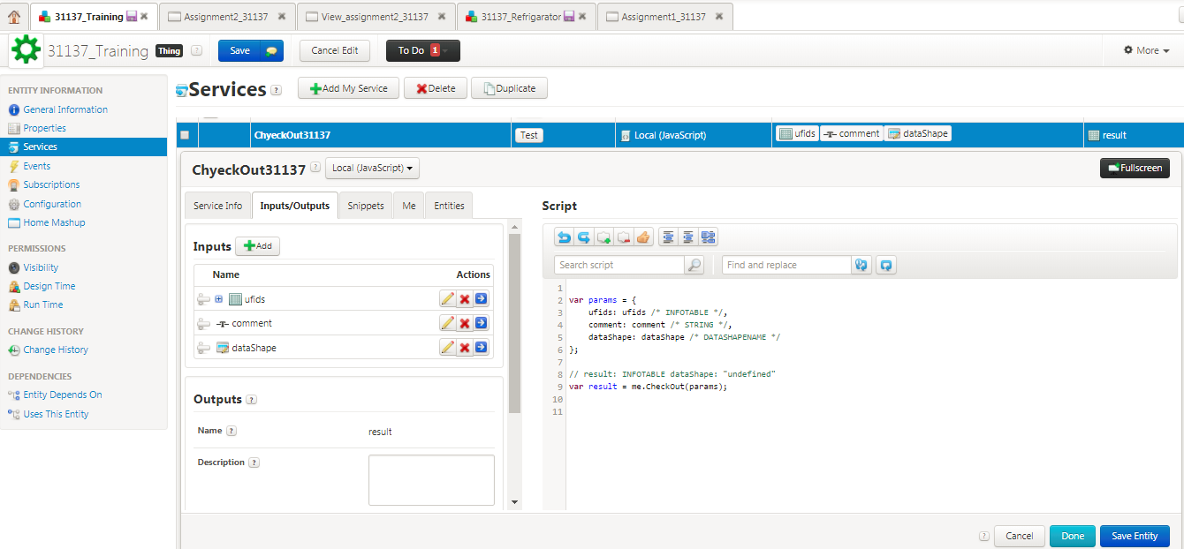
CheckOut service inputs=-ufid(infotable,ufidDS) comment(String) dataShape(dataShapeName)

Slide 9
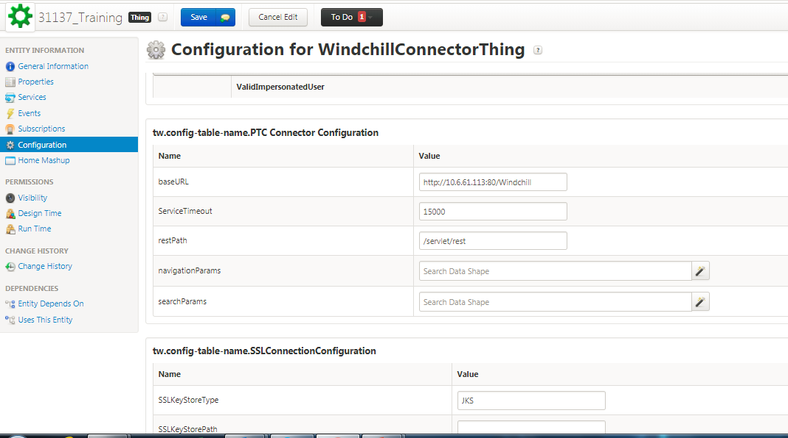
After Giving services select CONFIGURATION tab and give the BASEURL-windchill url (eg:http://10.6.61.113:80/Windchill)

Slide 10
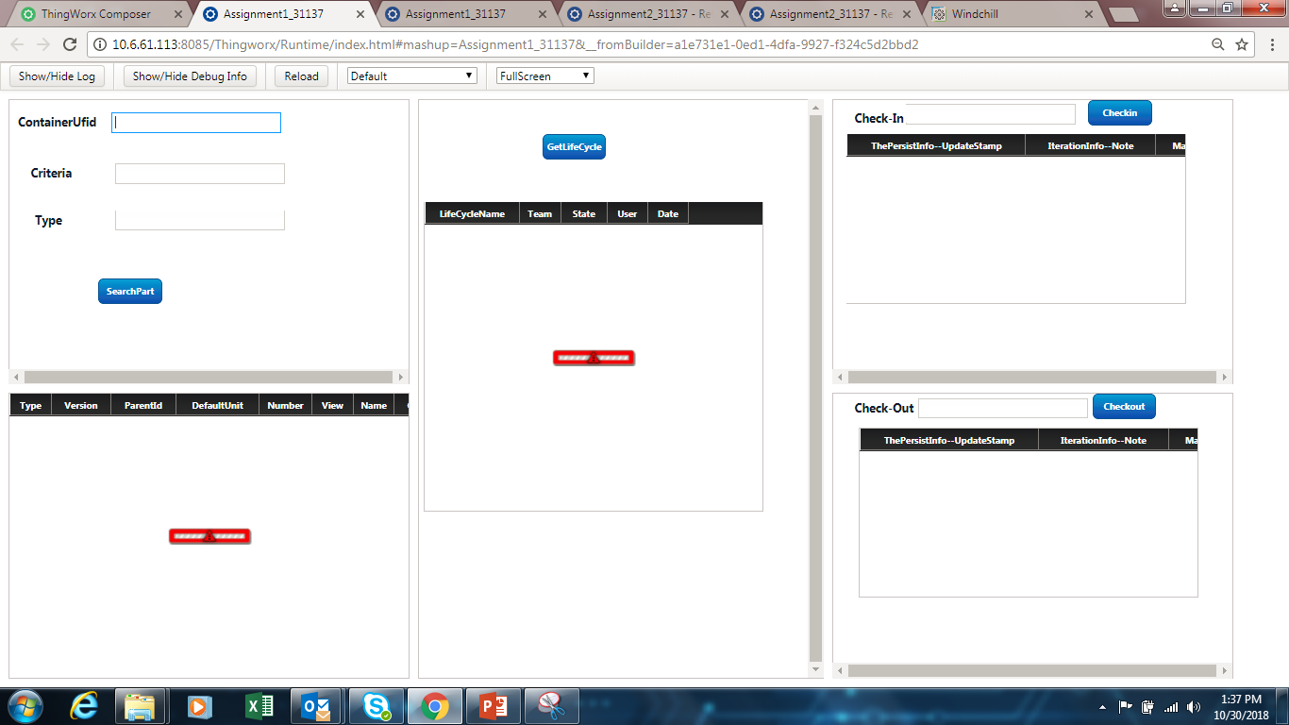
Create a Mashup as follows

Slide 11
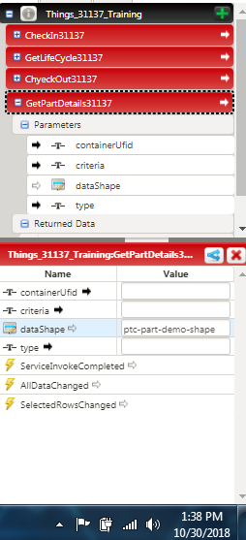
Give the data from the Text box which collects the Criteria ufid and type and datatype (should given by default as shown) to this service input and the output should be given to the 1st table (grid)

Slide 12
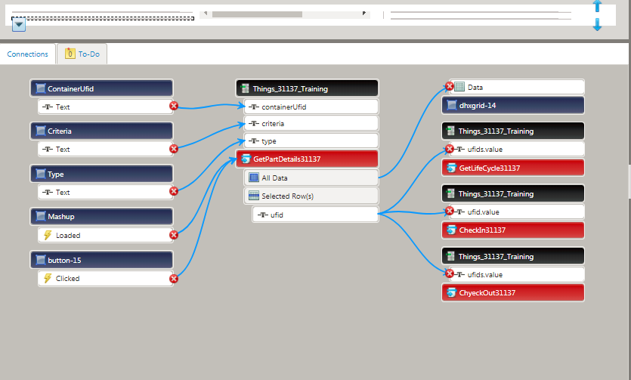
GetLifeCycle31137 service has input ufid-GetPartDetails31137→selected row→ufid Datashape→LifeCycleHistoryDS31137

Slide 13
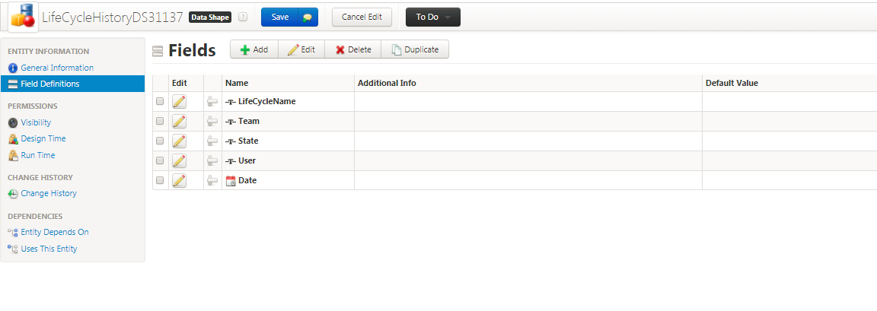
LifeCycleHistoryDS31137-See the windchill lifecycle history and create one datashape as follows

Slide 14
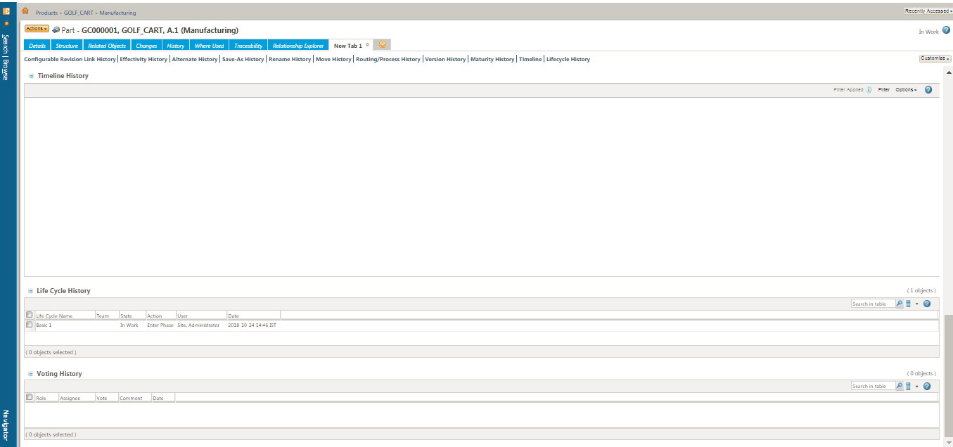
Windchill→folder→part→newTab→lifecycleHistory(Hence create the Datashape colums as previous slide)

Slide 15
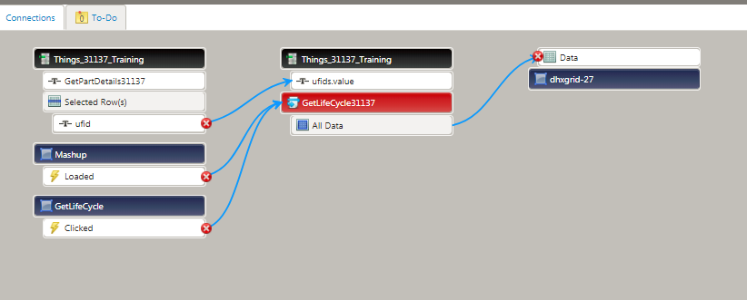
GetLifeCycleHistorey service

Slide 16
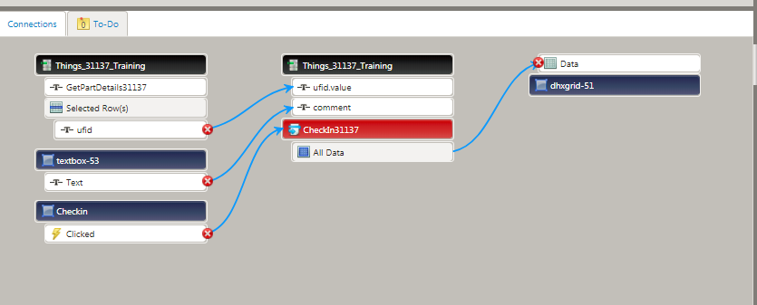
CheckIn31137 service input ufid- GetPartDetails31137→selected row→ufid Comment- take input from user(Text Box) OUTPUT-displays part details which is checked in(datashape-ptc-demo-part)

Slide 17
Simmilarly CheckOut311137 service

Slide 18
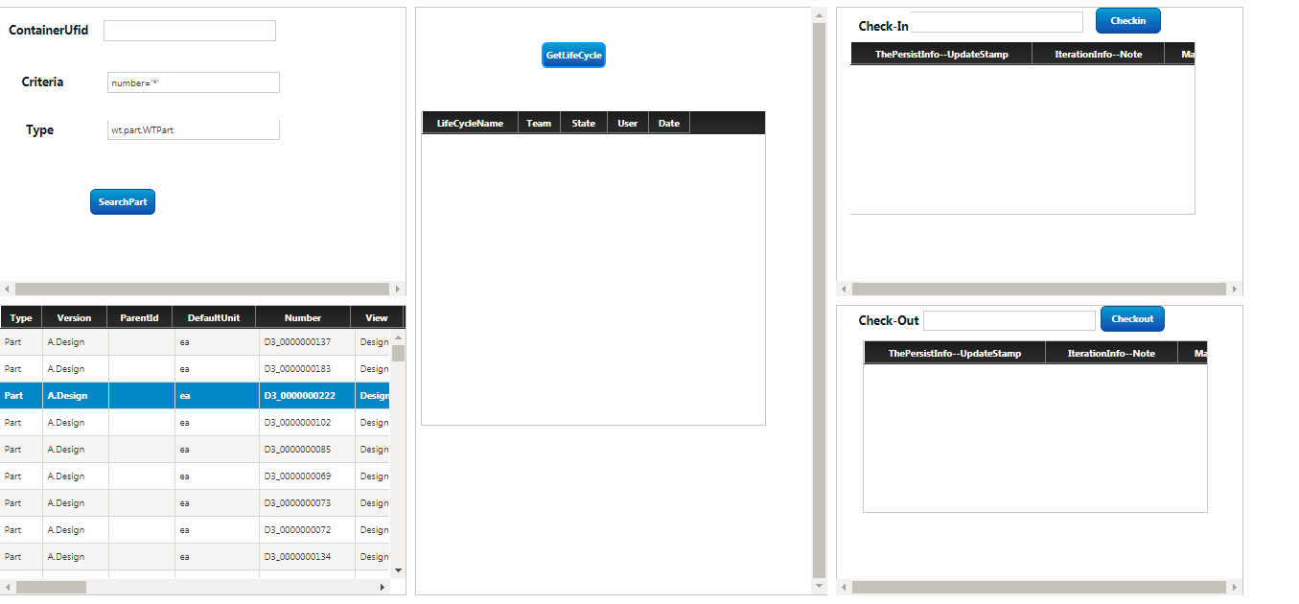
Final mashup look like after giving craiteria and type

Slide 19
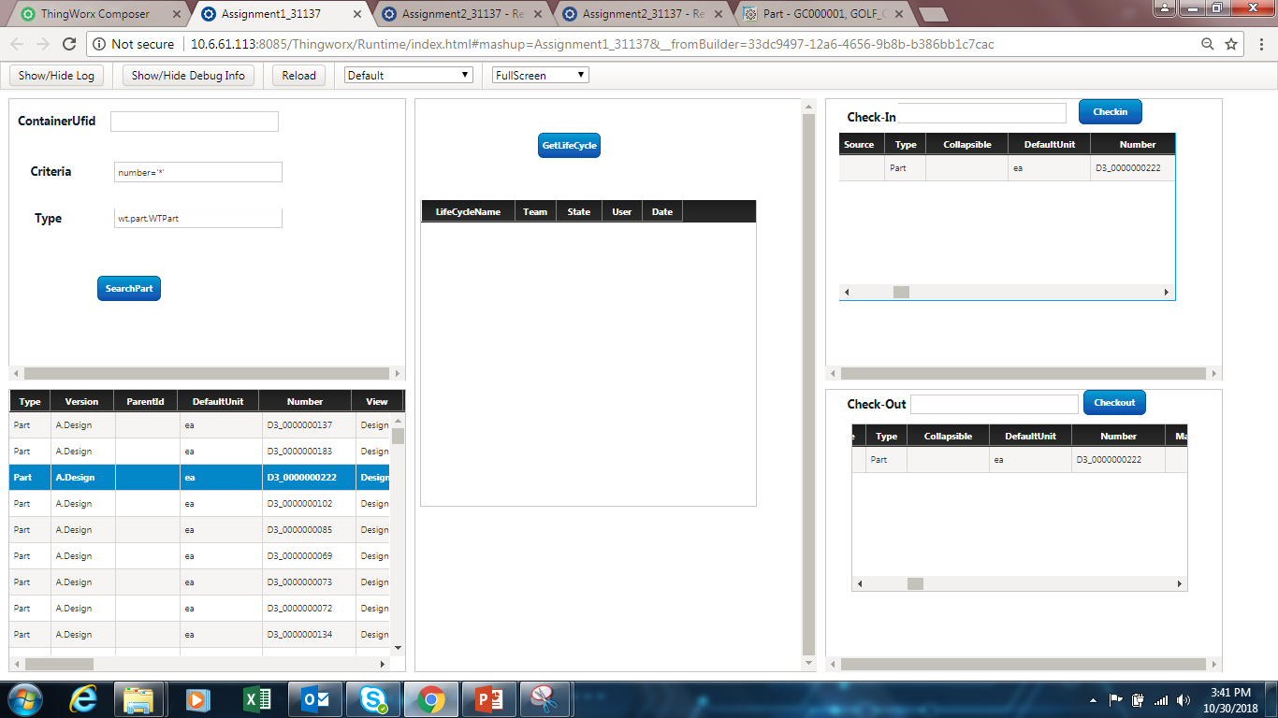
Same part is Selected for lifecycle(there is no data in windchill hence not displayed) history,checkin,checkout

