Slide 1
Assignment-3 Refrigarator

Slide 2
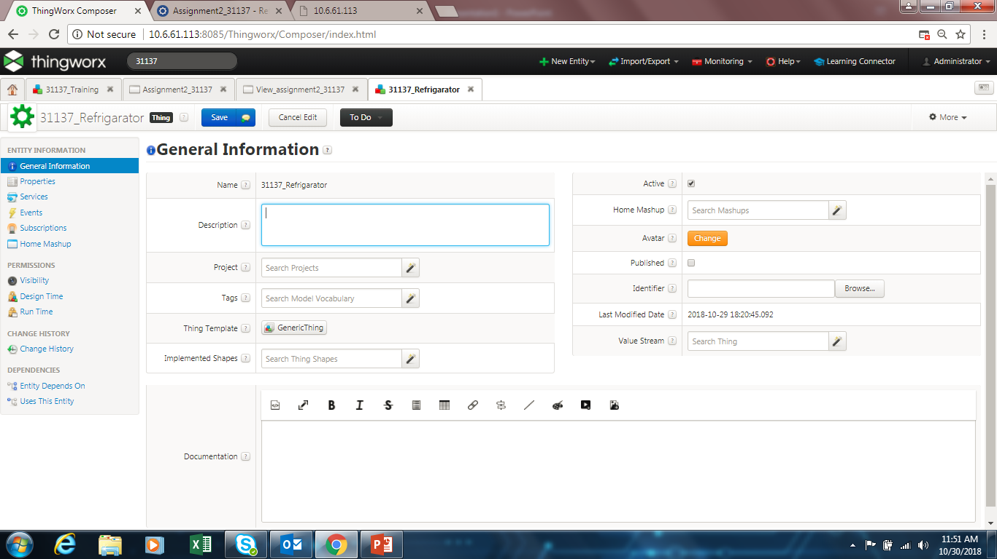

Slide 3
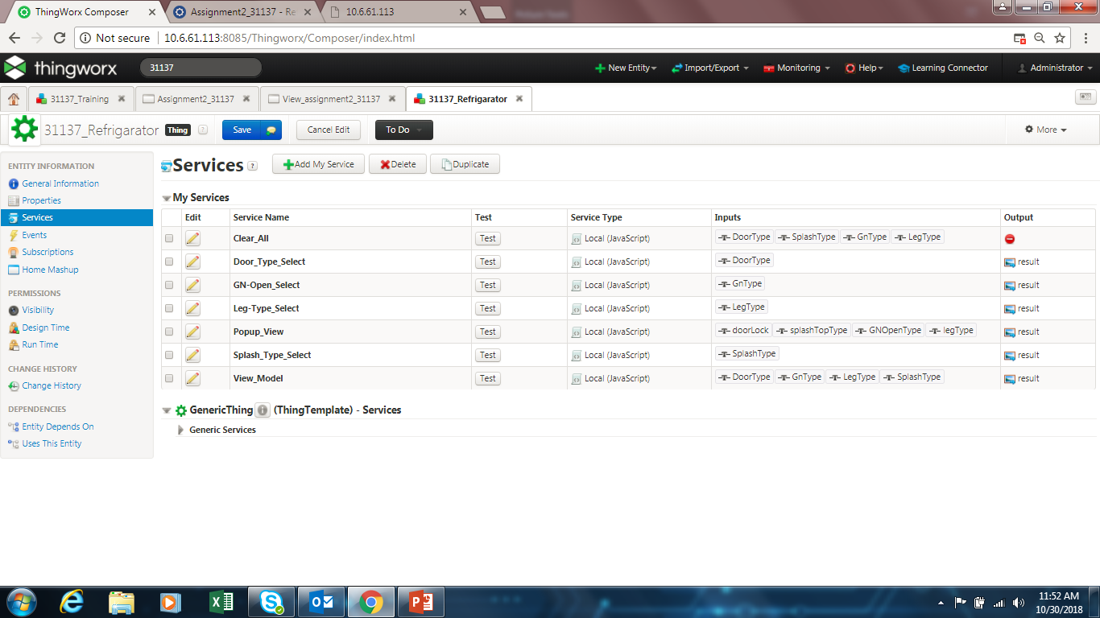

Slide 4
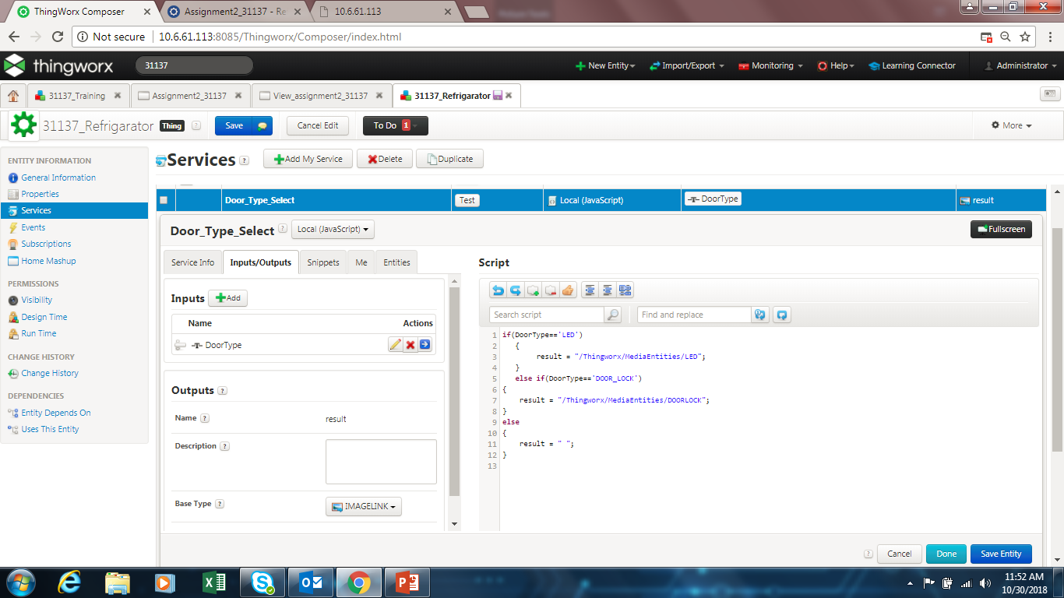
Door type select service

Slide 5
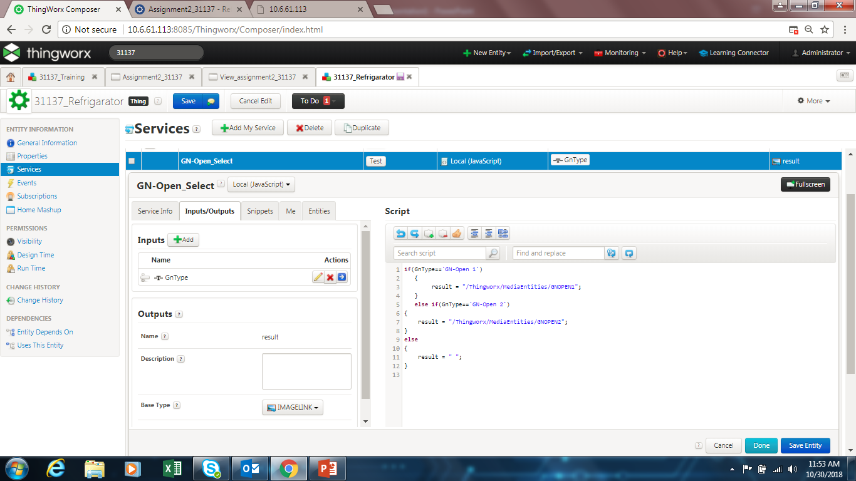
GN open select servioce

Slide 6
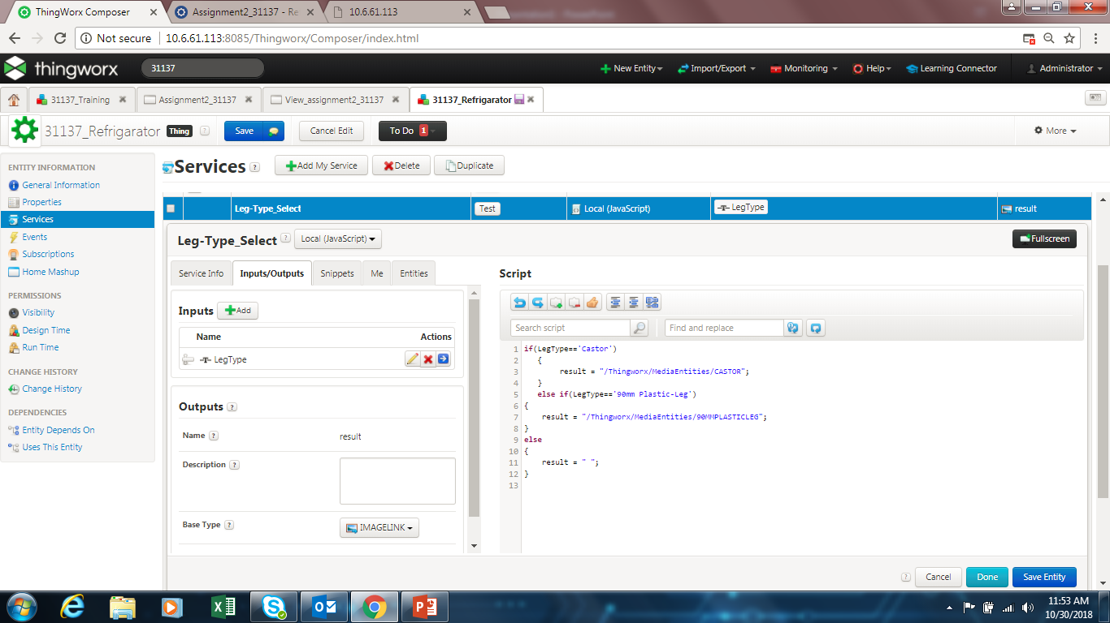
Leg type select service

Slide 7
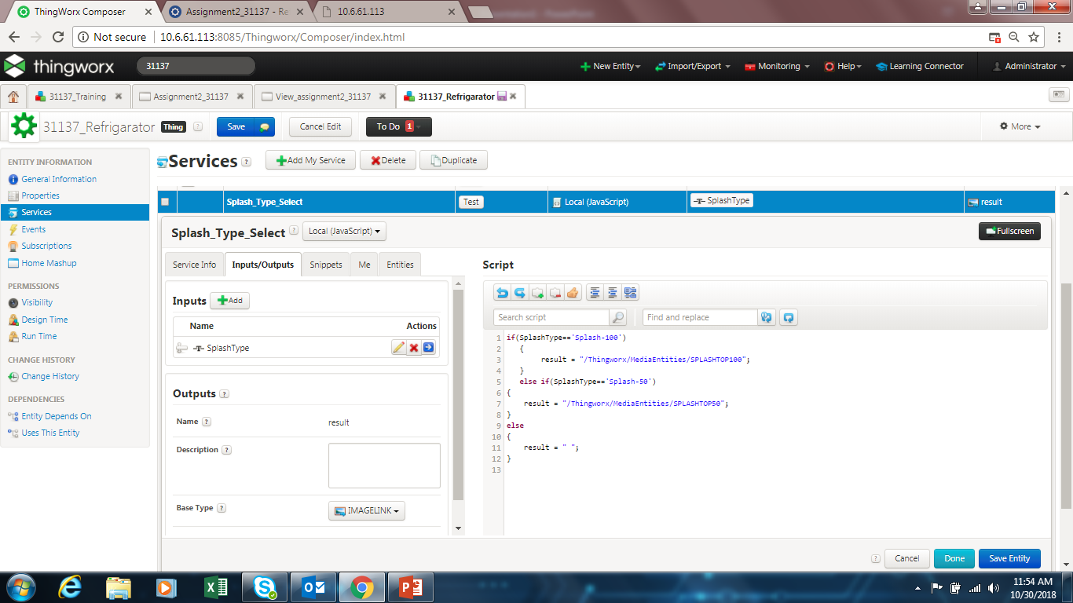
Splash type select

Slide 8
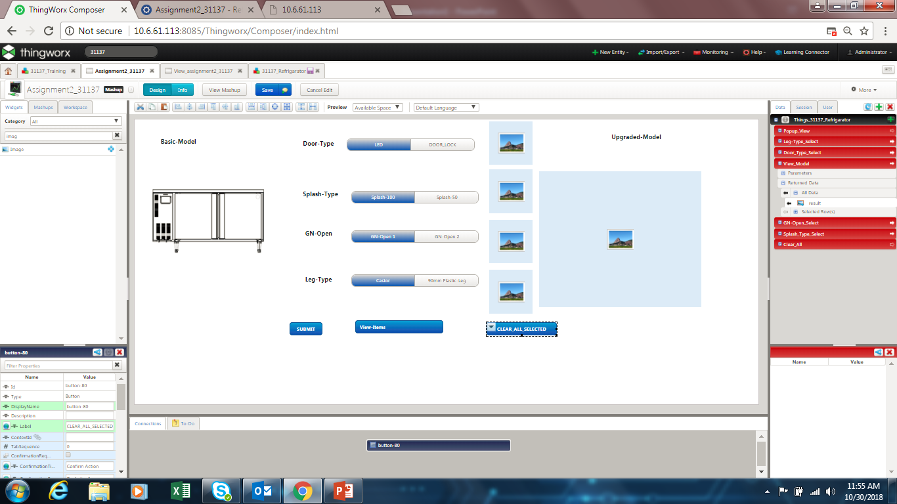
Mashup for refrigarotor

Slide 9
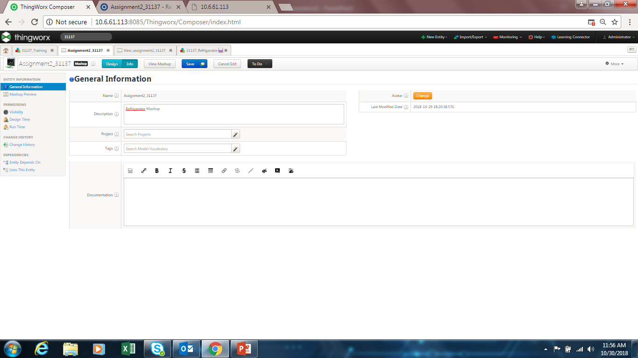
Mashup info

Slide 10
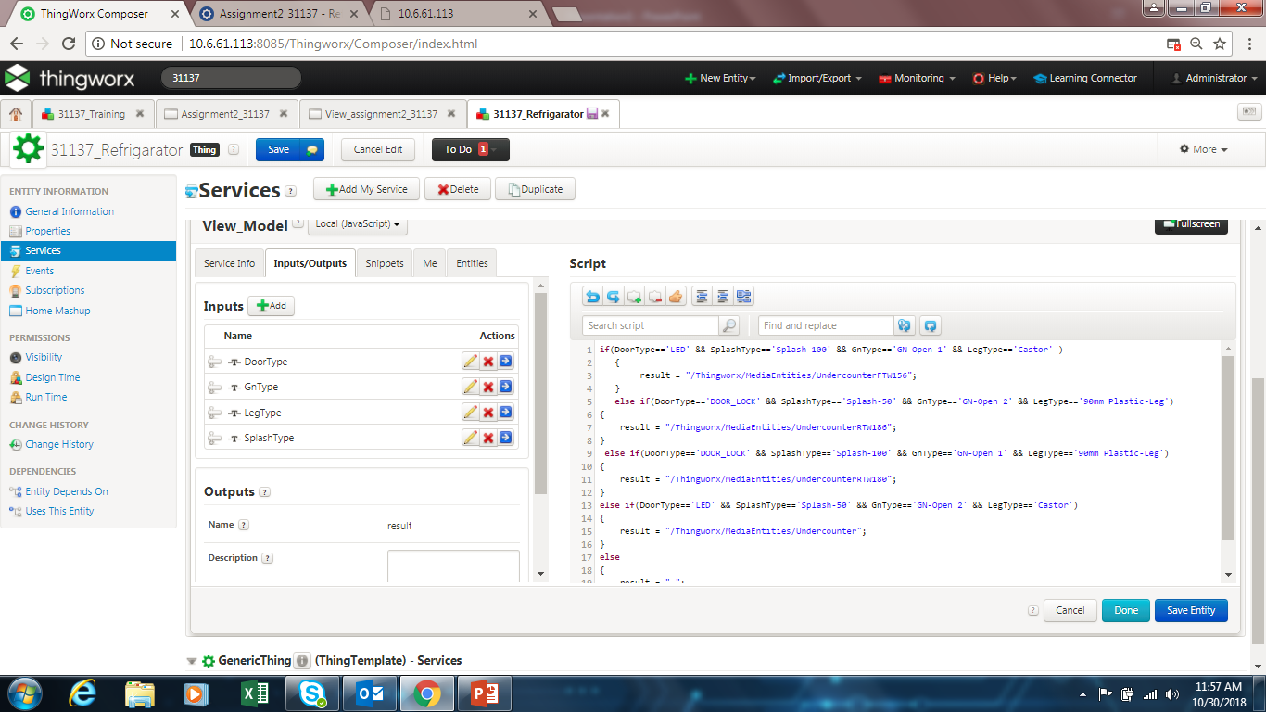
To view all selected option and give a final image of refrigerator-(output should b imagelink –url should b given)

Slide 11
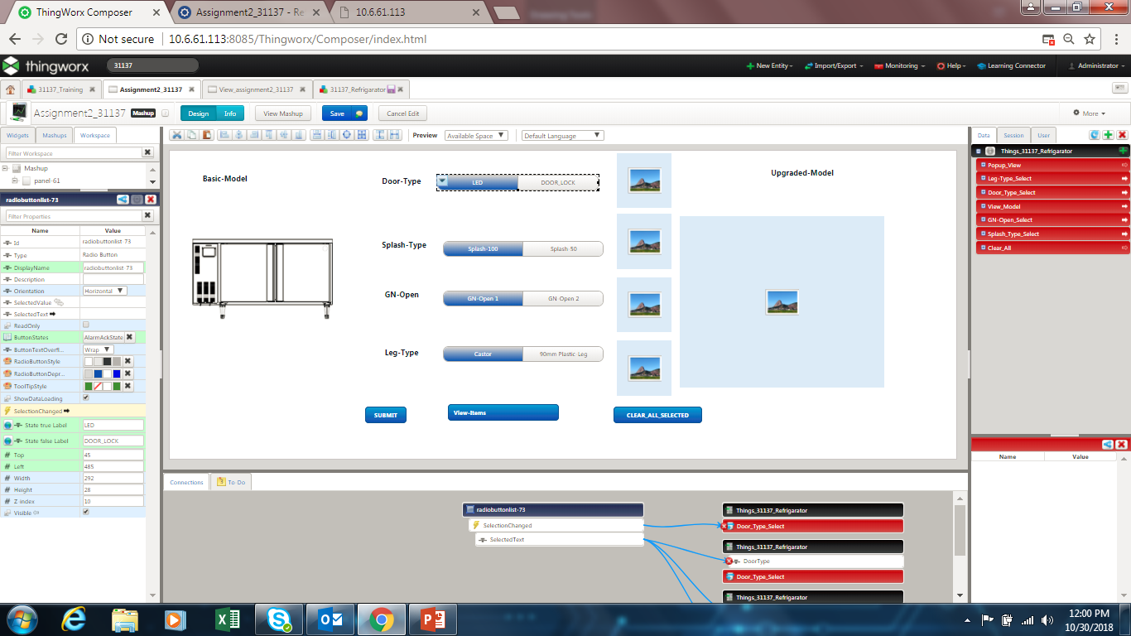
Radio button state should b seleted see as in ss

Slide 12
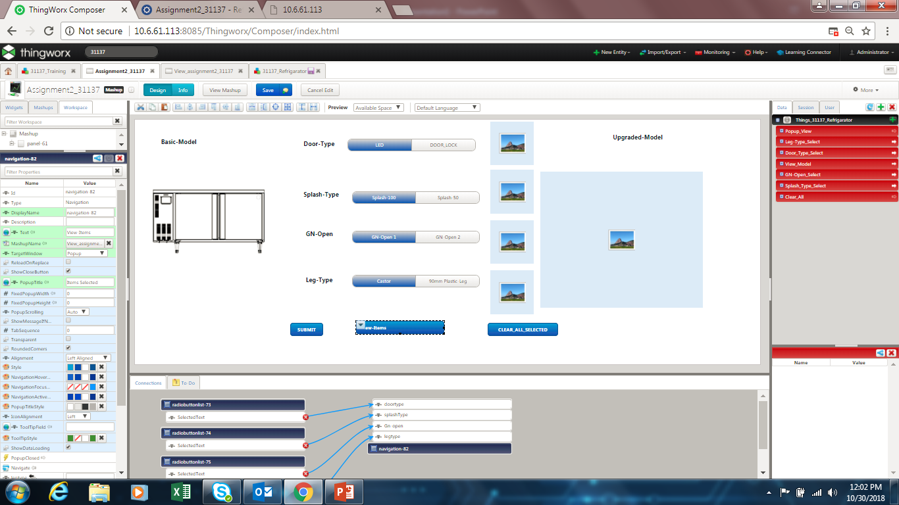
View item is a navigate widget which give popup of other window when clicked For tat mashup should be created n select that mashup in the options

Slide 13
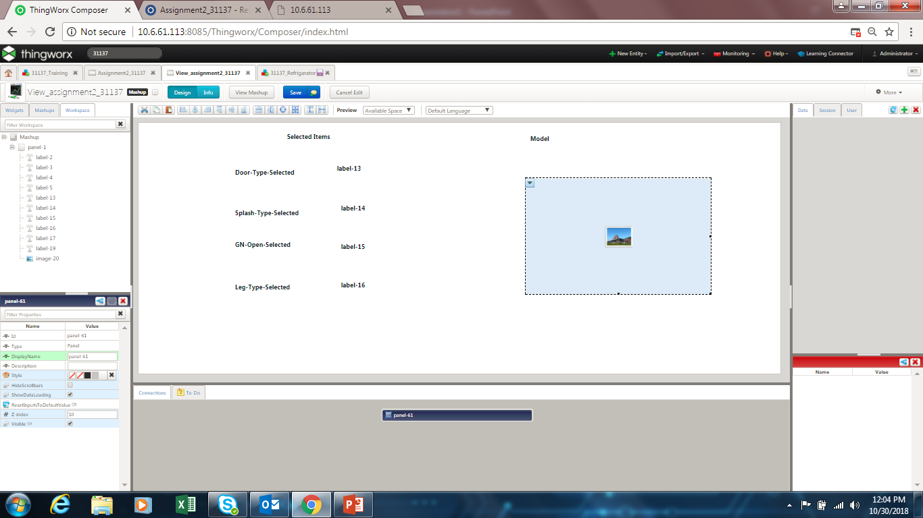
Mashup 2 which should be displayed when view all (navigate )is clicked

Slide 14
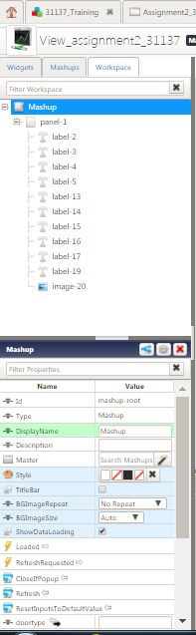
Go to workspace tab select mashup Go to Configure mashup parameter(fig2) all parameters ie parameters which should b collected from mashup1 tto mashup2

Slide 15
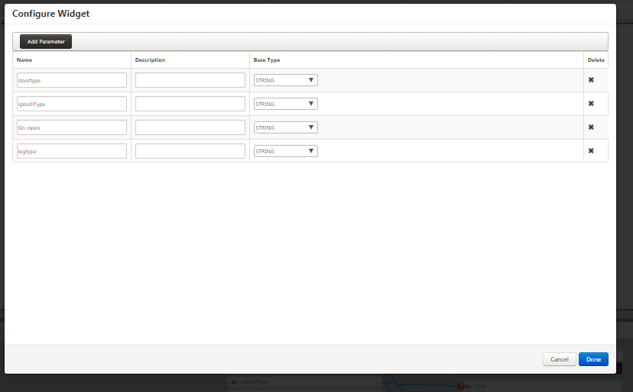
Parameters added

Slide 16
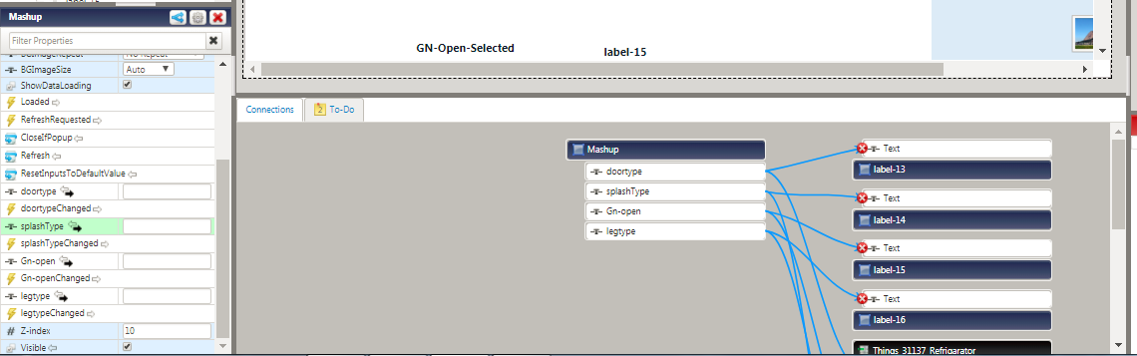
Bind these parameters to the label and select text

Slide 17
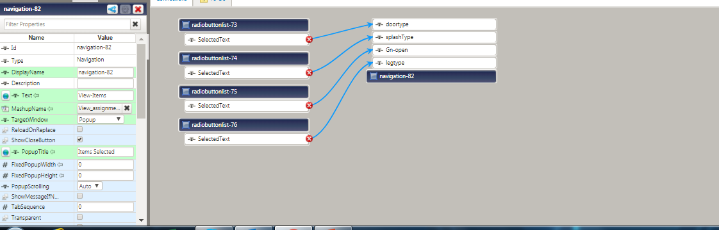
From mashup 1 now select the radio button selected text n bind to view all(navigate)n drop it to the parameters

Slide 18
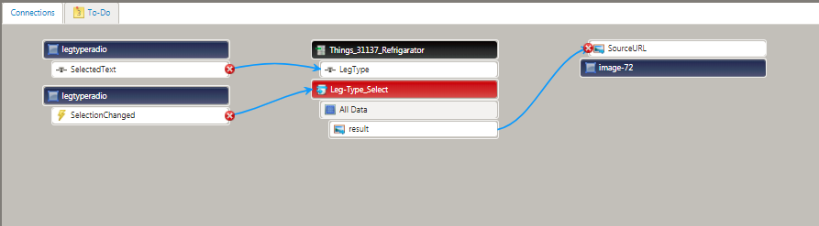
Each of the radio button should be maped to the respective service (Selected text+selection changed) from radio button to the service input (eg leg_type_select service have input as legtype and return output as image link ) map the image url to the image in the mashup

Slide 19
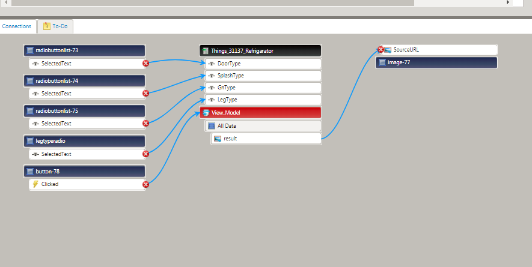
Similarly VIEWMODEL service takes all the input and displays the final image with which all the selected items r attached , the output url is mapped to the upgraded model image

Slide 20
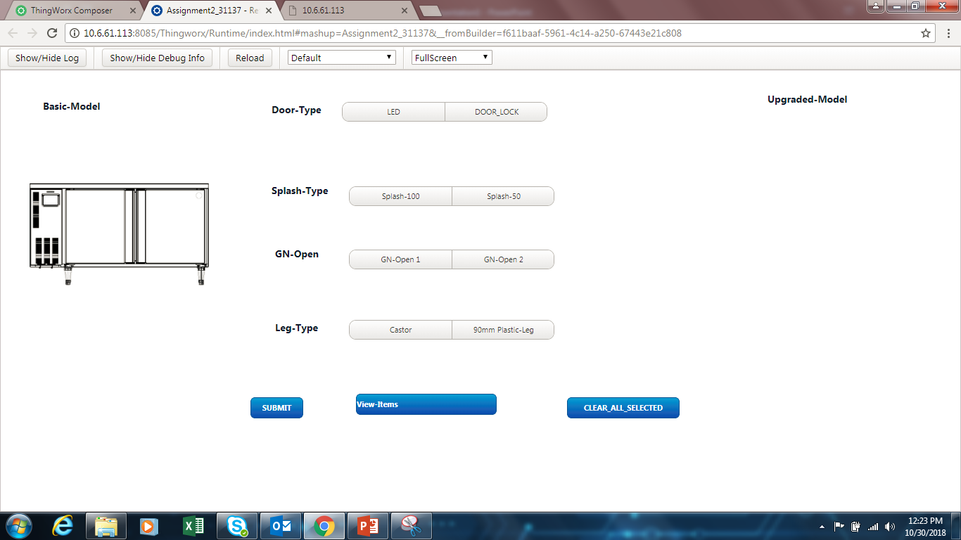
The final mashup look like Basic model- specify one image url(this does not change hence directly give in the image widget url on lhs)

Slide 21
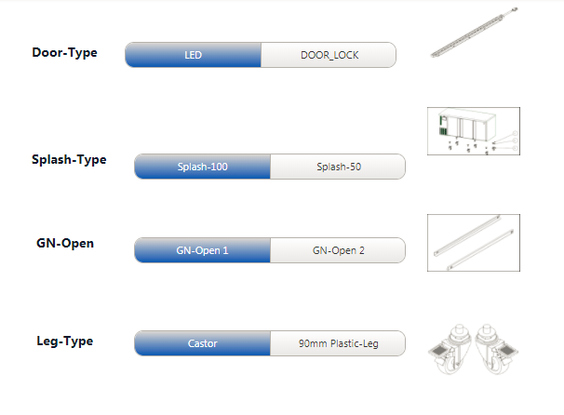
If u select the types (DoorType,SplashType,GNopenType,LegType) It should show those particular image on right side as shown

Slide 22
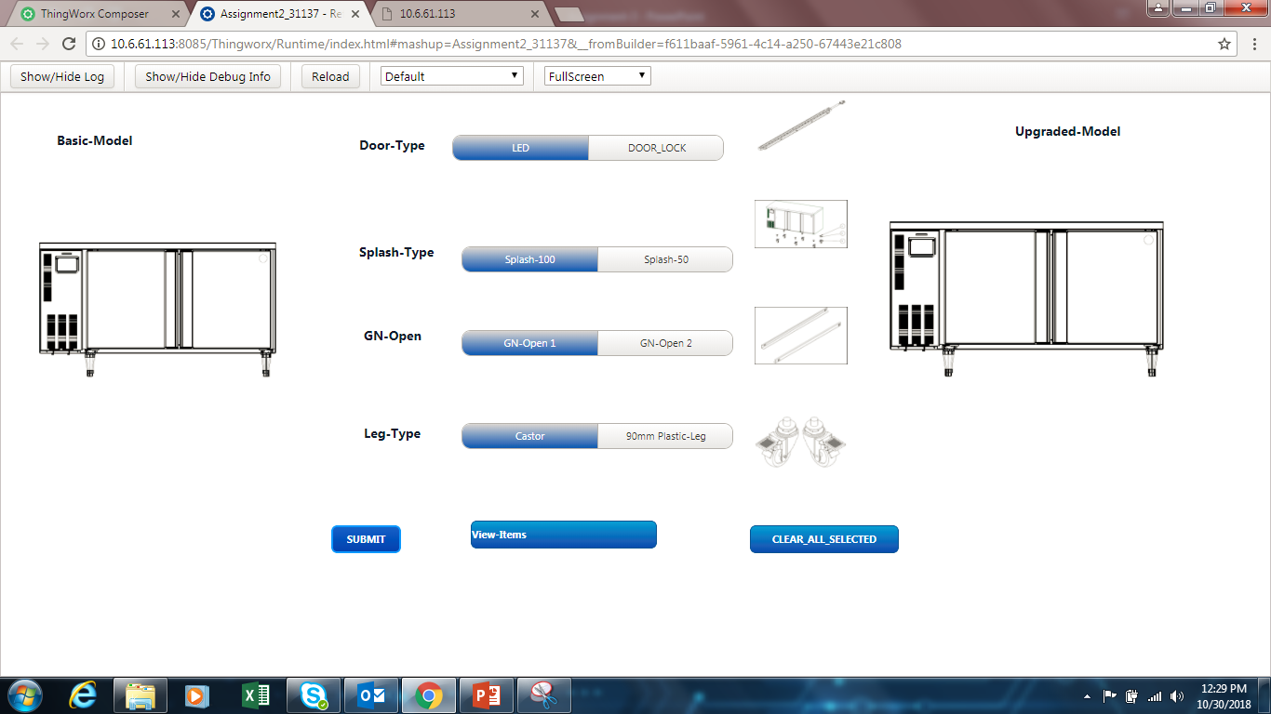
After selecting all types and on-click of SUBMIT button it should show the UPGRADED MODEL image as shown

Slide 23
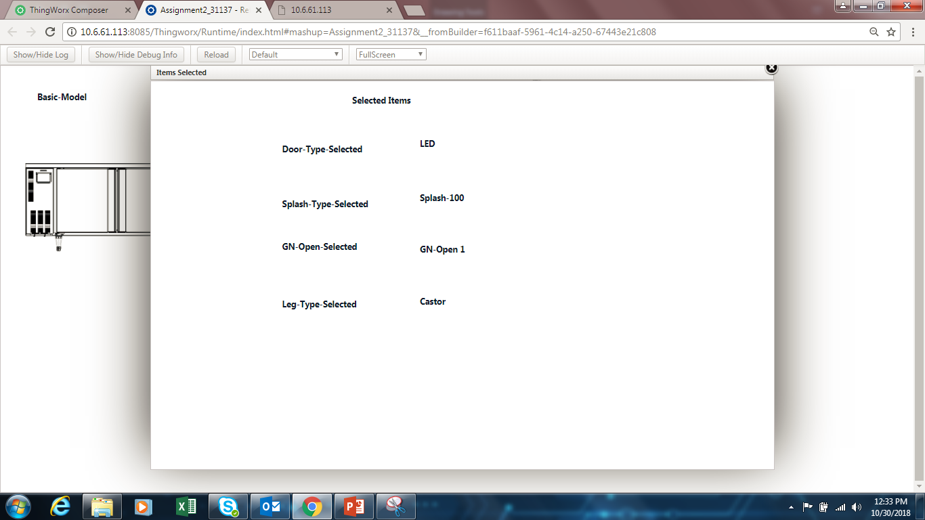
After selecting all types on click on VIEW ALL ITEMS (Navigation) it should display a pop-up window as follows

Slide 24
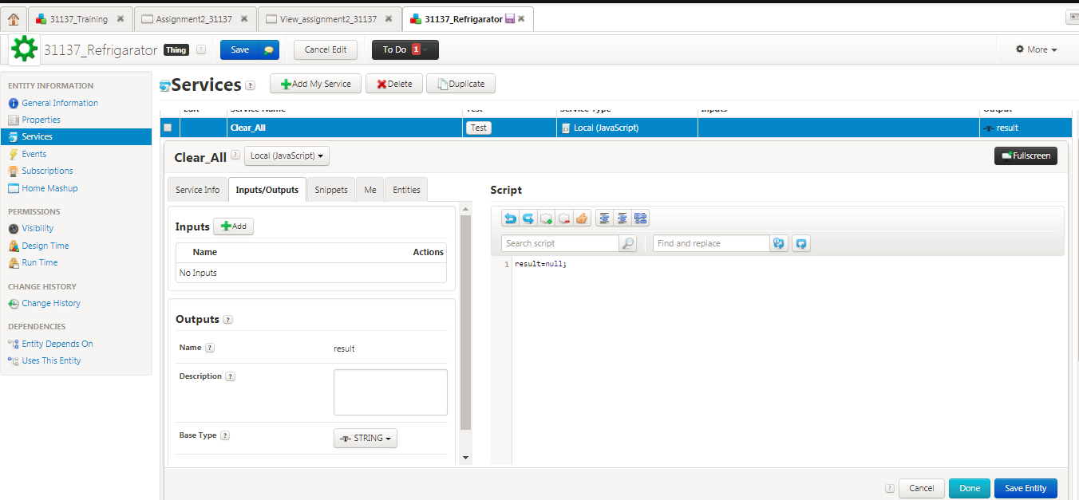
On-click of CLEAR_ALL_ITEMS button it should clear all the selection made in the radio buttons and the image should be cleared

Slide 25
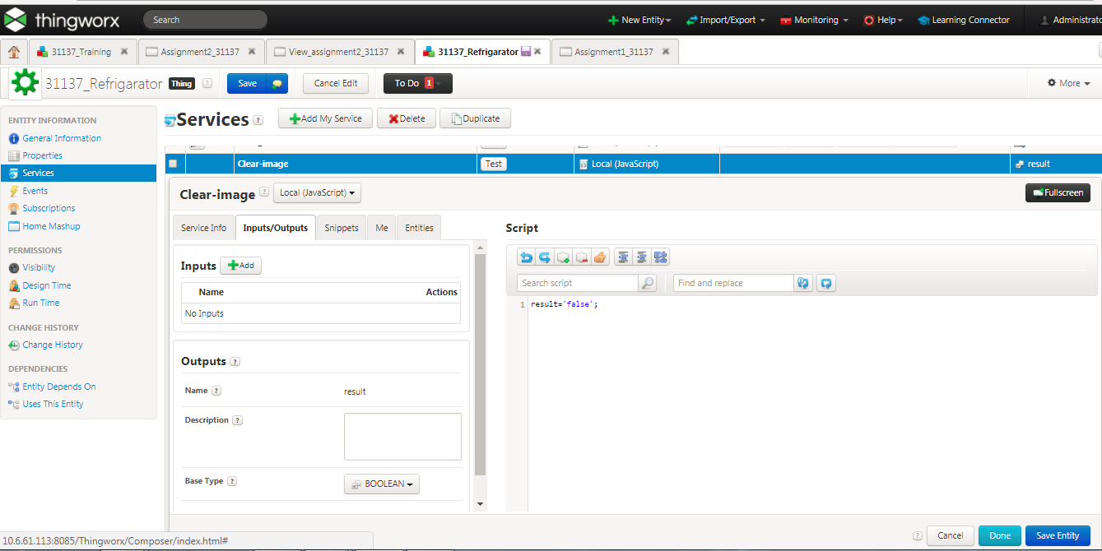
For clearing the image

Slide 26
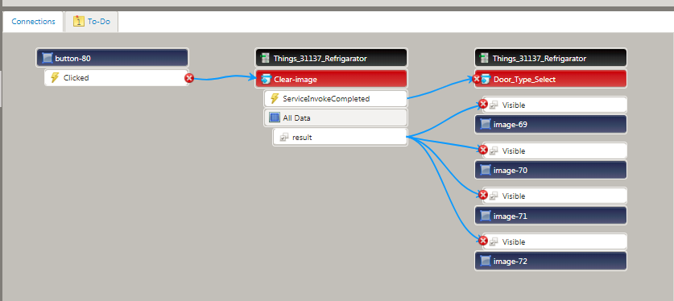
Map visible in the image with the result of the clear image service which is boolean

