Slide 1
Thingworx & Navigate

Slide 2
Agenda
Thingworx
Platform Overview
Basics
Application – Demo
Web App development
Navigate – Role based apps -OOTB
Navigate – Custom App

Slide 3
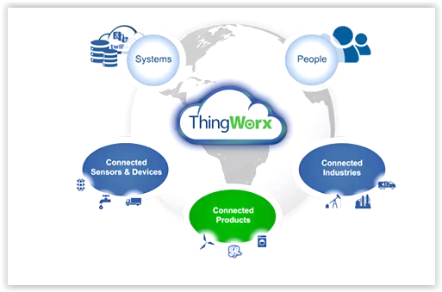
Thingworx Platform

Slide 4
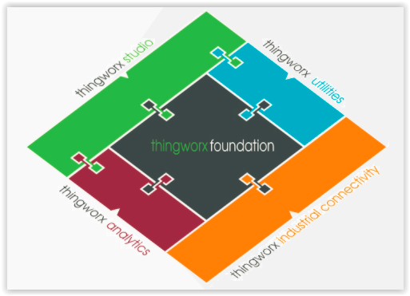
Thingworx platform
Enable users to better create, service, and operate products in the smart, connected world through augmented reality
Feature-rich tools and mash-ups that enable and support the rapid deployment and adoption of powerful IoT applications
Enables enterprises to find the true value in their IoT data – to learn from past data, understand and predict the future, and make decisions that will enhance outcomes
Powered by Kepware® connects disparate devices and applications, providing a single source of industrial automation data to the ThingWorx platform
Complete, end-to-end technology platform designed specifically for the IoT.
Empowers developers to connect, create, and deploy breakthrough, enterprise-ready IoT applications, solutions, and experiences

Slide 5
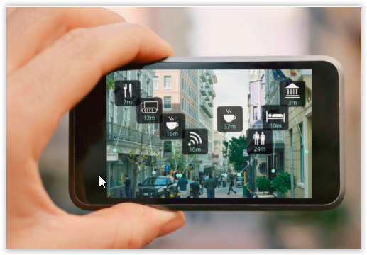
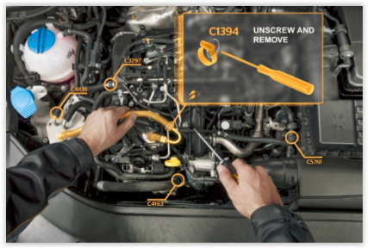
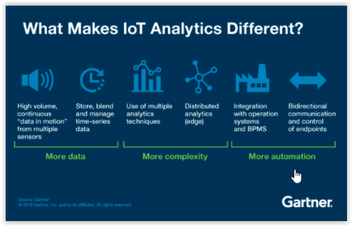
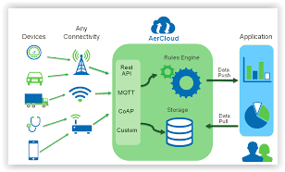
Augmented Reality ; Analytics

Slide 6
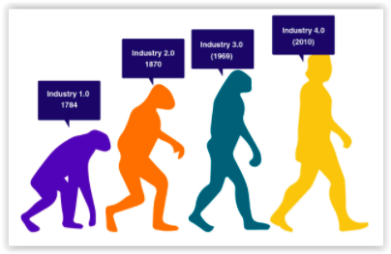
Industrial IoT
Evolution of IIoT
Industry 1.0 (1784) - The invention of steam engines kick started the Industry 1.0. However, the manufacturing was purely labor oriented and tiresome.
Industry 2.0 (1870)- The first assembly line production was introduced. This invention was a big relief for the workers as their labor was minimized to the possible extent. Henry Ford the Father of mass production and the assembly line introduced the process in a car manufacturing plant by Ford to improve the productivity using conveyor belt mechanism.
Industry 3.0 (1969)- Involved advancement of electronic technology and industrial robotics. Miniaturization of the circuit boards through programmable logic controllers, Industrial robotics to simplify, automate and increase the production. However, the operations still remained isolated from the entire enterprise.
Industry 4.0 (2010) - The vision of connected enterprise through interconnecting industrial assets through the internet was fulfilled with the introduction of Industry 4.0. The smart devices communicate with each other and create valuable insights. IIoT brought with it the advantages of asset optimization, production integration, smart monitoring, remote diagnosis, intelligent decision making and most importantly the feature of Predictive Maintenance.

Slide 7
Thingworx Utilities
Out-of-the-box, pre-defined capabilities that business analysts and line-of-business users can easily use without developer skills to manage and optimize the performance of connected products.
Includes pre-defined components that developers can readily customize and extend to build IoT applications fitting the unique needs of their business.
Includes utilities to provision, remotely monitor, and update connected products and assets.
IoT Process Workflow—Workflows can be created to execute across multiple systems, and initiated based on alerts and triggers from connected devices. Workflows can driven by decision support rules.
IoT Integration Connects business processes and people with systems to share consistent IoT information across the enterprise.
Provides a standard integration framework for creating and implementing pre-built and reusable connectors and can quickly integrate existing business systems with IoT applications.
ThingWorx Utilities provides a consistent framework on which application developers, system integrators, and technology providers can build a rich ecosystem of unique and reusable IoT applications and integrations that can distributed through the ThingWorx Marketplace

Slide 8





Thingworx - Architecture
External systems
Integration - Hub Connectors
PLM
ERP
CRM
Application – Thingworx 8.x
EDGE MICRO SERVER
WebApp Server – Tomcat - 8
Persistence provider – Postgres 9.4.x
SENSORS
Java – JDK 8
DEVICES

Slide 9
Integration Hub & Connectors
Enable integration with external business systems
Expose as resources, using REST principles, information about and related to manufactured products
Enable applications to access information about manufactured products without regard to where or how it is stored
TWX Application
TWX Application
Other Application
Mash Up
Mash Up
Mash Up
Mash Up
…
Customer
Contact
Opportunity
Customer
Contact
Asset
Ticket
Resource
Resource
Part
Resource
Resource
Problem Report
Change Request
Change Notice
Part Number
Warranty
Factory
Resource Providers
…
…
…
…
…
…
Connectors
Connector 1
Connector 2
Connector 3
Connector 4
Connector 5
Connector 6
…
Enterprise Business Systems
CRM 1
CRM 2
Service Application
ERP
PLM
Home Grown
…

Slide 10
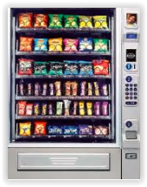
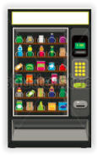
Online Vending Machine Management (Sample IoT App - Demo)

Slide 11
Online Vending Machine manager
Acme Vending Corp manages vending machines across multiple cities.
Monitoring and Managing vending machine operations is manual intensive
The company wants to implement an IoT solution to monitor & manage vending machines remotely
Manager, Service Technician, Sales, Operations personal will use the IoT app to efficiently manage the business
Basic features of the application :-
Monitor real time & historical health – Temperature, Humidity
Alert service technicians based on health parameters
Monitor Inventory & notify operations
Monitor real time sales – revenue/profit details

Slide 12
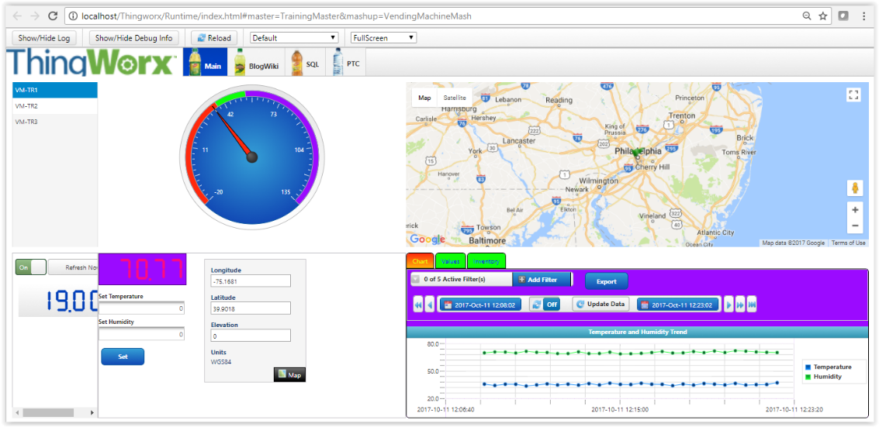
Vending Machine App Demo
http://localhost/Thingworx/Runtime/index.html#master=TrainingMaster&mashup=VendingMachineMash

Slide 13
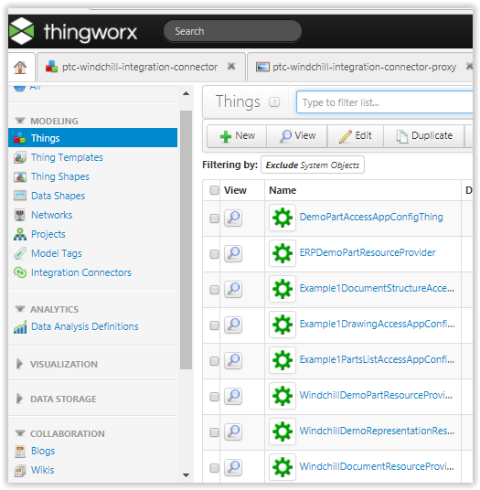
Thingworx Web App Development Basics

Slide 14
Web App Development – Key Steps
Model
Define Things (Properties, Services, Events, Subscriptions)
Mashup – Build UI
Build UI using Mashup, Widgets
Bind Data & Services
Connect data & services to UI elements
Establish connection to Remote Things/Ext systems/EMS
Define Security (users, user groups, permissions, visibility…)
Test

Slide 15
Thingworx Application Development
Data Model
User Interface
Data Storage
Collaboration
Security
Thing
ThingTemplate
ThingShape
Mashup Builder
Widgets
Menu, Media
Data Tables
Streams
Wiki
Blogs
User
User groups
App Keys

Slide 16




Thing Model
Vehicle Shape
Location
Driver
Mileage
Air-conditioned Shape
Temperature
Humidity
Armoured Vehicle Shape
Arm Type
Stike distance
Thing Shapes
Passenger Vehicle Template
Seats
Category
Commercial Vehicle Template
Load
Axles
Type
Thing Templates
Things
Bus1
Bus2
Car1
Car2
Truck1
Truck2
Truck3
Truck4
Army Truck1
Army Truck2

Slide 17
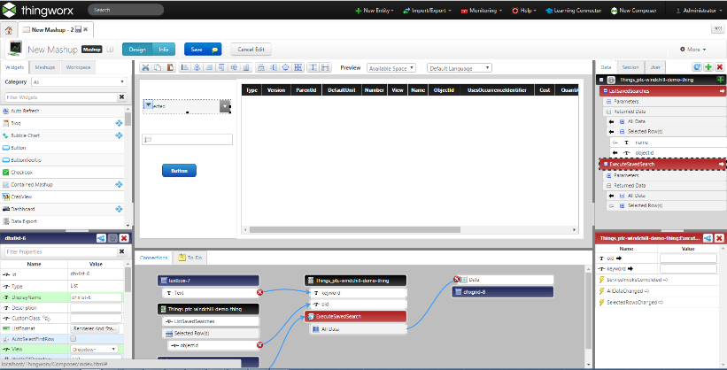
Development Sample
New Mashup
Add UI Widgets
Connect Data & Services
Test/View Mashup

