Slide 1
Complex System Project
Zipf’s Law
Jyoti - 277156

Slide 2

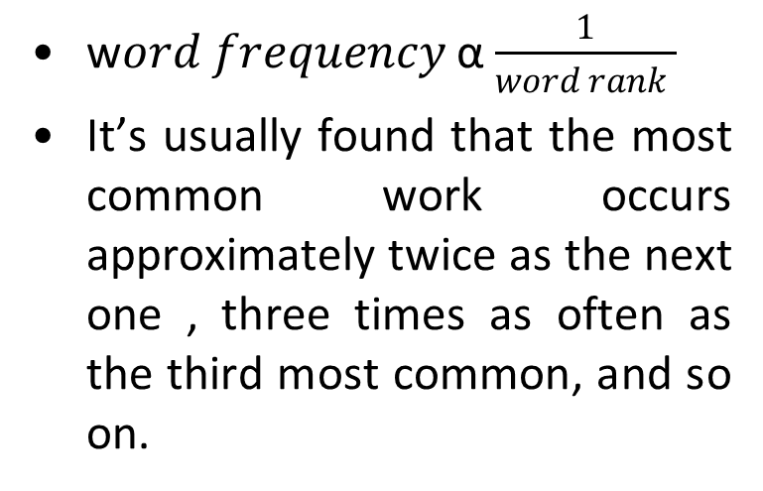
Zipf’s law state that the frequencies f of a certain event/word are inversely proportional to their rank r
George Kingsley Zipf
1902-1950
w$ord frequency$ α $\frac{1}{word rank }$
It’s usually found that the most common work occurs approximately twice as the next one , three times as often as the third most common, and so on.

Slide 3
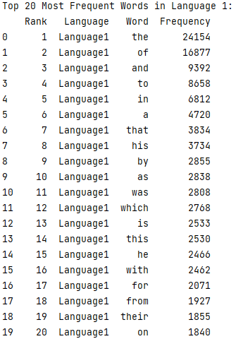
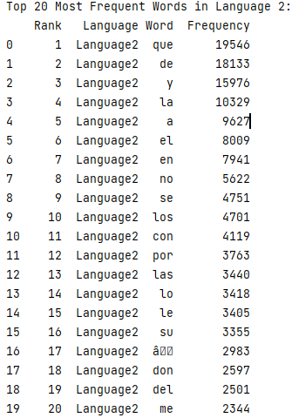
Most Frequent Word
Here are some most frequent word in English book 'Lives of the Apostles': 314654 and Spanish book 'Don Quijote': 389641 .
English
Spanish

Slide 4
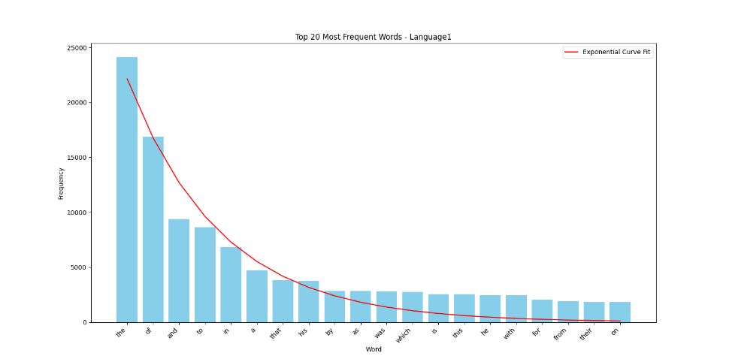
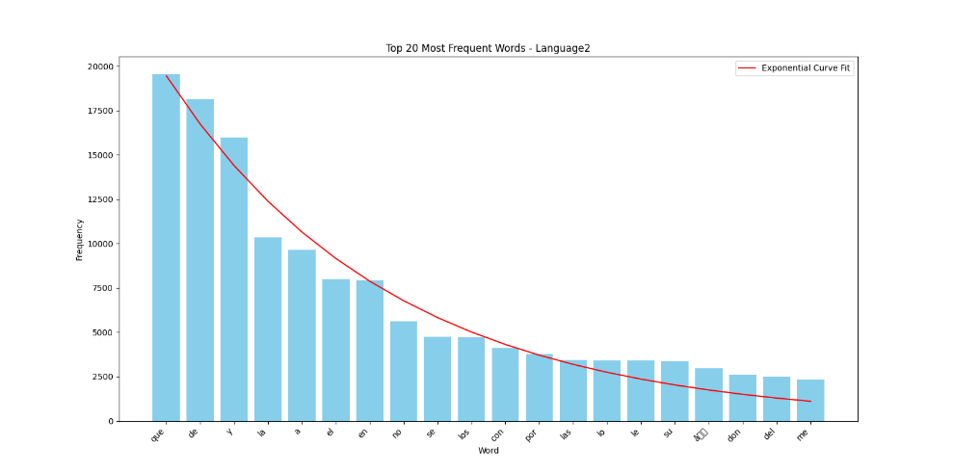
Representation of Frequency and Rank

Slide 5
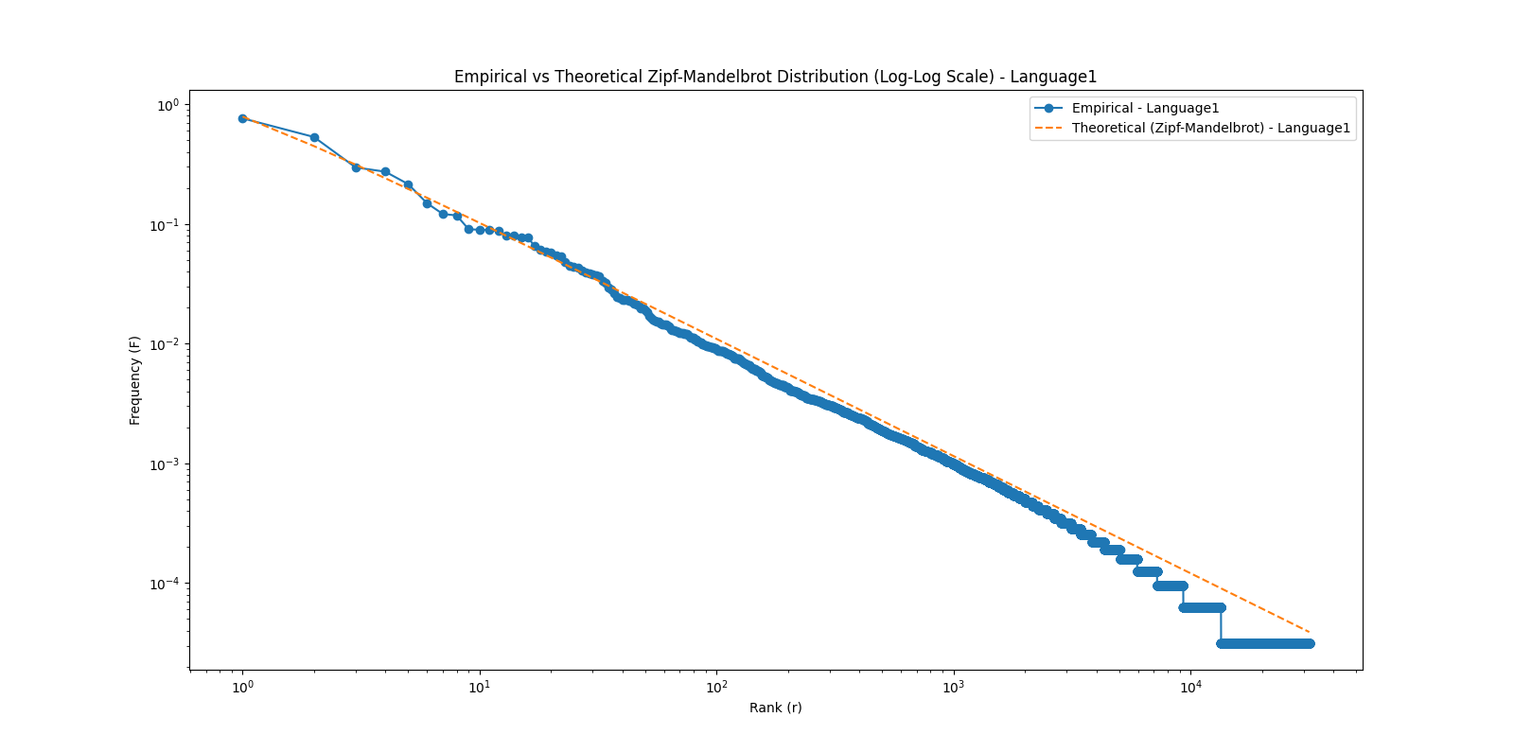
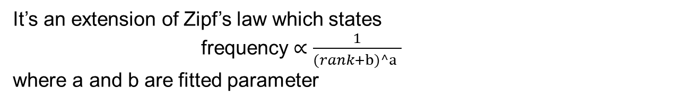
Zipf-Mandelbrot Law
It’s an extension of Zipf’s law which states
frequency ∝ $\frac{1}{(rank+b)^a }$​ where a and b are fitted parameter
a = 0.97968575, b = 0.27351501

Slide 6
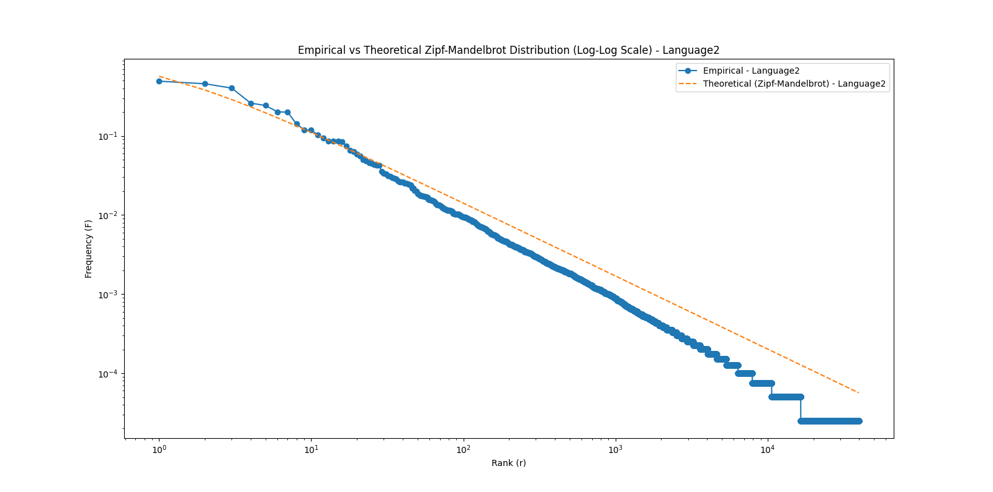
Empirical frequencies are calculated by dividing the frequency of each word by the total number of words in the dataset.
The formula used in the code to compute the theoretical frequency is: f(r)=1/(r+b)^a
a = 0.9233879, b = 0.84764076

Slide 7
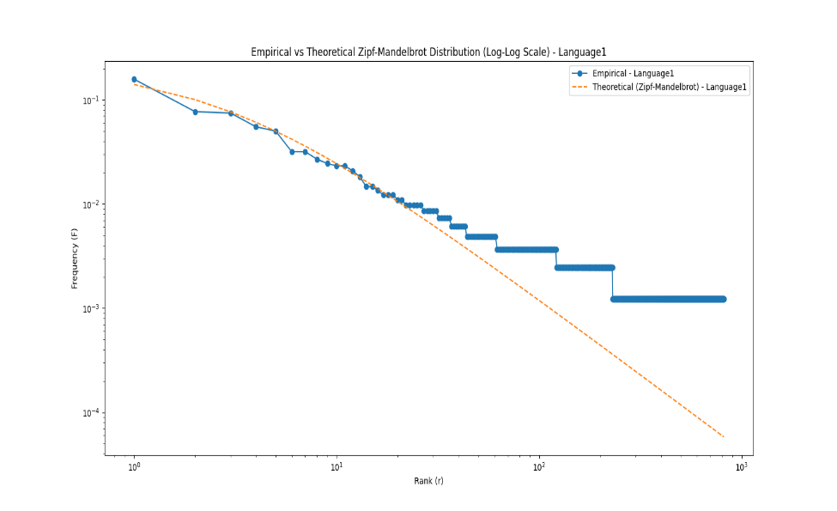
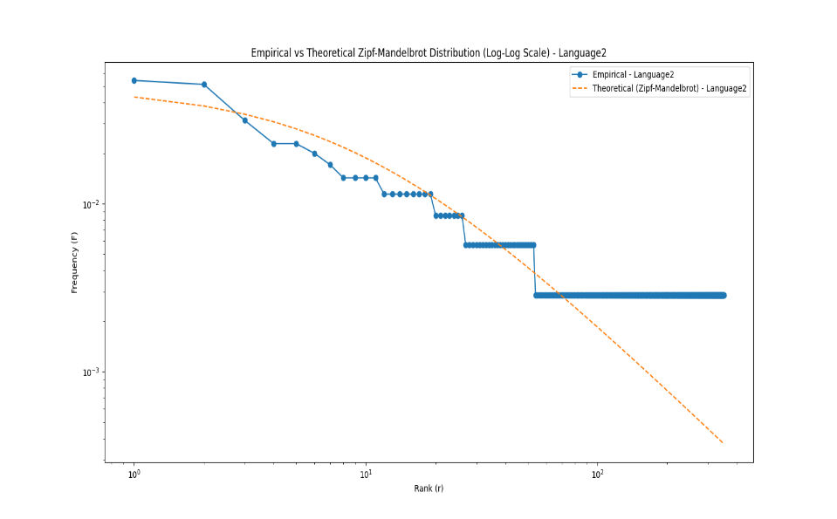
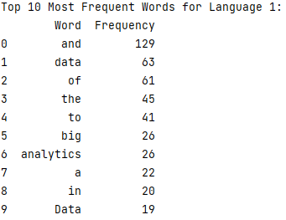
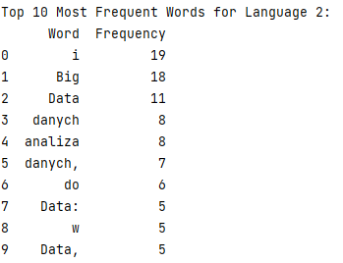
Here I implemented Zipf’s law for AI generated text on the big data analytics using English, Polish and Hindi
Fitted parameters for english(a, b): [1.45374937 2.8558311 ], Fitted parameters for polish (a, b): [1.34110006 9.41954713]
Fitted parameters for hindi(a, b): [1.14767216 5.16433284]

Slide 8
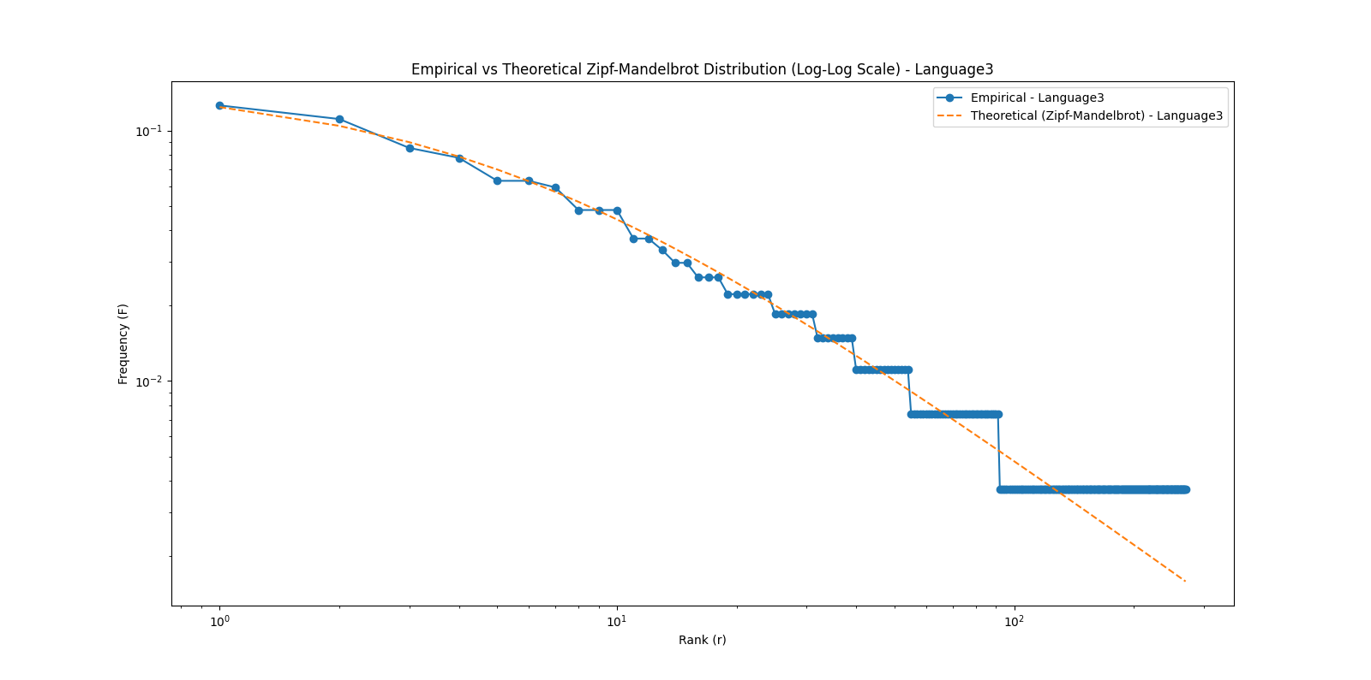
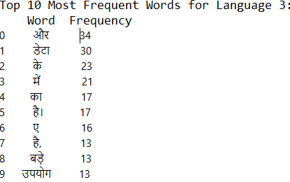

Slide 9
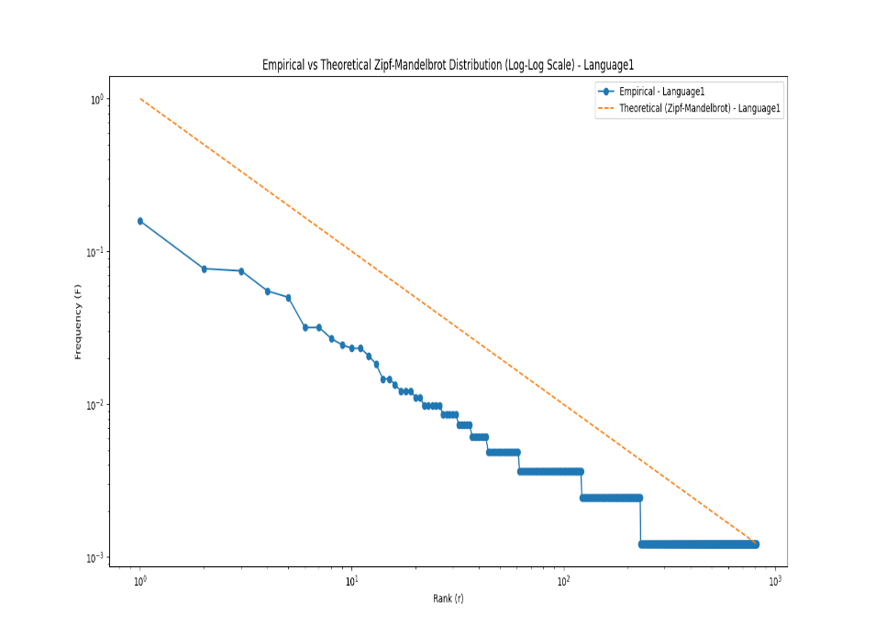
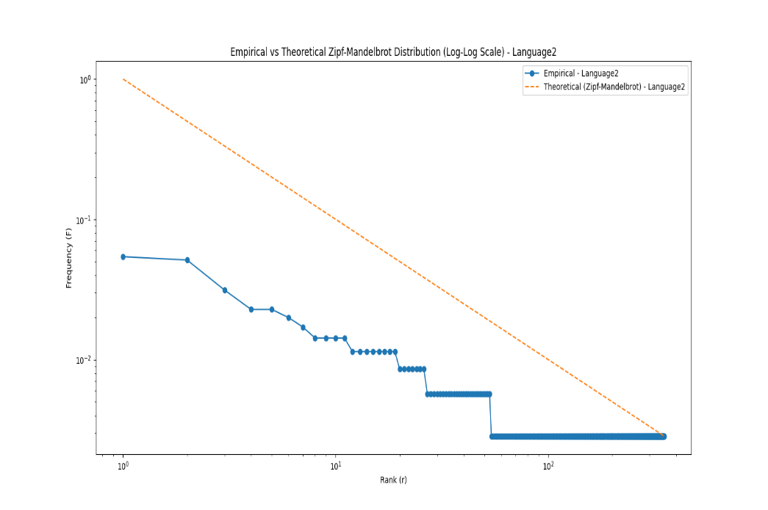
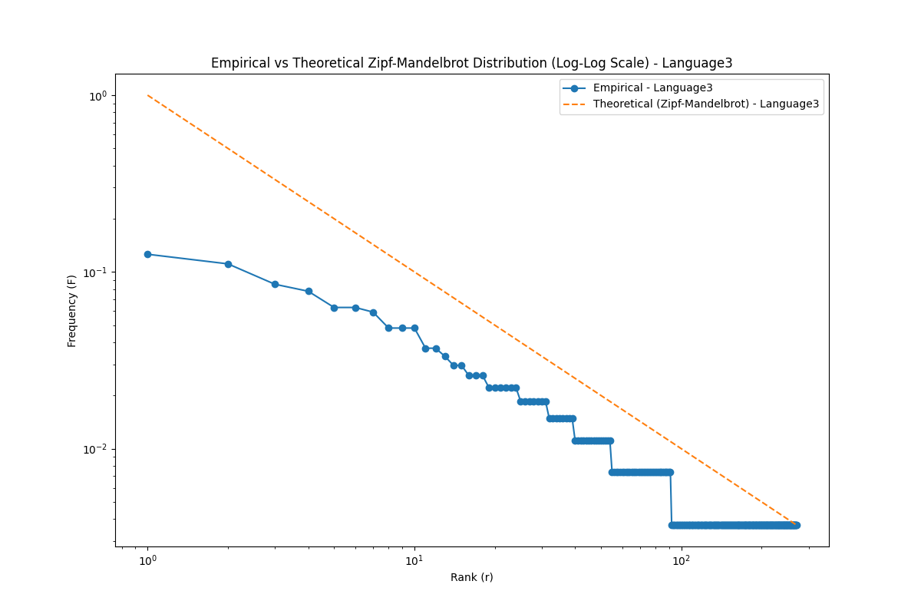

Slide 10
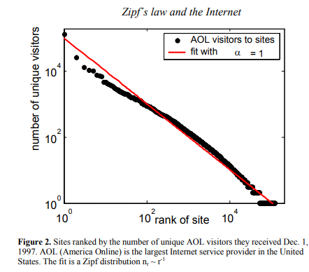
Applications of Zipf Law

Slide 11

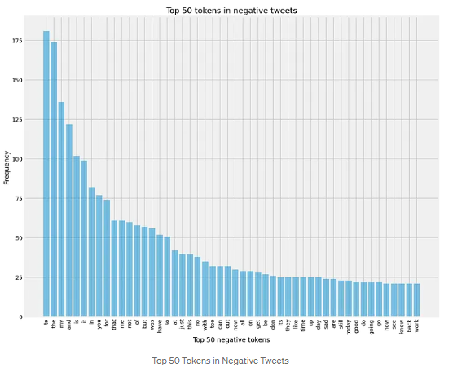
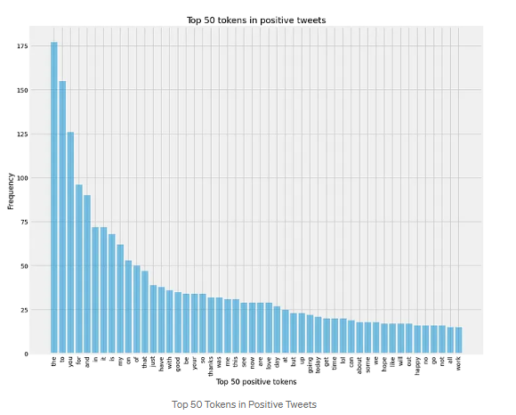
Sentiment Analysis

Slide 12
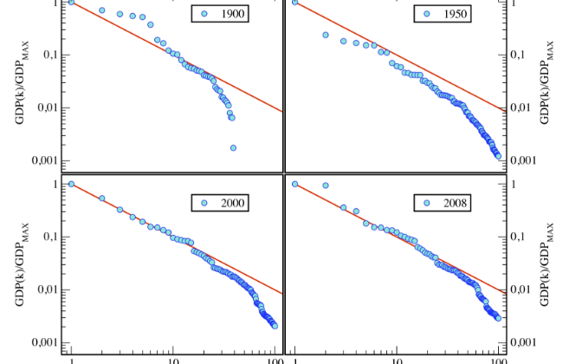
Zipf’s Law for National Gross Domestic Products

Slide 13
More Applications
Population (number of citizens) in cities.
The frequency of the names in the phone book.
Corporate income.
The number of companies in countries.
Principle of least effort.

Slide 14
Conclusion
While Zipf's Law provides valuable insights into the organization of complex systems, its exact mechanisms and applicability in different contexts remain subjects of ongoing research.
Despite debates and variations in application, the widespread occurrence of Zipfian distributions highlights their significance in understanding patterns of distribution and organization in natural and social systems

Slide 15
Refrences
https://en.wikipedia.org/wiki/Zipf%27s_law
https://www.nature.com/articles/srep00812
https://www.hpl.hp.com/research/idl/papers/ranking/adamicglottometrics.pdf
https://www.thoughtco.com/principle-of-least-effort-zipfs-law-1691104#:~:text=The%20principle%20of%20least%20effort%20is%20the%20theory,Least%20Effort%2C%20and%20the%20path%20of%20least%20resistance.
https://medium.com/techjingles/sentiment-analysis-part-3-19c00863c881

Slide 16
Thank you for your attention ☺

