Slide 1
Fractional CTO for Generative AI and AI
Fractional CTO provides both strategic vision and practical expertise
Build a technological roadmap,make technology decision and guide team.
Bring relevant technical expertise without full time commitment or cost
Provide expertise in
Generative AI, Large Language Model, Fine tuning
Machine Learning Modeling architecture, Training pipeline
Inference architecture set up
Vector Database
Data Lake, Data Warehouse and Data Engineering
Governance, Compliance, Data Quality

Slide 2
Determine which AI use cases have potential and should be adopted. Convert use cases to generative AI use cases including technical details.
What should we do to solve the specific business problem?
STRATEGY
STRUCTURE
Stakeholders
Define and Execute deployment
Integrate model, workflow in production
Set up MLOPS
Build PoC to prove technical and business feasibility - AI, GenAI, LLM
Productionize
Work with founders, investors , team
Feasibility
Build scope, roadmap and detail feature spec, architecture for training , finetuning, inference
Work with team to build data set for AI
deliver code for training and inference,
evaluate result
Scope and architecture
Development

Slide 3
Define and Build - Gen AI
Define Right Things
Build in Right manner
 | Ideas | Opportunity | Early concept | Business case | Featurer spec | Concept | Development | Testing | Many customer | Launch
MILESTONES | Determine evolving scenarios and dataset Market trends & insights Generate Ideas | Business strategy Customer & consumer benefit priorities Technology Readiness | Concept complete & validated Strategic alignment Business potential Early IP assessment | Rapid prototypes Tech feasibility complete Customer opportunity identified Business case | Product definition Customer commitment | Plan complete Prototype complete | Code complete CI-CD Built Automation Security check Static code analysis | Test Plan Test execution Automation Deployment script | Automated deployment Installer PAckaging | Deliverables sign off Production
CHECK POINTS | Validate desires | Validate viability | Validate feasibility | Get funding/ resources | Feature Spec Reviewed | Prototype Build | Development complete | Testing Complete | Package for many customers | Launch production

Slide 4
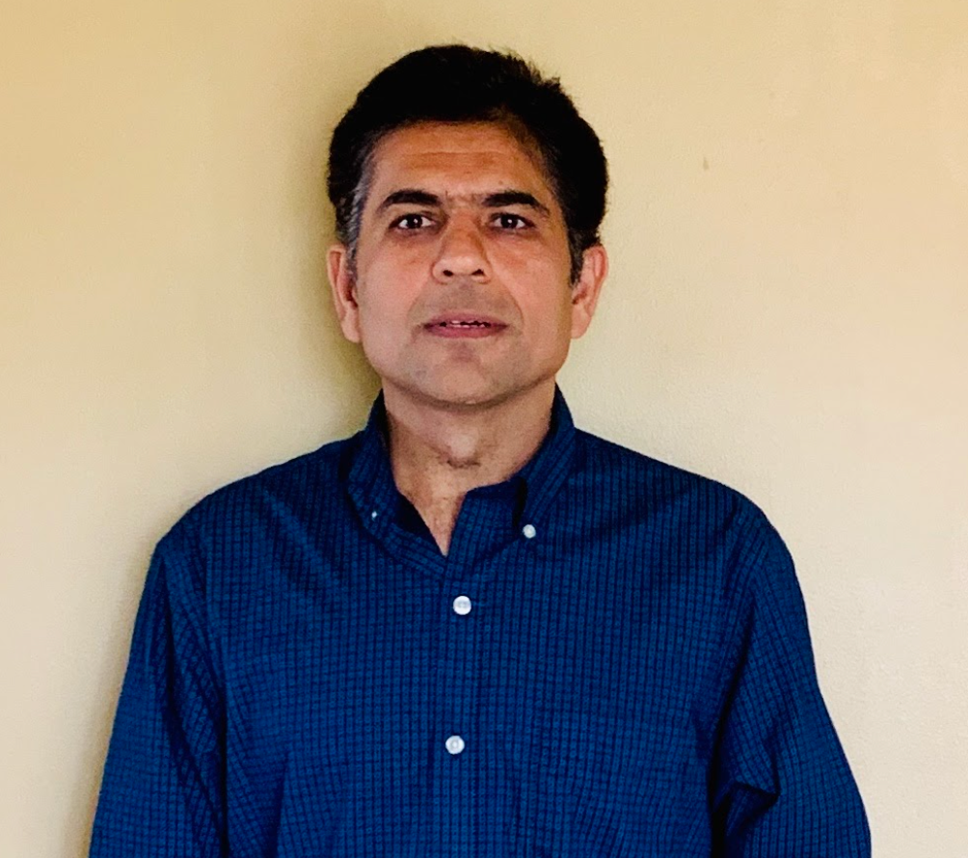
Prashant K Dhingra
Data Science & Engineering Executive
29 years Experience
Redmond, WA
BIO
Leadership
I have expertise in Engineering, Data science, Machine Learning, Data governance and privacy.
delivered 100+ ML projects.
worked on GCP, Azure and AWS
worked on Products, Data Products and services.
Data driven decision making
Servant Leadership
I simplify things for customers. My product teams and I solve complex problems ourselves and provide simpler and abstract interface to customers
Education
MS Data Science - UC Berkeley
Executive MBA - Quantic
B. Tech - TITS , India
Employer - Dataknobs.com
May 2022 - Startup - CTO and CDO
Jan 2019-May 2022 - JP Morgan Chase - Managing Director
Nov 2016-Jan 2019 - Google - Machine Learning LEad
Oct 2004-Nov 2016 - Microsoft - Principal
1993 - Oct 2004 - Steria, Wipro
Data Science
Product and Program Management
Software Engineering
SQL Server, Azure ML - Software product
Earning call analysis , Bing - Data Product
Cloud Architecture

Slide 5
Prashant Generative AI projects
Project Name | Company | Status
KREATE bot | Dataknobs | In development
KREATE | Dataknobs | In production
KONTROLS | Dataknobs | In development
Earning call analysis generation | JP Morgan Chase | In production
NLP to SQL | JP Morgan Chase | In production
Estimate car damage from car photos | Google -USAA | In production
English to Medical English translation | Google - ResearchSquare | In production
Flight landing anomaly | Google | In production
Prepare dataset for AI | Microsoft | In production

Slide 6
Prashant AI - Asset Mgmt Projects
Project worked on | Description
Predictive Monitoring | Monitor emergencies even when equipment fails. Implemented at National-Water-Center Dataset: Streamflow Link: Slides , Paper: Predict reservoir inflows Book:Machine Learning Research Paper to predict water flow in streams
Predictive Maintenance | Determine remaining life, when equipment will fail Link: Blog 1- Strategy Blog 2-Plan Blog 3 - Solution Youtube Video , Predictive Maintenance slides How to Lead ML projects
Industry 4.0 | Strategy for Industry 4.0 - Industry 4.0
Flight Landing anomaly | Implemented at Google. Determine which flight landing is anomalous. Use VAE to find an anomaly
Aircraft hijack risk | Implemented at Google - an anomaly in flight path behavior
Other | Identify when a software backup job will fail.
Automated Data Quality | Build a solution and wrote a paper at JP Morgan Link: Slide, additional information

Slide 7
Appendix

Slide 8
Product + Customer Experience
Infrastructure
decide which infrastructure, cloud, CPU/GPU/TPU are used with cost
Architecture
Select training, inference architecture
How Product is built
Integration, Data sources
Understand integration, data sources,pipeline, transformation, Algo
Output/Data generated
Data it generate for consumers
Market fit
How customer try
How customer evaluate
How do customer buy
Workflow for support
Working Product
Does product solve important problem
[building right things
Do we have right solution (Value prop]
Are we presenting it correctly [UX]
Free Trial
Demo
Workshop
How much effort it takes to set it up
Is there customization needed?
Does output work for customer
Does User + data + task align
Monthly subscription
Feature based
How do they request new feature/gaps
What if different logic/algo needed for different customer
Is there a feedback loop?
How do we measure satisfaction/value generated
How we support
How customer use it

Slide 9
Customer Journey Map
Awareness
Consideration
Acquisition
Service
Loyalty
Stages
Wants a news curation apps. Planning and analyzing is required
Discover landing page via search, compare apps
Browser features, gets trails, create accounts
Registers as paying user, receive activation email, updates accounts
Does not see the kind of news that interests
Applies filters & tags, sees the desired news
Receives offers for relevant events, discount for products, write review
Steps
Apps Discovery
Product Page
E - Shop
News Releases
Landing Page
Sign Up Page
Social media
All Features
Online Ads
Optimizations
Blog Content
Interaction
Personalization
User Experience
Emails
Engagement
Chat Options
Social Media
SMS Notifications
Reviews
Touchpoints
In App Purchase
Vendor Partners
Departments
2
3
4
2
5
4
3
Marketing
Design
Engineering
User Experience
Customer Success

Slide 10
Customer Journey Map
Stages
Pre-sales
Onboarding
Early Usage
Mature Usage
Support & Upsell
Sales Call
Training and Scope
Initial User
Major Rollout
Support
Steps
Trials
Get Setting
Develop Super User
User Forum
Feedback
Upsell
Wizard
Exam
Onboard
Intro
AM
AD
Proposal
CSAT Call
Phone
Website
Touchpoints
Scope
Training
Admin
Support
Training
Scope
Forum
Support
Did we answer your questions ?
Is there anything else you need ?
How are we doing ?
How did we serve your today ?
How are we performing ?
Is there anything else you need ?
Are there more feature required to add on ?
Do you have any other question ?
Would you recommend us based on your experience ?
Do you have any other question ?
CSAT Measures

Slide 11
30-60-90 DAY PLAN
Build right things, Build in right manner and Deliver at fast speed.
30
Understand and contribute
60
Agree approach for execution
90
Rhythm for execution
First month focus on understanding and contribution
Agree challenges, changes need and roadmap. Ensure team alignment.
Consistently delivering . Make standard for operations score
THEME:
THEME:
THEME:
Understand vision, customers & product
Prioritized list and execution
Success in Capital raising
Understand stakeholders, investor need
Have common data model, build
Customer success is bringing new customer
Understand architecture, technology
Investor : Focus on capital raising
Engineering & biz ops process set up.
Collect feedback and contribute to handle issues. Understand priority,
work with enterprises
Enterprise: Work with enterprises and onboard
Existing customers are gaining value. Position SQOR score as standard score/credit
Establish myself and company as thought leader
30 DAY PLAN
60 DAY PLAN
90 DAY PLAN
Author: Prashant K Dhingra

Slide 12
Questions
Next few slides have questions I will ask and use these for alignment
Value prop for customers/investors, market fit
How product built
How customer use it
How customer gain value
How it provide competitive advantage
How org structure is aligned for success
Notes:
Author: Prashant K Dhingra

Slide 13
Measure product & company competitive capability
VALUABLE
RARE
HARD TO IMITATE
ORGANIZED TO EXPLOIT
Valuable + Rare + Difficult to Imitate
Valuable + Rare + Difficult
to Imitate + Organized
to Exploit
How much Valuable + Rare
=
=
=
Temporary Competitive Advantage
Sustainable Advantage
Core Competence

Slide 14
Organizational responsibility for success
Productivity improvement
(bottom line)
Revenue growth
(top line)
Revenue growth
and productivity improvement
Financial Performance
Retain customers thru quality features
Sell to groups, large customers
Better value props to our customers
Customer Success
Operational
Products
Marketing
Sales
Processes, Architecture improvement
Technical & Process excellence
Do we have right team and skills?
Determine changes needed
Are performance
and accountability defined
Team alignment
Organizational structure
2

