Slide 1
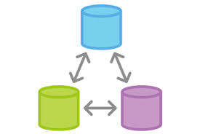
Need of Remote repositories
Remote repositories are needed, when more then one developer is working on the same project.
This single central repository act as a hub of communication and collaboration.
The remote repository which can be used efficiently with Git is “Github”.

Slide 2

Git-hub
GitHub is basically a “Git repository” web hosting service.
It’s a web-based application, which
can be accessed anywhere in the world
using internet.
If a project repository is stored in the GitHub, then it work as centralized repository, and can be used by multiple teams across the world.
It’s an ideal centralized repository for open-source projects.

Slide 3

Register with Git-hub
GitHub provides both public and private repositories services.
Public repositories are free, where private repositories are paid.
In order to use any Git service, first we need to register with the GitHub.

Slide 4


Social and watch feature of GitHub
GitHub works also act as a hub of communication between developers and contributors.
Follow-a-Friend feature:
This feature allow us to follow anyone on GitHub and can watch all it’s GitHub activity.
Watch feature:
Through this feature, any project can be watched i.e if there is any changed/update in the project, then GitHub automatically inform the Watcher.

Slide 5
Creating an empty repository on GitHub
In order to create a repository on GitHub use following steps:
Go to your repository section.
Click on “New” link to create a New repository.
Give Repository name and Description.
Click on “Create Repository” to create.

Slide 6
Secure Shell Cryptography
GitHub uses Secure Shell cryptography technique in order to securely connect a remote repository to Git repository.
This technique works on “RSA algorithm”. As per this algorithm, two keys needs to generate “public key” and “private key”.
The Public key resides on Centralized remote machine where private key on local machines.
If the Private key of local machine matches with the public key of remote machine, then connection can be made otherwise refused.

Slide 7
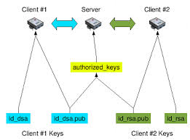
RSA – Key pairs

Slide 8
Generating SSH keys
Following are the steps to generate SSH-RSA key pair:
Open Git bash and run following command :
ssh-keygen -t rsa -b 4096 -C "jyoti@triconinfotech.com"
2. Enter the location in which these files will be saved (Default is fine!!!)
3. If you want to put one more security, on this RSA key, enter a “Passphrase”. This phrase will be asked every time we use RSA keys. (Press enter if don’t want to use this extra security).
4. A pair of RSA keys will be generated, one is public and other is private.

Slide 9
Adding public RSA key to GitHub
Following are the steps to add public RSA key to GitHub:
Login to your GitHub account.
Go to settings > Open SSh keys >Click on add SSH keys
Go to home/.ssh folder on your local repository and open public RSA id file using notepad/wordpad.
Copy public RSA key and paste it on GitHub.
Confirm password
In order to permanantly store this key with git hub run following command in Git bash :
ssh –T git@github.com

Slide 10
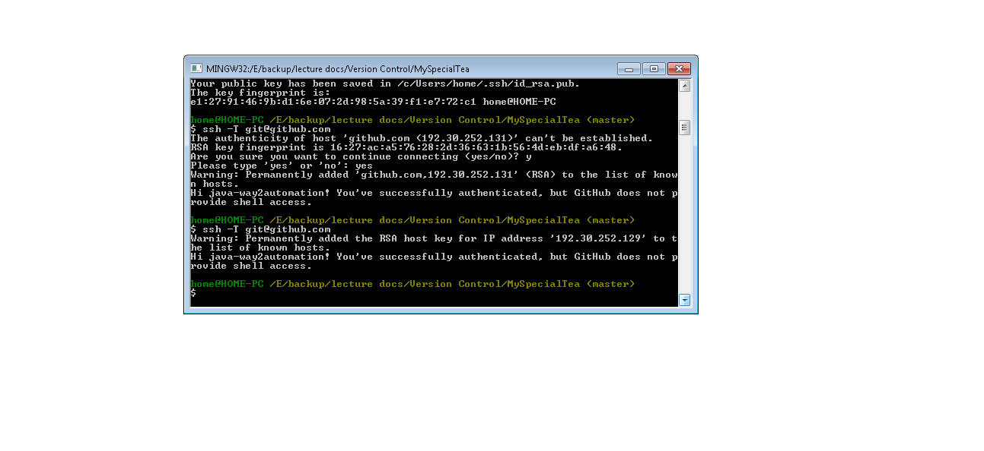

Slide 11
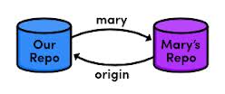
Adding remote repository to the project
In order to communicate with any remote repository, we need to add address of that repository to our project.
The address of remote repository can be added by following command :
git remote add gitHub <remote repository ssh key>

Slide 12

Pushing our code to the remote repository
In order to push our code to already added remote repository, following command is used:
git push <repository name> <branch name>

