Slide 1


Power Consumption Prediction
by Jyoti Sahu

Slide 2
Data Exploration
The dataset contains 52,583 entries.
Features are temperature, humidity, wind speed, diffuse flows, air quality index, cloudiness.
Target Variable is power consumption
The 'S no' column is dropped due to its insignificance.
Data Cleaning
Data Conversion
Data Exploration
Remove non-numeric characters from object columns.
Convert object columns like 'Temperature', 'Humidity', 'Wind Speed' to numeric data types.
Checked for null values and data types.

Slide 3



Preprocessing and Exploratory Data Analysis (EDA)
Outlier Visualization
Distribution Visualization
Outlier Handling
Used box plots to identify outliers in each column.
Used distribution plots to visualize the spread of values.
Used IQR method caps values at upper and lower bounds.

Slide 4
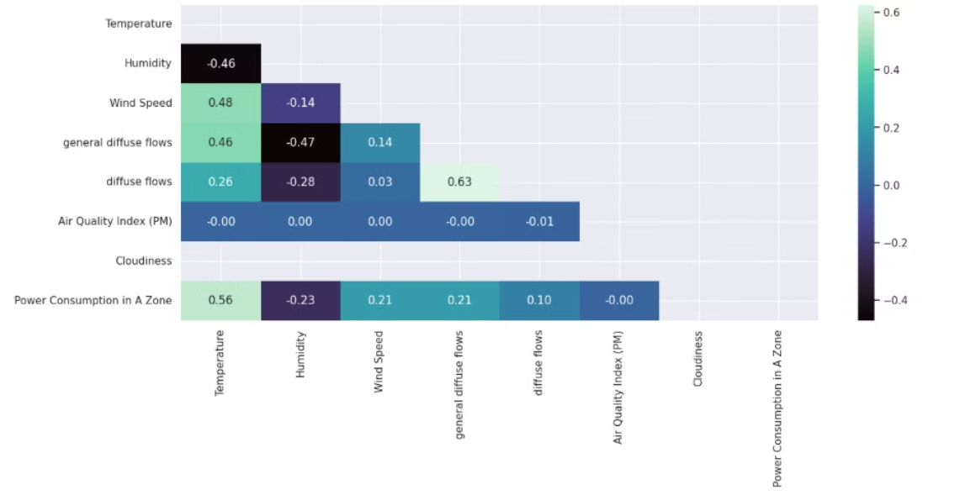
Correlation Matrix
The analysis revealed no significant correlation between the independent variables.
A weak correlation was observed between the target variable and the independent variables.

Slide 5
Model Building Preparation
1
Variable Separation
Separated independent (x) and dependent (y) variables.
2
Data Splitting
Divided data into training (80%) and testing (20%) sets.
3
Data Scaling
Applied StandardScaler to scale training and testing data to ensure all features have a similar range of values.

Slide 6
Model Building
Linear Regression
1
2
Random Forest
XGBoost
3
4
Adaboost
Bagging
5
6
Decision Tree
Gradient Boosting
7
8
KNN
SVM
9

Slide 7




Model Building: Linear Regression
Model Building
R-squared Score
Error Metrics
Build and train a Linear Regression model.
Assess model performance using R-squared score.
Quantify prediction errors using MSE and MAE.

Slide 8




Model Building: Random Forest
Model Building
Build and train a Random Forest Regressor model.
Hyperparameter Tuning
Optimize model parameters using GridSearchCV.
Cross-Validation
Address overfitting issues using cross-validation.

Slide 9



Model Building: Decision Tree
Performance Evaluation
2
Evaluate model using R-squared, MSE, and MAE.
Model Building
1
Build and train a Decision Tree Regressor model.
Pruning
Reduce overfitting by limiting maximum depth.
3

Slide 10
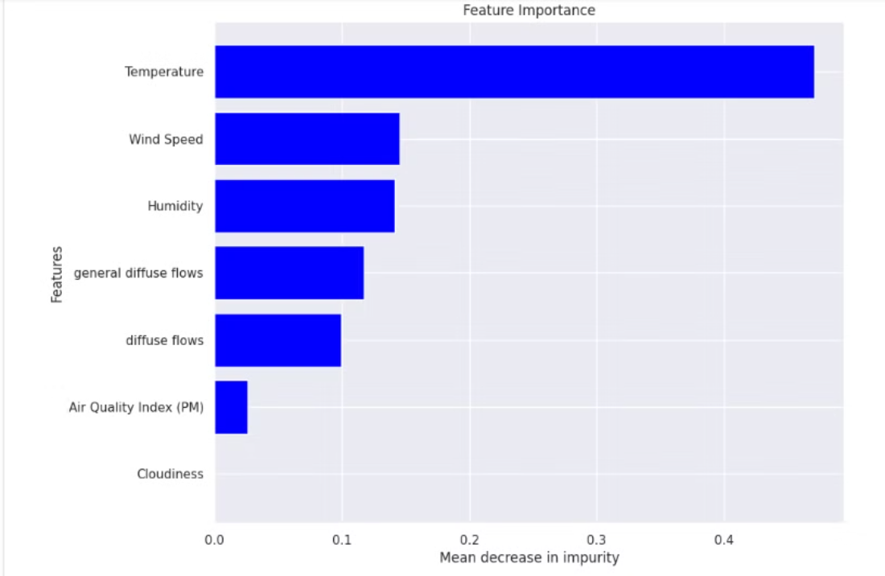
Feature Importance
Most influential features in predicting power consumption is Temperature.

Slide 11
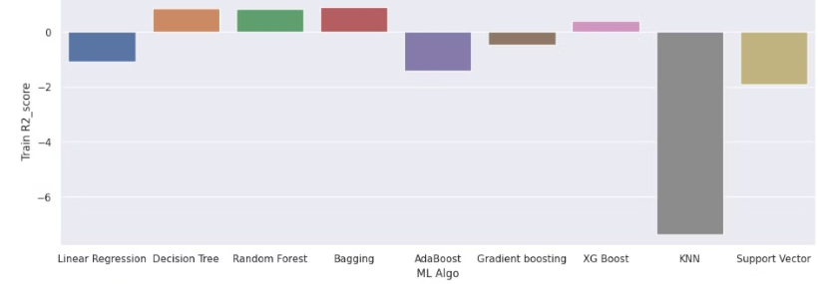
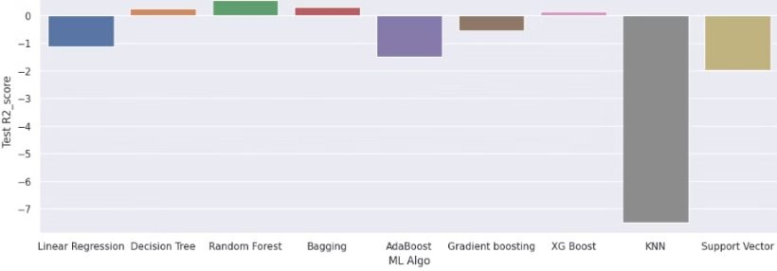
Comparing Models
Training Dataset
Test Dataset
R2 Score of Random Forest ML model : 0.835915
R2 Score of Random Forest ML model : 0.561606

Slide 12
Conclusion
Random Forest is the best model
No Multicollinearity & Neutral Correlation
Most Important Feature is Temperature

Slide 13


