Slide 1






Diabetes
Analysis
SQL Project
By- Jyoti Saraswat

Slide 2

Introduction:-
Diabetes is a chronic disease that occurs either when the pancreas does not produce enough insulin or when the body cannot effectively use the insulin it produces. Insulin is a hormone that regulates blood glucose.

Slide 3
PROJECT INTRODUCTION
This SQL project focused on analyzing a Diabetes dataset.
In healthcare, patient data is essential for understanding a person's health.
By using this data, doctors can make better decisions, create personalized treatment plans, and improve healthcare for everyone.
By harnessing the power of data analytics, we aim to extract valuable insights like patients having diabetes ,hbA1c level ,blood glucose level etc from the dataset.
Dataset Details :-
The dataset includes the following columns:
Employoee Name , Patient ID , Gender , D.O.B , Hypertension ,Heart Disease ,Smoking History ,Bmi ,hbA1c level ,blood glucose level , diabetes

Slide 4
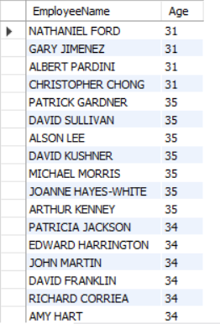
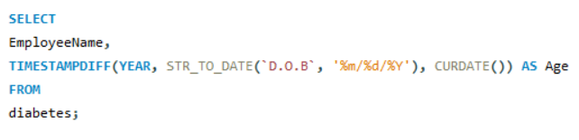
INSIGHTS
The Patient_id and ages of all patients.

Slide 5
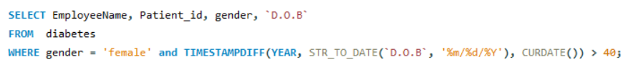
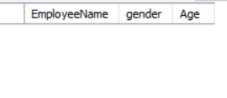
INSIGHTS
All female patients who are older than 40.
No Output
There are no female patients in the dataset whose age is greater than 40 . Hence the output is blank table.

Slide 6


INSIGHTS
The average BMI of patients

Slide 7
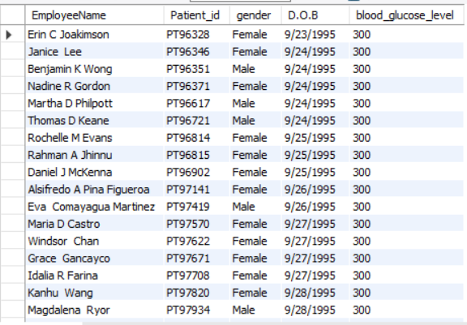
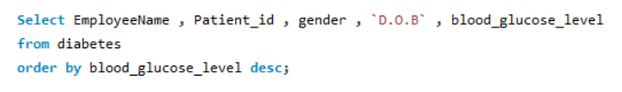
INSIGHTS
List of patients in descending order of blood glucose levels.

Slide 8
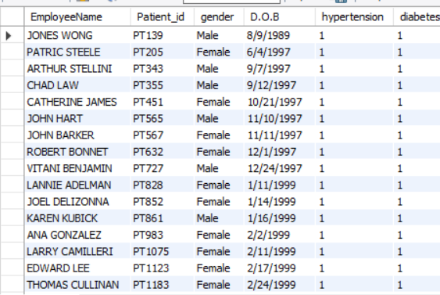
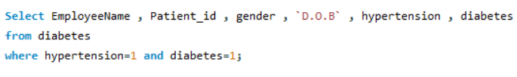
INSIGHTS
Patients who have both hypertension and diabetes.
2088 Patients have both hypertension & diabetes.

Slide 9
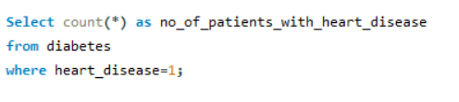

INSIGHTS
The number of patients with heart disease.

Slide 10
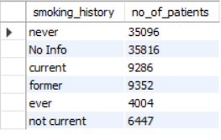
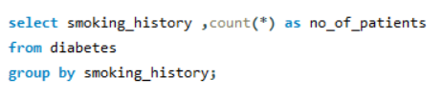
INSIGHTS
Group patients by smoking history and count how many smokers and non-smokers there are.

Slide 11
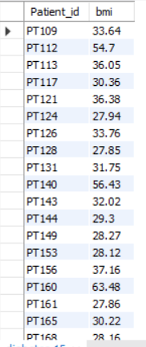

INSIGHTS
Retrieve the Patient_ids of patients who have a BMI greater than the average BMI

Slide 12
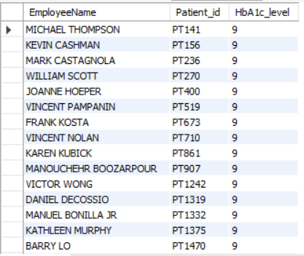
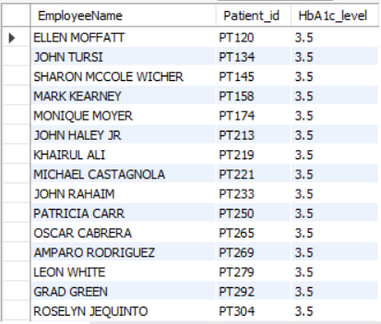
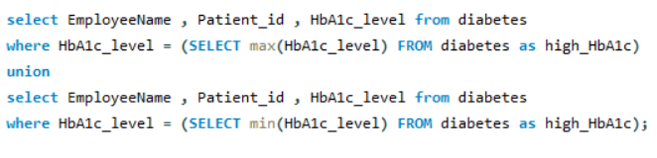
INSIGHTS
The patient with the highest HbA1c level and the patient with the lowest HbA1c level.

Slide 13
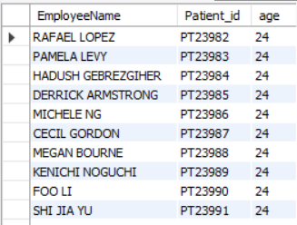
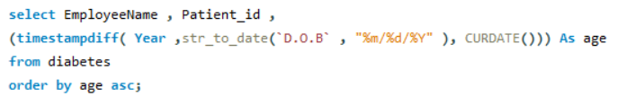
INSIGHTS
Calculate the age of patients in years (assuming the current date as of now).

Slide 14
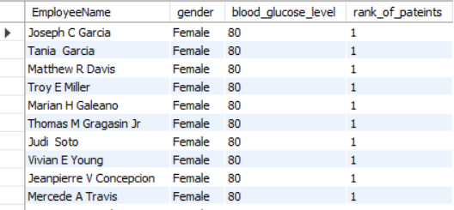

INSIGHTS
Rank patients by blood glucose level within each gender group.

Slide 15
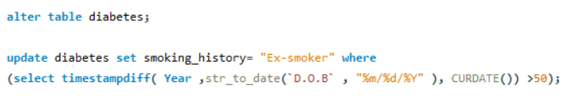
INSIGHTS
Update the smoking history of patients who are older than 50 to "Ex-smoker
There are no patient in the dataset where the age is greater than 50 , Hence the output is blank table.

Slide 16
INSIGHTS
Insert a new patient into the database with sample data.

Slide 17
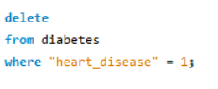
INSIGHTS
Delete all patients with heart disease from the database.

Slide 18
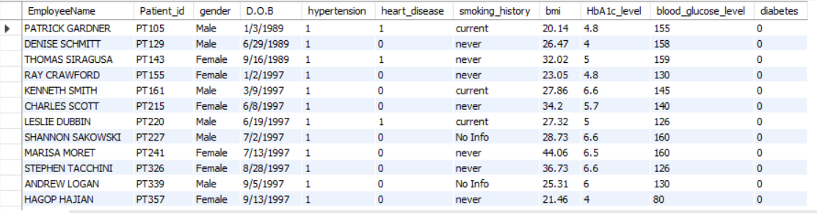
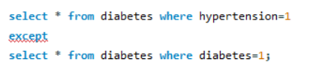
INSIGHTS
Patients who have hypertension but not diabetes using the EXCEPT operator.

Slide 19
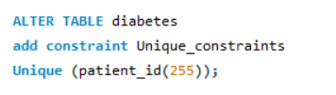
INSIGHTS
Define a unique constraint on the "patient_id" column to ensure its values are unique.

Slide 20
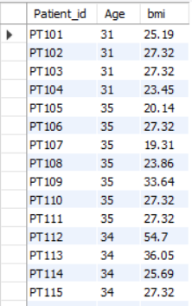

INSIGHTS
Create a view that displays the Patient_ids, ages, and BMI of patients.

Slide 21
INSIGHTS
Suggest improvements in the database schema to reduce data redundancy and improve data integrity.
Use of Primary Keys:
Each table should have a primary key that uniquely identifies each record to ensure data integrity.
Foreign Keys:
Establish relationships between tables using foreign keys to enforce referential integrity.
Data Types:
Avoid using TEXT or BLOB types for fields that can be represented with simpler data types like VARCHAR or INT.
Normalization:
Break down the data into smaller, more manageable tables to eliminate redundancy and dependency issues.

Slide 22
INSIGHTS
Explain how you can optimize the performance of SQL queries on this dataset.
Avoiding SELECT * and unnecessary columns:
By Using appropriate join strategies such as INNER JOIN, LEFT JOIN, or EXISTS based on the relationship between tables and the desired result set.
By Using appropriate data types for columns to minimize storage space and improve query performance & Avoid storing large data types (such as BLOBs or TEXT) in columns unless absolutely necessary.
By Using the LIMIT clause to restrict the number of rows returned by a query, especially for queries returning large result sets.

Slide 23
THANK YOU

