Slide 1
Probabilistic Modeling of Network Congestion and Queue Delay
Section 2 Group -7
Milestone -2
Yashika Ashar - AU2440182
Jyotier Vithlani - AU2440170

Slide 2
Probabilistic Modeling of Network Congestion and Queue Delay
Queueing Theoretic Framework Using M/M/1 Model
Formal stochastic modeling of packet delay
Congestion analysis using probability theory
Analytical + simulation validation

Slide 3
Objective of the Model
Why Probabilistic Modeling?
    Network nodes (routers/switches) experience random traffic
    Exact arrival counts and delays are uncertain
    Need a mathematical framework to quantify uncertainty
Objective:
Model packet arrivals
Model processing time
Derive queue length and delay
Analyze congestion onset

Slide 4
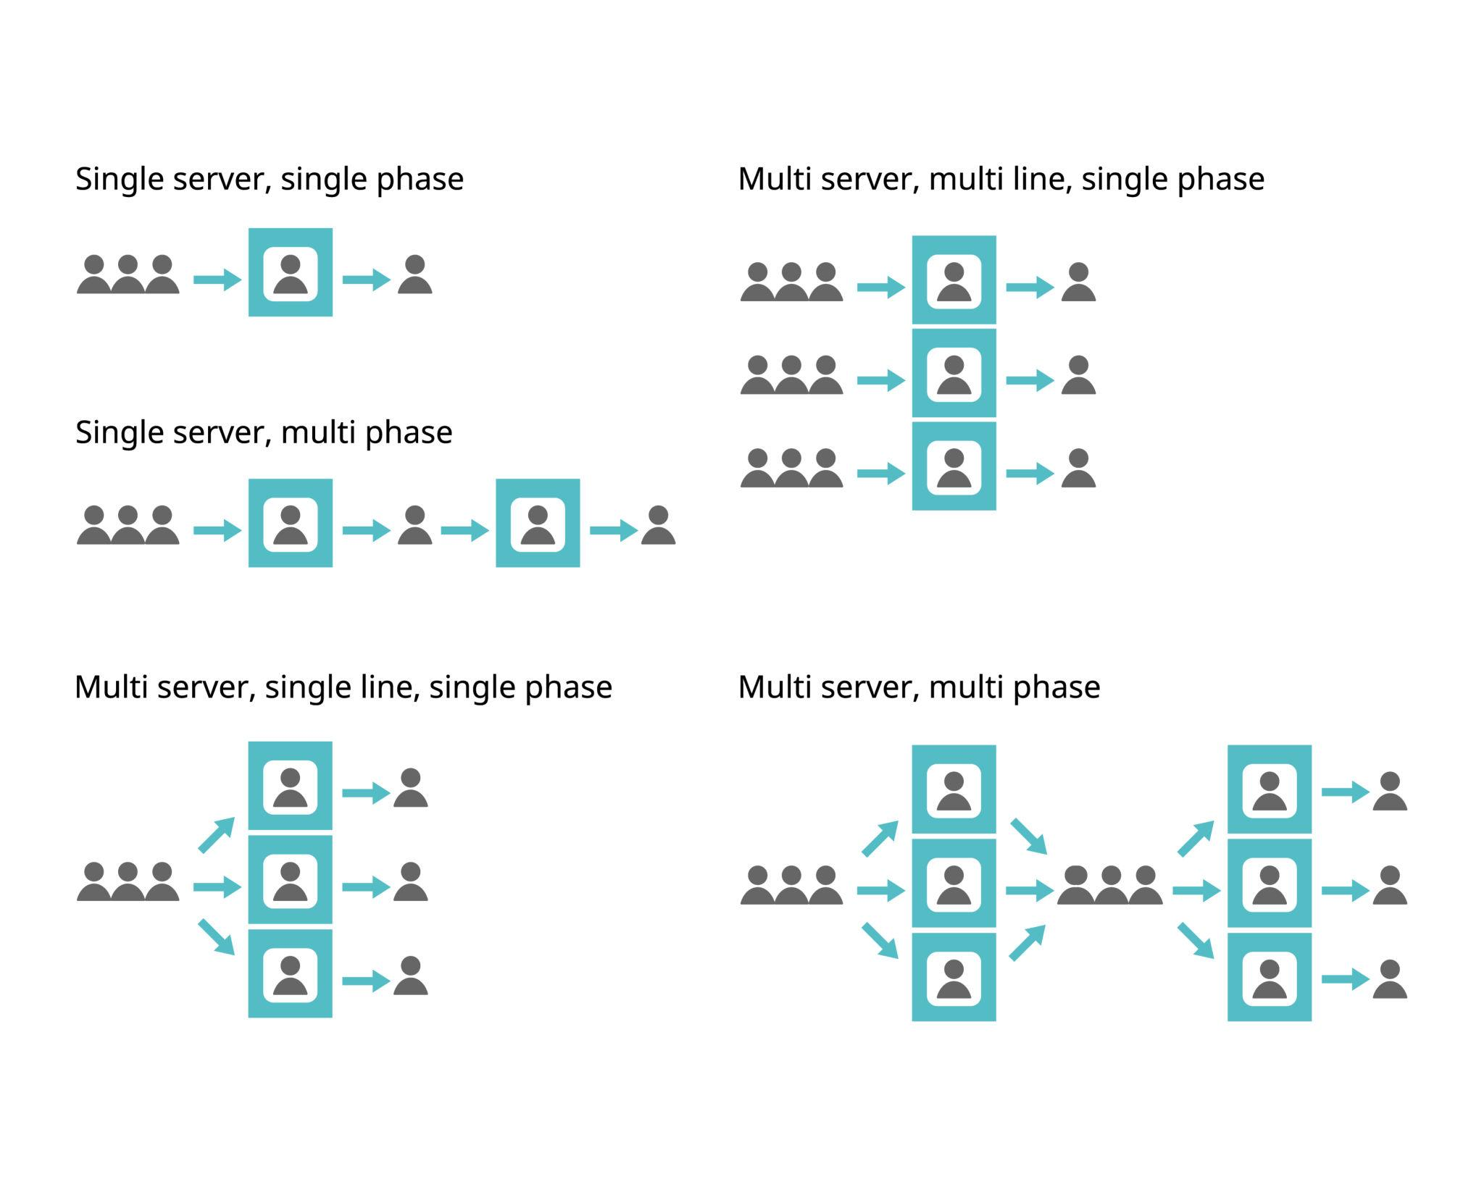
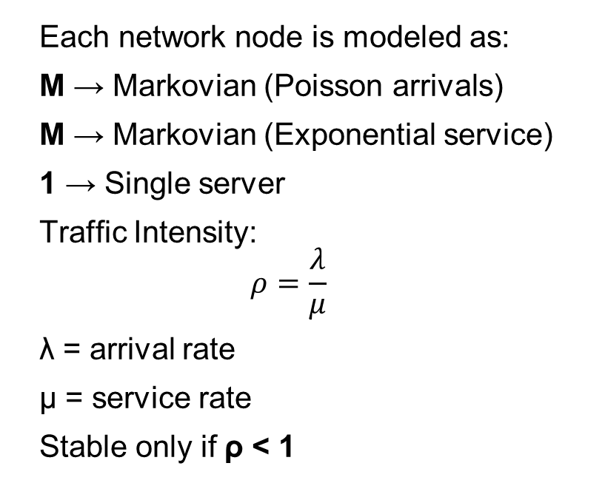
M/M/1 Queue Framework
Each network node is modeled as:
M → Markovian (Poisson arrivals)
M → Markovian (Exponential service)
1 → Single server
Traffic Intensity:
$$ρ=\frac{λ}{μ}$$
λ = arrival rate
μ = service rate
Stable only if ρ < 1

Slide 5
How Randomness Leads to Congestion
Packet arrivals and service times are random variables
Even if average arrival rate < service rate, temporary bursts still occur
Random arrivals cause:
  Packet buildup in queues
  Variable waiting time
  Occasional congestion
This randomness is why probabilistic modeling is essential
Leads naturally to analyzing:
  Queue length distribution
  Waiting time and delay

Slide 6
Key Random Variables
Random Variable | Type | Distribution | Parameter
Packet arrivals (X) | Discrete | Poisson | λ
Inter-arrival time | Continuous | Exponential | λ
Processing time | Continuous | Exponential | μ
Queue length (N) | Discrete | Geometric | ρ
Total delay (W) | Continuous | Exponential | μ − λ
Drop indicator (D) | Discrete | Bernoulli | p

Slide 7
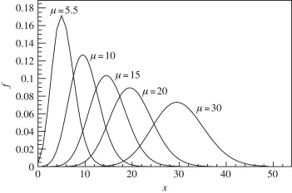
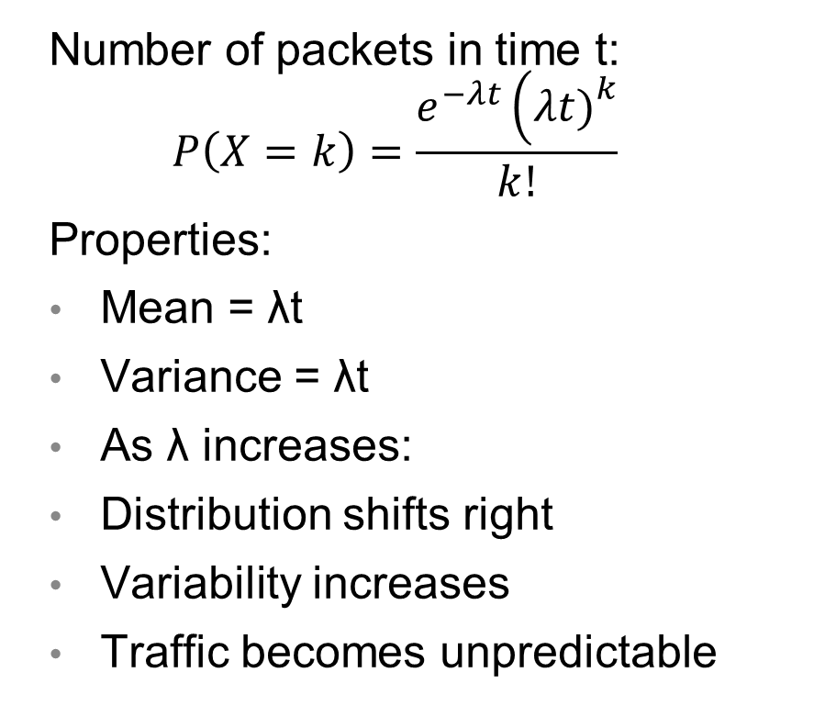
Poisson Distribution (Arrivals)
Number of packets in time t:
$$P\left(X=k\right)=\frac{e^{−λt}\left(λt{\left.)\right.}^{k}\right.}{k!}$$
Properties:
Mean = λt
Variance = λt
As λ increases:
Distribution shifts right
Variability increases
Traffic becomes unpredictable

Slide 8
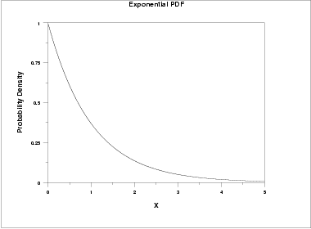
Exponential Distribution
PDF:
f(x)=λe^(-λx)
Mean:E[X]=1/λ
P(X>s+t∣X>s)=P(X>t)P(X>s+t|X>s)=P(X>t)P(X>s+t∣X>s)=P(X>t)
This makes M/M/1 mathematically tractable.

Slide 9
Queue Length Distribution
Under steady state (ρ < 1):
P(N=n)=(1-ρ)ρ^n
E[N]=ρ/1-ρ
Behavior:
ρ=0.5=E[N]=1
ρ=0.9=E[N]=9
Non linear growth → congestion onset

Slide 10
Delay at a Node
Average waiting time:
E[Wq]=ρ/μ(1-ρ)
Total time in System:
E[W]=1/μ-λ
As ρ→1:
Delay → ∞
System becomes unstable

Slide 11
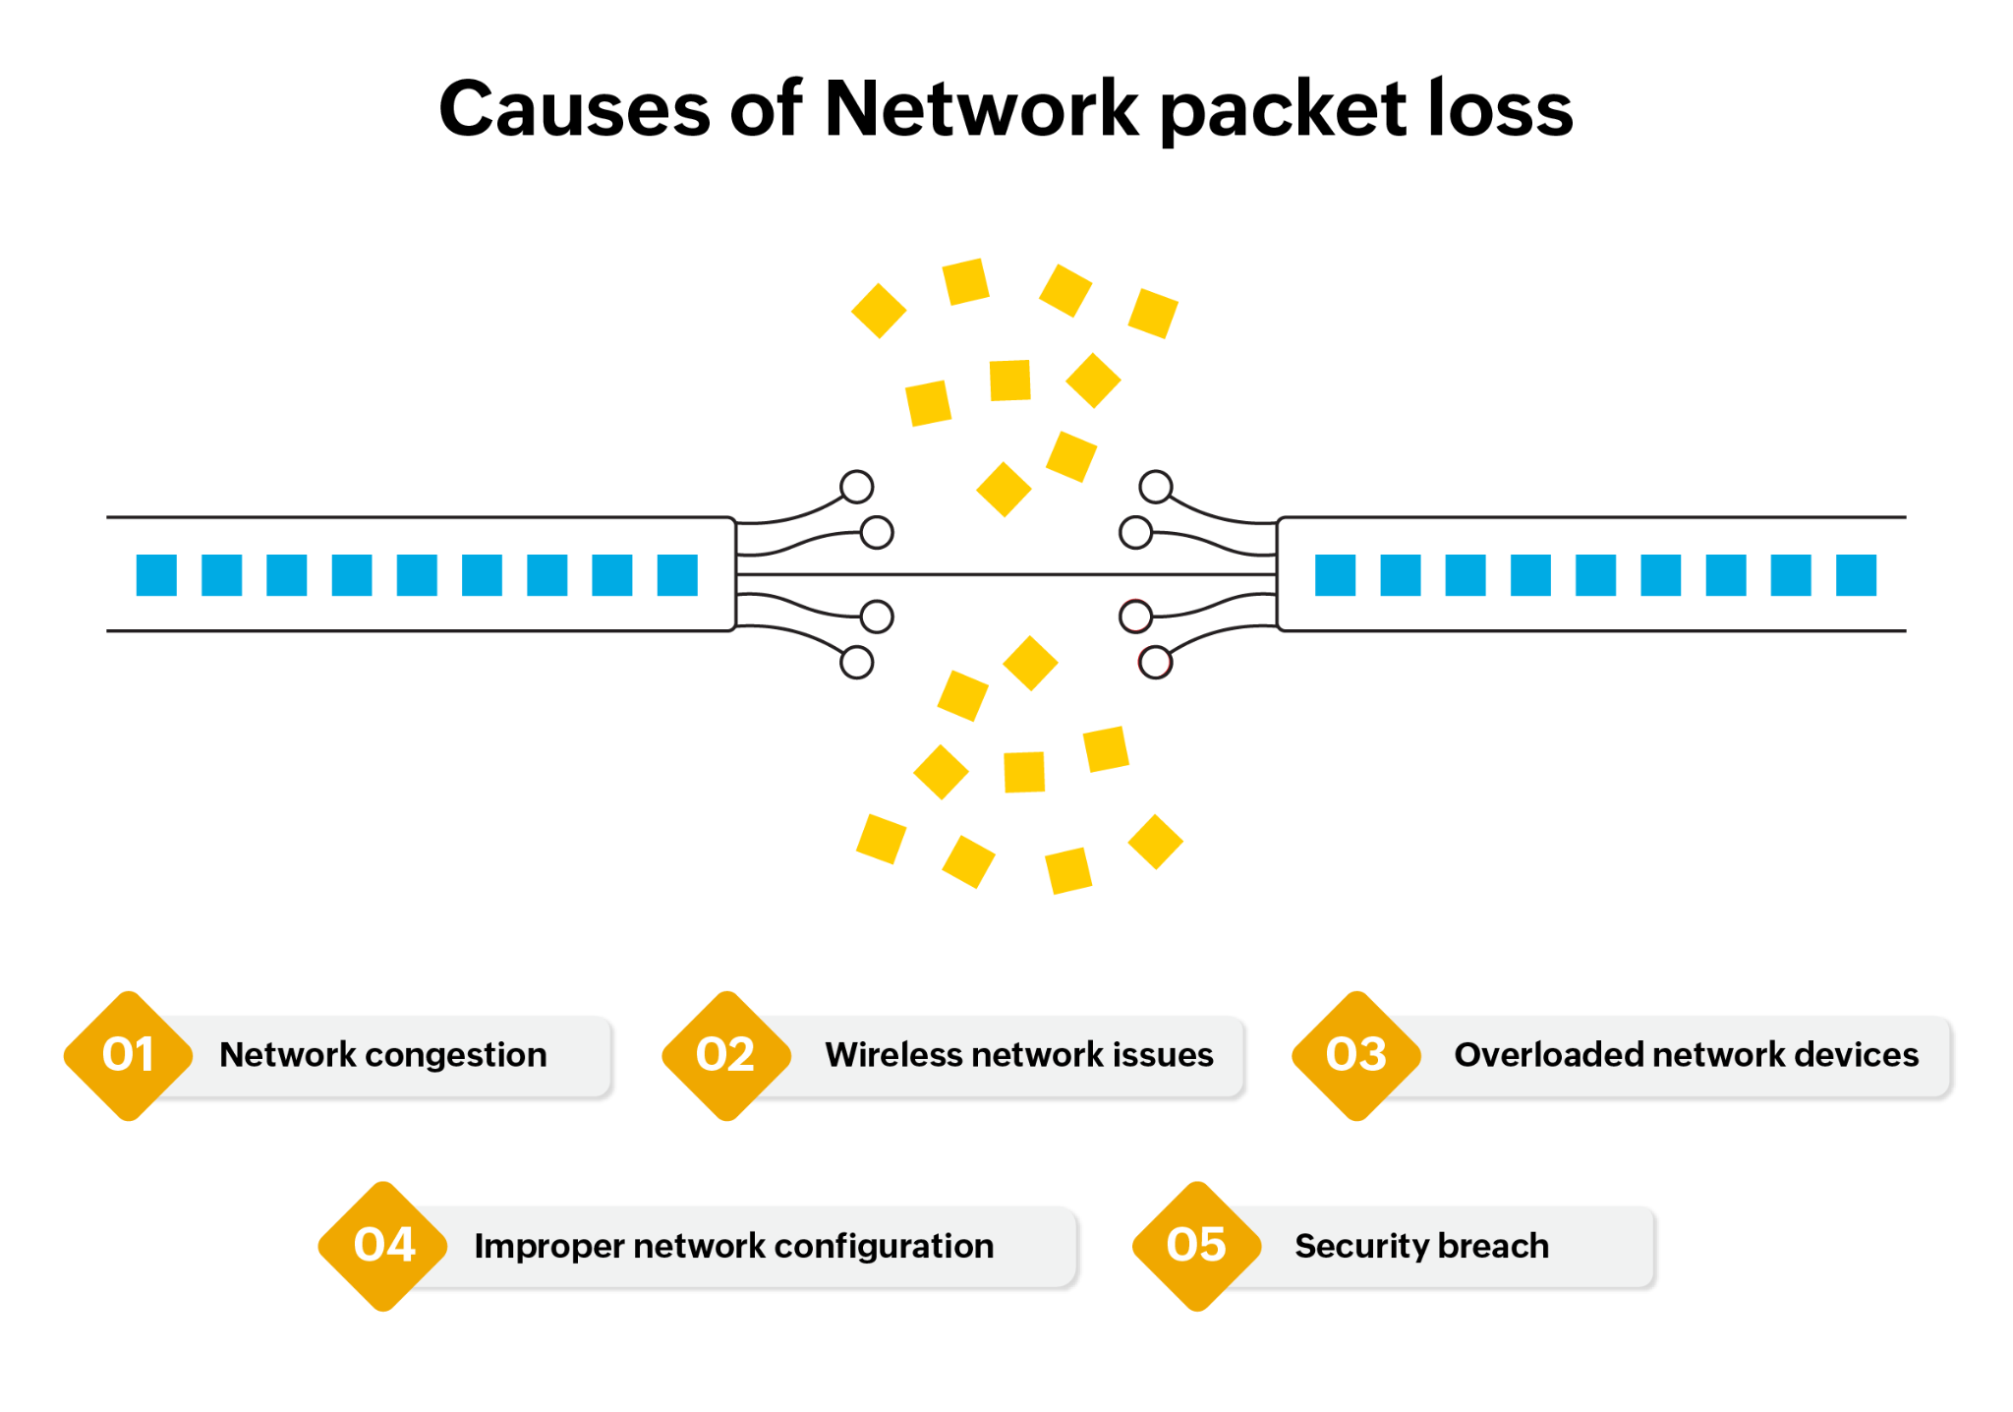
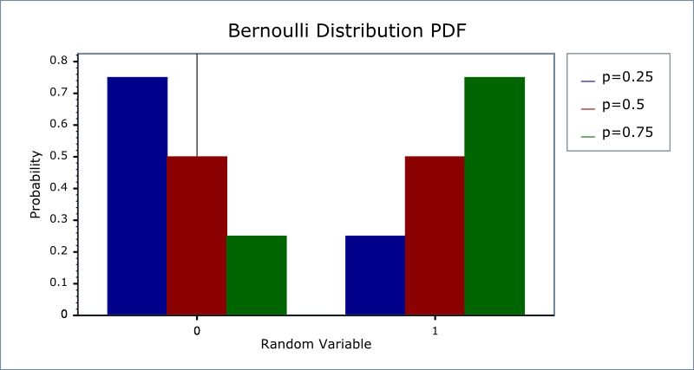
Bernoulli Model (Packet Drop)
Drop indicator:
P(D=1)=pP(D=1)=pP(D=1)=p
Mean:
E[D]=pE[D]=pE[D]=p
Variance:
p(1−p)p(1-p)p(1−p)
p increases as ρ increases.

Slide 12
Dependencies and Probabilistic Reasoning
Key dependencies:
N and W depend on ρ
Drop probability increases with congestion
Using PASTA property:
Poisson arrivals observe time-average state
Probability an arriving packet waits = ρ
Conditional delay:
If n packets present:
E[Delay]=n+1/μ

Slide 13
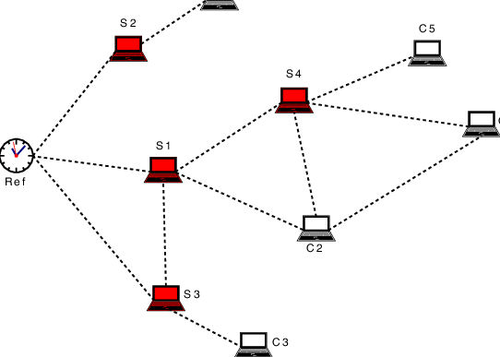
Multi-Node End-to-End Delay
Total delay across n nodes:
Wtotal=W1+W2+⋯⋯+Wn
Assumption:
Per-node delays approximately independent
Enables scalable end-to-end modeling.

Slide 14
Extensions and Open Issues
M/M/1/K finite buffer model
Derive drop probability analytically
Model bursty traffic
Simulation validation
Sensitivity analysis (ρ from 0.1 to 0.99)
Traffic intensity ρ is the unifying parameter:
ρ=λ/μ
As ρ increases:
Queue length ↑
Delay ↑
Drop probability ↑
All in mathematically consistent manner.

