Slide 1
Probabilistic Modeling of Network Congestion and Queue Delay
Section 2 Group -7
Milestone -3
Tanmay Kanani - AU2440234
Krisha Desai – AU2440103

Slide 2
Project Context and Motivation
Context:
Network routing requires packets to travel through multiple intermediate nodes.
When many packets arrive at nodes simultaneously, queues are formed.
Why Uncertainty Exists:
Multiple packets move through the network at the same time.
Queue length at each node changes dynamically.
Waiting time depends on the current queue size and service rate.

Slide 3
Project Objective and Deterministic Baseline
Exact Objective:
Measure and compare total queue delay experienced by packets when routed through the network.
Deterministic Baseline strategy:
Routing decisions are fixed using shortest-path algorithms:
Dijkstra’s Algorithm
A* Search Algorithm
Packets always follow the computed path.
Queue Handling:
Each node maintains a FIFO queue.
Queue delay is calculated for each packet at every node.

Slide 4
System Pipeline Overview
System Architecture:
Network represented as a graph
Nodes = routers, edges = communication links
Simulation Pipeline:
Generate a fixed number of packets
Compute shortest path using Dijkstra or A*
Packets move through nodes along the path
Queue delay is calculated at each node
Where Uncertainty Enters:
Multiple packets may reach nodes at the same time.
Queue length changes dynamically

Slide 5
Sources of Uncertainty
Variability in the System:
Different packets may reach nodes at similar times.
Queue length changes depending on network load.
Modelling Uncertainty:
Waiting time depends on the number of packets already in the queue.
Interaction between packets creates unpredictable delays.
How uncertainty is simulated:
Multiple packets are processed simultaneously.
Queue delay is computed dynamically based on queue size.

Slide 6
Key Random Variables
Queue Length (Q):
Number of packets waiting in a node queue.
Queue Delay (D):
Waiting time experienced by a packet at a node.
Queue Delay = Queue Length / Service Rate (μ)
Packet Delay (T):
Total delay accumulated along the path.
Total Delay = sum of queue delays across nodes.
Role in Simulation:
These variables determine congestion level and overall packet delay.

Slide 7
Probabilistic Modeling with Deterministic Decisions
Mathematical Assumptions:
Network represented as a graph.
Nodes process packets with service rate μ.
Deterministic Decisions:
Routing path determined by Dijkstra or A*.
Packets follow fixed paths.
Delay Model:
QueueDelayᵢ = Qᵢ / μ
TotalDelay = Σ QueueDelayᵢ

Slide 8
Deterministic Baseline Logic
Baseline Strategy
Shortest path routing with FIFO queue processing at each node.
Step-by-step operation
Represent the network as a graph of routers and links
Assign queue delay weights to nodes
Compute shortest path using Dijkstra or A*
Packets follow a fixed deterministic path
Queue delays accumulate along the path
Routing decisions are deterministic with no randomization.

Slide 9
Simulation Implementation
Algorithm Used
Dijkstra’s Algorithm: minimum delay path
A* Search Algorithm: heuristic-guided shortest path search
Code Structure
QueueDelayGraph – build graph & compute delays
run_dijkstra() - priority queue based shortest path
run_astar() - heuristic-guided search
main driver – runs simulation
Pipeline Execution
Load network data
Build graph with queue delays
Run Dijkstra and A*
Record path, delay, expanded nodes, runtime

Slide 10
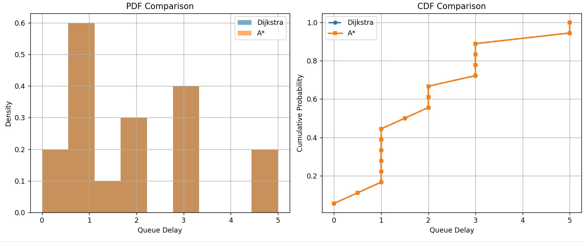
Results and Performance Analysis
Metrics
Total queue delay
Expanded nodes
Algorithm runtime
Computed routing path
Path length comparison
PDF/CDF plots
PDF - distribution of queue delays
CDF - cumulative delay probability
Most delays occur between 0 and 3 units, indicating moderate congestion.
Curves for Dijkstra and A* almost overlap since both find the same optimal path.

Slide 11
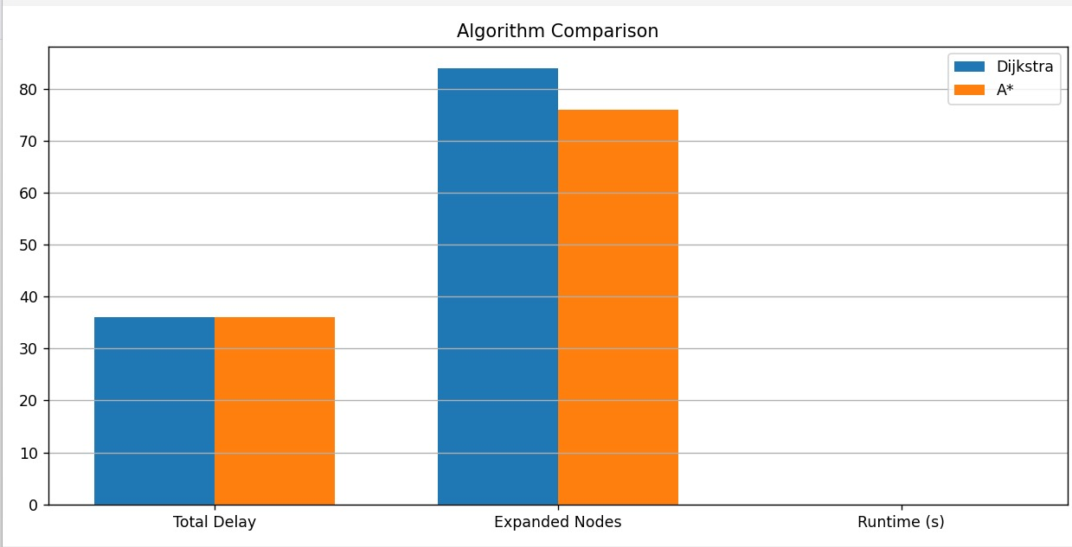
Observed behavior under deterministic baseline
Both produce the same optimal delay
A* expands fewer nodes than Dijkstra
More efficient search with similar results

Slide 12
Limitations of Deterministic Strategy
Key Limitations
Routing paths are fixed and deterministic
Algorithms do not adapt to changing congestion
Traffic may concentrate on specific nodes
Queue delays may grow under high load
Situations where baseline performs poorly
High network traffic
Congested routers along shortest path
Multiple alternative routes available
Dynamic or unpredictable network loads

Slide 13
Summary and Transition to Randomized Strategies
Key insights from deterministic simulation
Network routing can be modeled as a graph where edge weights represent queue delay.
Dijkstra and A* compute the minimum queue delay path from source to destination.
A* improves efficiency by reducing search space
Why a randomized approach may be useful next
Deterministic routing may concentrate traffic on the same shortest path.
This can create congestion and queue buildup at certain routers.
A randomized strategy could distribute packets across multiple paths.
This may help balance network load and reduce delays.

