Slide 1
S2_g7_net : Probabilistic Modeling of Network Congestion and Queue Delay
CSE400 : Fundamentals of Probability in Computing
Tanmay Kanani - AU2440234
Jyotier Vithalani - AU2440170
Yashika Ashar - AU2440182
Rudra Mehta - AU2440268
Krisha Desai - AU2440103
Instructor - Dr. Dhaval Patel

Slide 2
Background and Motivation
Course Perspective:
Network congestion is a direct application of probability theory
Concepts like Poisson arrivals, Markov chains, and stochastic processes apply here
Bridges theoretical probability with a practical computing problem
Real-World Perspective:
Every packet traversing the internet passes through multiple queues
Congestion causes delays in video streaming, cloud services, and communication
ISPs and data centers constantly deal with unpredictable traffic loads
Why This Problem Matters:
Traffic arrivals are random - deterministic routing cannot adapt
A probabilistic approach models uncertainty and enables smarter routing
Goal: minimize end-to-end delay under real-world unpredictability

Slide 3
Base Paper Overview
Paper: Bisnik & Abouzeid (2006) — Queuing Network Models for Delay Analysis of Multihop Wireless Ad Hoc Networks
Main Idea:
Models multihop wireless network as an open G/G/1 queuing network
Uses Diffusion Approximation to derive closed-form expressions for average end-to-end delay
Accounts for random packet arrivals, back-off mechanisms, and collision avoidance
Key Contributions:
Derives mean service time at each node
Obtains maximum achievable per-node throughput
Analytical results closely match simulation results
Connection to Our Project:
We adopt the same core model: queues with arrival rate λ and service rate μ
Extend it by comparing deterministic vs randomized routing under queue delay

Slide 4
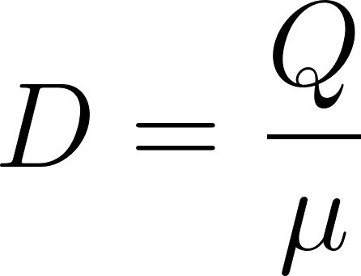
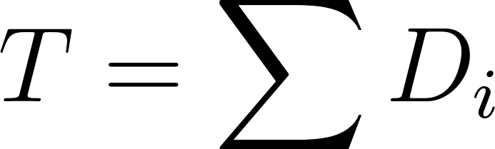
Problem Formulation
System Representation:
[ Source ]
↓
[ Node 1 ] → [ Node 2 ] → [ Node 3 ] → [ Destination ]
📦 📦 📦
Q1 Q2 Q3
Queueing Behavior:
Every node maintains a queue.
If Multiple arrivals come up, queue builds.
Packets served at rate μ.
Delay Modeling:
Node delay ≈
End-to-end delay:

Slide 5
Uncertainty, challenge and objective
Sources of Uncertainty:
Packet arrivals are random
Queue lengths change dynamically
Congestion varies across nodes
Key Challenge:
Same path may experience different delays over time
Deterministic routing does not adapt to congestion
Leads to traffic concentration and bottlenecks
Example Insight:
A congested path may still be selected
Alternative paths remain underutilized
Objective:
To minimize end-to-end delay.
Analyze routing under uncertainty.
Try to improve routing decisions.

Slide 6


Mathematical Model
Network modeled as a graph G(V,E).
Packets travel from source → destination through nodes.
Key Variables:
Arrival Rate: λ
Service rate: μ
Queue length: Q(t)
Queue delay:
Traffic Intesity:
Stability condition:
λ<μ → stable
λ≥μ → congestion

Slide 7

Deterministic Approach
Fixed routing using:
Dijkstra’s Algorithm
A* Search Algorithm
Packets follow single shortest path.
Assumptions:
FIFO queue at each node
Fixed number of packets
No randomness in decision
Delay calculation:
Limitations:
Traffic concentrated on one path.
Leads to congestion hotspots.

Slide 8
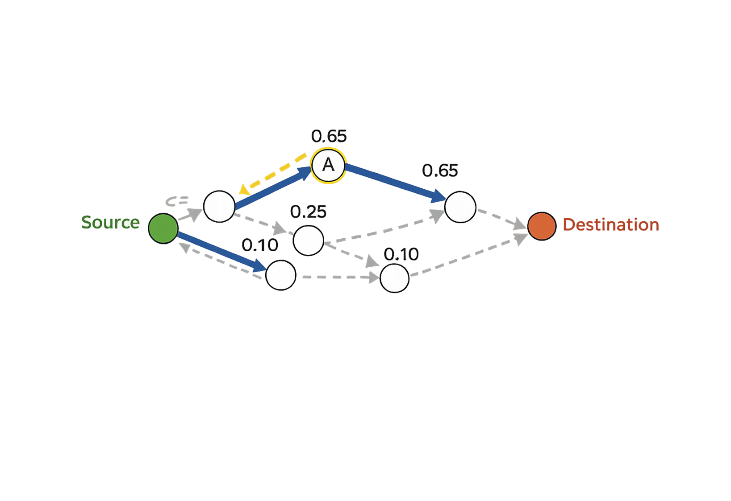
Randomized Approach
1.Stochastic next-hop selection
2.Softmax-based decision rule
3.Cost-aware probabilistic routing
4.Temperature-based control
5.Near-optimal path discovery
6.Route diversity under congestion
This approach does not always choose one fixed path. Instead, it selects paths probabilistically, where lower-delay paths have a higher chance of being chosen.

Slide 9
Coding & Simulation
1.Implemented in Python
2.Network modeled as a graph
3.Queue delay used as routing cost
4.Multiple trials performed
5.Compared with Dijkstra and A*
The complete model was implemented and tested through simulation. The randomized approach was evaluated by running multiple trials and comparing its delay performance with deterministic algorithms.
Input Network Data
Build Graph Model
Apply Routing Algorithm
Run Multiple Trials
Compare with Dijkstra & A*
Analyze Delay Results

Slide 10
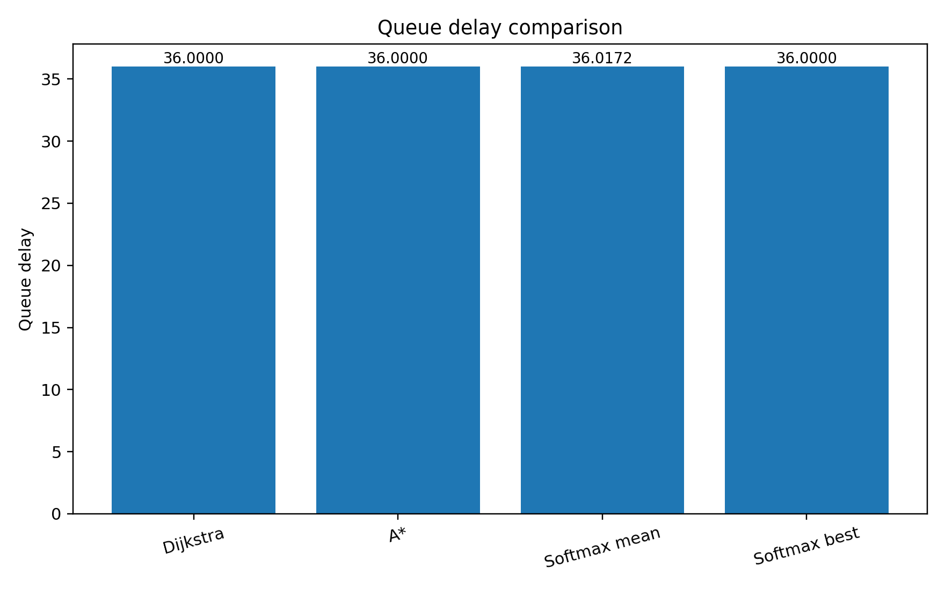
Results
Algorithm | Best Delay | Mean Delay | Nodes Expanded
Dijkstra | 36.0 | 36.0 | 84
A* | 36.0 | 36.0 | 76
Softmax τ =0.15 | 36.0 | 36.017 | 18
Softmax τ =0.30 | 36.0 | 36.088 | 18
Softmax τ =0.50 | 36.0 | 36.268 | 18
Softmax τ =0.80 | 36.0 | 38.337 | 18.7
Softmax τ =1.20 | 36.0 | 44.321 | 20.6
(τ = temperature - controls randomness in path selection)
• Deterministic methods achieve optimal delay = 36.0
• Softmax (τ = 0.15) achieves near-optimal performance (36.017)
• Very small difference shows effectiveness of randomized approach

Slide 11
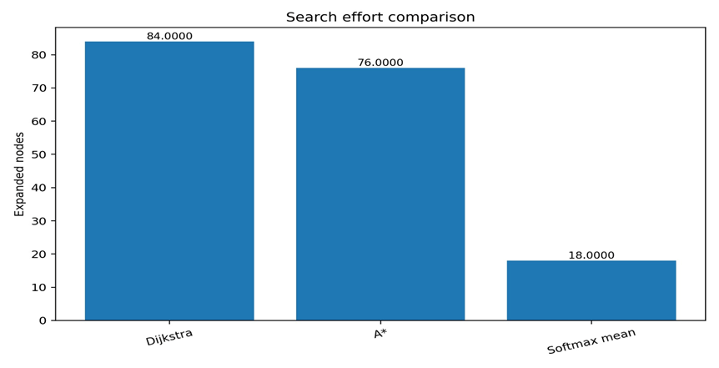
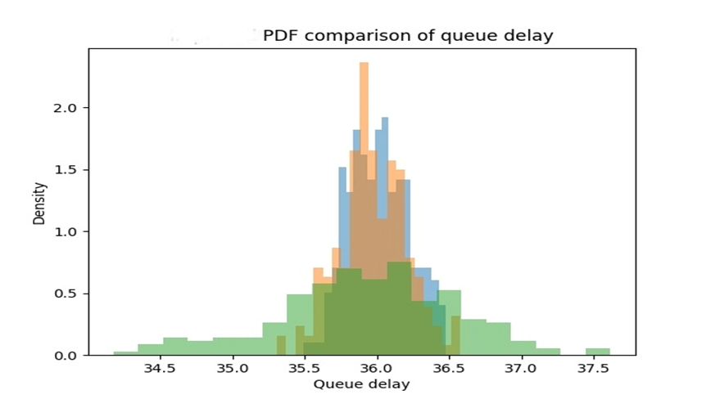
• Randomized approach reduces search effort significantly
• Most delays are concentrated near optimal value (36.0)
• High probability (~96%) of obtaining optimal path
• Increasing randomness increases delay variation

Slide 12
Inference – Domain Perspective
1. Nature of Real Systems
Queue lengths are uncertain and continuously changing
Arrival and service processes are not fixed
Fixed routing decisions may become inefficient
3. Exploration vs Efficiency
Always choosing one path can overload it
Exploring different paths helps balance load
Leads to better resource utilization
2. Need for Adaptive Routing
Systems must adjust decisions dynamically
Considering multiple paths helps avoid congestion
Improves overall system performance
4. Reliability in Practical Systems
System consistently reaches the destination
Maintains stable performance under uncertainty
Suitable for real-world dynamic environments

Slide 13

Inference – Computer Science Perspective
Deterministic Approach (Dijkstra)
Always selects minimum cost path
Single optimal solution
Efficient for static environments
3. Efficiency vs Exploration
Deterministic → fast but rigid
Randomized → flexible, multiple trials
Trade-off: optimality vs adaptability
Useful in dynamic systems
2. Randomized Approach (Softmax)
Uses probability distribution
Explores multiple paths
Controlled by temperature (τ)
Balances exploration & exploitation
4. System Behavior & Output
Deterministic → single path
Randomized → multiple paths
Avoids congestion
Better for real-world variability

Slide 14
References
Bisnik, Nabhendra & Abouzeid, Alhussein. (2006). Queuing Network Models for Delay Analysis of 1 Multihop Wireless Ad Hoc Networks. 773-778.

