Slide 1
BANK / CREDIT CARD FRAUD DETECTION
A Data Analytics & Machine Learning Project
Submitted by: Jyoti Kaushal

Slide 2
Problem Statement & Objectives
The Challenge
Credit card fraud causes major financial loss and erodes customer trust. Given 284,807 anonymized transactions, the goal is to classify each as Legitimate or Fraudulent using machine learning - despite fraud representing only 0.17% of all records.
0.17%
of transactions are fraudulent
Objectives
492 fraud vs 284,315 legitimate
Explore & clean real-world transaction data
Handle severe class imbalance correctly
Build and compare multiple ML models
Evaluate using Precision, Recall, F1-Score
Translate results into business recommendations
Binary Classification Task: Legitimate (0) vs Fraud (1)
2

Slide 3
Dataset Overview
284,807
31
0
1,081
Total Transactions
Total Columns
Missing Values
Duplicate Rows
Feature Composition
Key Observations
Time - seconds elapsed since first transaction
V1 to V28 - PCA-anonymized features (privacy protected)
Amount - transaction value
Class - target variable (0 = Legit, 1 = Fraud)
All 30 features are numeric - no categorical encoding needed
No missing values across the dataset
Data spans approximately 2 days of transactions
3

Slide 4
Project Methodology
Data
Understanding
→
Data
Cleaning
→
EDA
→
Preprocessing
& Split
→
Model
Building
→
Evaluation
& Comparison
→
Business
Insights
Two critical practices were followed throughout the pipeline:
Preventing Data Leakage - all preprocessing (scaling) fit only on training data
Stratified Train-Test Split - preserves the fraud-to-legitimate ratio in both sets (80% train / 20% test)
4

Slide 5
Data Cleaning: Duplicate Records
1,081 duplicate rows were found. Instead of removing them blindly, a class-wise breakdown was performed:
Class | Duplicate Count | % of Class Total
Legitimate (0) | 1,062 | 0.37%
Fraud (1) | 19 | 3.86%
Key Insight
Fraud transactions show a proportional duplication rate nearly 10x higher than legitimate transactions (3.86% vs 0.37%). Since fraud is already extremely rare, blind deduplication risks discarding valuable fraud signal.
Decision: Removal deferred - prioritizing preservation of the minority fraud class over routine deduplication.
5

Slide 6
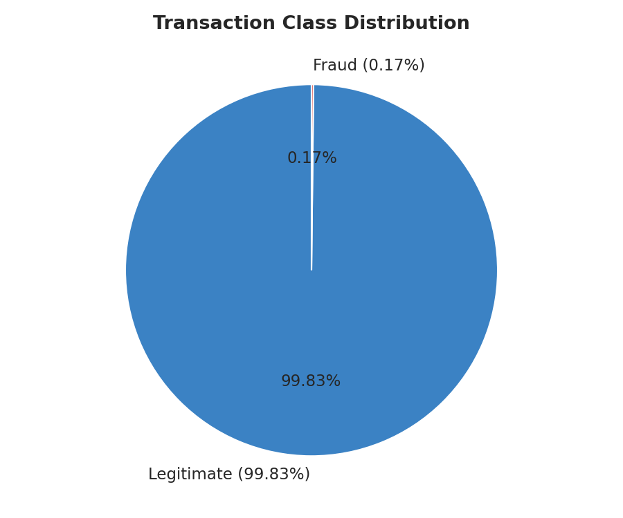
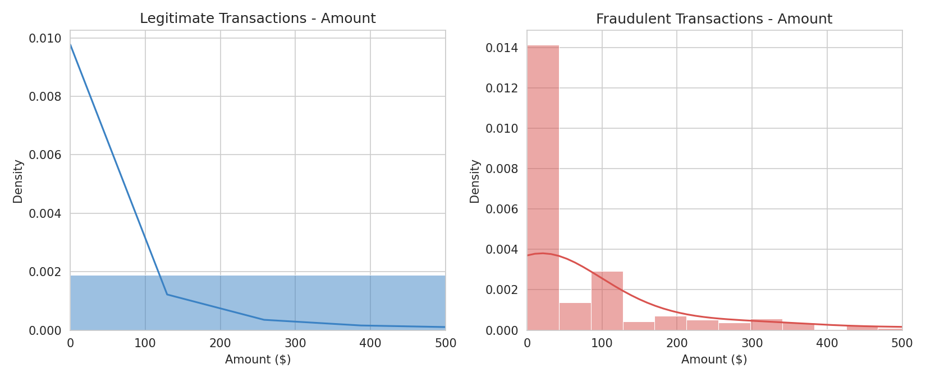
EDA: Class Imbalance & Transaction Amount
Observation
Fraud transactions have a higher mean amount ($122.21) but lower median ($9.25) than legitimate ones ($88.29 / $22.00) - suggesting fraudsters often use small “test” transactions before larger fraudulent charges.
6

Slide 7
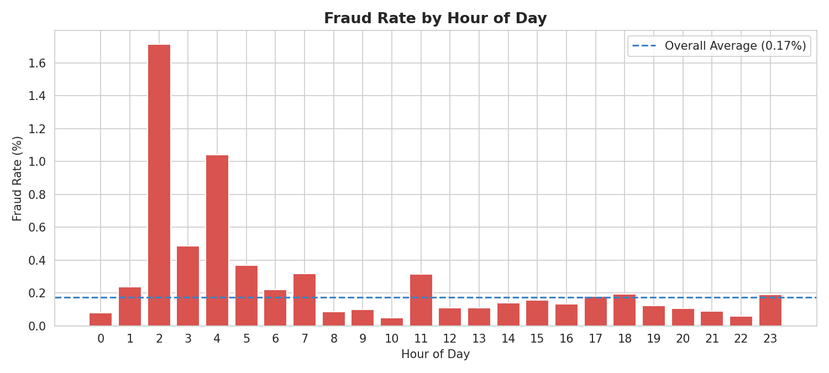
EDA: Fraud Rate by Hour of Day
Fraud rate peaks at Hour 2 (1.71%) - nearly 10x the overall average (0.17%). Legitimate transaction volume drops at night, inflating fraud's proportional share during these hours.
7

Slide 8
Preprocessing & Model Building
Preprocessing
Models Trained
StandardScaler applied - resolves scale mismatch between Amount/Time and PCA features
Scaler fit only on training data, then applied to test data (prevents data leakage)
Stratified 80/20 split verified: Train 0.173% fraud, Test 0.172% fraud
Logistic Regression
Linear baseline model; class_weight='balanced' compensates for imbalance
Random Forest (100 trees)
Ensemble of decision trees; captures non-linear patterns; no scaling required
Why Not Just Accuracy?
A model predicting “Legit” always would score 99.83% accuracy while catching zero fraud. Precision, Recall & F1-Score are used instead.
8

Slide 9
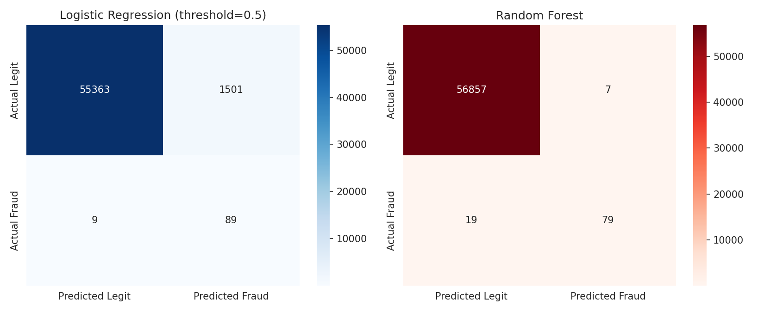
Model Evaluation: Confusion Matrices
Model | Precision | Recall | F1-Score
Logistic Regression (0.5) | 0.06 | 0.91 | 0.11
Logistic Regression (0.9) | 0.20 | 0.89 | 0.33
Random Forest | 0.92 | 0.81 | 0.86
9

Slide 10
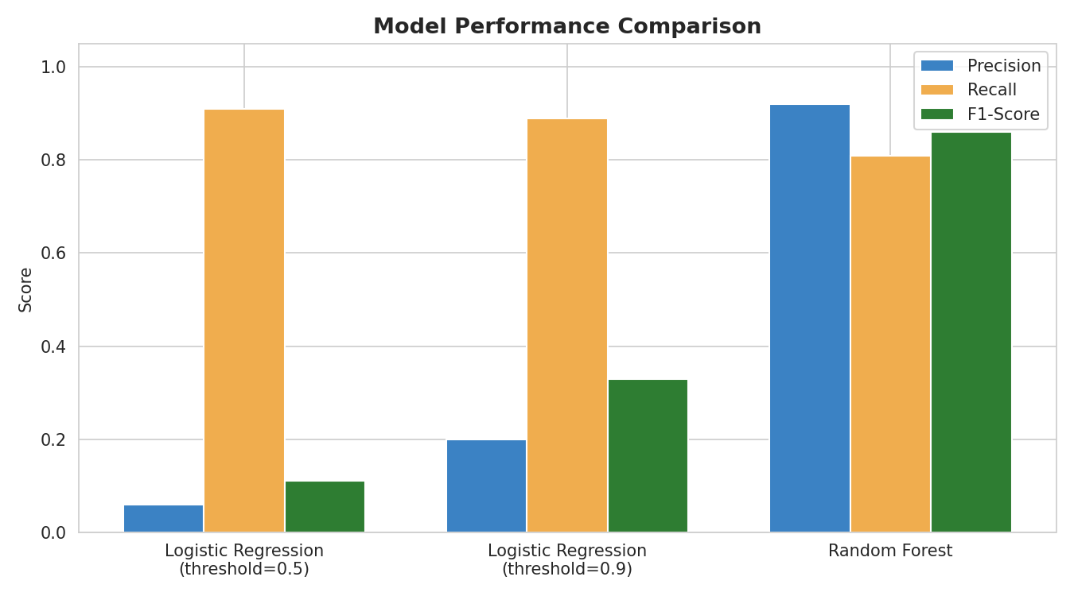
Model Comparison
Random Forest gives the best overall balance (F1 = 0.86), cutting false alarms from 1,501 to just 7 - making it the practical choice for deployment, though model selection should also reflect business risk tolerance.
10

Slide 11
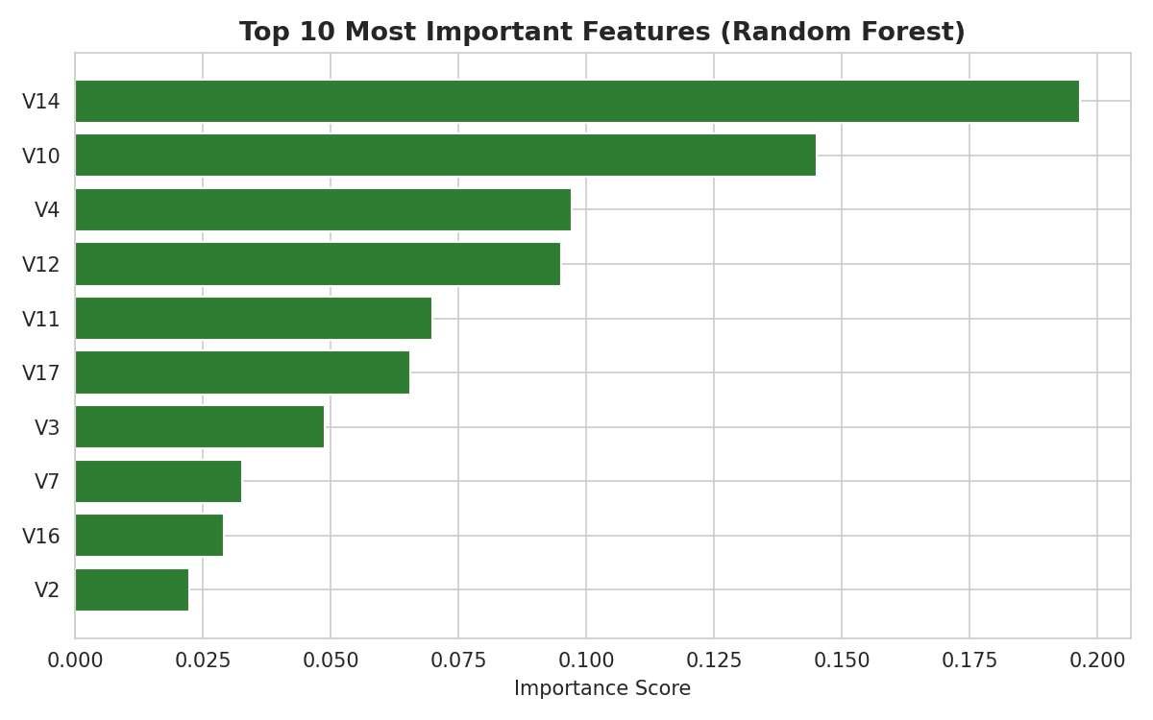
Feature Importance
Key Takeaways
V14, V10 and V4 are the strongest predictors
All top features are PCA-anonymized components
Amount and Hour did not rank in the top 10
Business meaning of V-features is undisclosed (privacy protection) - limiting explainability
11

Slide 12
Business Insights & Recommendations
Time-Based Risk Scoring
Small-Amount Monitoring
Configurable Threshold
Apply extra verification (e.g. OTP) for transactions during high-risk night hours.
Low-value transactions should not be treated as automatically safe - fraudsters test cards with tiny amounts.
Fraud-alert threshold should be tunable to match the institution's risk tolerance.
Reduced Customer Friction
Operational Savings
Societal Impact
High precision (7 false alarms) means fewer genuine customers face unnecessary blocks.
Fewer false alarms reduce manual investigation workload for fraud teams.
Reliable fraud detection protects consumers and strengthens trust in digital payments.
12

Slide 13
Limitations & Future Scope
Limitations
Future Scope
PCA features limit business explainability
Dataset covers only ~2 days of transactions
19 of 98 frauds still missed by the best model
No real-time / live pipeline integration yet
Hyperparameter tuning (GridSearchCV)
SMOTE-based resampling for imbalance
SHAP values for prediction explainability
Real-time monitoring dashboard
Conclusion
Random Forest achieved Precision 0.92, Recall 0.81, F1 0.86 - correctly detecting 79 of 98 fraud cases while flagging only 7 false alarms. This project demonstrates a complete, evidence-based data analytics pipeline and a working prototype dashboard for real-time fraud prediction.
Thank You

