Slide 1
Heart Disease Classification Using Machine Learning
Minor Project | Cleveland dataset (UCI)
Jyoti Kaushal | 8 ,October 2026

Slide 2
Problem and Dataset
Goal: predict whether a patient has heart disease (1) or not (0) from clinical data
Binary classification, supervised learning
Source: UCI Heart Disease, Cleveland file
Original target (0 to 4) converted to binary: num > 0 = disease
Features: age, sex, chest pain, BP, cholesterol, ECG, heart rate, ca, thal and more
Other 3 hospital files skipped: very high missing data
303
13
Patients
Features
164
139
No disease
Disease
Classes nearly balanced (54% / 46%)

Slide 3
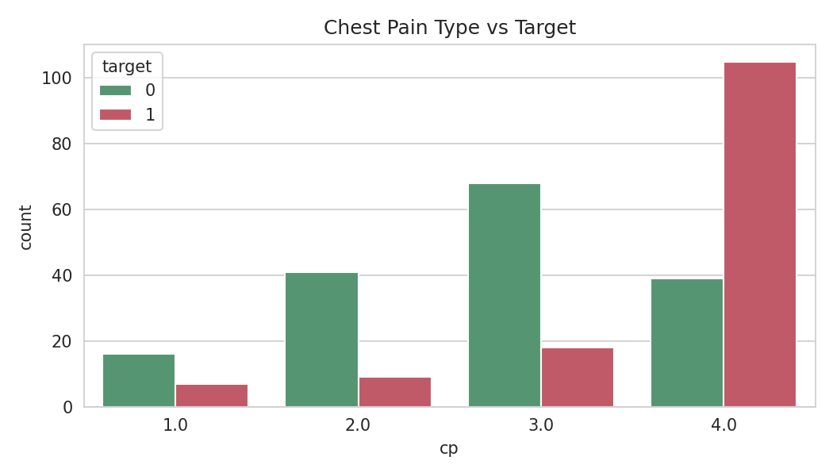
Data Cleaning and EDA Findings
Cleaning
0 duplicates; only 6 missing cells (ca 4, thal 2)
Imputed inside pipeline after split (no leakage)
Outliers kept: medically plausible
Key observations
Asymptomatic chest pain: 73% disease rate (others 18 to 30%)
Exercise angina: 77% vs 31% without
Lower max heart rate in disease group (139 vs 158 bpm)
Disease rate rises with ca: 26% to 85%
Association only, not causation
Chest pain type vs target

Slide 4
Preprocessing and Models
80/20 stratified split: 242 train, 61 test
Numeric: median impute + StandardScaler
Categorical (cp, restecg, slope, thal): mode impute + one-hot
Everything in one Pipeline: fitted on train only, so no data leakage
Logistic Regression
Decision Tree (depth 4)
Random Forest (200 trees)
Linear model giving probability of disease. Simple and explainable.
Yes/no rules on features. Easy to read but can overfit.
Many trees voting together. More stable and accurate.

Slide 5
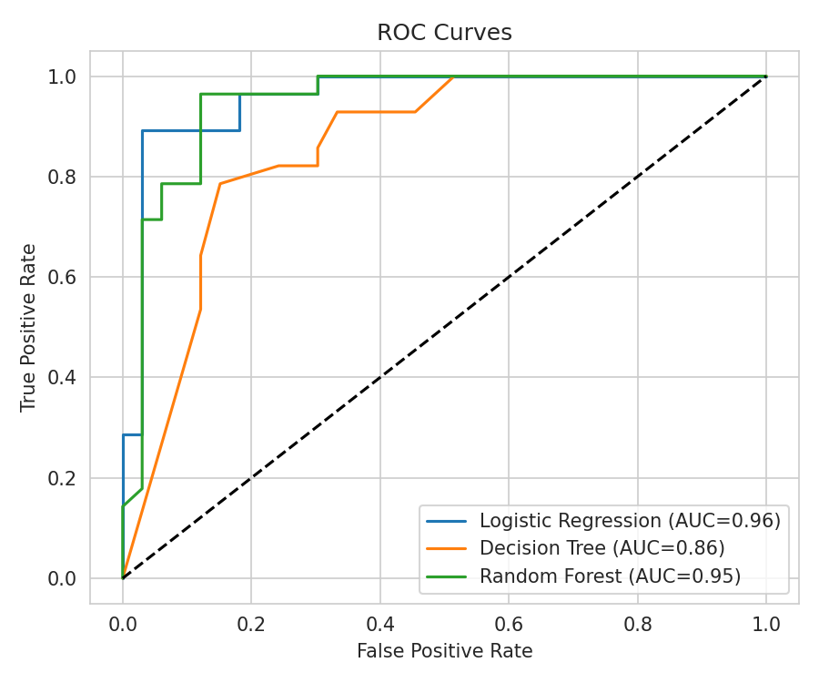
Evaluation and Model Comparison
Model | Acc | Prec | Recall | F1 | AUC
Logistic Regression | 0.869 | 0.812 | 0.929 | 0.867 | 0.958
Decision Tree | 0.787 | 0.742 | 0.821 | 0.780 | 0.860
Random Forest | 0.885 | 0.818 | 0.964 | 0.885 | 0.946
Random Forest missed only 1 of 28 diseased patients (recall 96.4%)
Final model: Random Forest, chosen for recall, F1 and accuracy
Logistic Regression very close (best AUC and CV F1: 0.806 vs 0.795)
Decision Tree weakest on every metric
Recall matters most: a missed patient (FN) is the costliest error

Slide 6
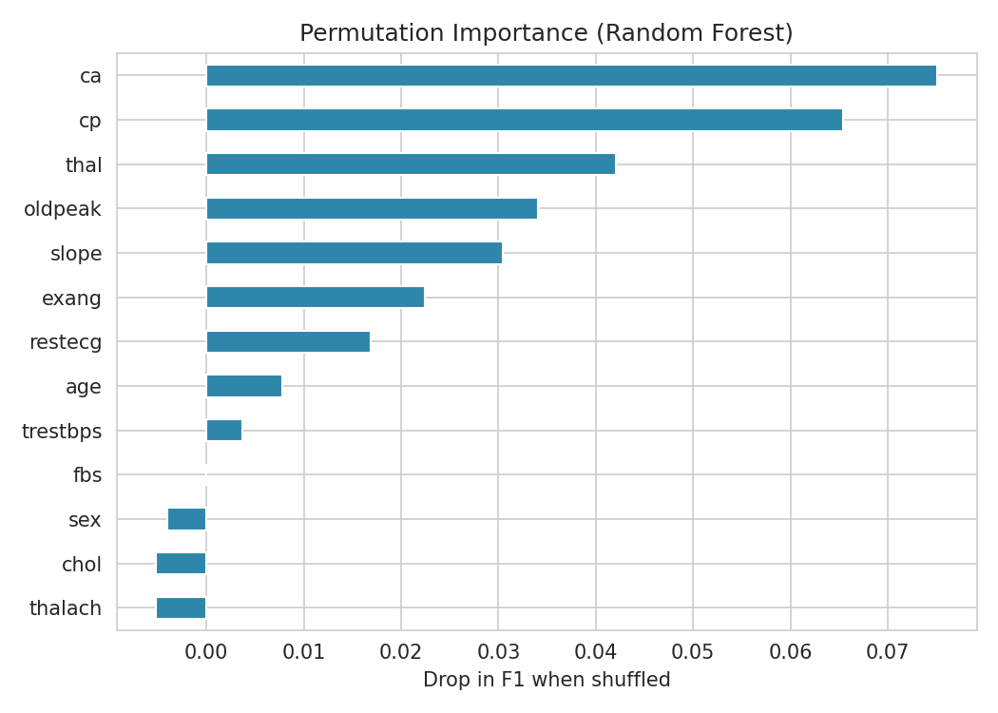
Model Interpretation and Dashboard
What the model relies on
Top features: ca, cp, thal, oldpeak
Cholesterol, fasting sugar, sex add almost nothing
Importance is not causation
Power BI dashboard
Cards: 303 patients, 139 cases, 45.9%
Donut, age group, chest pain, sex, heart rate charts
Slicers for sex and age group
Permutation importance (Random Forest)

Slide 7
Limitations, Future Scope and Conclusion
Limitations
Future scope
Conclusion
Only 303 patients, one hospital
Test set of 61: results can vary
Little hyperparameter tuning
Not clinically validated
GridSearchCV tuning
XGBoost, SVM, KNN
Multi-hospital data
Streamlit web app
Complete leakage-free ML workflow
Random Forest: 88.5% accuracy, 96.4% recall
ca, cp, thal, oldpeak matter most
Educational project, not a diagnostic tool

