Slide 1

Note: The data and information in this document is reflective of a hypothetical situation and client. This document is to be used for KPMG Virtual Internship purposes only.
Sprocket Central Pty Ltd
Data analytics approach
[Division Name] - [Engagement Manager], [Senior Consultant], [Junior Consultant]

Slide 2
Note: The data and information in this document is reflective of a hypothetical situation and client. This document is to be used for KPMG Virtual Internship purposes only.
Agenda
Introduction
Data Exploration
Model Development
Interpretation

Slide 3
Introduction
Analysis for Sprocket Central PTY LTD
Completeness
I have successfully addressed the data quality issues, and in my initial module, I have placed my focus on columns that exhibited deficiencies in the following attributes.
Accuracy
Consistency
Validity
Uniqueness
Relevance

Slide 4
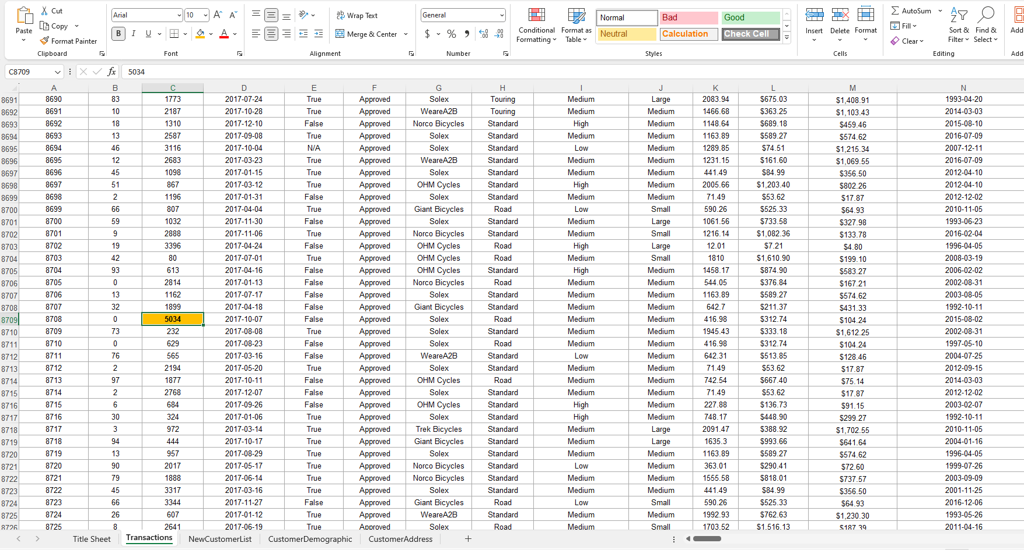
Note: The data and information in this document is reflective of a hypothetical situation and client. This document is to be used for KPMG Virtual Internship purposes only.
Data Exploration
Data Cleaning and Preparation for Transaction Sheet
Outlier Identification and Removal
My key step in data preparation is the identification and handling of outliers. In the transaction sheet, I observed an outlier with a Customer_Id of 5034, which deviates significantly from the expected range of Customer_Ids (e.g., 4000). To ensure the integrity of our dataset, I have made the decision to remove this particular row.

Slide 5
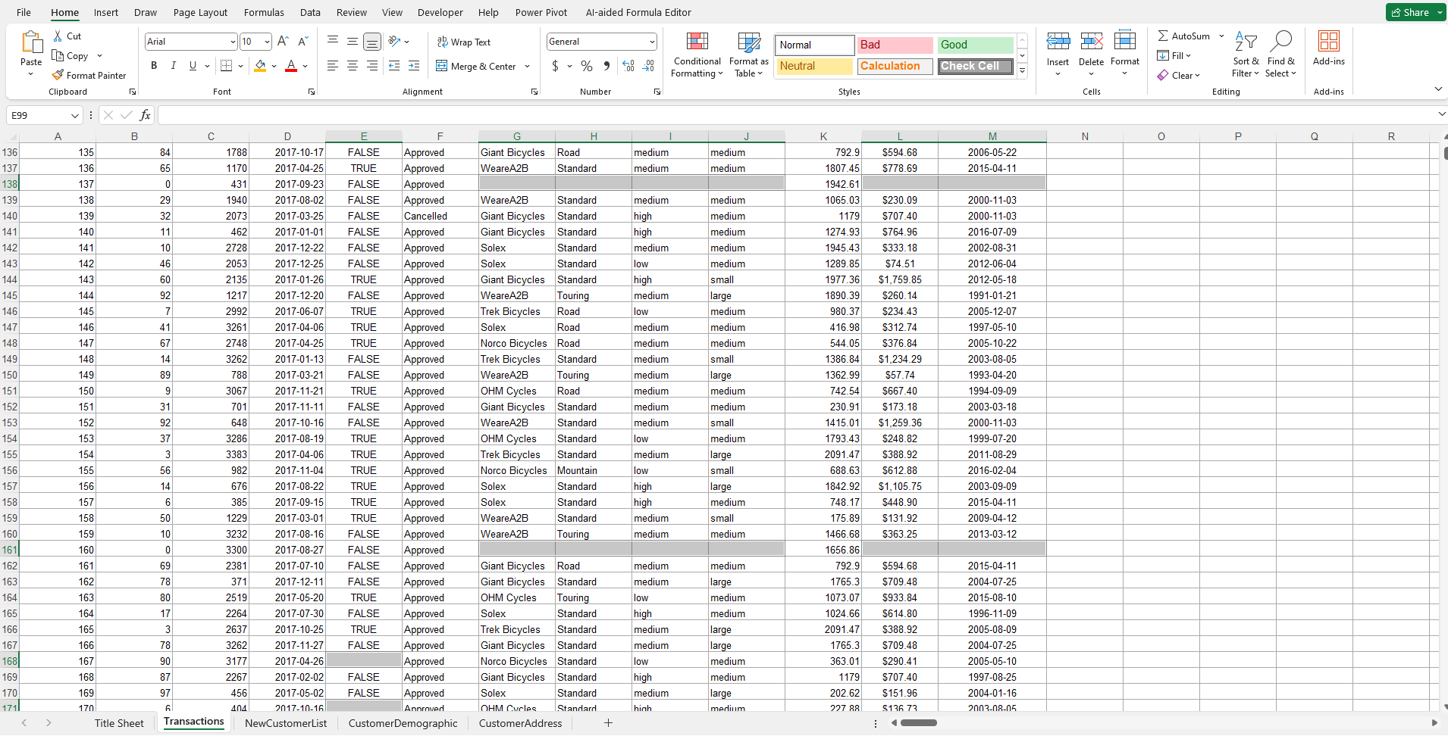
Note: The data and information in this document is reflective of a hypothetical situation and client. This document is to be used for KPMG Virtual Internship purposes only.
Data Exploration
Data Cleaning and Preparation for Transaction Sheet
Handling Missing Columns
Another aspect of data cleaning involves handling missing or irrelevant columns. In my analysis, I noticed that some columns were missing in the transaction sheet. To maintain consistency and focus on the relevant data, I have chosen to delete these missing columns from the dataset.

Slide 6
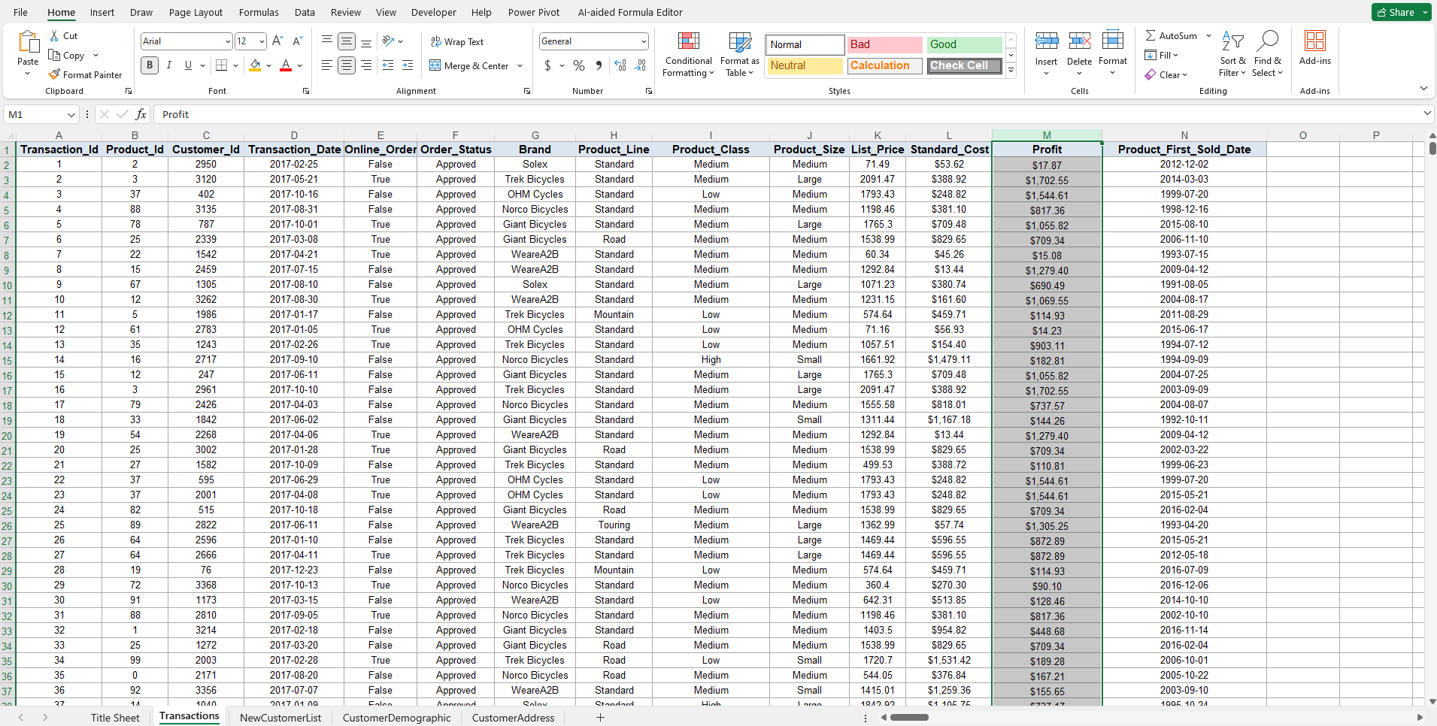
Note: The data and information in this document is reflective of a hypothetical situation and client. This document is to be used for KPMG Virtual Internship purposes only.
Data Exploration
Data Cleaning and Preparation for Transaction Sheet
Profit Calculation
To derive meaningful insights from the transaction data, I introduced a calculated metric: profit. This metric was computed by subtracting the list price from the standard cost for each transaction. This step helps us gain a better understanding of the financial aspect of the transactions.

Slide 7
Note: The data and information in this document is reflective of a hypothetical situation and client. This document is to be used for KPMG Virtual Internship purposes only.
Data Exploration
Data Cleaning and Preparation for Transaction Sheet
Summary
In summary, the data preparation process for the transaction sheet involved removing outliers, eliminating missing columns, and calculating profit. These steps were crucial in ensuring the accuracy and relevance of our dataset for subsequent analyses.
Removing Outliers
Eliminating Missing Columns
Calculating Profit

Slide 8
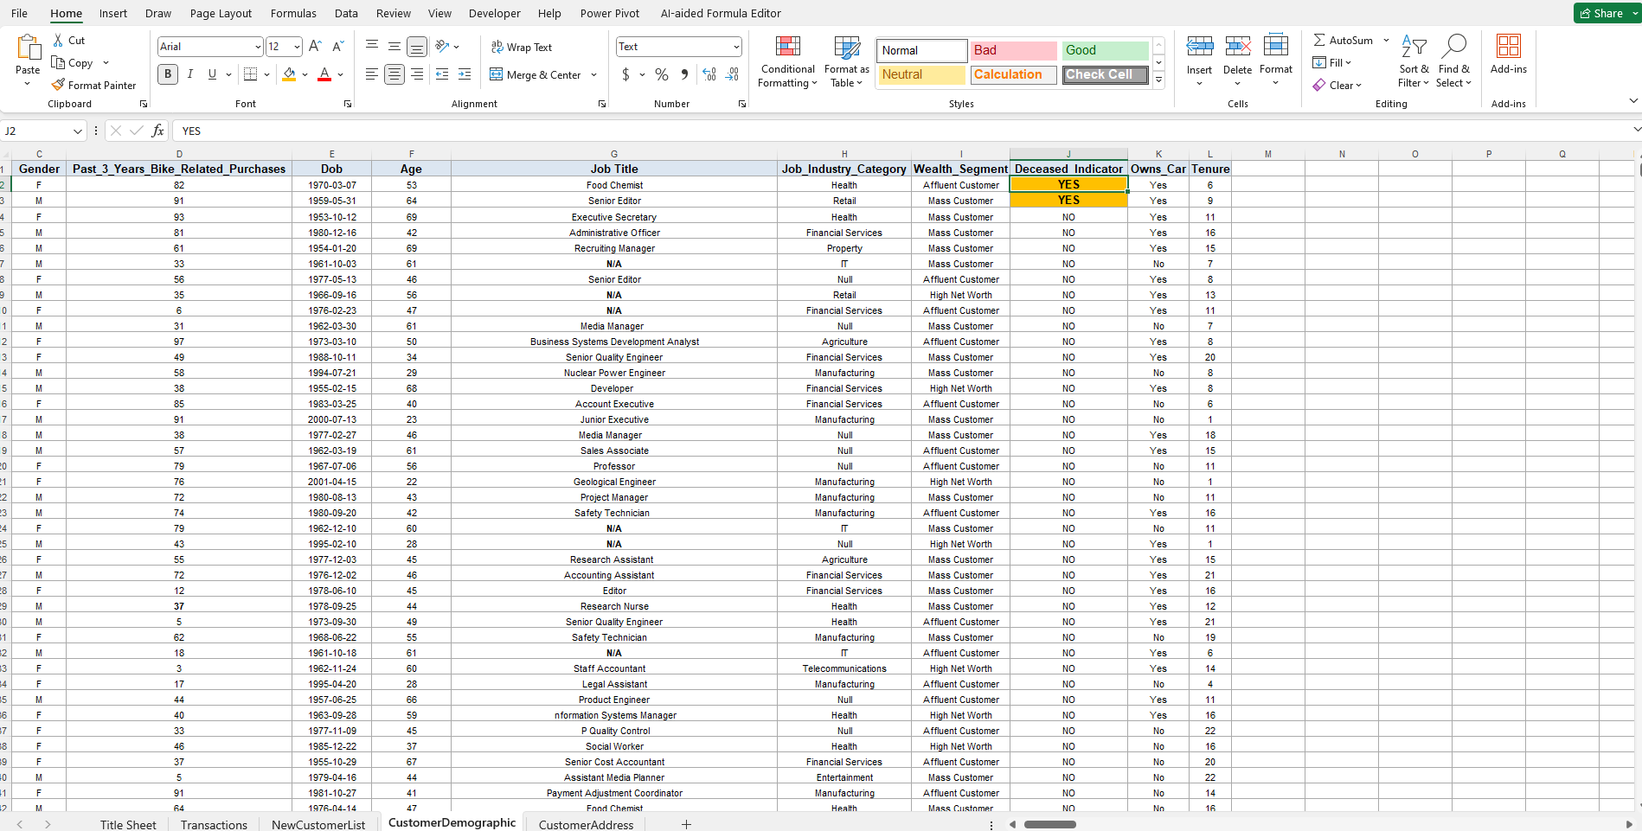
Note: The data and information in this document is reflective of a hypothetical situation and client. This document is to be used for KPMG Virtual Internship purposes only.
Data Exploration
Data Cleaning - Removing Deceased Individuals
Deceased Individuals
To identify deceased individuals, I closely examined the "Deceased Indicator" column. Based on the criteria, which includes the "Deceased Indicator" being marked as "Yes," I have identified two customer IDs associated with deceased indicator: 753 and 3790.
In order to maintain the accuracy and relevance of our dataset, I have taken the necessary step of removing the data associated with these deceased individuals. Therefore, customer IDs 753 and 3790 have been successfully removed from the dataset.

Slide 9
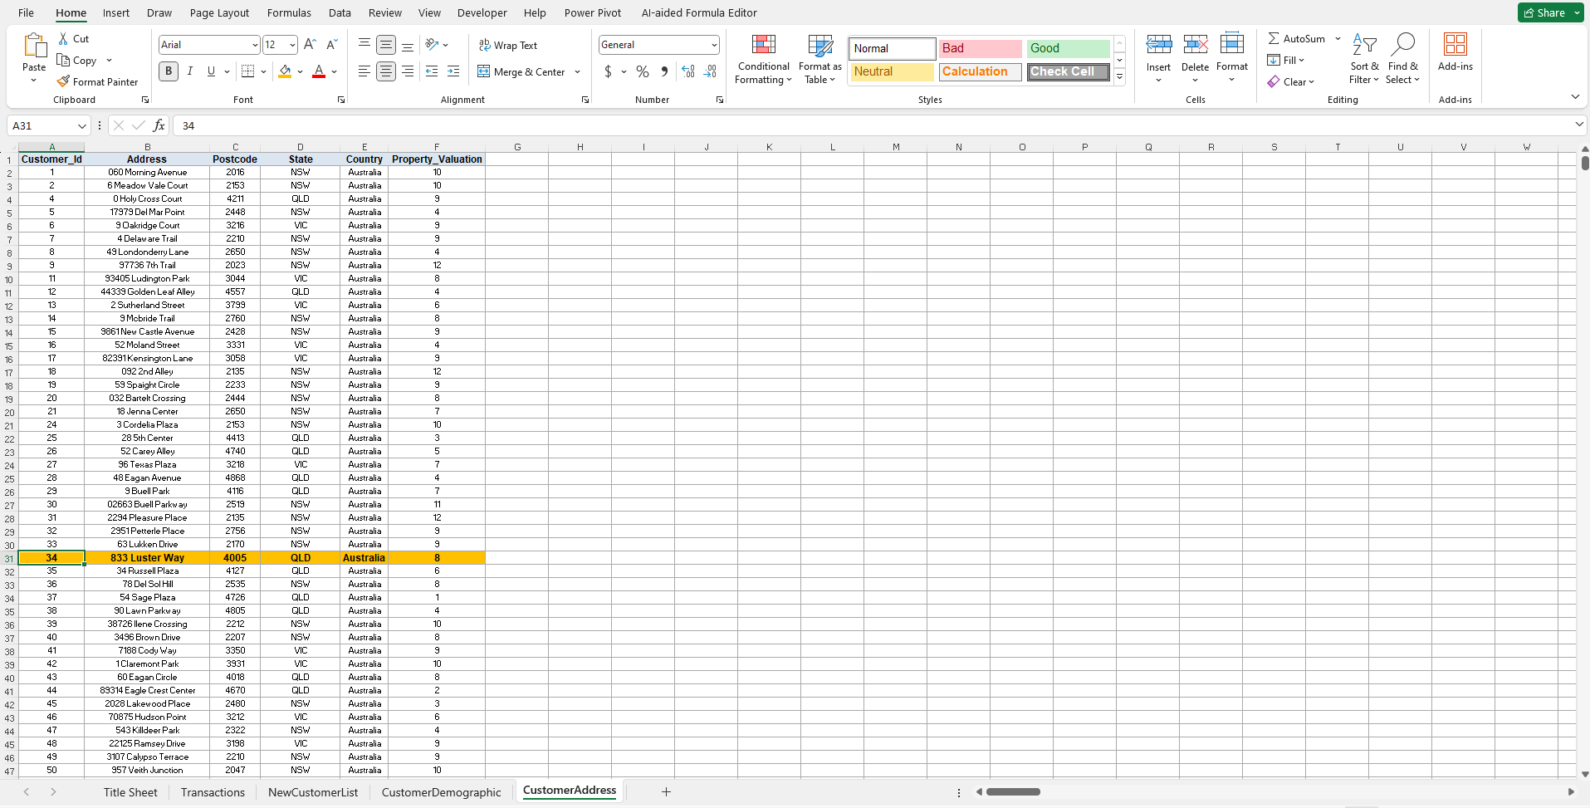
Note: The data and information in this document is reflective of a hypothetical situation and client. This document is to be used for KPMG Virtual Internship purposes only.
Data Exploration
Data Cleaning and Preparation for Transaction Sheet
Removing Customer_Id(Outlier)
In the process of aligning the data, I identified an inconsistency related to Customer_Id 34 within the Customer Address dataset. This discrepancy arose because Customer_Id 34 had been deleted from the Customer Demographic sheet due to the presence of an individual whose age is listed as 180 years, which is incompatible with our data. To maintain data consistency and accuracy, I have also removed Customer_Id 34 from the Customer Address dataset.

Slide 10
Note: The data and information in this document is reflective of a hypothetical situation and client. This document is to be used for KPMG Virtual Internship purposes only.
Model Development
Data Model Presentation
Addressing Missing Data in Transaction, Customer Demographic Tables & Customer Address
This presentation aims to demonstrate my approach to handling missing data in the Transaction, Customer Address and Customer Demographic tables and integrating them into a comprehensive data model.

Slide 11
Note: The data and information in this document is reflective of a hypothetical situation and client. This document is to be used for KPMG Virtual Internship purposes only.
Model Development
Data Model Presentation
Data Overview
We have three primary datasets: Transaction Table and Customer Demographic Table & Customer Address.
Transaction Table | Customer Demographic | Customer Address

Slide 12
Note: The data and information in this document is reflective of a hypothetical situation and client. This document is to be used for KPMG Virtual Internship purposes only.
Model Development
Transaction Table Missing Data
Transaction Table has 1,542 missing values in total, including:
Online Order | 360
Brand | 197
Product Line | 197
Product Class | 197
Product Size | 197
Standard Cost | 197
Product First Sold Date | 197

Slide 13
Note: The data and information in this document is reflective of a hypothetical situation and client. This document is to be used for KPMG Virtual Internship purposes only.
Model Development
Customer Demographic Table Missing Data
Customer Demographic Table has 1,701 missing values in total, including:
Last Name | 125
Date Of Birth(DOB) | 87
Job Title | 506
Job Industry Category | 656
Default Columns | 240
Tenure | 87

Slide 14
Note: The data and information in this document is reflective of a hypothetical situation and client. This document is to be used for KPMG Virtual Internship purposes only.
Model Development
Data Model Approach
My approach involves integrating customer address, postal code, state, and country data from the Customer Address Table into the Transaction Table using a common identifier.

Slide 15
Note: The data and information in this document is reflective of a hypothetical situation and client. This document is to be used for KPMG Virtual Internship purposes only.
Model Development
Address Integration
I am using the 'Customer ID' as the common identifier to merge customer address data and customer Demographic data into the Transaction Table.
Customer Demographic
Transaction Table
Customer Address

Slide 16
Note: The data and information in this document is reflective of a hypothetical situation and client. This document is to be used for KPMG Virtual Internship purposes only.
Model Development
Index and Match Function
Index and match function has been used to merge two tables together.
By using index and match function I can be sure that data is consistent and accurate. Somewhere it became impossible for me to use VLOOKUP function as it was showing an error (#N/A).

Slide 17
Note: The data and information in this document is reflective of a hypothetical situation and client. This document is to be used for KPMG Virtual Internship purposes only.
Model Development
Conclusion
In conclusion, data model approach addresses missing data challenges and creates a more comprehensive and valuable dataset for analysis.

Slide 18
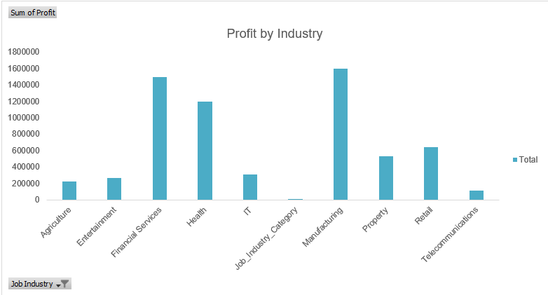
Note: The data and information in this document is reflective of a hypothetical situation and client. This document is to be used for KPMG Virtual Internship purposes only.
Interpretation
Strategic Insights for Future Targeting
Industry Focus
The data analysis suggests that the health industry, financial services industry, and manufacturing industry are promising sectors for future business targeting. These industries appear to have growth potential or other favorable characteristics that make them attractive for investment and expansion.

Slide 19
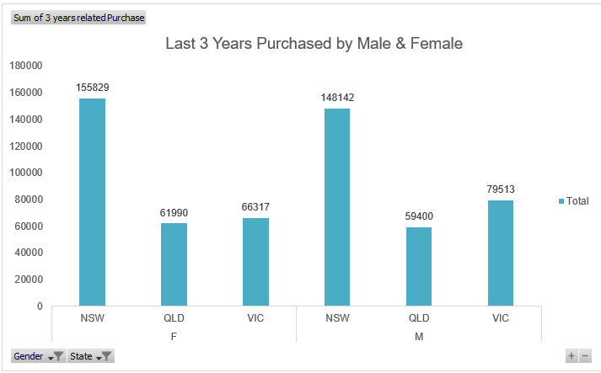
Note: The data and information in this document is reflective of a hypothetical situation and client. This document is to be used for KPMG Virtual Internship purposes only.
Interpretation
Strategic Insights for Future Targeting
Gender and Location Insights
Over the last three years, females have outpaced males in terms of purchases in New South Wales (NSW). Therefore, when planning marketing campaigns or strategies, it is advisable to target the female demographic, particularly in the NSW region. This regional focus can help maximize your marketing efforts and potential returns.

Slide 20
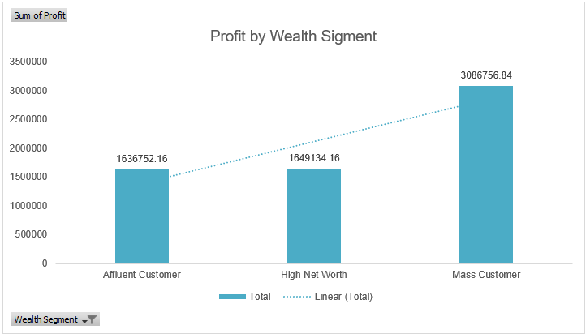
Note: The data and information in this document is reflective of a hypothetical situation and client. This document is to be used for KPMG Virtual Internship purposes only.
Interpretation
Strategic Insights for Future Targeting
Profit by Wealth Segment
The majority of your valuable customers fall into the "Mass Customer Wealth" category. This insight emphasizes the importance of retaining and further engaging this segment of your customer base. Crafting tailored marketing and retention strategies for the Mass Customer Wealth category can yield significant returns.

Slide 21
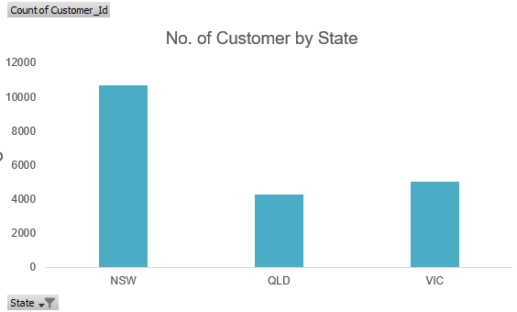
Note: The data and information in this document is reflective of a hypothetical situation and client. This document is to be used for KPMG Virtual Internship purposes only.
Interpretation
Strategic Insights for Future Targeting
Regional Profit Analysis
The data highlights that customers from New South Wales (NSW) and Victoria (VIC) have exhibited the highest profit rates. To optimize profitability, it is advisable to prioritize these two states in your business strategies. This could involve increasing marketing efforts, product/service offerings, or customer engagement initiatives in these regions to capitalize on their high-profit potential.

Slide 22
Note: The data and information in this document is reflective of a hypothetical situation and client. This document is to be used for KPMG Virtual Internship purposes only.
Appendix

Slide 23
Note: The data and information in this document is reflective of a hypothetical situation and client. This document is to be used for KPMG Virtual Internship purposes only.
Appendix
Data Source

