Slide 1
Language JAJ Team 15
Jyotinder Pal singh
Jeme john
Ayush gupta

Slide 2
Introduction
JAJ is a procedural language syntactically and semantically similar to C
JAJ execution starts from main()
Parsing logic is done using JAVA and ANTLR4
Runtime written in Python.
Platform independent.

Slide 3
Compiling and Running
The JAJ grammar resides in the JAJ.g4 file.
JAJ.g4 is basically a grammar rule file which is recognized by antlr4 .
Each time a rule is changed or updated the grammar syntax tree should also be updated by running the command
java –jar <path-to-antlr-jar-file> JAJ.g4
This command creates the corresponding Lexer, Parser, Listener and Visitor classes of the grammar.
Once the syntax tree is generated , the source code is run by passing the source file (.jaj) name as argument to Main.java
java Main.java <source-file-path.jaj>

Slide 4
Compiling and Running (contd..)
This command allows performing actions specified in the visitor class function corresponding to each rule. Thus generating an intermediate file, with the same name as the input file but extension changed to “.jaji”
The actions performed in the visitor function are basically those that are required to map the source code statements to statements in intermediate low level language.
Once the intermediate file is generated it is fed into the python runtime environment and is run to produce the desired output.
python runtime.py –f <intermediate-file-path.jaji>

Slide 5
Getting started
Writing a simple Hello world program in JAJ is quite easy as the syntax is pretty similar to C .
A program can be as simple as a single statement within main().
If the user wishes to include the statement with a main() block the following needs to be done.
main() {
print “Hello World”;
}

Slide 6
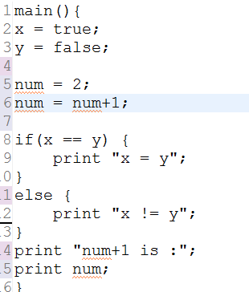
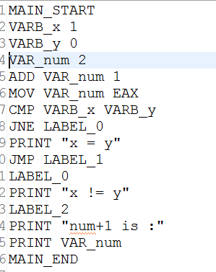
Features
Data Types: Integer, Boolean
JAJ supports dynamic typing.
The user need not assign a datatype during initialization .
The appropriate variable type is assigned during runtime .
Fig:1 data_type.jaj data_type.jaji

Slide 7
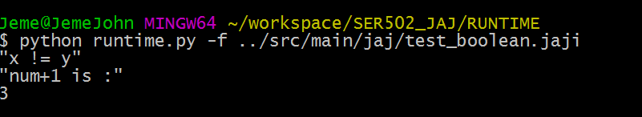
Datatypes (contd..)
FIG 1. Output for boolean, integer, if..else constructs

Slide 8
Functions
JAJ supports parameterized procedures, functions, or methods.
main() is the special function from which execution starts.
The functions may or may not return a value.
A function can call other functions, including itself, thereby supporting recursion.
Whenever there is a CALL statement in the .jaji file , the EIP+1 and local variable are saved onto the call stack so after stack unwinding we can continue to execute sequentially.
Moreover you can pass n number of arguments to the function by pushing all these argument to the argument stack.

Slide 9
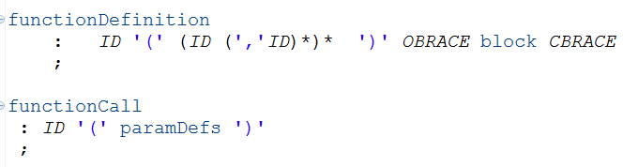
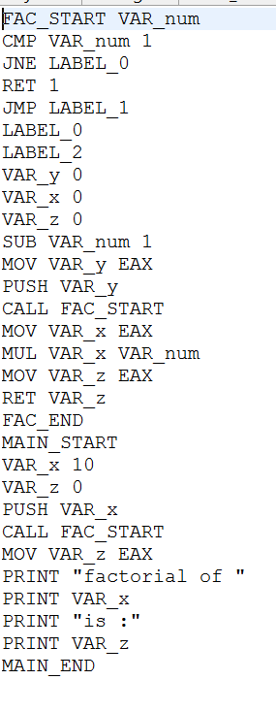
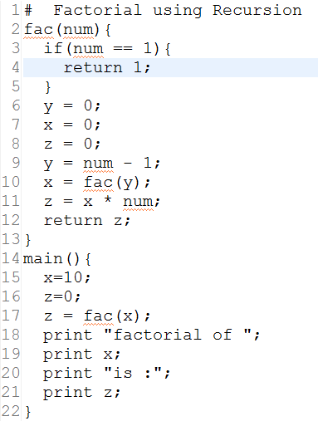
Functions (contd..)
FIG 2 function grammar rule Factorial.jaj Factorial.jaji

Slide 10
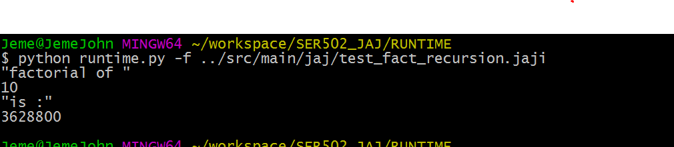
Functions (contd..)
FIG 2 Factorial Runtime Ouput

Slide 11
Scope
JAJ implements static scoping.
Scope of a variable can be global, local and within nested blocks.
To manage this we have used global symbol table which takes care of all the global variables.
Local variables are handled in a local call stack which handles nested blocks
When a new block is created we create a new local scope and push the earlier local scope into stack.
JAJ wraps the global scope within the characters ‘< >’ , which marks the global region.
Blocks are enclosed with ‘[ ]’ brackets as shown below.

Slide 12
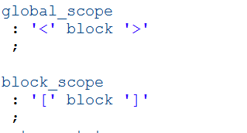
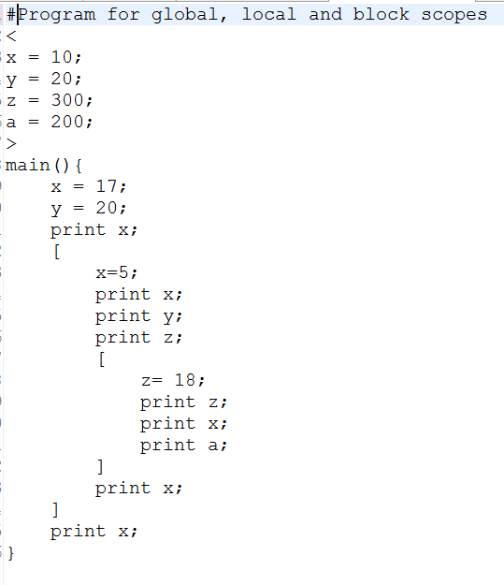
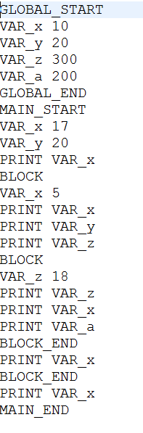
Scope (contd..)
FIG 3 scope grammar rule Scope.jaj Scope.jaji

Slide 13
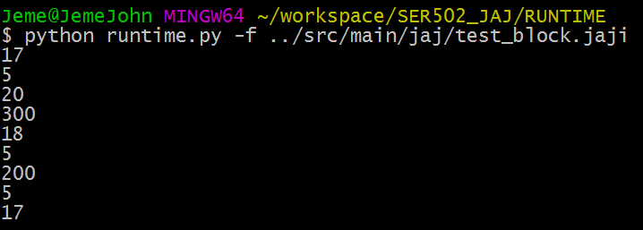
Scope (contd..)
FIG 3 Scope output

Slide 14
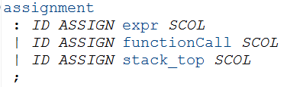
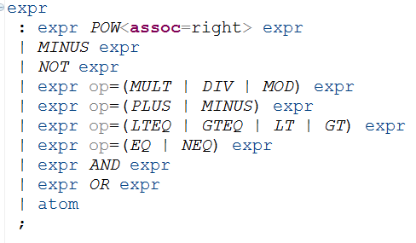
Expressions and Assignments
JAJ support basic operation where priority is associated with using BODMAS
Assignment statements are used to associate a value with an identifier.
FIG 4 assignment and expression grammar rule

Slide 15
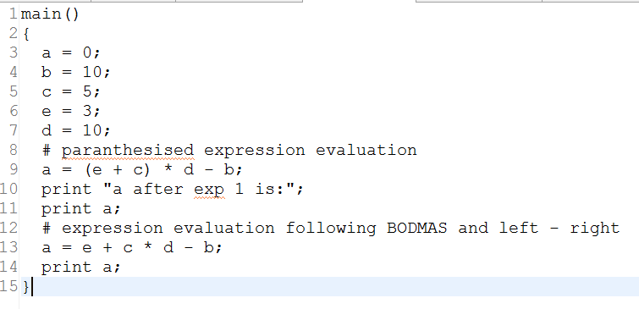
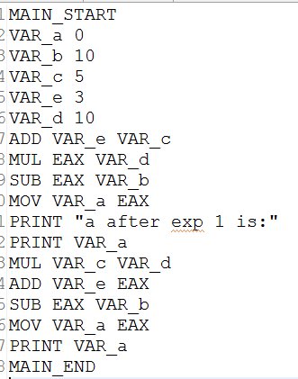
Expressions and Assignments (contd..)
FIG 4 expression.jaj expression.jaji

Slide 16
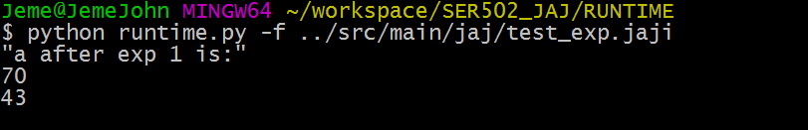
Expressions and Assignments (contd..)
FIG 4 expression output

Slide 17
Control Statement
JAJ support the if..else conditional block, with syntax similar to that of C.
The intermediate code for if-else is also similar to C intermediate code where the expression for if is evaluated using CMP and conditional JMP to labels.
The source and intermediate sample code can be found in FIG 1.

Slide 18

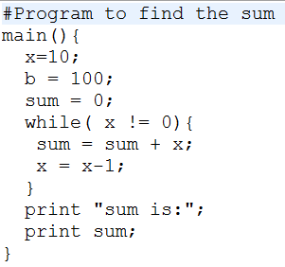
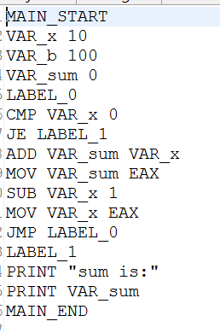
Iteration
Loop: While
JAJ supports while-loop whose syntax is pretty much similar to while loop syntax in C. The grammar rules and sample programs have been attached below :-
Fig 5. while grammar rule sum_while.jaj sum_while.jaji

Slide 19
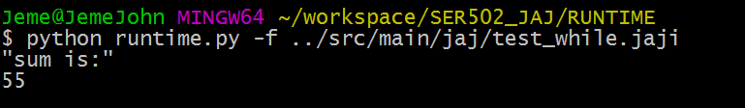
Iteration (contd..)
FIG 5. Output for source code in FIG 1

Slide 20
Stack
JAJ supports stack datastructure .
JAJ initializes a stack variable using ‘stack’ keyword and supports the following operations.
Operations
TOP: will tell the top of the stack.
POP: will remove the top element.
PUSH: will push the element on the stack
EMPTY: will check if stack is empty or not

Slide 21
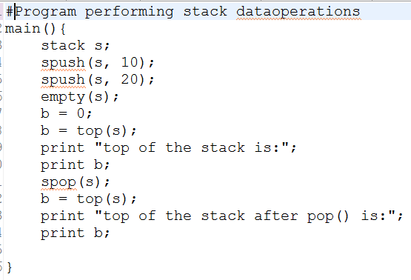
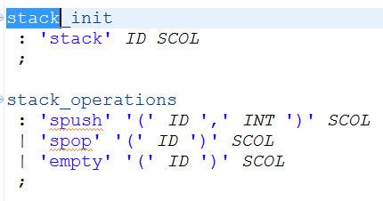
Stack (contd..)

Slide 22
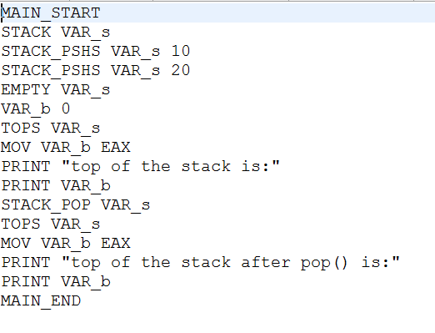
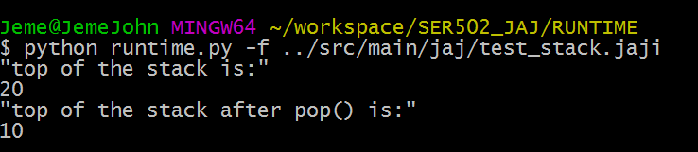
Stack (contd..)

Slide 23
Compiler
Antlr 4 with Java
Parse tree generated
Extended visitor class generated by Antlr to parse tree and generate intermediate code
Arithmetic Operations
Defined common registers to store intermediate result
Relational Operator
Stores the result of operator in register R
R is used by JNE (JUMP if not equal), JGE (JUMP if greater), JE (JUMP if equal) and JMP (is a unconditional JUMP)

Slide 24
Runtime
Developed in Python
Main function in the program is the start point
Maintains two stacks
Instruction Pointer (EIP)
Symbol Table (Python Dictionary)
Variable Resolution
Looks for a variable in symbol table of current scope
If not found, searches for the variable in the parent scope until global scope.
Function Call
Next EIP is stored and pushed into stack
New EIP and symbol table is created for the current function

