Slide 1

7th Semester
Project Presentation
on
Smart Door Locking System
Presented by
Anshuman Samal (Regd. No. : 20UG010461)
Jyotiraditya Pattnaik (Regd. No. : 20UG010464)
Chinmay Kumar Behera (Regd. No. : 20UG010440)
Under the guidance of
Mrs.Gitanjali Mishra
Professor, Department of CSE, GIET University
Gandhi Institute of Engineering and Technology University
November 2023

Slide 2
“Smart Door Locking System”
Outline
Project Title: "Smart Door Locking System"
Subtitle: Modernizing Access Control with Arduino Uno, Servo Motor, and Bluetooth Technology
Introduction
Project Components
System Architecture
User Requirements
System Features
Testing Overview
Results and Conclusions
Future Developments
Challenges and Solutions
Acknowledgments
Q&A

Slide 3
“Smart Door Locking System”
Introduction
Brief Overview:
Traditional door locking mechanisms have served us well, but in an era of technological advancements, it's time to introduce a more secure and user-friendly solution.
Project Objectives:
Introduce the Smart Door Locking System, a cutting-edge project leveraging modern electronic components.
Enhance security, convenience, and accessibility in door access control.
Combine the power of Arduino Uno, servo motor, LCD display, buzzer, Bluetooth, and smartphone integration.
Key Features:
Robust access control through user authentication and permission-based access.
Remote control capabilities via smartphones for added convenience.
Intuitive user interface for seamless interaction.
Integration of advanced security features such as encryption and tamper detection.

Slide 4
“Smart Door Locking System”
Project Components
Hardware Components
Arduino Uno
Servo Motor
16x2 LCD Display
Potentiometer
Buzzer
Bluetooth Module
Smartphone Integration
Bread Board
Jumper Wires
Power Source
Door Lock Mechanism
Software Components
Arduino IDE
Arduino Bluetooth Controller Application

Slide 5
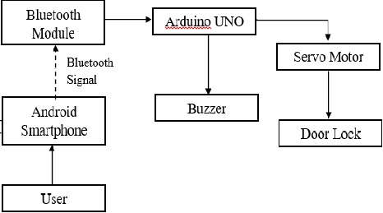
“Smart Door Locking System”
SYSTEM ARCHITECTURE

Slide 6
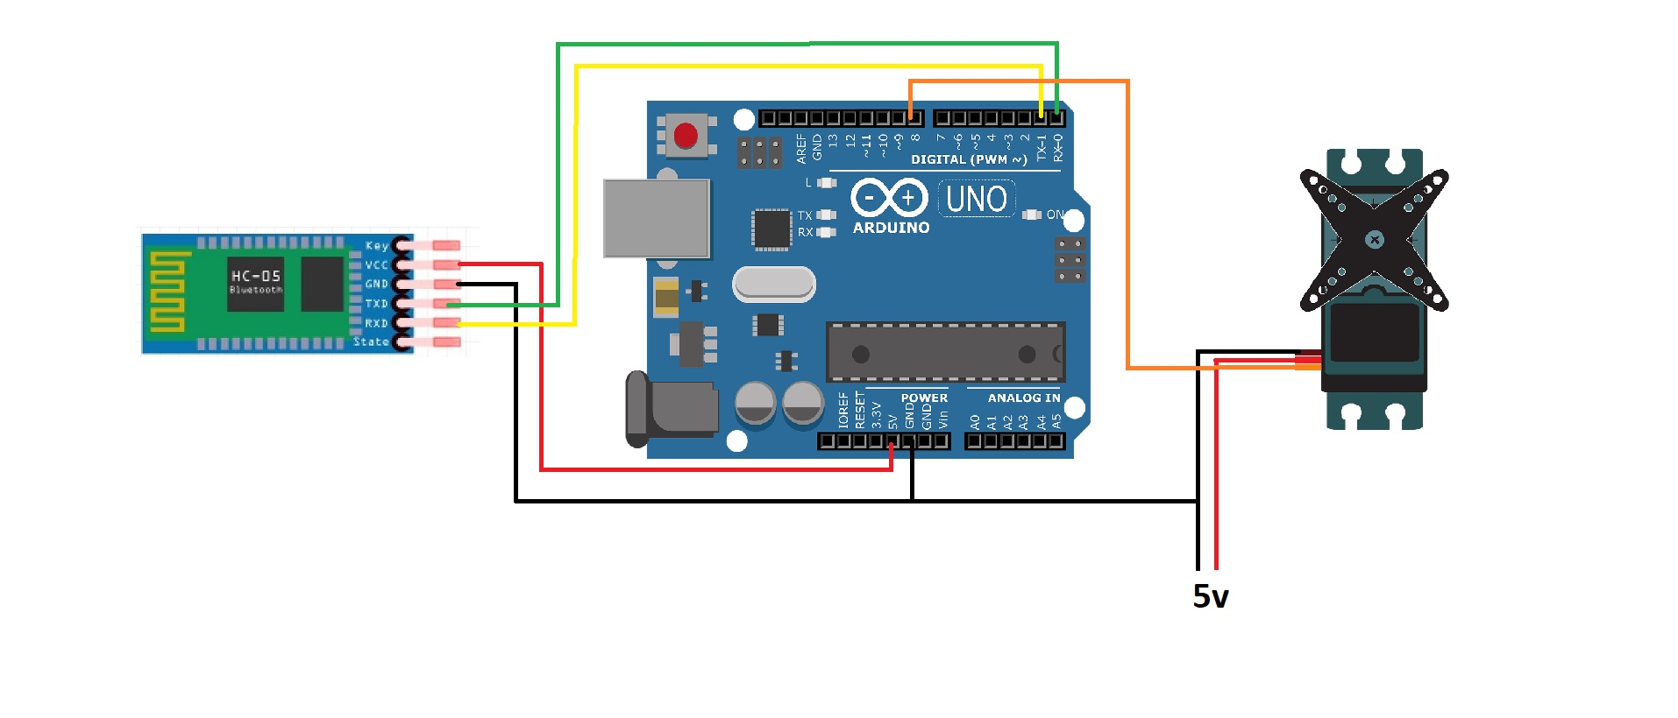
“Smart Door Locking System”
SYSTEM ARCHITECTURE

Slide 7
“Smart Door Locking System”
USER REQUIREMENT
User Interface:
Intuitive and easy-to-use interface.
Access Control:
Differentiated access levels, authentication, and permission-based control.
Compatibility:
Compatible with various doors, frames, and materials.
Security:
High-level security with encryption, tamper detection, and alarms.
Monitoring:
System monitoring with user logs, events, and error reports.
Remote Access:
Remote door control via smartphones.
Power Supply:
Reliable and efficient power supply options (batteries/AC).

Slide 8
“Smart Door Locking System”
SYSTEM FEATURES
Secure Access Control:
Advanced electronic components ensure secure access.
Remote Smartphone Control:
Users control the door lock remotely via a dedicated app.
User-Friendly Interface:
Intuitive 16x2 LCD display provides real-time information.
Precise Servo Motor Actuation:
Servo motor ensures accurate and controlled locking/unlocking.
Audible Feedback with Buzzer:
Immediate feedback on access attempts via a buzzer.
Bluetooth Connectivity:
Wireless communication with smartphones for seamless interaction.
User Management:
Easy addition, removal, and modification of user codes.
Real-time System Feedback:
LCD display offers live updates on system status.

Slide 9
“Smart Door Locking System”
SYSTEM FEATURES
CONTINUED…
9.Keyless Access:
Eliminates the need for physical keys, reducing risks.
10.Customizable and Adaptable:
Tailorable to specific access control needs and adaptable to diverse environments.
11.Easy Installation:
Designed for straightforward installation and operation.
12.Versatility Across Applications:
Suitable for various applications, from homes to offices.
13.Cost-Effective Solution:
Economical alternative to traditional lock methods.
14.Efficient Power Management:
Operates reliably with efficient power sources

Slide 10
“Smart Door Locking System”
TESTING OVERVIEW
Unit Testing:
Individual component testing for functionality.
Integration Testing:
Interaction testing between system components.
Functional Testing:
Evaluating access control, remote access, and user management.
Security Testing:
Ensuring encryption, tamper detection, and secure communication.
Performance Testing:
Assessing response times, power consumption, and overall efficiency.
Usability Testing:
User interface evaluation and feedback assessment.
Compatibility Testing:
Verifying compatibility with various doors, frames, and Bluetooth devices.

Slide 11
“Smart Door Locking System”
RESULTS AND CONCLUSION
Key Results:
Security Validation:
Encryption, tamper detection, and secure communication verified.
Efficient Remote Access:
Smartphone app demonstrated efficient remote control.
User-Friendly Interface:
Intuitive 16x2 LCD display provided real-time information.
Smooth Component Integration:
Seamless operation observed in component integration testing.
Reliable Power Management:
Efficient power consumption and reliable operation.
Conclusion:
Smart Door Locking System achieved secure, efficient, and user-friendly results.
Explore the impact of these results on modern access control in the following slides.

Slide 12
“Smart Door Locking System”
FUTURE DEVELOPMENT
Scalability:
Explore options for scaling the system to accommodate a growing number of users seamlessly.
Advanced Security Measures:
Investigate and implement additional security features to stay ahead of evolving threats.
Integration with Emerging Technologies:
Stay abreast of new technologies and consider integration possibilities for continuous improvement.
Enhanced User Experience:
Focus on refining the user interface and experience for even greater ease of use.
AI and Machine Learning Integration:
Explore the potential integration of AI and machine learning for adaptive security and access control.
Energy-Efficient Solutions:
Investigate further options for optimizing power consumption and exploring sustainable energy sources.

Slide 13
“Smart Door Locking System”
CHALLENGES AND SOLUTIONS
Challenges Faced:
Integration Complexity:
Integrating diverse components posed challenges in ensuring seamless communication.
Security Vulnerabilities:
Identifying and addressing potential security vulnerabilities in the system.
Power Management:
Efficiently managing power consumption, especially in scenarios where battery power is relied upon.
User Interface Optimization:
Optimizing the user interface to balance simplicity with comprehensive functionality.

Slide 14
“Smart Door Locking System”
CONTINUED…
Solutions Implemented:
Prototyping and Testing:
Rigorous prototyping and testing ensured smooth integration and identified potential issues early in the development phase.
Security Audits:
Conducted comprehensive security audits and implemented encryption and tamper detection features to fortify the system.
Power Optimization Algorithms:
Developed power optimization algorithms to enhance efficiency and extend the system's operational life.
User Feedback Iterations:
Incorporated user feedback iteratively to optimize the user interface for an intuitive and efficient experience.

Slide 15
“Smart Door Locking System”
ACKNOWLEDGEMENTS
We express our sincere gratitude to Prof.Mrs.Gitanjali Mishra of Computer science and engineering for giving us an opportunity to accomplish the project. With her active support and guidance, this project report has been successfully completed.
We also thank Dr. Kakita Murali Gopal, Head of the department of computer science, Prof. (Dr.) Sanjay Kumar Kuanar, Dy. Dean, SOET and Dr. Chandrakanta Mahanty, Project Coordinator for their consistent support, guidance and help.
Anshuman Samal (Regd. No.20UG010461)
Jyotiraditya Pattnaik (Regd. No.20UG010464)
Chinmay Kumar Behera(Regd. No.20UG010440)

Slide 16

“Smart Door Locking System”

Slide 17
“Smart Door Locking System”
THANK YOU!

