Slide 1
MULTIPURPOSE TEXT GENERATION
NAME : JYOTIREKHA BORA
NM-id : au721221104023
KARPAGAM INSTITUTE OF TECHNOLOGY
3/21/2024 Annual Review

Slide 2
PROJECT TITLE
Multipurpose Text Generation Using LLM
3/21/2024 Annual Review

Slide 3


AGENDA
The primary goal of this project is to automatically produce coherent and contextually relevant written or verbal content. This content can serve various purposes, including:
Content Creation: Generating articles, blog posts, product descriptions, and other forms of written content for websites, marketing materials, and publications.
Personalization: Tailoring text to specific users based on their preferences, behaviors, or demographics, thereby enhancing user engagement and satisfaction.
Automation: Automating repetitive writing tasks, such as generating reports, emails, and summaries, to improve efficiency and productivity.
Summarization: Condensing large volumes of text into shorter, more manageable summaries or abstracts.
3/21/2024 Annual Review

Slide 4

PROBLEM STATEMENT
Many tasks currently automated through text generation, such as content creation, report generation, and email responses, would require manual intervention, leading to increased time and labor costs. personalized content tailored to individual preferences, such as personalized product recommendations, would be challenging to deliver efficiently. these tasks would be slower and less accurate, hindering productivity. creative expression through AI would be limited, impacting artistic and entertainment domains.
3/21/2024 Annual Review

Slide 5

PROJECT OVERVIEW
Personalized Content: Text generation allows for the generation of personalized content tailored to individual preferences, behaviors, or demographics. This includes personalized product recommendations, marketing messages, news articles, and more, improving user engagement and satisfaction.
Transcription and Captioning: Text generation is used for automatic transcription of audio and video content, as well as generating captions for accessibility purposes. This enables users to access and understand multimedia content more easily, benefiting individuals with hearing impairments and improving content accessibility overall.
Generating Test Data: Text generation can be used to create synthetic datasets for testing and training machine learning models. This is particularly useful in scenarios where collecting real-world data is impractical or expensive, allowing researchers and developers to evaluate model performance under various conditions.
3/21/2024 Annual Review

Slide 6
WHO ARE THE END USERS?
Content Consumers: End users who consume generated content, such as articles, product descriptions, or news summaries, benefit from text generation by accessing relevant and engaging information tailored to their interests.
Customer Service Representatives: End users in customer service roles utilize text generation-powered chatbots and virtual assistants to assist customers with inquiries, troubleshoot issues, and provide support services efficiently and effectively.
Media Consumers: End users who consume multimedia content, such as videos or podcasts, benefit from text generation systems for automatic transcription and captioning, improving accessibility and comprehension of audiovisual content.
Testers and Developers: End users involved in software testing and development use text generation systems to generate synthetic test data, evaluate system performance, and validate the functionality of text-based features and applications.
3/21/2024 Annual Review

Slide 7

YOUR SOLUTION AND ITS VALUE PROPOSITION
I'd start by diving deep into the specific needs and goals of the project. Understanding what kind of text I need to generate, who the audience is, and what tone or style is required is crucial.
Once I have a clear picture of the task at hand, I'd gather a dataset of relevant text samples. This could involve scraping data from various sources or curating existing datasets to ensure they reflect the domain I'm working in.
Next comes preprocessing the data. This step is all about cleaning up the text, removing any noise or irrelevant information, and getting it into a format that's ready for modeling. It might involve tasks like tokenization and encoding.
When it comes to choosing a model, I'd weigh the options carefully, considering factors like the complexity of the task, the size of the dataset, and the computational resources available. Whether it's a traditional statistical model or a cutting-edge deep learning architecture, the goal is to find the best fit for the job.
3/21/2024 Annual Review

Slide 8

THE WOW IN YOUR SOLUTION
I'd craft a hybrid model architecture that melds the rigidity of rule-based systems with the adaptability of neural networks. This architecture would consist of distinct components:
Rule-based Module: This module would draw on linguistic rules, grammar constraints, and domain-specific knowledge to generate coherent and structured text.
Neural Network Module: Here, I'd employ advanced deep learning techniques like recurrent neural networks (RNNs) or transformer models to capture intricate patterns and relationships within the text data.
3/21/2024 Annual Review
8

Slide 9
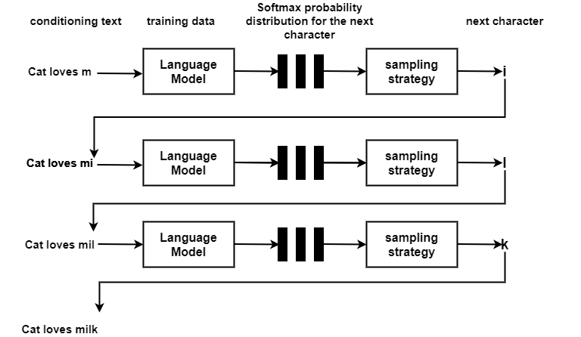
MODELLING
An explanation of the architecture of the deep learning model.
Model training and assessment procedures are explained.
3/21/2024 A nual Review
9
n

Slide 10
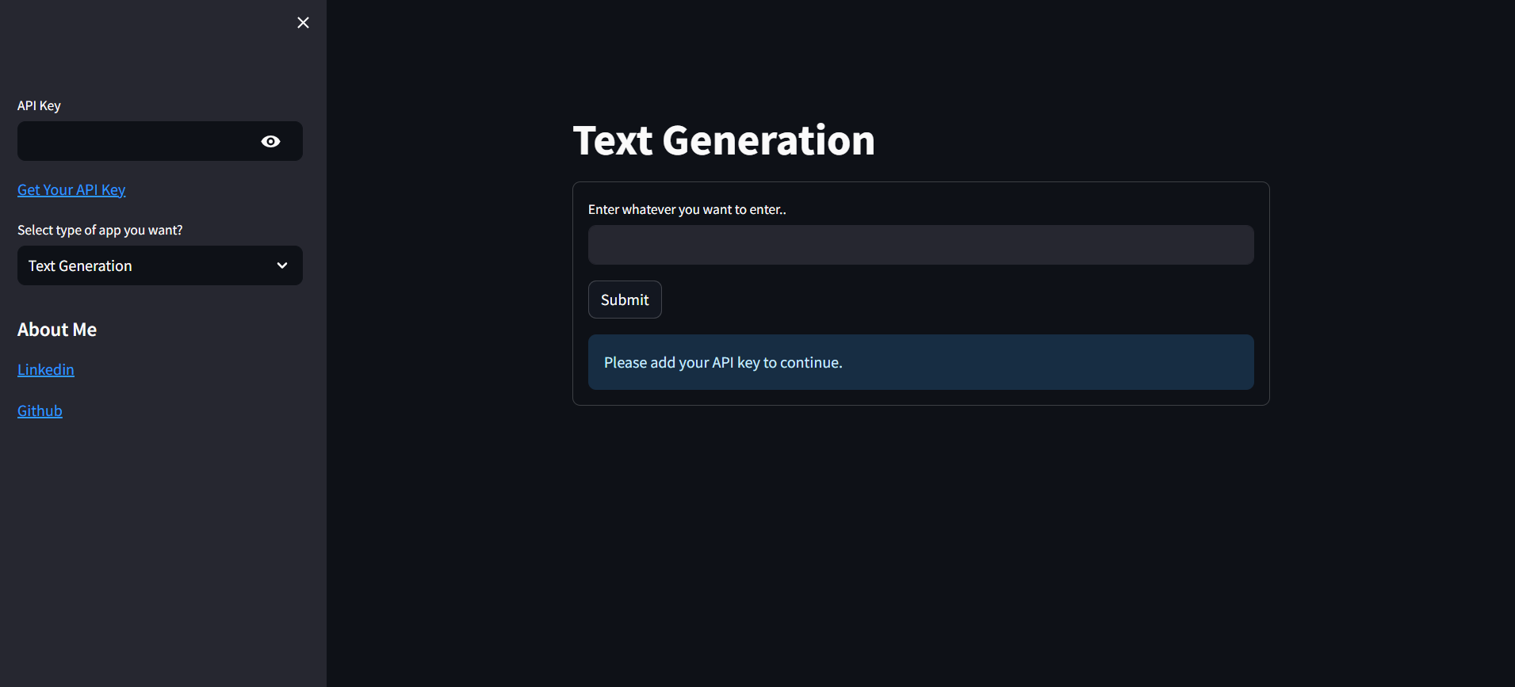
RESULTS
the results of text generation can range from highly accurate and contextually relevant to flawed and biased, depending on various factors. Continuous refinement and improvement of text generation models are essential to enhance the quality and reliability of the generated text across different applications and domains.
10

