Slide 1


Presentation on Title of Project
Guided By: Presented By:
Prof. (Dr.) Prashant Lakkadwala Aashi Garg Akrati Nigam Jyotirjay Narayan Gupta Jatin Sani

Slide 2
Contents
Introduction
1.1 Overview
1.2 Purpose
Requirement Engineering
2.1 Requirement Collection
2.2 Functional Requirements
2.3 Non Functional Requirements
2.4 Use Case Diagram
Technical Design
3.1 Technical Architecture
3.2 Sequence Diagram
3.3 Class Diagram
3.4 DFD
User Interface Design
Data Design
5.1 Schema Design
5.2 E-R Diagram
REFERENCES

Slide 3
1. Introduction
1.1 Overview
The project aims to create a data-driven solution that offers farmers optimal fertilizer usage recommendations based on soil health, crop type, and weather conditions.
By analyzing various factors affecting soil and crop growth, this solution will promote sustainable farming practices, increase crop yields, and boost farmer incomes.
1.2 Purpose
Promote healthy soil by making recommendations on fertilizer use.
Increase agricultural productivity by fertilizing certain areas.
Minimize damage to the environment by avoiding excessive use of fertilizer.
Maximize farmers' profits by offering data-driven advice.

Slide 4
2. Requirement Engineering 2.1 Requirement Collection
Farmers:
Need an easy-to-use tool for fertilizer recommendations.
Desire increased crop yields and reduced farming costs.
Expect localized recommendations based on specific soil and weather conditions.
Agricultural Experts:
Need tools to analyze and compare fertilizer strategies.
Require access to accurate data for advisory services.
Government and Agencies:
Aim to promote sustainable farming practices.
Need data for policy-making and subsidy allocation.
Development Team:
Require a clear specification of functional and non-functional requirements.
Need access to real-time and historical data sources.

Slide 5
2.2 Function Requirements
Data Input:
Collect data on soil health, crop type, weather, and location from farmers or external systems.
Data Integration:
Integrate real-time weather data and soil health reports using APIs or test results.
Processing and Analysis:
Use machine learning (Random Forest Algorithm) to predict fertilizer type and quantity.
Recommendation System:
Provide precise fertilizer recommendations tailored to crop and environmental data.
Data Storage:
Store user inputs, recommendation history, and regional datasets for analysis and improvements.
User Interaction:
Offer an intuitive interface for input and output (e.g., mobile app or web application).
Feedback System:
Allow users to validate recommendations and provide feedback for continuous improvement.

Slide 6
2.2 Non Functional Requirements
Performance:
Quick response time (< 3 seconds) for recommendations.
Scalability:
Ability to support a growing number of users and regions.
Usability:
Design must cater to non-technical users, with multilingual support.
Security:
Ensure data confidentiality and secure access to the system.
Availability:
The system should be operational 24/7 with >99% uptime.
Compatibility:
Work on a range of devices, including low-spec smartphones and PCs.
Sustainability:
Promote environmentally sustainable fertilizer use.

Slide 7
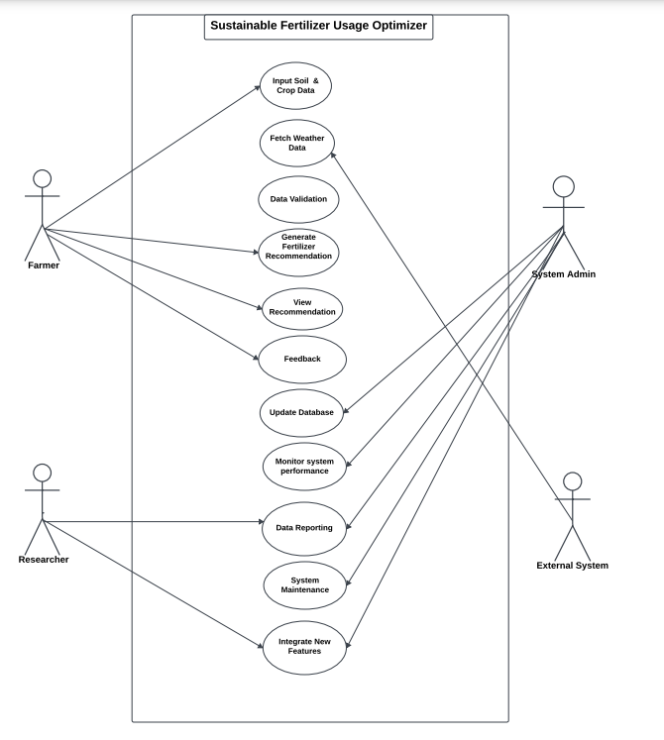
2.3 Use Case Diagram
Actors:
Farmer , Agricultural Expert, System Admin, External Systems
Use Cases:
Input Soil and Crop Data
Fetch Weather Data
Data Validation
Generate Fertilizer Recommendations
View Recommendations
Provide Feedback
Update Database
Monitor System Performance
Data Reporting
System Maintenance
Integrate New Features

Slide 8
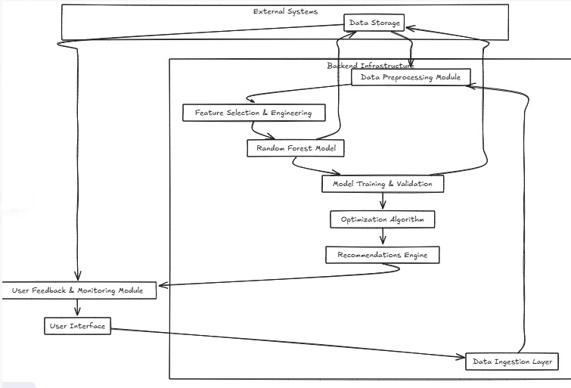
3. Technical Design 3.1 Technical Architecture

Slide 9
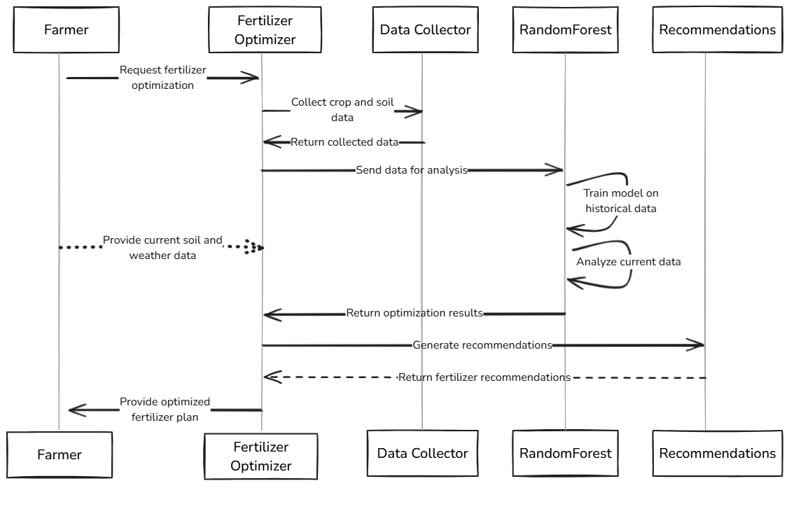
3.2 Sequence Diagram

Slide 10
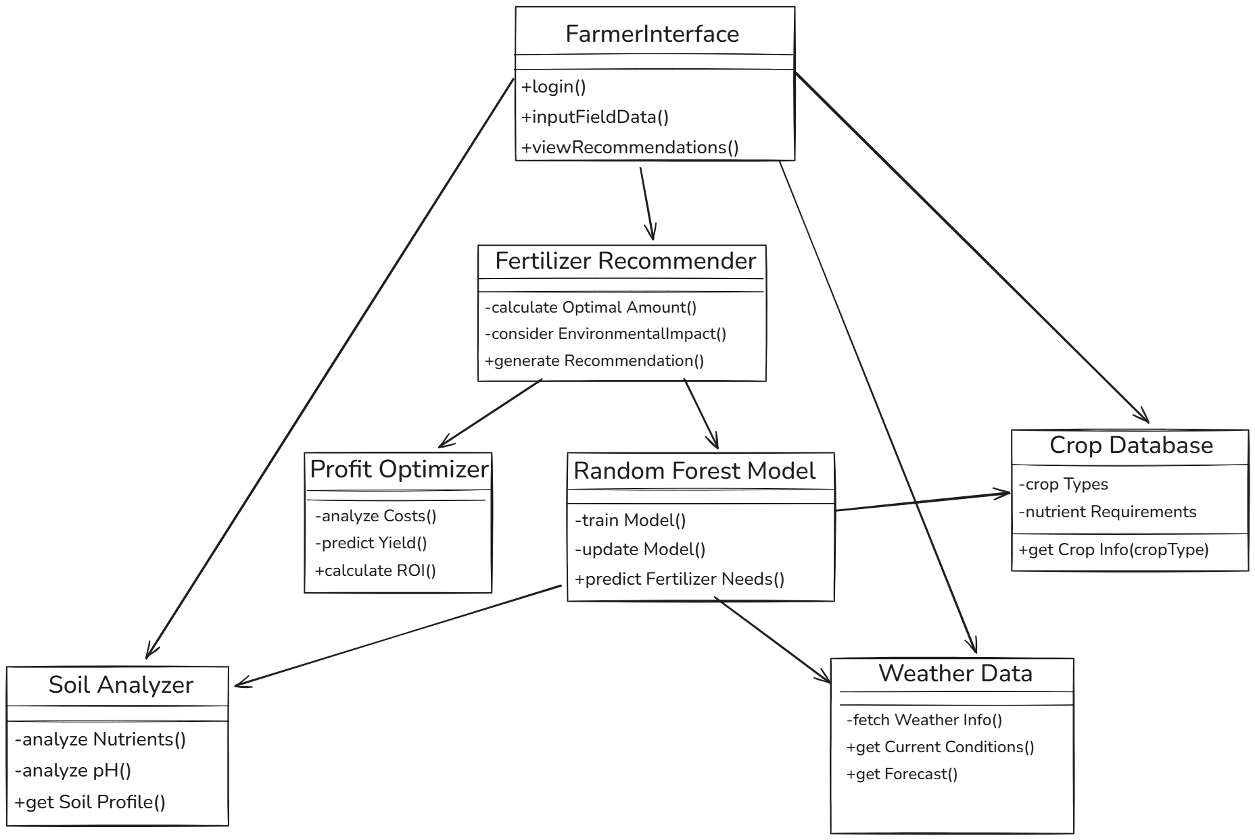
3.3 Class Diagram

Slide 11
3.4 DFD
DFD Diagram

Slide 12
3.4 DFD
DFD Diagram

Slide 13
4. User Inface Design
(Note: Need to show the Working UI during the presentation and Attach Screen Shots of working UI here)

Slide 14
4. Data Design 4.1 Schema Definition
Complete Database Design.

Slide 15
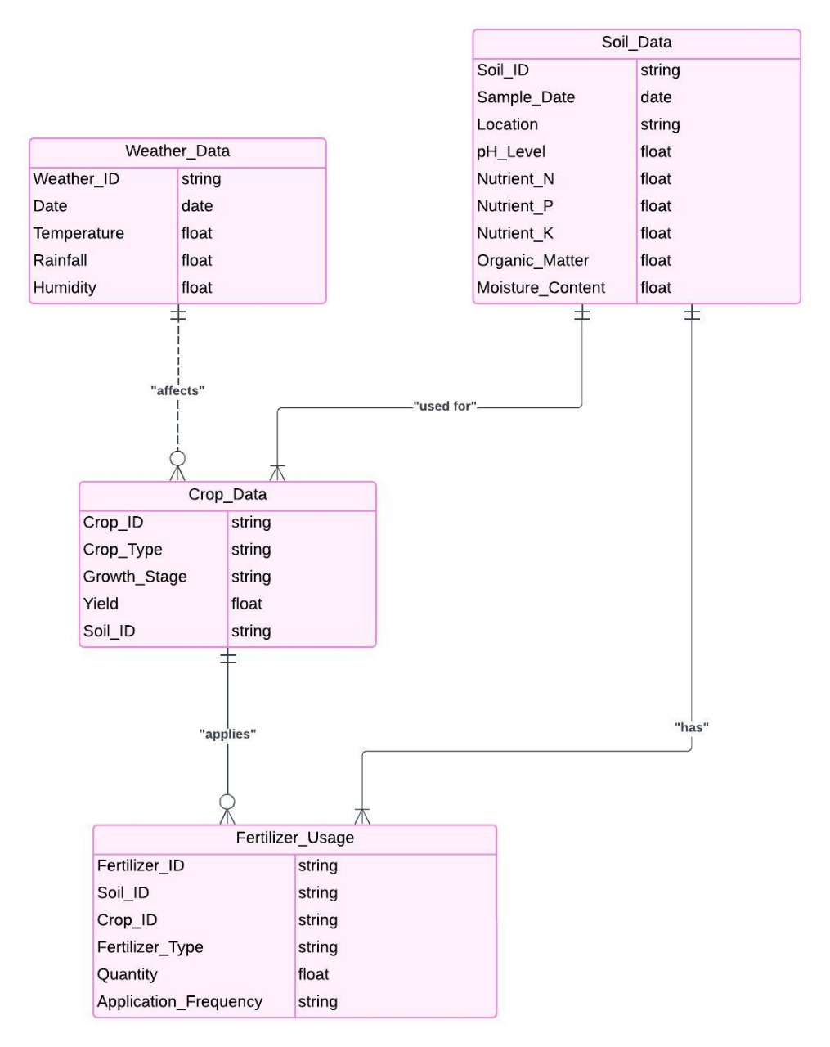
4.2 E-R Diagram

Slide 16
GitHub Link
https://github.com/AkratiNigam/Fertilizer-optimizer

Slide 17
REFERENCES
Analytics Vidhya. (2023, Jun. 10). Machine Learning Algorithms for Precision Agriculture [Online]. Available:https://www.analyticsvidhya.com/blog/2023/06/machine-learning-algorithms-for-precision- agriculture .
Fawcett, T. An Introduction to ROC Analysis. Pattern Recognition Letters, (2006).
Kaggle. (2024). Algorithms for Fertilizer Optimization for higher yield [Online]. Available: https://www.kaggle.com/datasets/algorithms-for-fertilizer-optimization .
M. Green. (2021, Jul. 10). Data-Driven Approaches to Fertilizer Application [Online]. Available: https://www.agritech.org/data-driven-fertilizer

Slide 18
Thank You
Queries ?

