Slide 1
Quarterly Business Report
Auto-generated by multi-agent GenAI pipeline

Slide 2
Key Performance Indicators
$12,410,000
Total Revenue
32,110
Total Units Sold
25.8%
Q1→Q4 Growth
North America
Top Region

Slide 3
Data Findings
• Total revenue across all regions grew from roughly $2.79M in Q1 to $3.51M in Q4.
• APAC had the smallest revenue base but the fastest growth rate.
• Churned customers declined in APAC and EMEA across the year but rose in North America in Q3 before recovering in Q4.

Slide 4
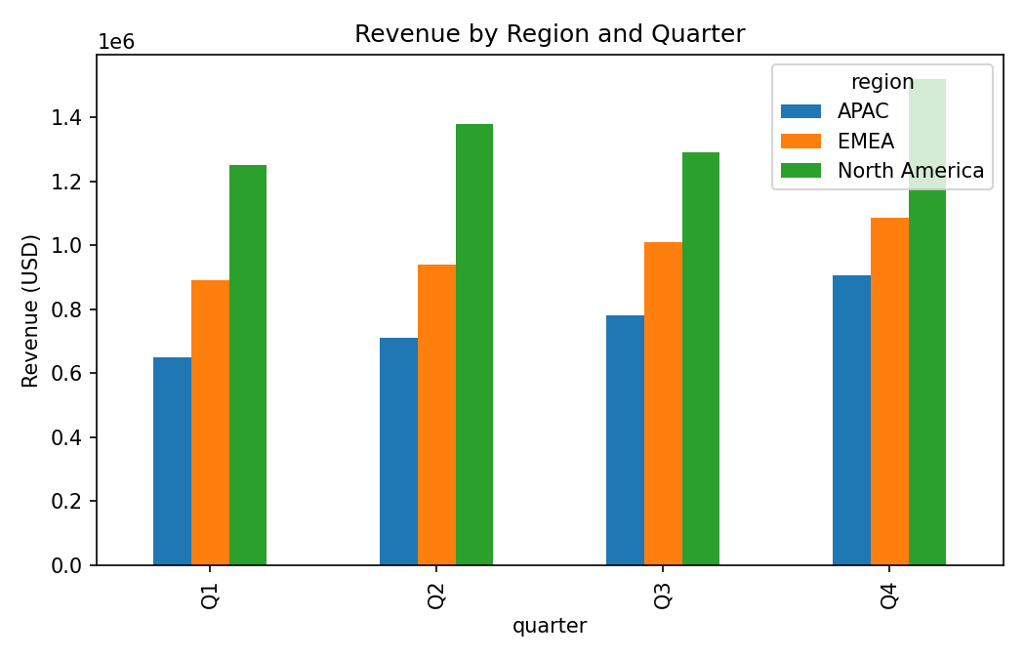
Supporting Chart

Slide 5
Chart & Document Findings
• The revenue chart shows all three regions trending upward from Q1 to Q4, with North America consistently the largest bar each quarter.
• The gap between North America and the other two regions narrows slightly by Q4 as APAC and EMEA grow faster.

Slide 6
Inferences & Recommendations
• Revenue grew across all three regions quarter over quarter, with APAC showing the steepest acceleration (+39% Q1->Q4).
• North America remains the largest revenue base but has the highest customer churn of the three regions, worth flagging to account teams.
• EMEA shows the most stable net customer growth (new minus churned), suggesting retention practices there could be a template for other regions.

