Slide 1

https://www.ana.co.jp/ja/in/

Slide 2
User Interface Design
Findings & Observations

Slide 3
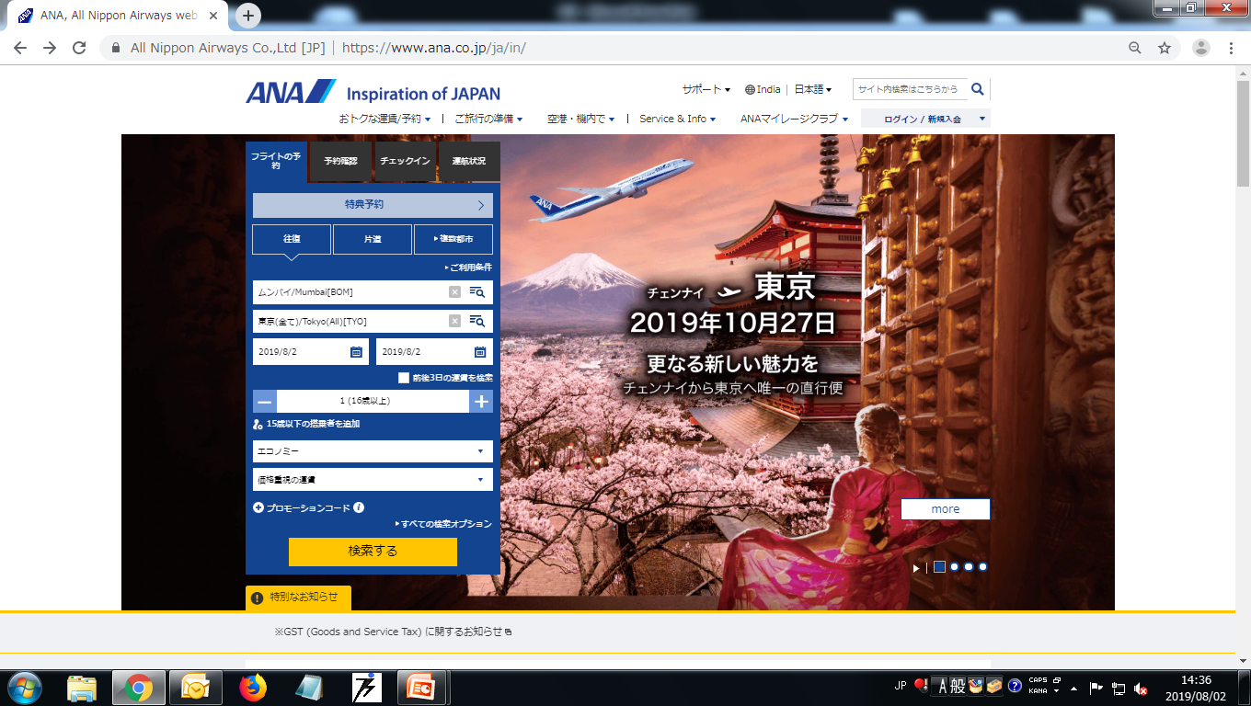
Home Page
1
3
4
6
2
5
7
8
9
10
11
12

Slide 4
What Looks Good in Home Page
① Title is Left Aligned in header section With Blue Color.
② Language Change Button taken in heading section, User can easy change language.
③ Textbox for Searching in heading session and also give Searching symbol there.
④ Main Menu in Black color and down arrow in blue color.
⑤ Login/Join Link in blue color in heading section with down arrow symbol.
⑥ Selected Link in Square blue color and not selected in black square and text in white color.

Slide 5
⑦ Square with white color boarder and background blue color with select square show down arrow
⑧ No extra space for Clear button and Search button.
⑨ The Calendar control show 3 months in single popup window.
⑩ Plus and minus symbol with white color and background in light blue and middle box in white color.
⑪ Button in yellow color and background blue color.
⑫ Background image slide show and play/Pause Functionality.

Slide 6
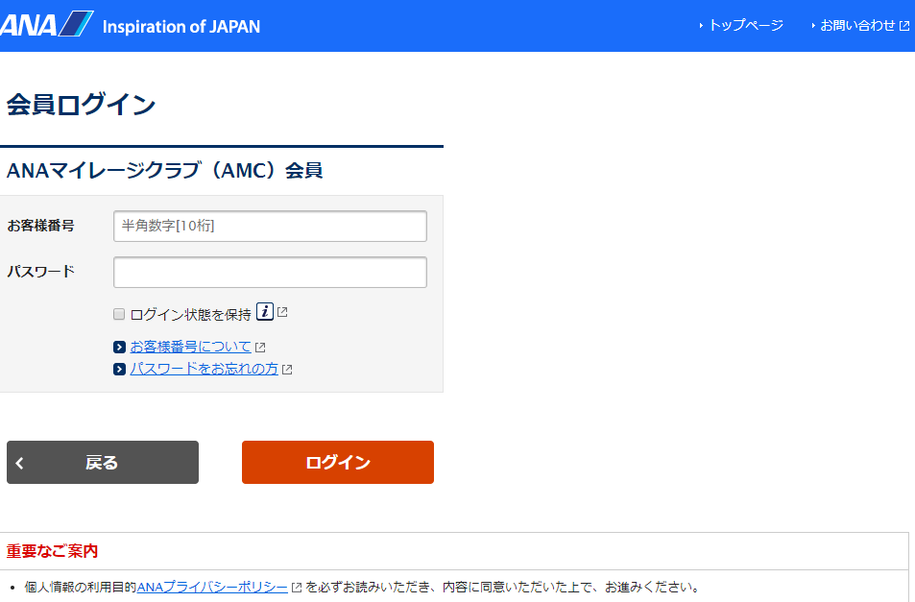
Login Ｐａｇｅ
1
2
3
4
5
6

Slide 7
Member login title is Left Aligned in blue color.
After clicking on textbox border of textbox show in blue color.
On Mouse Hover link color change blue to grey.
Login Button color is Orange and white text and when mouse hover on login button change orange color to light orange color.
Back button color is grey with white text and back arrow symbol.
Important Information text is Red color
What Looks Good in Ｌｏｇｉｎ Page

Slide 8
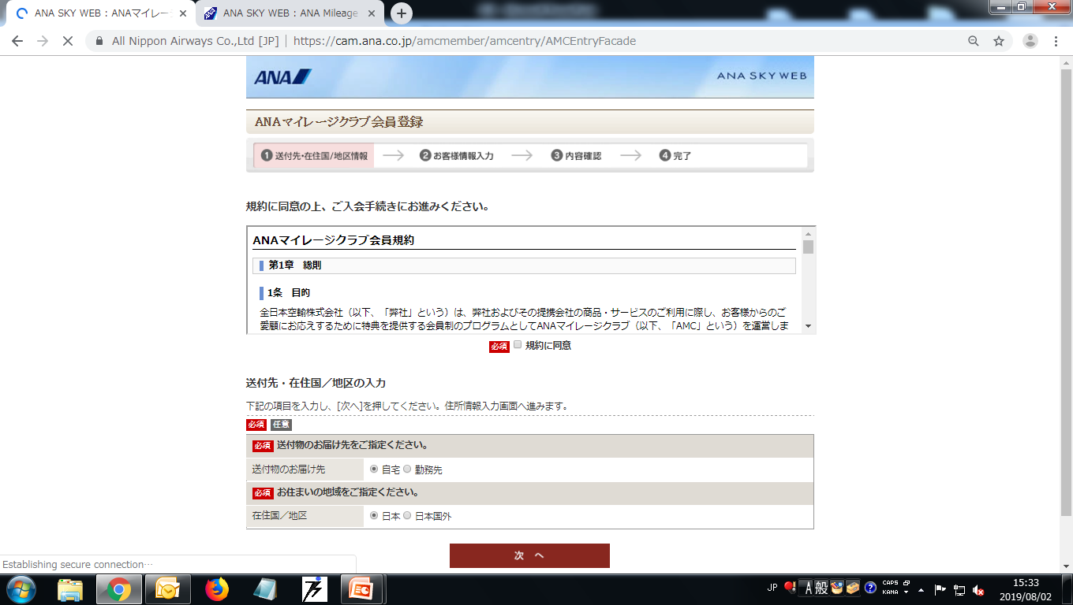
Registration Ｐａｇｅ
1
2
3
4
5

Slide 9
What Looks Good in Ｒｅｇｉｓｔｒａｔｉｏｎ Page
① Selected section square border and text in red color and background in light red color.
Terms and Conditions fond name is Time new roman and font size is 10.5 with black color text and bold.
Required label in red color and small uncheck checkbox.
"Required" text is white color and other text is black color and background is light pink.
Button text white color and background brown color and Button Alignment is Center.

Slide 10
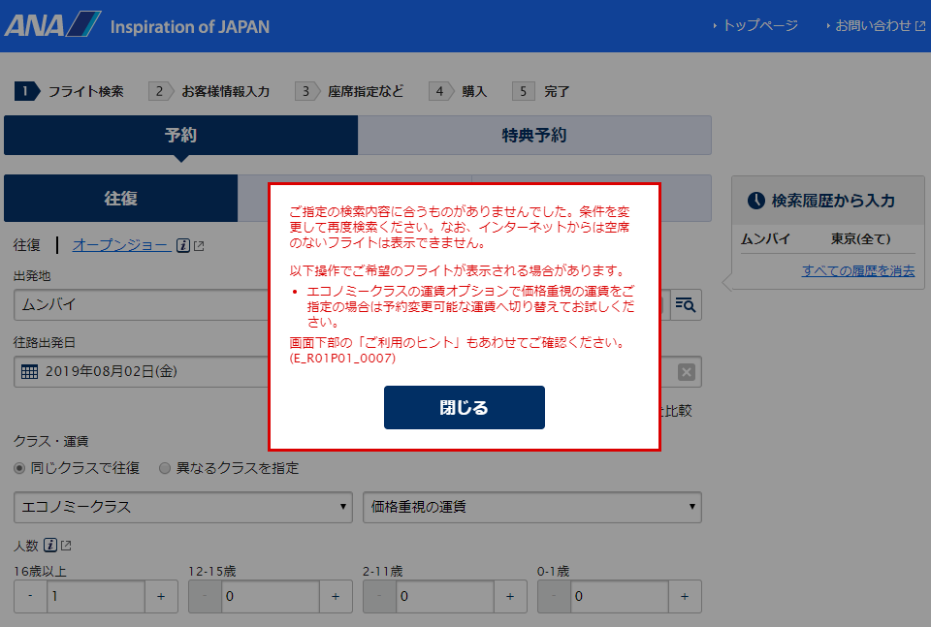
Popup For Error Message
1
2
3

Slide 11
What Looks Good in Popup windows
① Background window in hold state until an unless you not click on close button.
Error message in red color and border of popup window is red and background is white.
Close Button text in white color and background blue color.

Slide 12
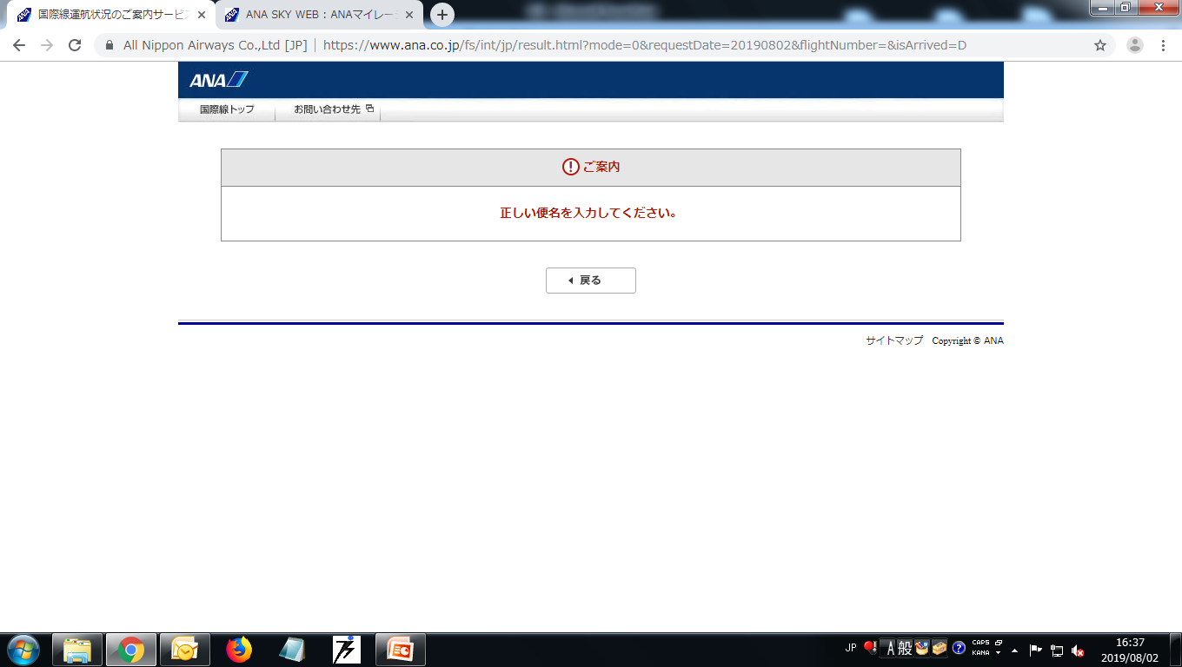
Error Page
1
23
4

Slide 13
What Looks Good in ＥｒｒｏｒＰａｇｅ
Top Menu with black text and grey background at Left alignment
Error Symbol in red color .
Error Message in red color and center alignment.
Back button with back arrow and back color text, white background and alignment is center.

Slide 14
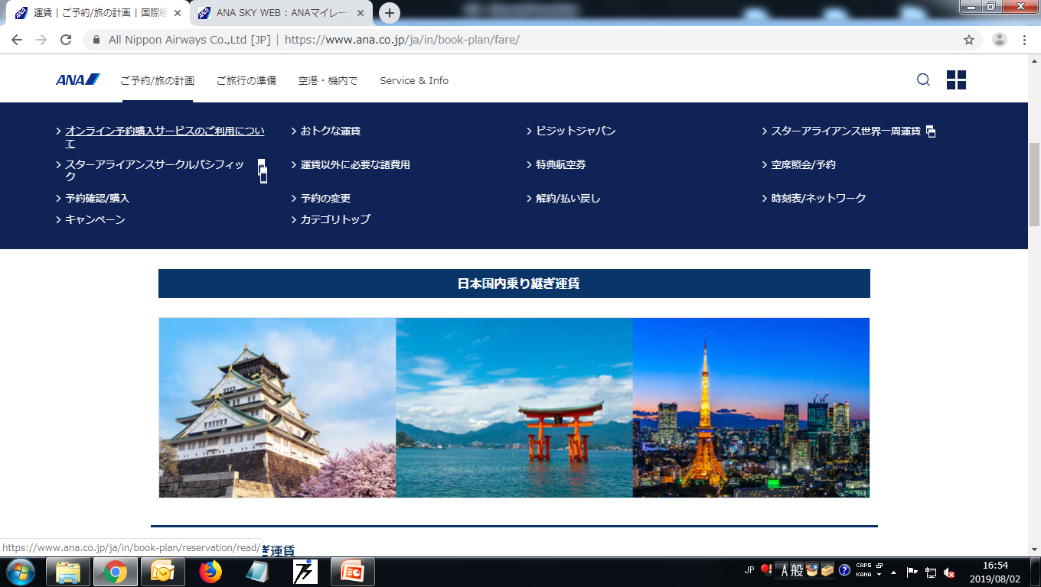
Menu And Submenu
1
2

Slide 15
What Looks Good in Ｍｅｎｕｓ
Ｍａｉｎ Ｍｅｎｕ ：
Main Menu text color is black and background is white.
when mouse hover on main menu blue color underline will show.
On Mouse hover sub menu will display.
② Ｓｕｂ Ｍｅｎｕ ：
Text Color White.
Background color blue.
Ｏn mouse hover show white color underline.

Slide 16
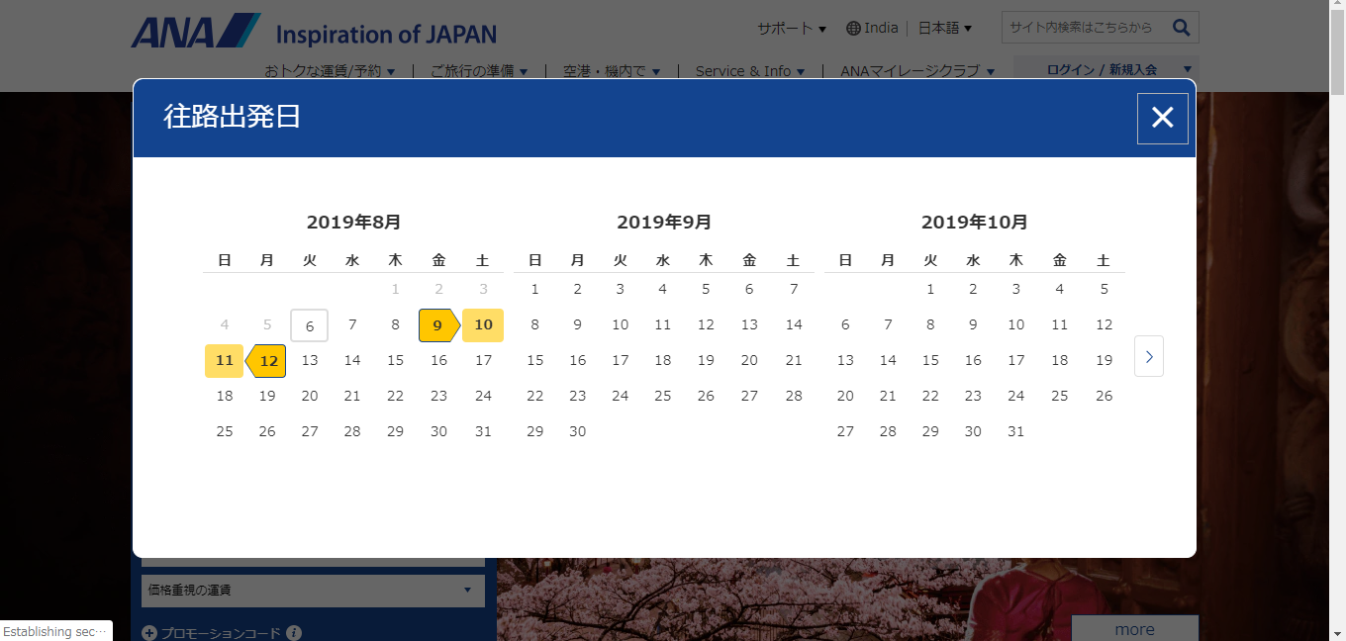
Ｃａｌｅｎｄｅｒ Ｖｉｅｗ
3
1
2

Slide 17
What Looks Good in Ｃａｌｅｎｄｅｒ Ｃｏｎｔｒｏｌ
① Calendar show 3 months in single popup.
② Selected date show in yellow color.
③ Ｗhen click on out of popup window space then popup
window will close.

Slide 18
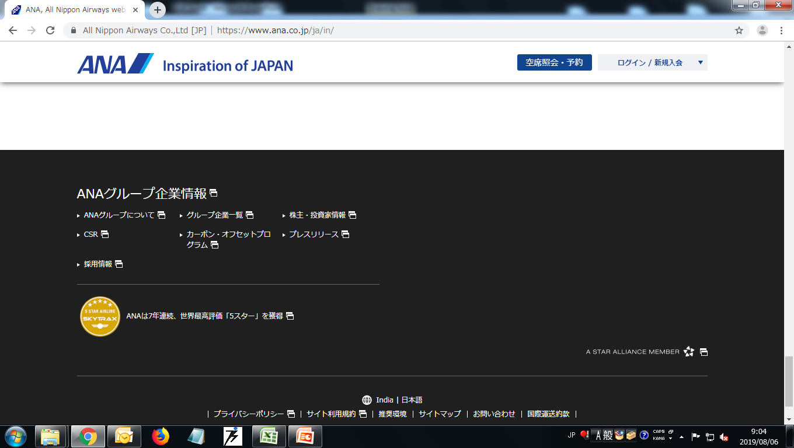
Ｈｅａｄｅｒ ａｎｄ Ｆｏｏｔｅｒ
1
2
3
4

Slide 19
What Looks Good in Ｈｅａｄｅｒ＆Ｆｏｏｔｅｒ
① The Header is freezing with background white color.
Logo is clickable. After clicking on logo then redirect
on home page.
Flight Reservation is link in blue color background and
white color text. After clicking on this link, page control
will jump at top.
④ Footer is Black color and text color is white.

Slide 20
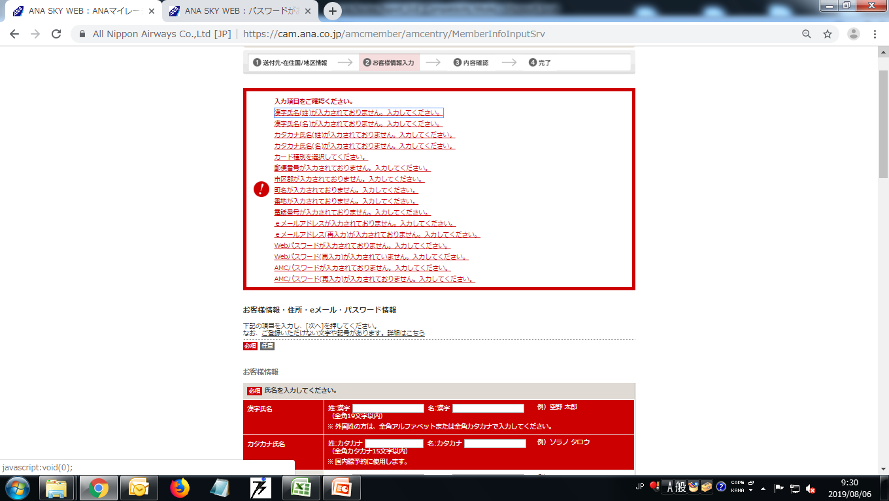
Registration Ｐａｇｅ
2
1
3

Slide 21
What Looks Good in Registration Ｐａｇｅ
① Show error message in rectangle box with red color.
The error message as a link. when click on error message
link then focus redirect on appropriate error section.
Error section background in red color and text in white
color.

Slide 22
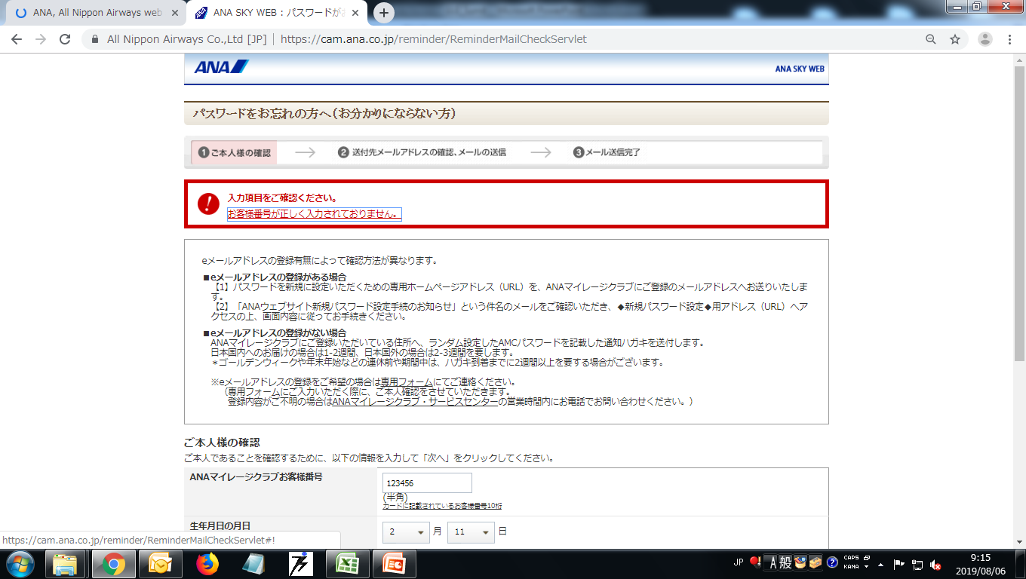
Ｆｏｒｇｅｔ Ｐａｓｓｗｏｒｄ Ｐａｇｅ
1
2
3

Slide 23
What Looks Good in Ｆｏｒｇｅｔ Ｐａｓｓｗｏｒｄ Ｐａｇｅ
① Show error message in rectangle box with red color.
The error message as a link. when click on error message
link then focus on textbox.
"Password will send on registered email" this information
shows.

Slide 24
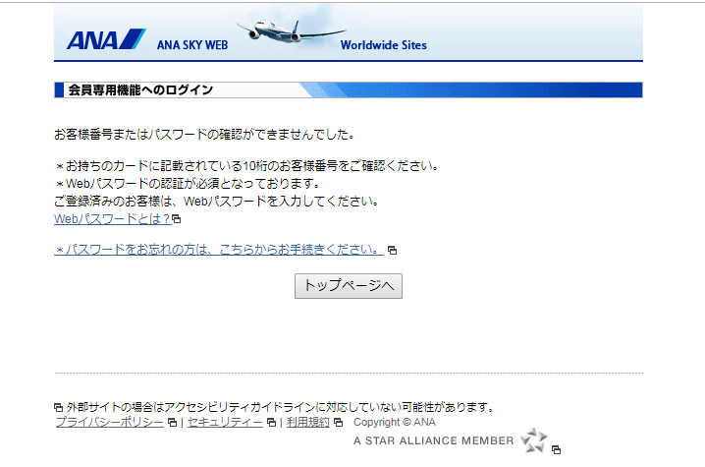
Ｌｏｇｉｎ Ｐｒｏｃｅｓｓ Ａｎｄ Ｅｒｒｏｒ Ｍｅｓｓａｇｅ
1
2
3

Slide 25
What Looks Good in Ｌｏｇｉｎ Ｐｒｏｃｅｓｓ Ａｎｄ Ｅｒｒｏｒ
Ｍｅｓｓａｇｅ
When user give wrong login input and click on Login button
then redirect on this page.
① Error Message with star(*) Symbol.
Forget Password page link.
Button for redirect on home page.

