Slide 1
Lead score case study
Logistic Regression

Slide 2
Problem staement

Slide 3
Business Goal

Slide 4
Strategy

Slide 5
Exploratory Data Analysis

Slide 6
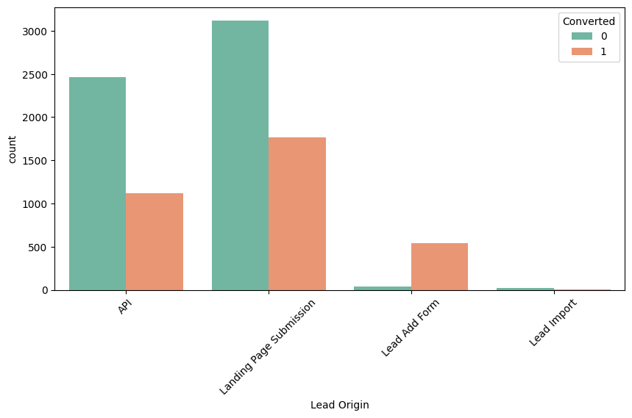
Lead origin Vs converted
Landing page submission has highest number of conversion followed by API
Lead Add Form has more than 90% conversion rate but count of lead are not very high.
Lead import is very insignificant.

Slide 7
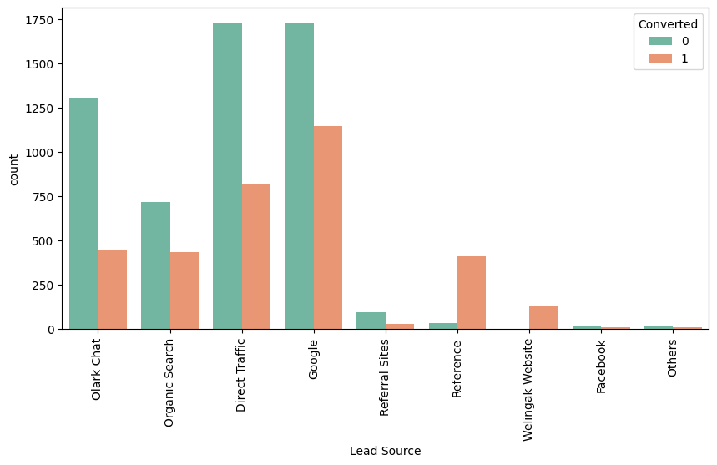
Lead Source Vs converted
Google and Direct traffic generates maximum number of leads.
Conversion Rate of reference leads and leads through welingak website is high.

Slide 8
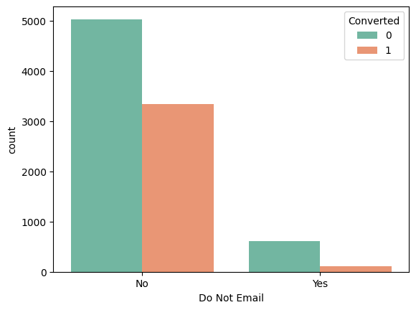
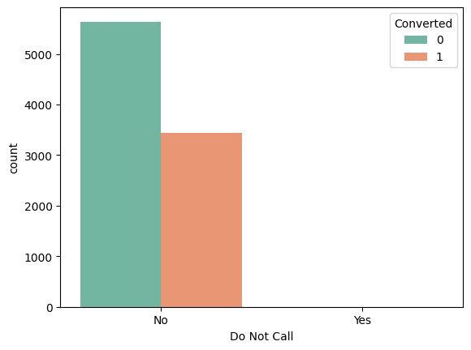
Do not call, Do not Email Vs converted
Most entries are 'No'. No Inference can be drawn with this parameter.

Slide 9
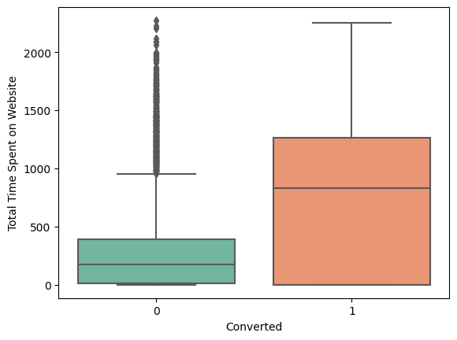
Total time spent on website Vs converted
Leads spending more time on the website are more likely to be converted.
Insight: Website should be made more engaging to make leads spend more time.

Slide 10
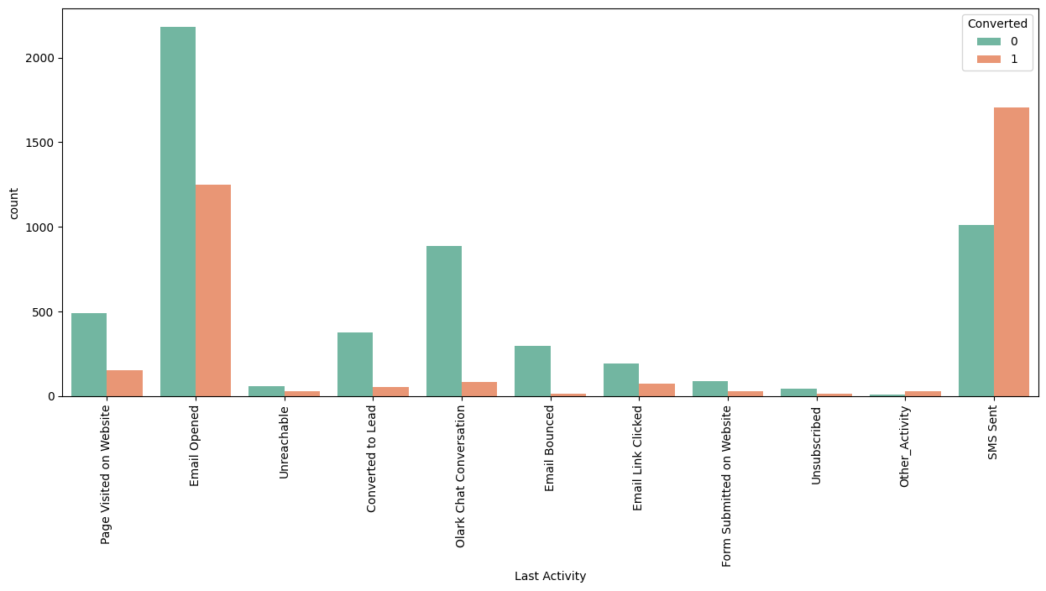
Last activity Vs converted
Most of the lead have their Email opened as their last activity.
Conversion rate for leads with last activity as SMS Sent is almost 60%.

Slide 11
Model building
Splitting into train and test set
Scale variable in train test
Build the first model
Eliminate variables on the basis of high p value
Check VIF value for all the existing variables
Predict using train set
Evaluate accuracy and other metrics
Predict using test set
Decision and recall analysis on test predictions

Slide 12
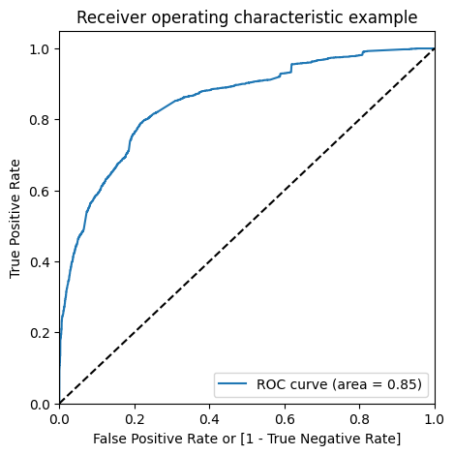
ROC curve
Since we have higher (0.85) area under the ROC curve , therefore our model is a good one.

Slide 13
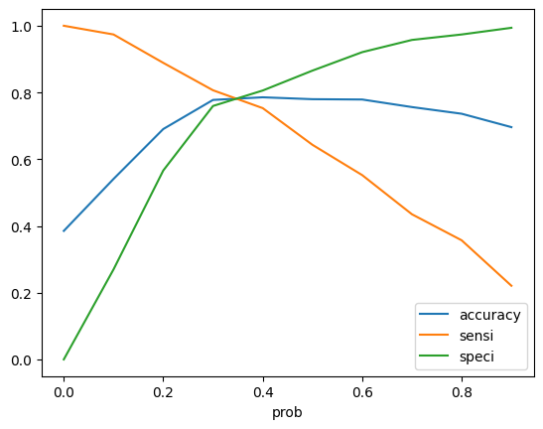
Deciding the optimum cut off
From the curve above, 0.35 is the optimum point to take it as a cutoff probability

Slide 14
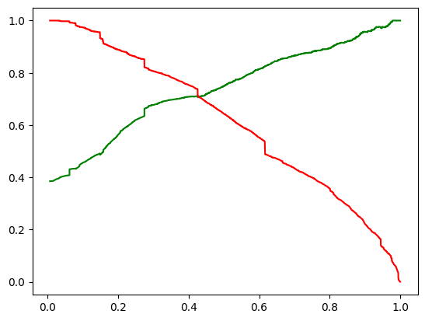
Trade off between precision and recall
Train Data:
Accuracy : 78.07 %
Sensitivity :78.29 %
Specificity : 78.64 %
Test Data:
Accuracy : 77 %
Sensitivity : 77 %
Specificity : 78.2%
We have achieved our goal of getting a ballpark of the target lead conversion rate to be around 80% . The Model seems to predict the Conversion Rate very well and we should be able to give the CEO confidence in making good calls based on this model to get a higher lead conversion rate of 80%.

Slide 15
Conclusion
The company should make calls to the leads who are the "working professionals" as they are more likely to get converted.
The company should make calls to the leads who spent "more time on the websites" as these are more likely to get converted.
The company should make calls to the leads coming from the lead sources "Olark Chat" as these are more likely to get converted.
The company should make calls to the leads whose last activity was SMS Sent as they are more likely to get converted.
The company should not make calls to the leads whose last activity was "Olark Chat Conversation" as they are not likely to get converted.
The company should not make calls to the leads whose lead origin is "Landing Page Submission" as they are not likely to get converted.
The company should not make calls to the leads whose Specialization was "Others" as they are not likely to get converted.
The company should not make calls to the leads who chose the option of "Do not Email" as "yes" as they are not likely to get converted.

