Slide 1
Polycystic Ovary Syndrome Detection
Using ULTRASOUND Images
2034023 JYOTSHSNA S

Slide 2
Table of contents
01
02
03
04
Objective
Dataset
Models
Code & Output
05
Inference

Slide 3
OBJECTIVE
To develop a disease diagnostics for PCOS
The aim of this network is to classify images as either depicting individuals diagnosed with polycystic ovary syndrome or not.
Aimed to train using Siamese network
We have our data as pairs along with their label From the image pair, we feed one image to the network A and another image to the network B. We use two convolution layers with relu activations for extracting the features. Once we have learned the feature, we train our network by feeding the image pair to learn the semantic similarity between them.

Slide 4
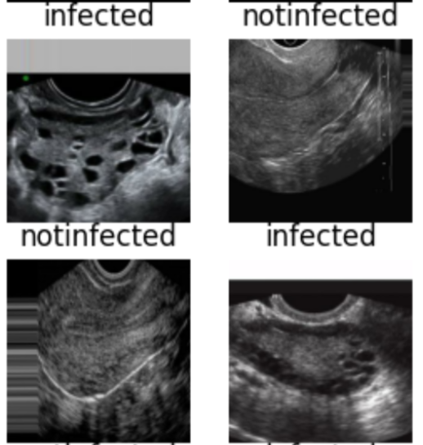
DATASET
A Datasets included ultrasound pictures of healthy ovaries as well as cystic ovaries. The ultrasound photos that showed infected cysts on the ovary were given the label ‘infected’ while the ultrasound images that showed a healthy ovary were given the label ‘not infected’.

Slide 5
Data Preprocessing
ImageDataGenerator class from the Keras library to perform various preprocessing techniques on image data.
Rescaling: The pixel values of the images are rescaled to the range of [0, 1] using the rescale parameter, which is set to 1./255.
Shear Transformation: Random shear transformations are applied to the images with a shear intensity of 0.2 using the shear_range parameter, which is set to 0.
Zooming: Random zoom transformations are applied to the images with a zoom range of 0.2 using the zoom_range parameter, which is set to 0.2
Flipping: Random horizontal and vertical flips are applied to the images
Rotation: Random rotation transformations are applied to the images with a rotation range of 30 degrees ,where the parameter is set to 30.
Fill Mode: The pixels that are created during the above transformations and do not have a value are filled with the nearest pixel value from the original image using the fill_mode parameter, which is set to 'nearest'. This can help to fill in gaps or missing values in the transformed images.

Slide 6
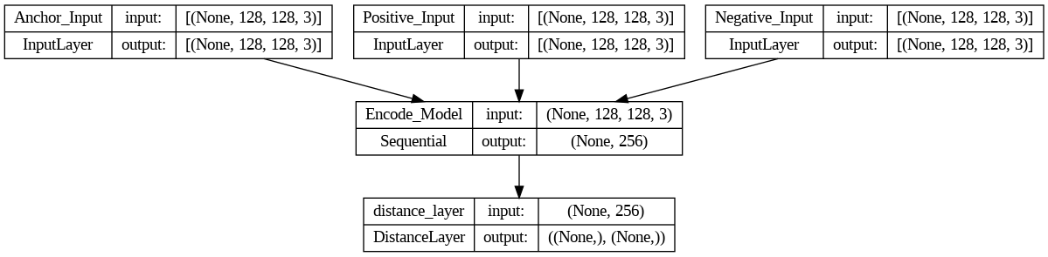
Siamese model

Slide 7
MODEL
1.Transfer learning was used with the respective models as a starting point.
2. The pre-trained models were loaded without the top layers.
3. Custom top layers were added to adapt the model to the specific dataset.
4. The model was compiled using the Adam optimizer and categorical crossentropy loss.
5. Data generators were utilized to provide the model with augmented data during training.
6. The model was trained for 10 epochs with a batch size of 32 and specific hyperparameters.
7. The validation set was used to determine that accuracy.
MobileNet : loss: 2.9671 - accuracy: 0.5000
DenseNet : loss: 0.2136 - accuracy: 0.9222
InceptionV3 : loss: 0.0041 - accuracy: 0.9988

Slide 8
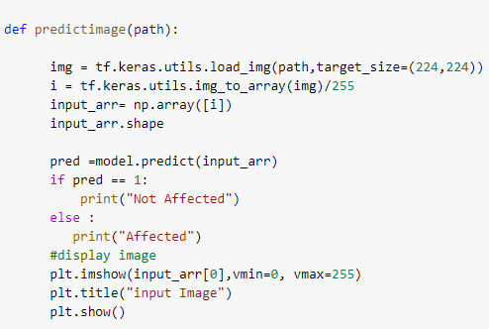
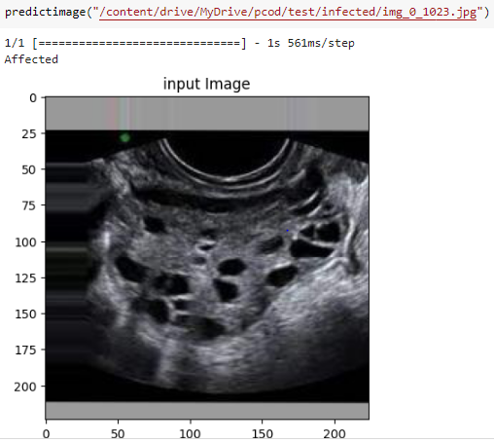
INFERENCE

Slide 9
Thank You

