Slide 1
IBM TELCO customer CHURN ANALYsIS
Python | sql | Excel | power bi
By jyotsana
https://github.com/Jyotsana1107/
www.linkedin.com/in/jyotsanaanand11

Slide 2
Executive Summary
This report details the comprehensive analysis of customer churn undertaken to identify key drivers and provide actionable insights. By leveraging SQL for data extraction and manipulation, Power BI for visualization, and Excel for supplementary analysis, we have gained a deep understanding of why customers are leaving. The findings presented herein will guide strategic decision-making to improve customer retention and drive sustainable business growth.

Slide 3
Business problem
High customer churn rates present a significant challenge to business growth and profitability. Understanding the underlying reasons for customer attrition is crucial for developing effective retention strategies. Without a clear understanding of churn drivers, the business risks continued revenue loss and a decline in market share.

Slide 4
Business objectives
Identify the primary drivers of customer churn.
Quantify the impact of various factors on churn probability.
Provide data-backed recommendations for improving customer retention.
Establish a foundation for ongoing churn monitoring and prediction.
Develop a clear and actionable understanding of customers leading to churn.

Slide 5
The objective of this project is to identify the major factors associated with customer churn and provide business-focused recommendations
_{Total Customers - 7032}
Churned Customers - 26.58% (1869)
Retained Customers - 73.42% (5163)
_{10+ Business Factors Analyzed}
The analysis was performed on a comprehensive dataset containing Customer Profile, Core Services, Additional Services, Streaming Services, Contract, Billing, Revenue, number of Customers Churned and Retained. The dataset comprises 7032 records and 8 main features, providing a rich source of information for understanding customer behavior.

Slide 6
Project methodology
Data Extraction & Understanding: Retrieved relevant data using Excel and performed an initial exploration to understand data structure and quality.
Data Cleaning & Pre-processing: Handled missing values, corrected inconsistencies, and transformed data into a suitable format for analysis using Python
Exploratory Data Analysis (EDA): Analyzed key variables and their relationships with churn using SQL.
Churn Driver Identification: Identified and quantified the factors most strongly associated with customer churn.
Visualization & Reporting: Developed Power BI dashboards to present findings and created this comprehensive report.

Slide 7
Dashboard overview
The accompanying Power BI dashboard provides a dynamic and interactive view of customer churn.
Key features include:
Overall Churn Rate: A clear indicator of the current churn situation.
Churn by Demographics: Breakdown of churn across different age groups, genders, and locations.
Service Usage Impact: Visualization of how usage patterns affect churn.
Contractual Factors: Analysis of churn based on contract type, tenure, and charges.
Customer Support Trends: Insights into the relationship between support interactions and churn.
Key Churn Drivers: Highlights of the most influential factors contributing to churn

Slide 8
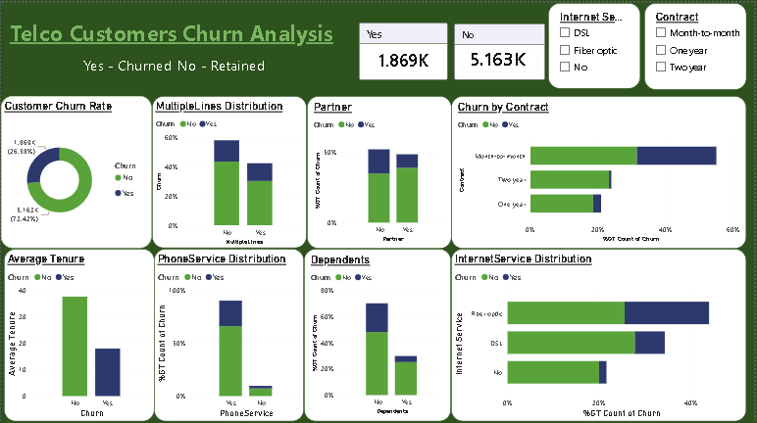
Customer Profile and Core Services

Slide 9
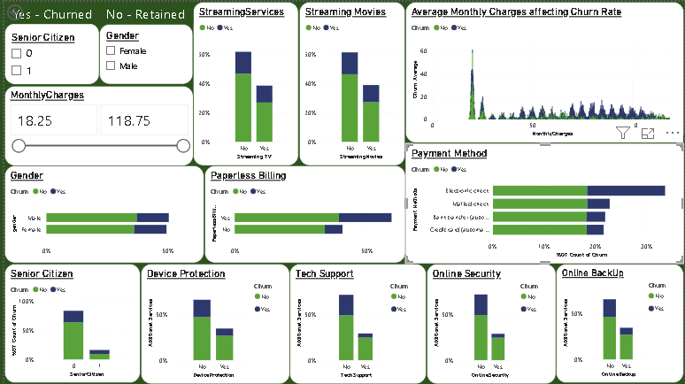
Additional Services and Billing Methods

Slide 10
Business insights
Overall churn rate is 26.58% (1 in every 4 customers leaves).
Month-to-Month contracts contribute the highest share of customer churn.
Fiber Optic customers represent the largest churn segment among internet service types.
Customers with shorter tenure are more likely to churn.
Customers without Online Security, Online Backup, Device Protection, and Tech Support consistently show higher churn.
Electronic Check users exhibit higher churn than customers using other payment methods.
Streaming Services and Phone Service show comparatively weaker relationships with churn.

Slide 11
Business recommendations
Develop targeted retention campaigns for Month-to-Month customers.
Investigate the reasons behind higher churn among Fiber Optic customers.
Strengthen customer engagement during the early months of the customer lifecycle.
Promote value-added services such as Online Security and Tech Support where appropriate.
Review the Electronic Check payment experience and evaluate improvements.

Slide 12
conclusion
This customer churn analysis identified the key factors associated with customer attrition using Python, SQL and Power BI. Customers with Month-to-Month contracts, Fiber Optic internet, shorter tenure, and fewer additional services contributed a larger share of churn. The findings highlight customer segments that require greater attention and support. These insights can help the company make informed decisions, improve customer retention strategies, and enhance overall business performance through data-driven decision-making.

