Slide 1

PS Code : NK827
Problem Statement Title : Prediction of Oil Spills Events at Sea
(POSEatSea)
Team Leader Name : Jyotshsna S
Institute Name : Coimbatore Institute of Technology
Theme Name : Disaster Management

Slide 2
Problem Statement
The problem statement is to develop an AI-based system that can accurately predict and promptly detect oil spill events at Sea and enable faster mitigation to reduce risk of pollution caused by the spill. The system needs to be able to predict and locate the exact location of spill accurately, intimate the authorities and response teams to take disaster recovery methods and communicate real-time status. The goal is to enhance the response to environmental disasters, reducing their impact and safeguarding the environment and sensitive ecosystems. By achieving specific objectives, the response's speed and efficacy can significantly improve, ultimately multiple of UN-SDGs and UNDOSSD objectives.

Slide 3
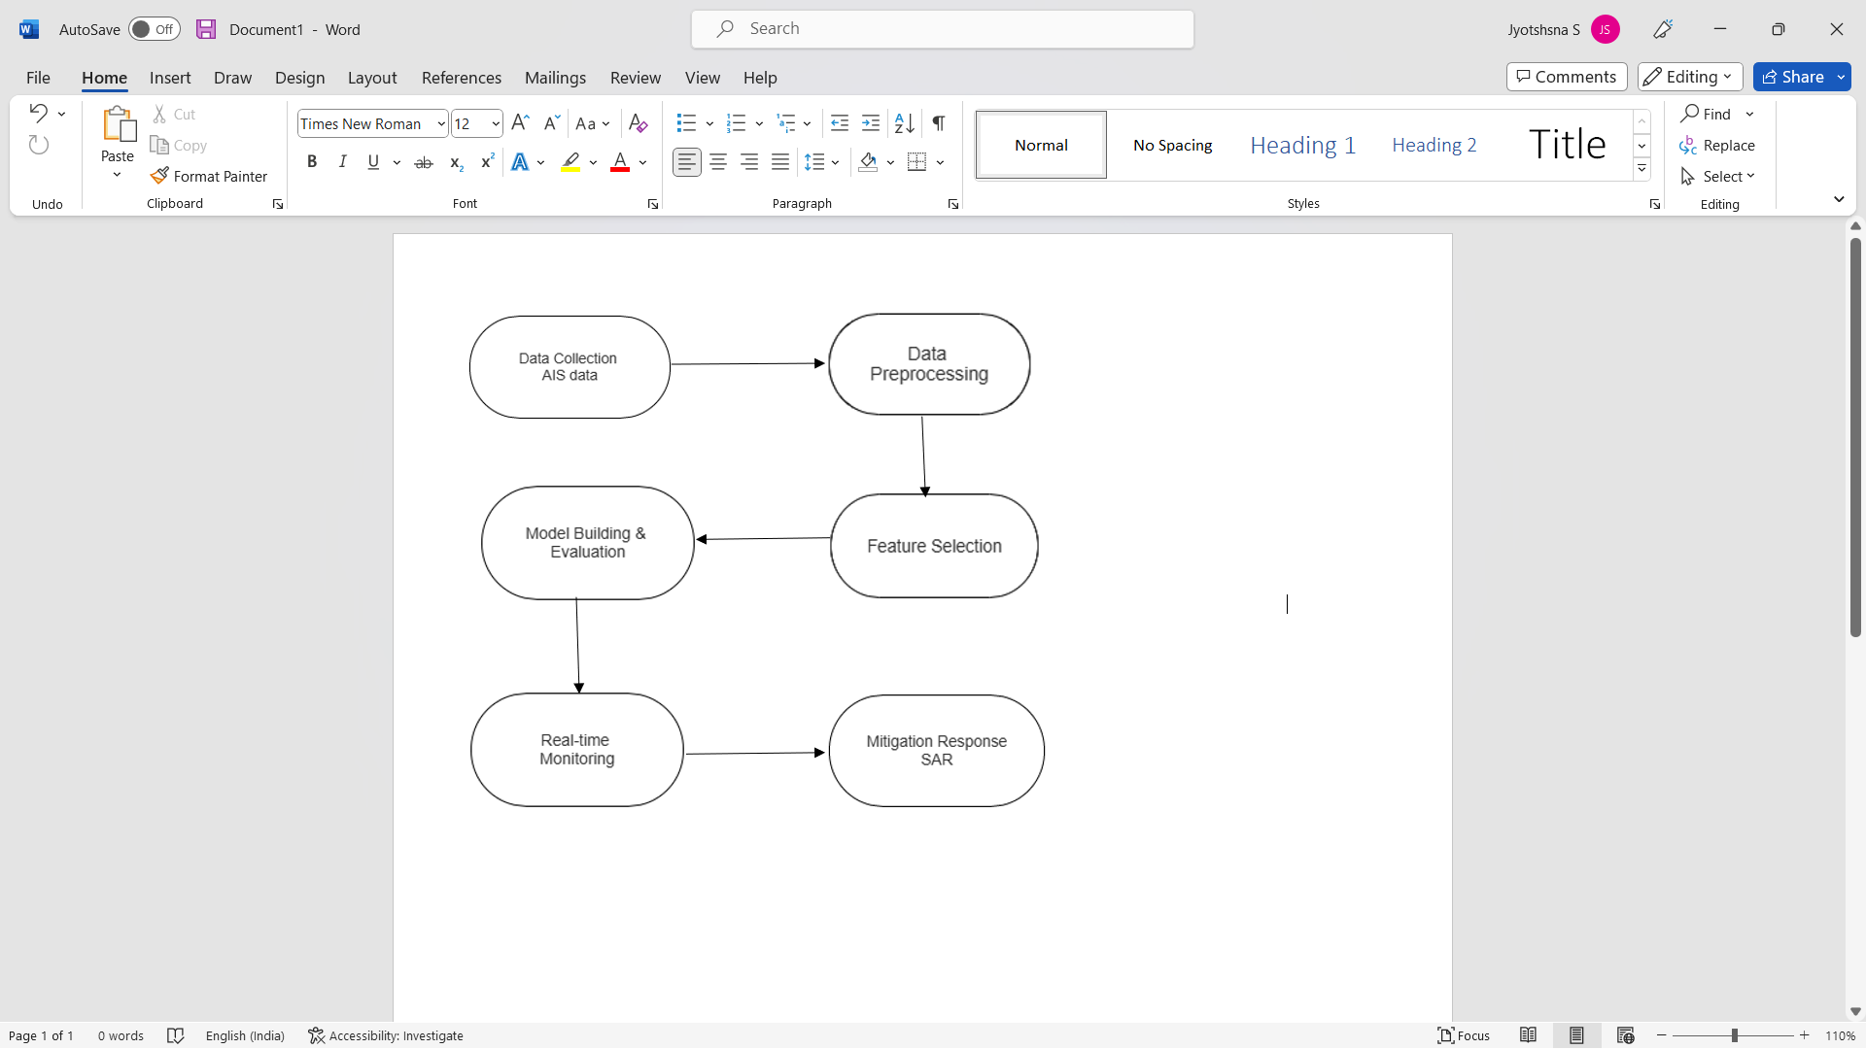
Idea
Process Flow
The system uses deep learning algorithms to predict oil spill events when there is a slick and uses computer vision techniques to mitigate the effects, thereby protecting and conserving the ecosystem.
These algorithms have shown promising results in time-series analysis and prediction tasks.
Once a potential oil spill event is predicted based on the analysis of AIS data, SAR data can be used to narrow down the region to identify the exact location of the spill by comparing images of the ocean surface to identify any changes in water surface roughness, which could indicate the presence of an oil slick.

Slide 4
Solution
RNN - LSTM
LSTM models are used for predicting oil spills as they can analyze ship movements and behaviors over time to predict the likelihood of a spill occurring. These models are capable of capturing long-term dependencies in sequential data, which is crucial when predicting events that may occur over extended periods.
LSTMs are trained on historical AIS data to learn the patterns of ship movements and identify any anomalous behavior.
The model learns to associate certain patterns in the AIS data with the occurrence of an oil spill, and The model can then output a prediction for whether an oil spill is likely to occur based on the input sequence.
TECHNOLOGY STACKS USED
Deep Learning
Computer Vision
Communication Protocols
Hardware
Programming Languages & Frameworks
USE CASES
Offshore oil rigs
National Disaster Response Force (NDRF)
Ocean conservation agencies
Port cities and Coastal regions
Emergency Services
DEPENDENCIES
Availability and Quality of Data
Environmental factors
Access to SAR data from satellites or drones
Computational Resources
Accuracy and Reliability

Slide 5
Thank You !

