Slide 1

Automating Leave Approval System:
We contributed by designing and developing a user-friendly Leave Approval System that simplifies leave tracking and ensures smooth communication between Students and Mentors.
Meet Our Team :
23A91A61C7 T.Surya
23A91A6116 G.Lakshmi Durga
23P31A4421 M.V.Phani Sai Teja
23A91A61H5 P.L.M.Neeraja
24P35A4230 S.Sarika Reddy
23P31A4441 S.Jyotsna Sai Surekha

Slide 2


Automating Leave: Our New Approval System
This system automates the process of applying and approving student leave requests by the Mentors using Microsoft tools.
This project was developed by our dedicated team.
We are transforming administrative burdens into streamlined, efficient workflows through our Leave Approval System.

Slide 3

The Challenge: Manual Leave Management Pain Points
Slow Approvals
Average 3-5 days for a single leave request cycle.
Error Prone
Manual data entry leads to 15-20% error rate in tracking.
Lack of Visibility
Mentor spends 10+ hours/week on status inquiries.
Compliance Risks
Inconsistent application of leave policies makes audit trails difficult.

Slide 4




Our Solution: The Automated Leave Approval System
Objective
Our Leave Approval System is to streamline and simplify the process of requesting, approving, and tracking leaves that are submitted by the Students via Forms .
Scope
Covers all types of leaves like, sick, vacation and other leaves.
Outcome
Enhanced efficiency, accuracy, and transparency for all Mentors

Slide 5
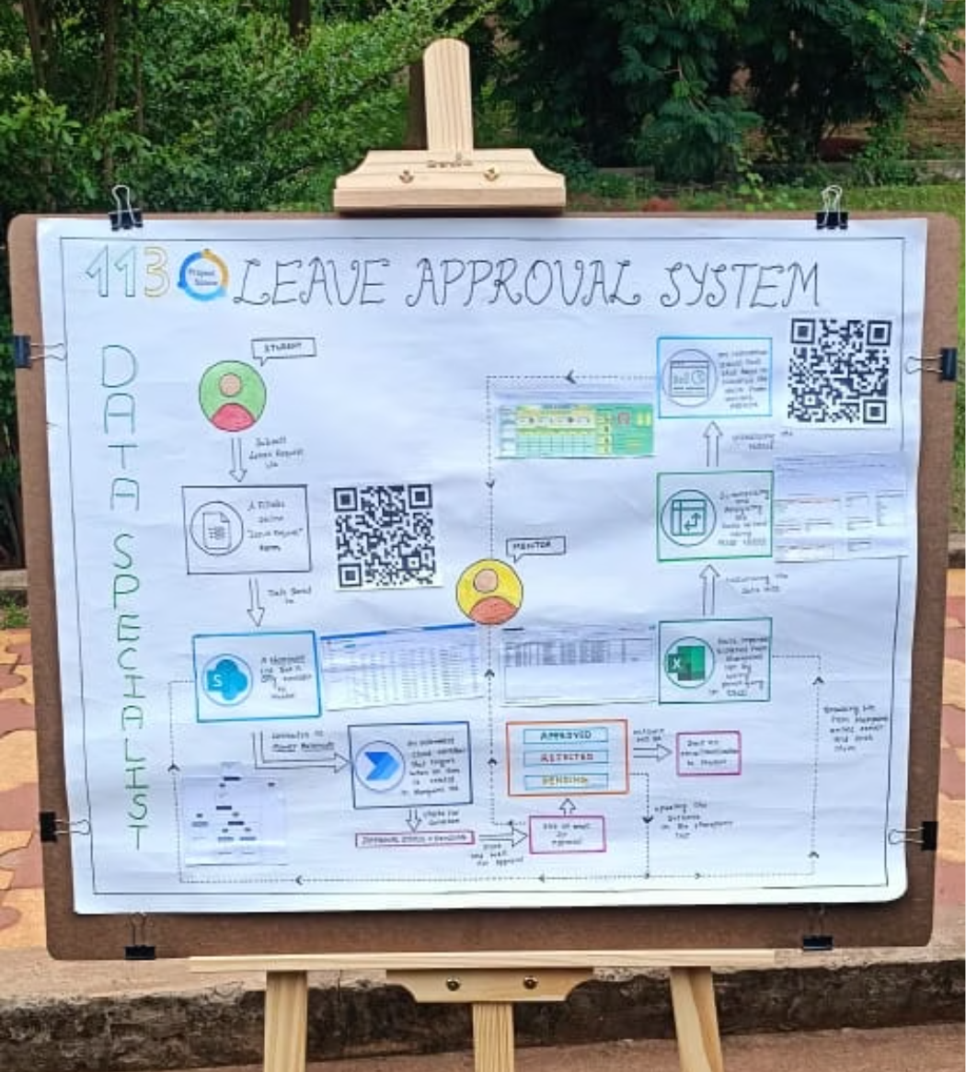
Overall Flowchart of the System
This flowchart represents the complete end-to-end process flow of the Leave Approval System.

Slide 6



Technology Stack: SharePoint, Excel, & Power Automate
Power Automate
SharePoint Online
Excel Online
Powers the workflow engine for requests.
Centralized portal for forms and data storage.
Used for dynamic reporting dashboards.
Handles approvals and automated notifications.
Supports bulk data uploads within SharePoint.
Uses SharePoint Lists for robust record-keeping.

Slide 7
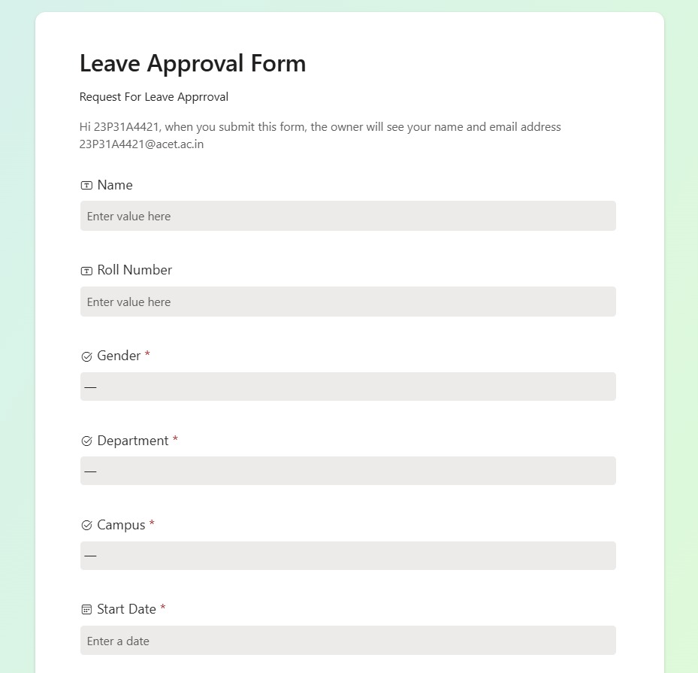
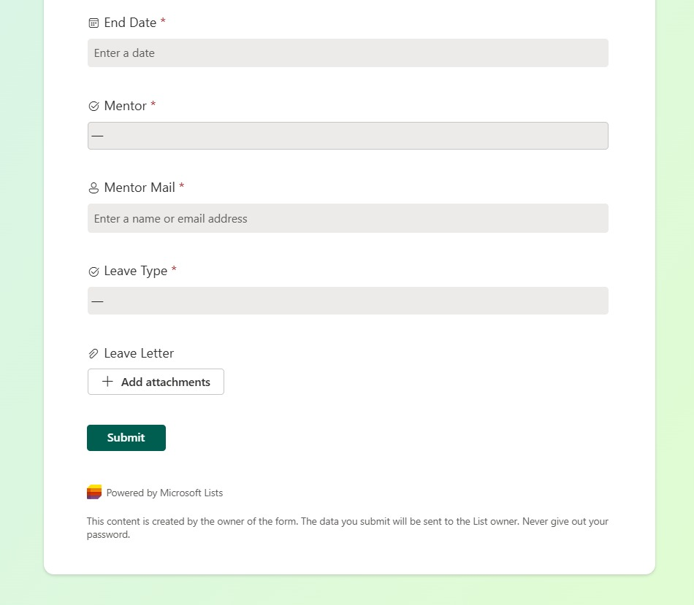
SharePoint Form In Leave Approval System
The SharePoint Form is used as the front-end interface for students or employees to submit their leave requests.
Benefits:
Reduces paperwork and manual tracking.
Ensures consistent leave request entries.
Enables centralized leave data management.

Slide 8
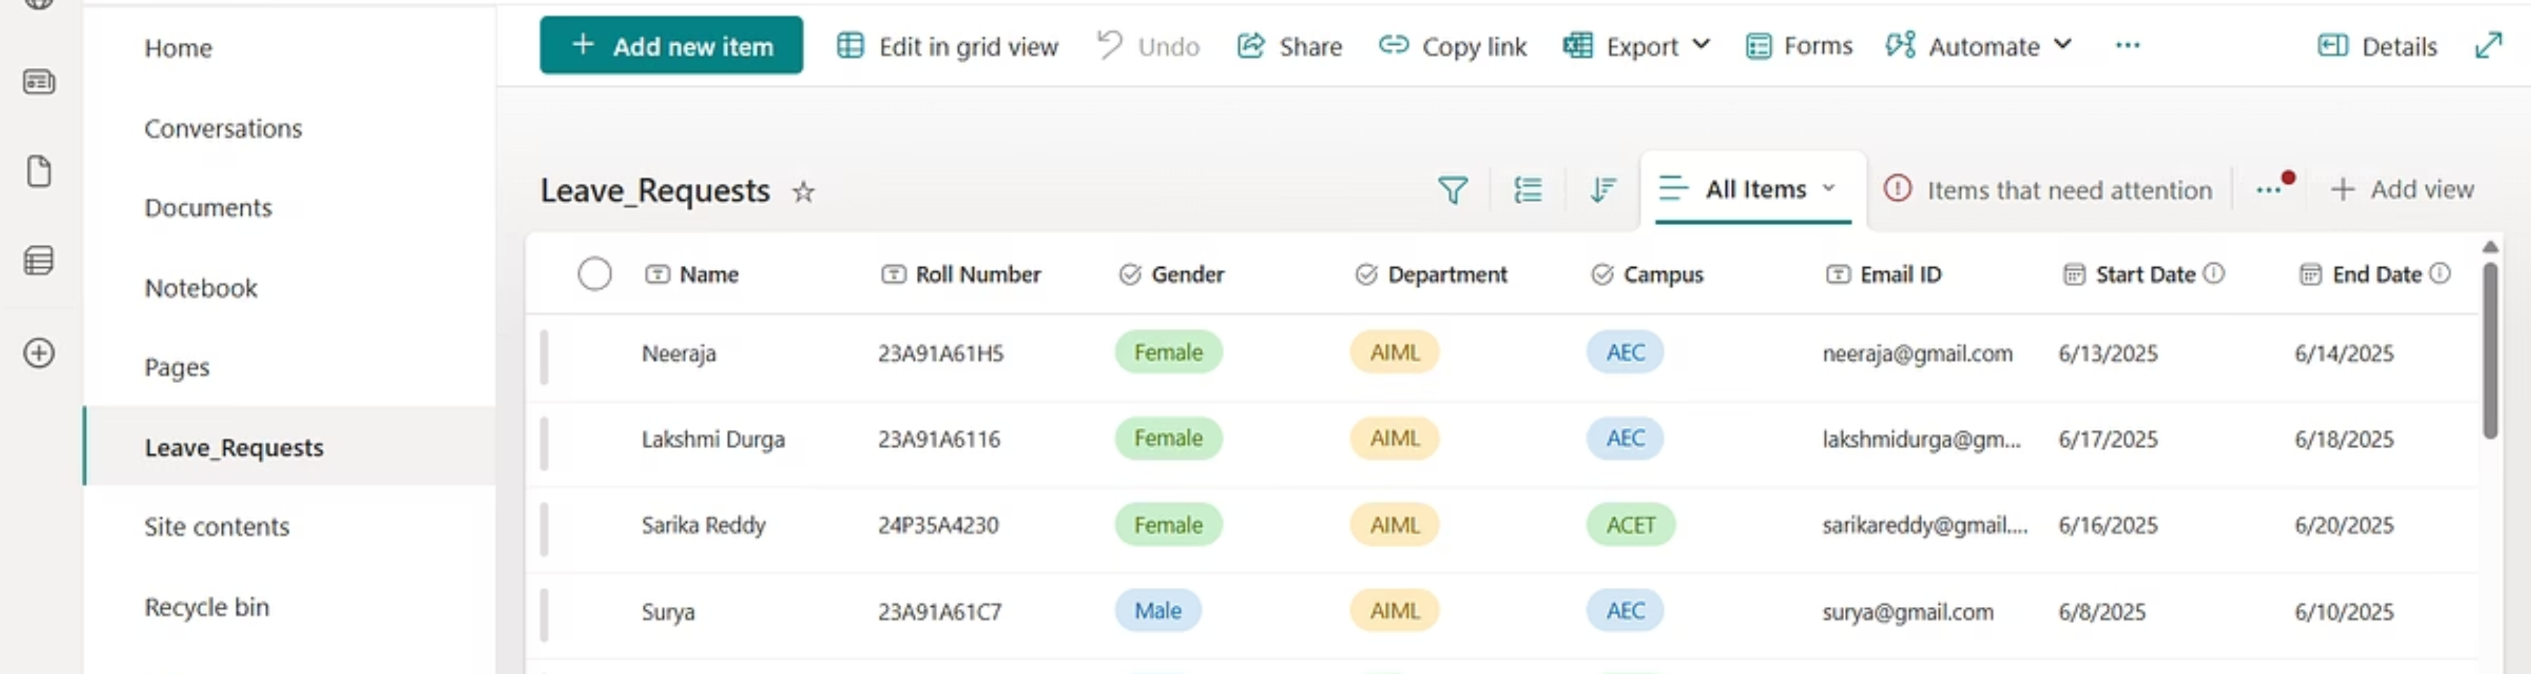
SharePoint Form Creation – Data Collection
🔹 We designed a custom SharePoint Form as the first step in the Leave Approval process.
🔹 This form collects leave requests from students and captures the following fields Name,Roll Number,Start Date of Leave,End Date of Leave,etc.
🔹 Once the form is submitted, all the data is automatically stored in a SharePoint List for further processing.
🎯 This setup ensures centralized, organized, and easily accessible records of student leave requests.

Slide 9
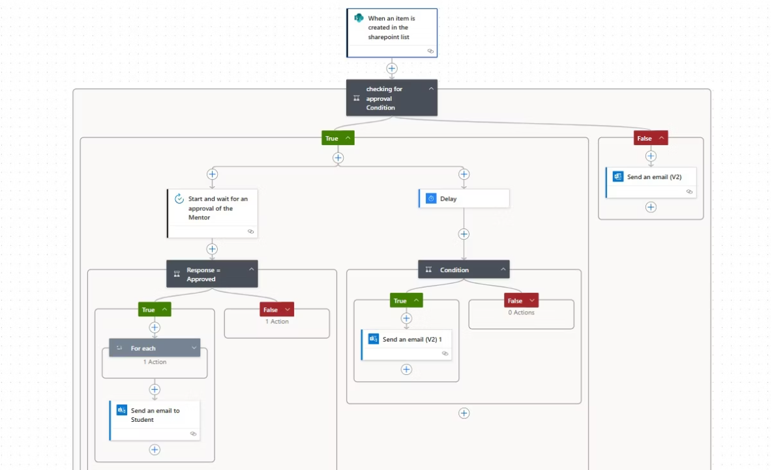
Power Automate – Automated Approval Workflow
📥 Trigger Point:
The flow is automatically triggered when a student submits the Leave Approval Form in SharePoint.
📤 Email to Mentor:
Power Automate captures the form data (Name, Roll No, Dates, Reason)
It then generates a formatted approval email and sends it to the respective mentor for decision-making.
✅❌ Approval Response Handling:
Once the mentor approves or rejects, Power Automate:
Updates the SharePoint List with the decision
Sends an automatic email to the student with their leave status (Approved/Rejected)
🚀 This eliminates manual follow-ups and ensures a smooth, fast, and transparent approval process.

Slide 10

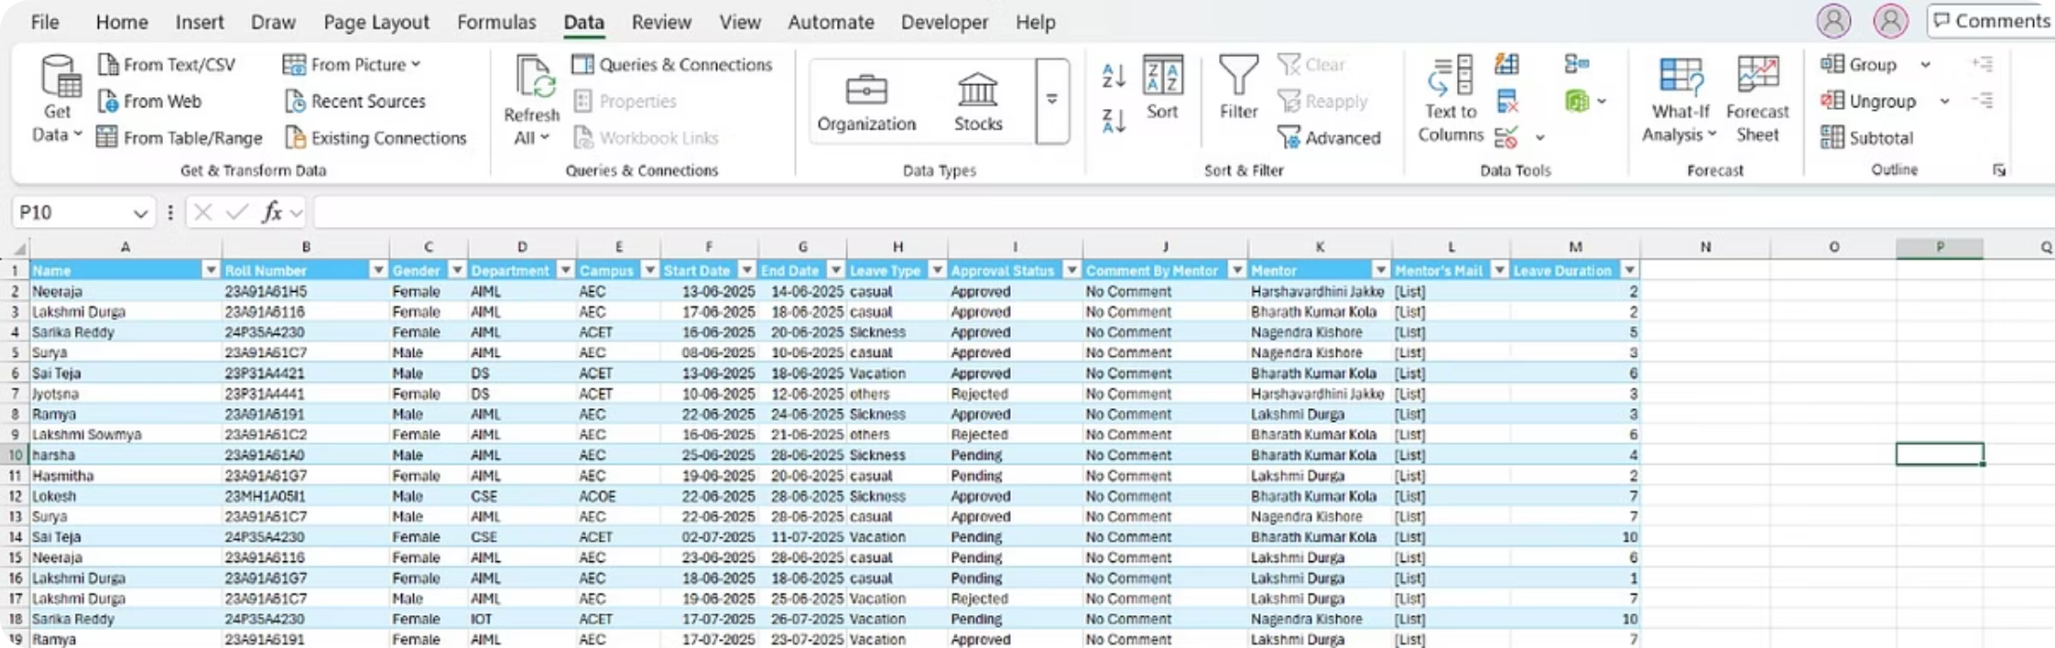
Excel Integration for Leave Data
Objective:To automate the collection and analysis of student leave requests submitted via SharePoint Forms using Excel.
In Excel, go to Data tab → Select Get Data → Choose From Online Services → From SharePoint Online List
Paste your SharePoint site URL and select the required list.
Once the list is selected, it opens in Power Query Editor.
You can see all the columns from the SharePoint list.
Use Power Query to:
Remove unwanted columns (like system metadata)
Filter by leave status (e.g., Approved only)
After filtering, click Close & Load to insert the cleaned data into your Excel sheet.
This data can now be used for dashboards, pivot tables, and charts.

Slide 11

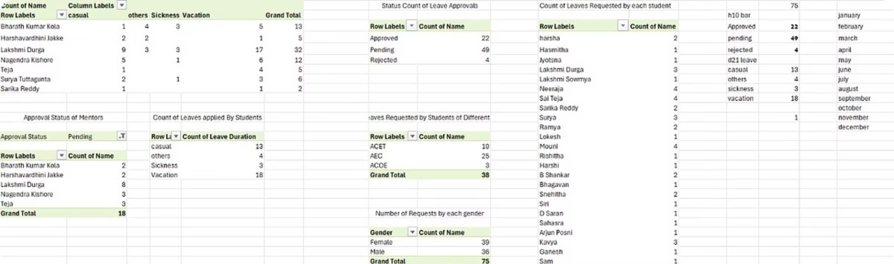
Creating Pivot Tables in Excel from Filtered Data
Go to Insert tab → Click Pivot Table
Select your data range → Choose whether to insert in a new worksheet or existing one
Drag and drop fields into:
Rows: (e.g., Student Name or Month)
Columns: (e.g., Leave Status: Approved/Rejected)
Values: (e.g., Count of Leaves)
Filters: (e.g., Filter by Department or Date)
Use Value Filters, Slicers, and Conditional Formatting
Visualize leave trends, total leaves per student, or monthly leave reports

Slide 12

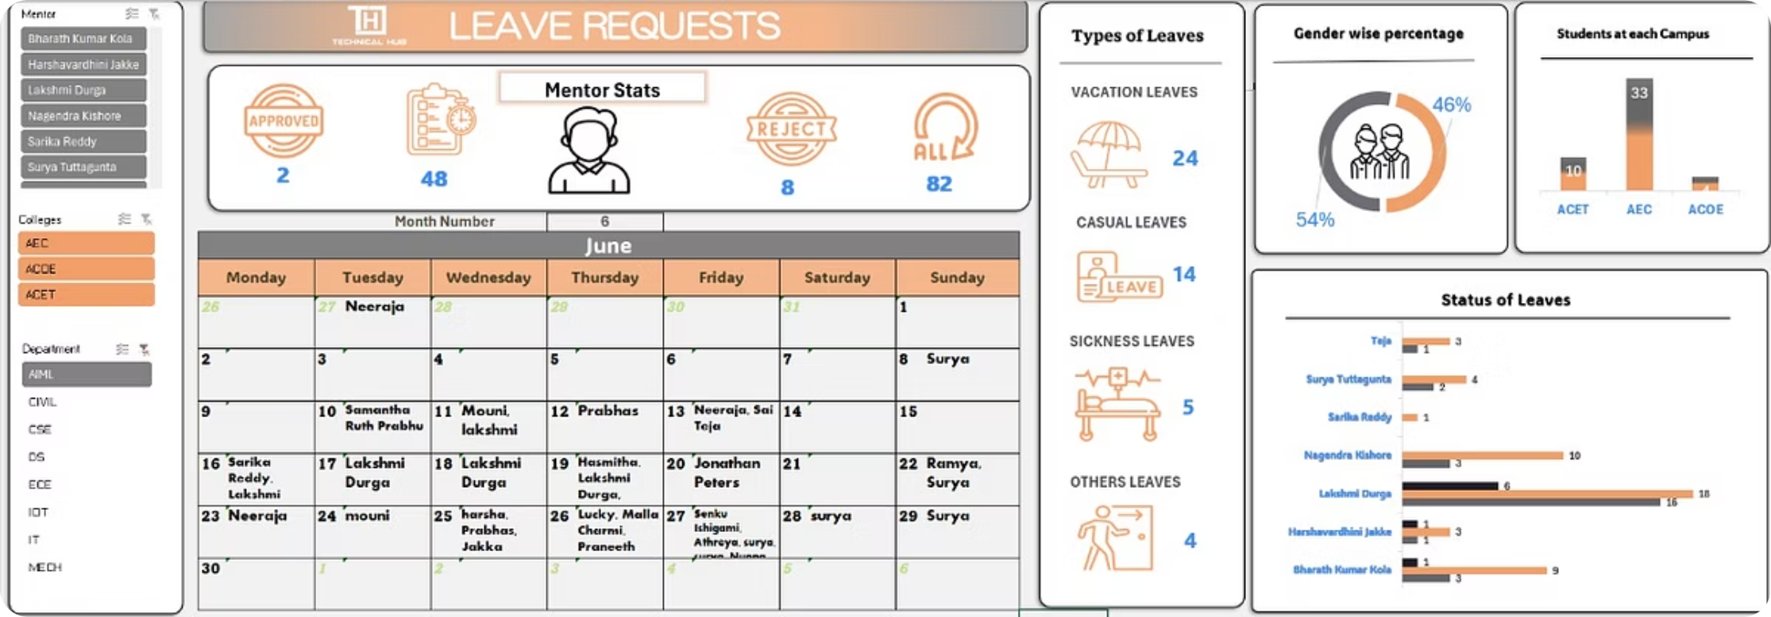
Building an Interactive Dashboard using Pivot Tables
Convert Pivot Tables into Pivot Charts for better visualization.
Use Bar, Line, Pie, or Column charts to make data insights more engaging.
Insert Slicers to filter data by:
Mentor's Names
Department
Campuses
Add Calender to view leave records by date or month
Use consistent colors, fonts, and spacing.
Add titles, legends, and data labels to make it clear and professional.

Slide 13




Key Benefits & Impact
Rapid Approvals
Accuracy Achieved
Strategic Focus
Enhanced Satisfaction
Experience significantly reduced average approval times, streamlining operations.
Manual data entry mistakes are virtually eliminated, ensuring high accuracy and data integrity.
HODs and HR save valuable time previously spent on manual tasks, redirecting efforts to key strategic initiatives.
A projected increase in NPS reflects improved employee satisfaction and engagement with the system.

Slide 14
Any Queries?

Slide 15

Thank You!
We sincerely thank you for taking the time to understand our project on Automated Leave Approval Systempowered by Microsoft Sharepoint, Power Automate, and Excel.

