Slide 1

Task- Pulse
– Project Task Tracker and Status Reporting
Presented by:Team-3
Jyotsna Sai Surekha -23p31a4441
Madatala Chaitanya-23mhla4434
Pilli Mounika Sai Sruthi-24p35a4225
Sathi Mahalakshmi-23p31a1226
Katta LakshmiPriya-23a91a4429
Vanakala Likitha-23a91a4465
Date: [Presentation Date]

Slide 2

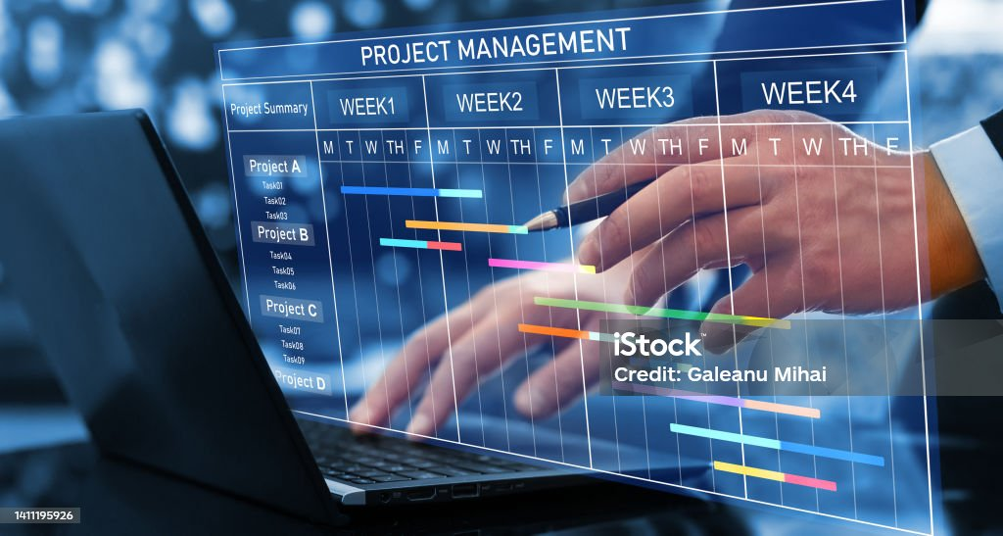
Agenda
Project Overview
Objectives
Key Features
System Architecture
Tools & Technologies
Workflow Demonstration
Reporting Capabilities
Benefits
Future Scope
Q&A

Slide 3
Project Overview
Task-Pulse is a centralized platform to track project tasks, statuses, owners, and deadlines, and automate approvals for high-priority activities.
Why it’s needed:
- Improve task visibility
- Increase accountability
- Enable performance tracking
- It’s having Clean, modern interface

Slide 4
Objectives
- Enable centralized task management
- Improve real-time tracking and transparency
- Automate status reporting and reminders
- Facilitate inter-department collaboration

Slide 5
Key Features
- Task assignment & due dates
- Department-wise tracking
- Priority & approval status indicators
- Automated reminders
- Custom dashboards & filters

Slide 6
System Architecture
Tools Used:
- Microsoft Excel
- SharePoint List
- Power Automate
Flow:
1. Task entered in SharePoint List
2. Automated flows handle reminders and approvals
3. Status updated and synced

Slide 7
Workflow Demonstration
Step 1: Task Entry in SharePoint
Step 2: Trigger Power Automate
Step 3: Send Approval (if high priority)
Step 4: Update Status & Notify Owner
Step 5: Weekly Summary to Manager

Slide 8
Reporting & Dashboards
Dashboards display:
- Task status (Pending/In Progress/Completed)
- Department-wise workload
- Overdue tasks
Use pivot tables and charts

Slide 9
Benefits
- Increased visibility into project progress
- Time-saving through automation
- Reduced missed deadlines
- Easy reporting to leadership
- Scalable across departments

Slide 10
Future Scope
- Integration with Teams or Outlook Calendar
- Advanced analytics via Power BI
- Mobile task updates
- Task categorization by project phases

Slide 11
Q&A
Any Questions?

Slide 12
Thank You
Thank you for your time!
[Your Contact Information]

