Slide 1
3. What property characteristics predict an "abnormal" sale?
Jyotsna Sateesh

Slide 2
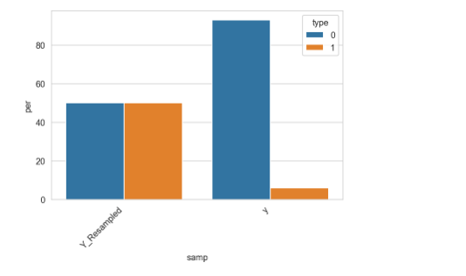
class imbalance classifiers:

Slide 3
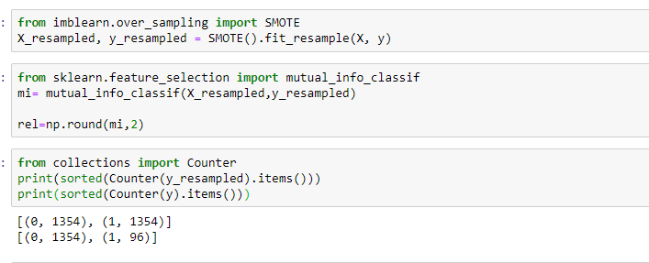
Libraries:

Slide 4
SMOTE:
The Synthetic Minority Oversampling Technique (SMOTE)
samples used to interpolate/generate new synthetic samples differ
No distinction between easy and hard samples to be classified using the nearest neighbors rule.

Slide 5
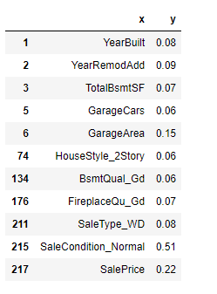
from sklearn.feature_selection import mutual_info_classif
Estimate mutual information
for a discrete target variable.

Slide 6
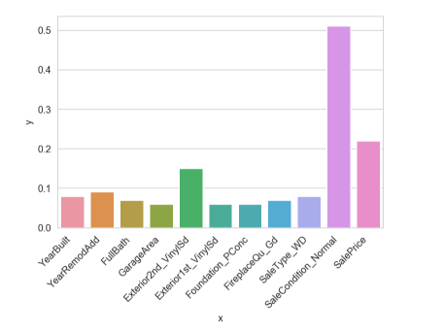
Dependency:

Slide 7
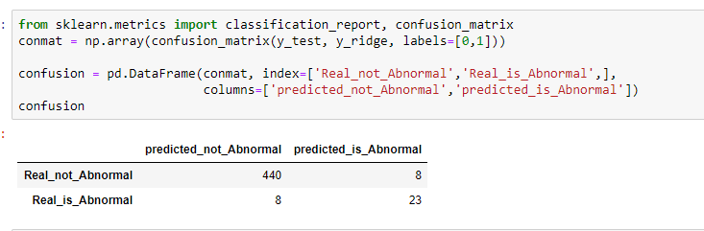
Code:

Slide 8
Scores:

Slide 9
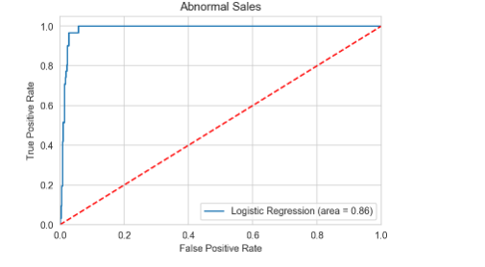
Area under ROC curve:0.86 -
Almost Perfect discrimination ability

