Slide 1

Project 4
Jyotsna Sateesh

Slide 2

Web Scraping:
Job Details from
(https://www.seek.com.au/)
Data Scientist
Data Analyst
Research Scientist
Data Engineer
Big Data
(Jobs from all over Australia)

Slide 3
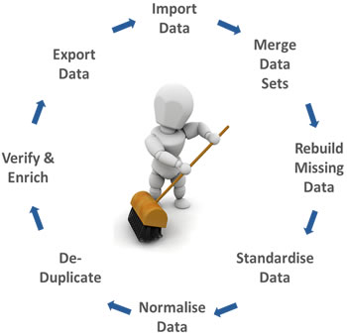
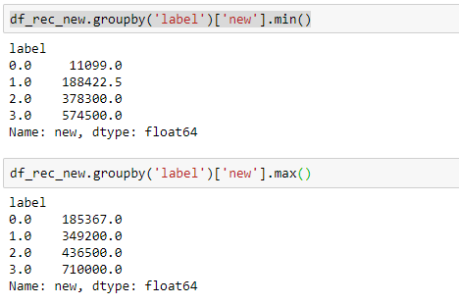
Data Cleaning:
Salary:
Divided the Salary into 4 bins

Slide 4
Data Cleaning:
Salary:
Within each bin grouped on Skills, Location and Job type for missing salary values.
Skills
Used Spacy to extract proper nouns from Title and divide title into
Jr. Analysts
Sr. Analysts
Jr. Scientist
Sr. Scientist
Big Data Eng
Research
Category:
Jobs binned into fewer major category depending on the industry.

Slide 5
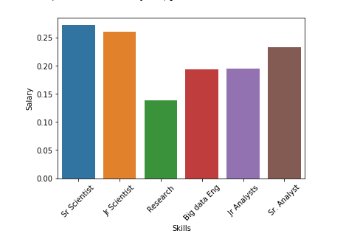
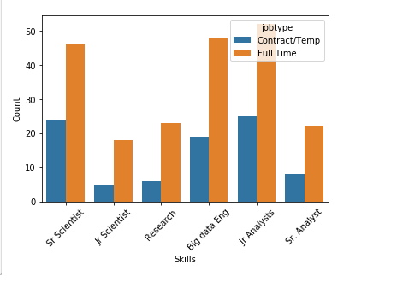
Skills Vs Salary: Job Counts Vs Type:

Slide 6
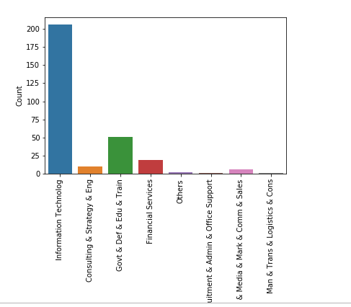
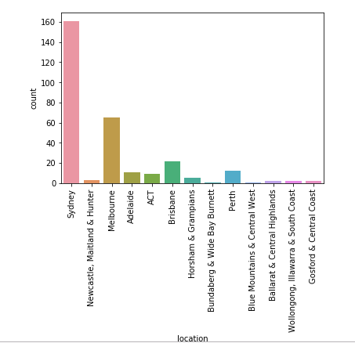
No.of Jobs vs Category No of jobs vs Location
Skills Vs Salary: Job Counts Vs Type:

Slide 7
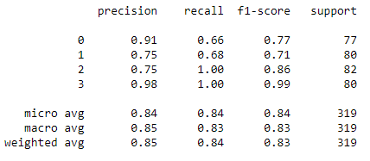
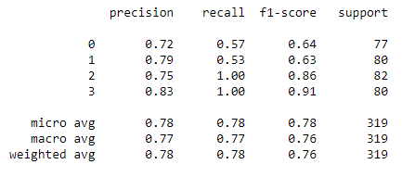
Models:
Logistic regression:
KNN:

Slide 8
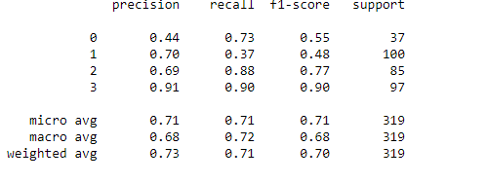
Models:
Random Forest:
Avg Score:0.8369905956112853

Slide 9
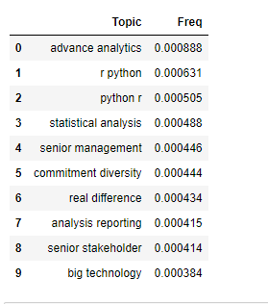
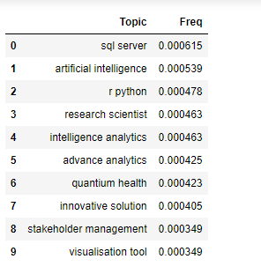
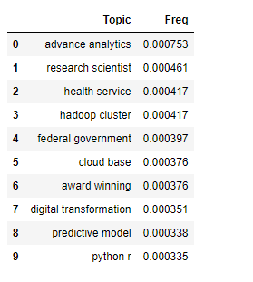
Data Scientist Research Sr.Data Scientist

Slide 10
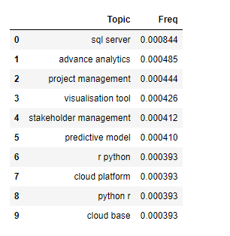
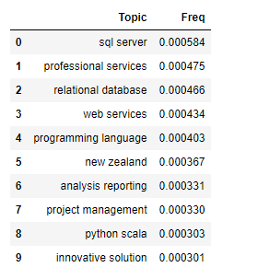
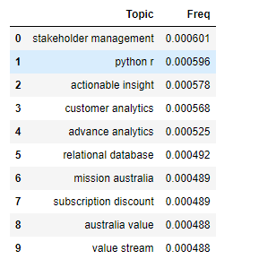
Sr.Data Analyst Data Engineer Data Analyst
Topic 1:

Slide 11
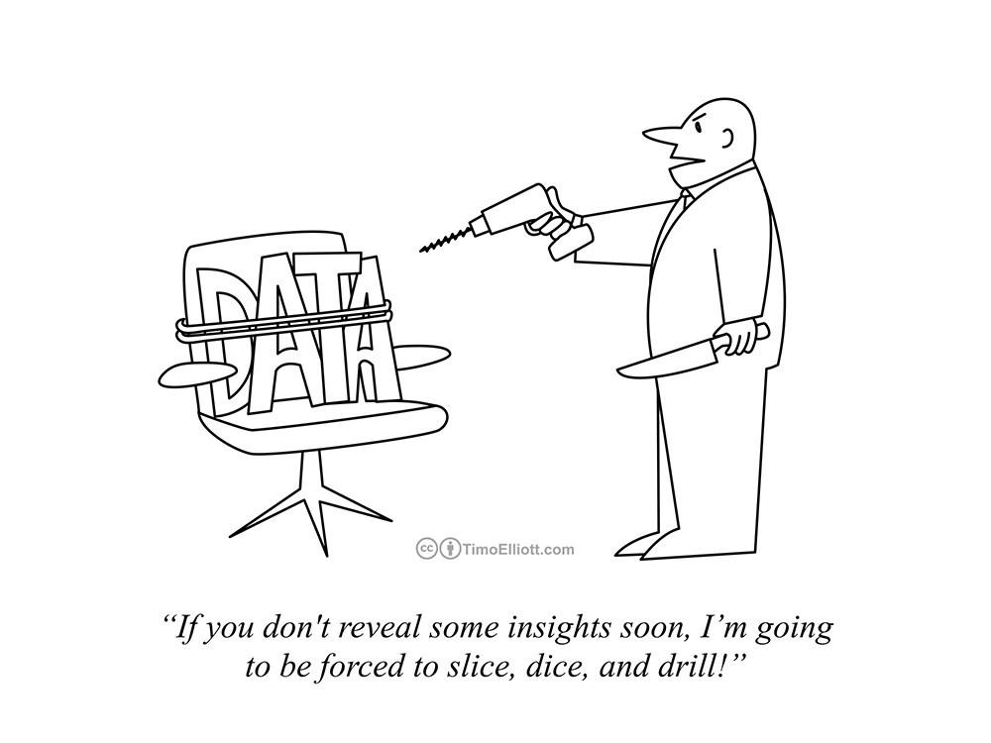
Thank You
Thank You

