Slide 1
image processing (CSE-4019) – PROJECT COMPONENT Quality analysis and classification of Rice Grains
TEAM MEMBERS:
Malla Jyotsna Sree Mahima-18BCE0912
Pavan Siddharth E-18BCE0044
Preetham Lekkala-18BCE0854

Slide 2
INTRODUCTION
Rice is favorable and high consumed cereal grain in Asian countries. It can be easily found all over the world. Many values added products are produced by using rice for human beings. In the rice market, key determinant of milled rice is quality. The quality measurement becomes more important with the import and export trade. Rice samples contain different dispensable objects like paddy, chaff, damaged grains, weed seeds, stones etc. Rice quality is varying according to these impurity content.
The main purpose of the proposed method is, to offer an alternative way for quality control and analysis which reduce the required effort, cost and time. Image processing is significant and advanced technological area where important developments have been made.
In agricultural and farming production quality control and analysis of manufactured goods is vital. Quality of grain is analyzed visually by veteran person and technician. But the effect of such measurement is changing in results and prolonged. The excellence and quality also influenced by the mood and atmosphere of technician; so to overcome the shortcoming occurred due to conventional methods advanced technique i.e. Image processing technique is projected, to Maintaining the Integrity of the Specifications.
Image processing manipulates image for performing some operations on targeted image to get an improved and desirable image. And extort some valuable information from input image. Nowadays, image processing is hastily growing technologies. All types of data have to go through three general phases while using DIP technique which are pre-processing, enhancement, and display, information extraction.

Slide 3
OBJECTIVE
Use of image processing algorithms to analyse grains quality by its size. To analysis and classify the quality of rice grains.

Slide 4
MOTIVATION
In this study, the image processing algorithms are developed to segment and identify rice grains. use of image processing algorithm is an efficient method to analyze grains quality by its size. The paper presents a solution of grading and evaluation of rice grains on the basis of grain size and shape using image processing techniques. Specifically, edge detection algorithm is used to find out the region of boundaries of each grain. In thistechnique we find the endpoints of each grain and after using caliper we can measure the length and breadth of rice. This method requires minimum time and it is low in cost.
The conventional methods used for grain shape and size measurement are grain shape tester, dial micrometer and graphical method, but these methods are very lengthy. In above equipment we can measure breadth and length of one grain at a time. The result of this methods is also lengthy and costly and higher possibility of human errors, so it requires high accuracy to assure customers need as well as to conquer restrictions of manual.
Many studies that consider the morphological features of grains such as its area, shape etc. have already been performed. However, the shapes and sizes of the different varieties are too varied to generalize a common formula for the classification of all varieties of rice. In this paper, Fourier features are also extracted from grain images in addition to the spatial features to arrive at an improved accuracy for classification.

Slide 5
BACKGROUND
The Agricultural industry on the whole is very vast and ancient. Quality assessment of grains is a very big challenge since time immemorial. The project presents a solution for quality evaluation and grading of rice grains using image processing techniques.
Commercially the grading of rice is done according to the size of the grain (full, half or broken). The food grains quality is rapidly assessed through visual inspection by human inspectors. The decision-making capabilities of human-inspectors are subjected to external influences such as fatigue, vengeance, bias etc. With the help of image processing techniques, we can overcome that and which are also a non-destructive and cost-effective techniques.
Here we also discuss the procedure used to obtain the percentage quality of rice grains. Rice quality is nothing but the combination of physical and chemical characteristics. Grain size and shape, chalkiness, whiteness, milling degree, bulk density and moisture content are some physical characteristics, gelatinization temperature and gel consistency are chemical characteristics of rice.

Slide 6
LITERATURE REVIEW
SL.NO | Title of Paper | Authors | Year of Publication | Dataset Used | Methodology Proposed | Pros and Cons | Future work possible
1 | Rice Quality Analysis Based on Physical Attributes Using Image Processing Technique . | Namita Patel,Hardik Jayswal,Amit Thakkar | 2017 2nd IEEE International Conference On Recent Trends In Electronics Information Communication Technology, May 19-20, 2017, India | RGB IMAGE | Classifiying rice grains into three categories small seed, medium seed and long seed based on the parameters: area, major axis length,minor axis length;eccentricity.Methodology consists of preprocessing of image(conversion from rgb to grayscale and then to binary),morphological operations(dilation and erosion),edge detection,object measurement, classification of rice grains | Pros:Canny edge detection is used which gives better results than prewitt and sobel edge detections.Cons:But the quality analysis of the rice grains is not done. The amout of dust which can also be present in the rice grains is also not considered.Noticing the precise quality is difficult. | A future extension to this work is to apply different classification techniques for better classification of seeds. Possibility of adding more parameters for better classification.

Slide 7
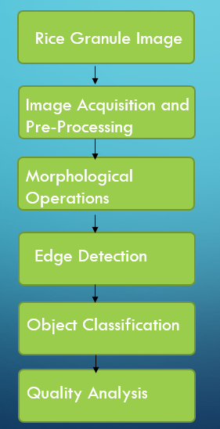
SYSTEM ARCHITECTURE

Slide 8
PROJECT DESCRIPTION AND GOALS
TECHICAL SPECIFICATIONS:
Python
Python Flask

Slide 9
Design approach
The image processing technique is used for counting the number of rice seeds and classifies them on the basis of length, breadth and length - breadth ratio.
Length is the average length of rice grain while breadth is the average breadth of rice grain and length-breadth ratio is calculated as: L/B = [(Average length of rice grain)/(average breadth of rice)]*10.
In first pre-processing step image registration takes place and noise is removed from the image by using filter.
Shrinkage algorithm used for segmenting the touching kernels which is second step.
In third step we perform edge detection to find out the region of boundaries.
In fourth step rice seed measurement is done and in the same step length, breadth and length-breadth is also measured.
In the fifth step of the algorithm rice is classified according to its size and shape.

Slide 10
Methods used
Image pre-processing –
Filter is applied to remove noise which occurs during the acquisition of image. Filter also sharpens the image. Threshold algorithm is used to segment the rice grains from the black background.
Shrinkage morphological operation-
Erosion is applied to separate the touching features of rice grains without losing the integrity of single feature. Dilation process follows erosion process. The goal of dilation is to grow the eroded features to their original shape without re-joining the separated features.
Edge detection
Edge detection helps to find out the region of boundaries of rice grains. We use canny algorithm to detect the edges.

Slide 11
Object measurement
Measurement indicates the count of rice grains. After getting the count of rice grains, edge detection algorithms applied on the image and outcome of the applied algorithm is we get endpoint values of each grain. We use calliper to join the endpoints and measure the value of length and breadth of each grain. After getting the value of length and breadth we can calculate length-breadth ratio.
Object classification
Classification requires all standard, measured and calculated results. The standard database for rice size and shape measurement is referred from laboratory manual on rice grain quality, Directorate of Rice Research, Rajendra nagar, Hyderabad. The classification of rice grains as per the standard database is shown in following tables.

Slide 12
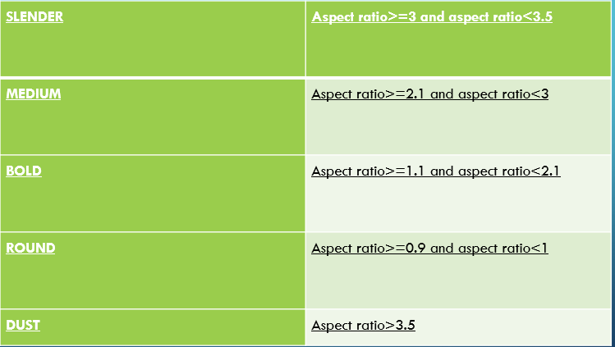
Table below indicates classification of rice grains on the basis of length and length- breadth ratio:

Slide 13
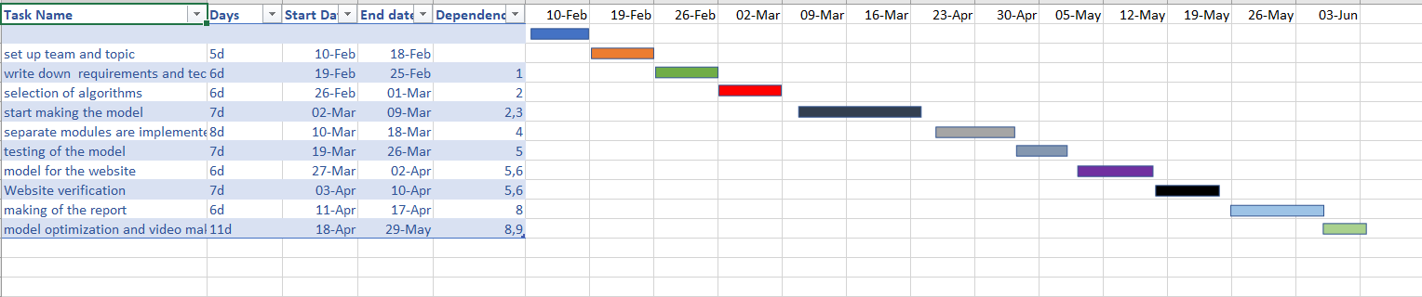
Schedule tasks and milestones

Slide 14
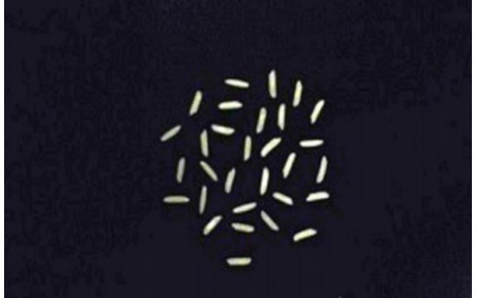
Project demonstration
INPUT IMAGE

Slide 15
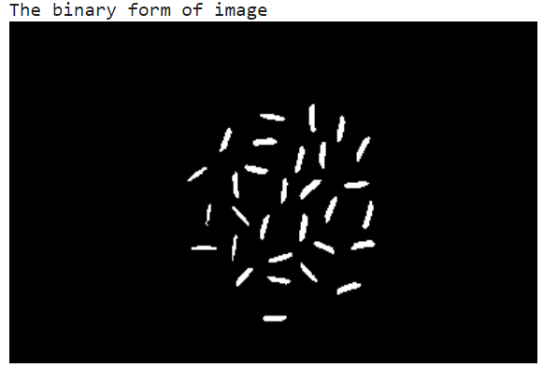
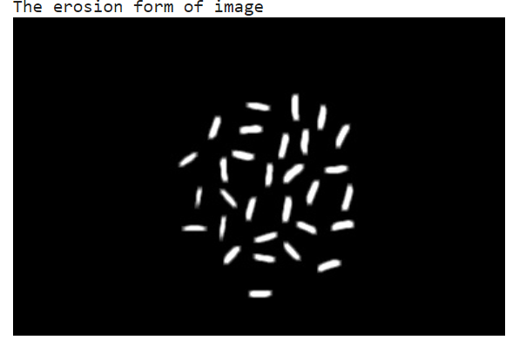
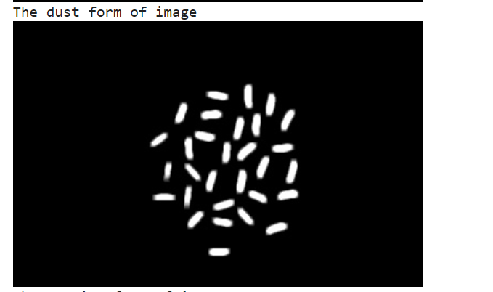
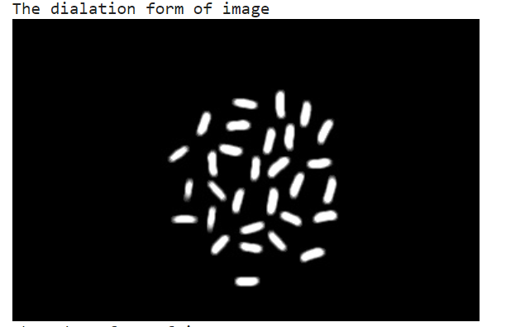

Slide 16
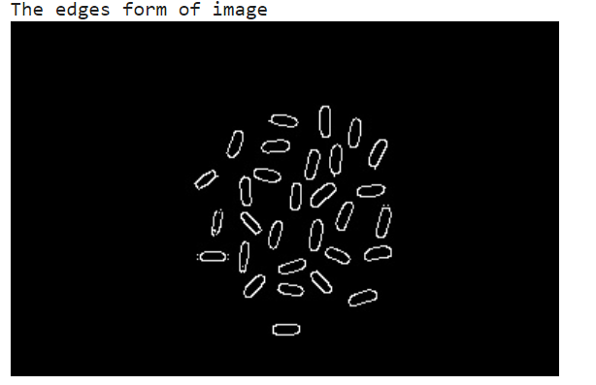

Slide 17
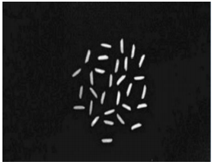
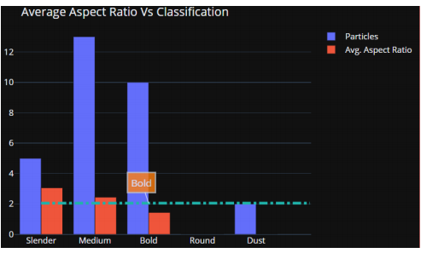
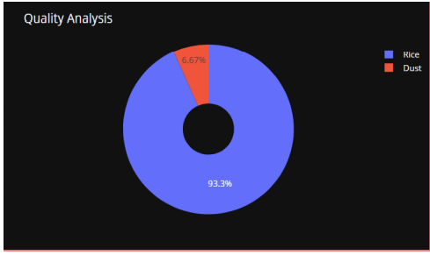
comparision
S.no | INPUT | OUTPUT
1

Slide 18
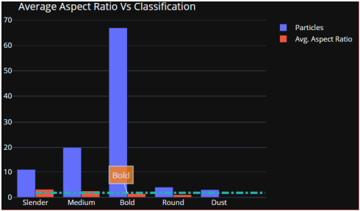
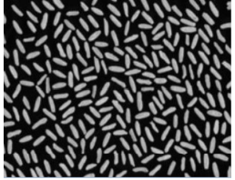
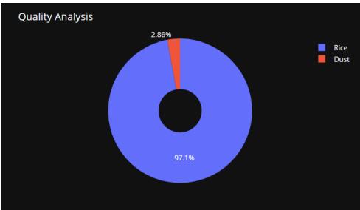
S.no | INPUT | OUTPUT
2

Slide 19
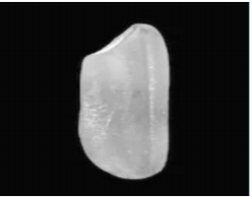
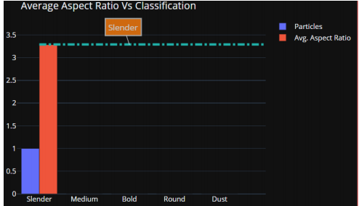
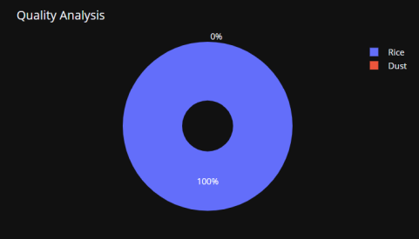
S.no | INPUT | OUTPUT
3

Slide 20
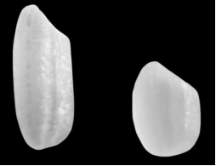
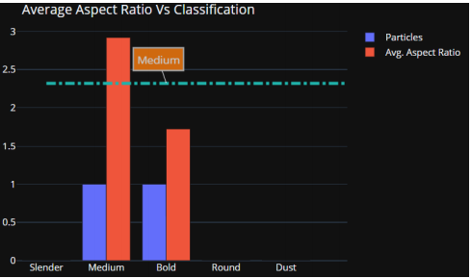
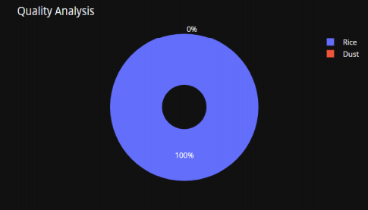
S.no | INPUT | OUTPUT
4

Slide 21
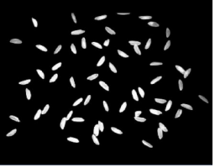
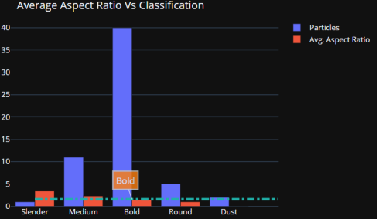
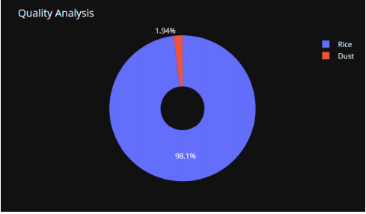
S.no | INPUT | OUTPUT
5

Slide 22
Grouped Bar chart – Used for Classification purpose
• Blue Bar indicates the Number of Rice grains.
• Red Bar indicates Average Aspect Ratio.
Pie chart – Used for Quality Analysis purpose
• Blue Section indicates percentage of Rice grains in the given sample.
• Red Section indicates percentage of Dust in the given sample.

Slide 23
Results and discussion
In this project, we are classifying the rice grain sample taken into various categories and also analysing its quality based on its aspect ratio, so it is not possible to compare with other works. Existing works only detect the rice grains, or calculate number of rice grains in the given sample but our work helps to analyse the quality of rice sample and classify them into particular category.
Quality of grains in the samples should be nearly 100% accurate and it should be suitable to grade large quality of grains efficiently, which otherwise will consume lot of time in manual analysis, this feature will be able to save lot of time & human effort

Slide 24
The image analysis algorithms are applied on image in which rice grains are randomly placed and spread in one layer. If the error occurs like touching kernels shrinkage operation works efficiently for separating the connecting part from point touching kernels.
Edge detection is performed to find out the region of boundaries and endpoints of each grain; and then after that using calliper length and breadth can be measured.
After getting the values for length and breadth, length-breadth ratio is to be calculated. In this study, the image processing algorithms are developed to segment and identify rice grains. use of image processing algorithm is an efficient method to analyse grains quality by its size.
The main benefit of proposed method is it requires minimum time; cost is less and gives better results compared with manual results or traditional methods.
We have successfully executed all the steps proposed. Last two steps include calculating the size of the grains and then classifying them according to the Table provided.

Slide 25
Presentation video link
https://drive.google.com/file/d/1HcAGtkk2JPcWX1udWSx793l-ouWjtP_d/view?usp=sharing

