Slide 1
TEAM 5Py
Team Lead:
Prashanti T
-Team Members:
Jyotsna John
Syeda Nowreen
Hema S

Slide 2
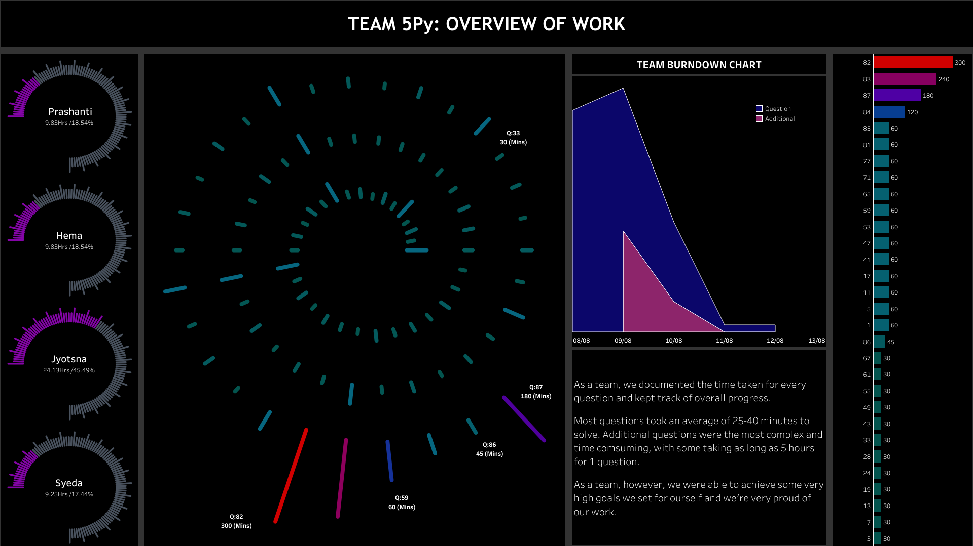

Slide 3
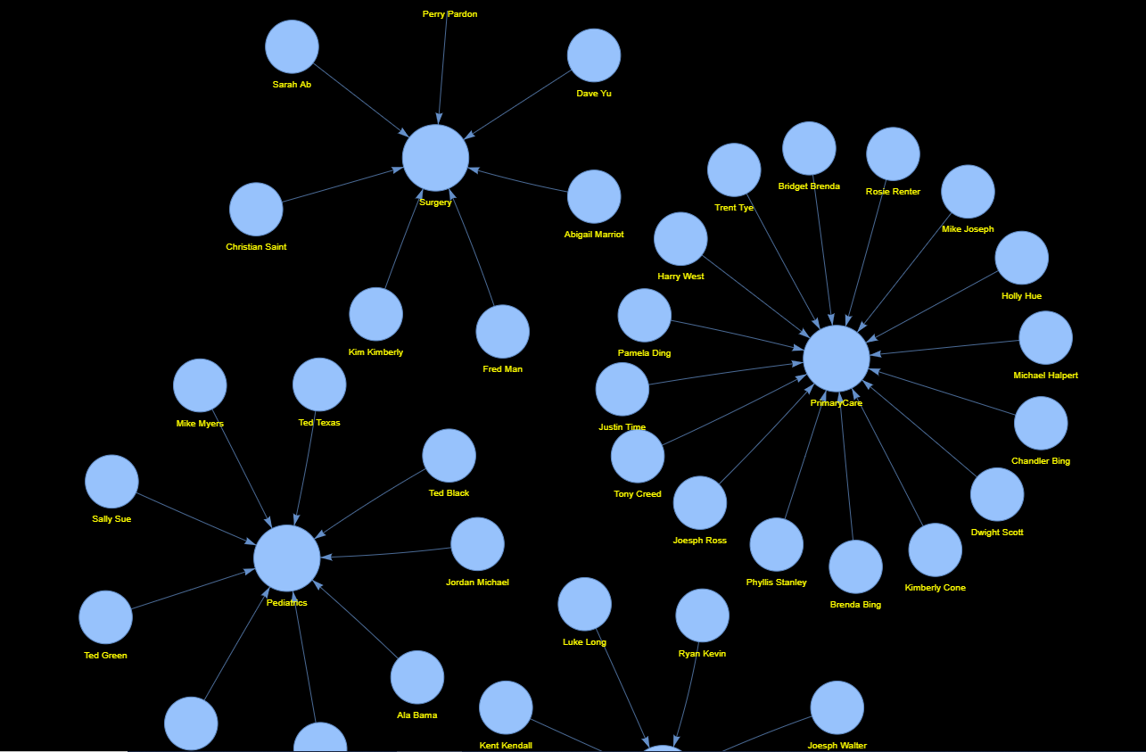
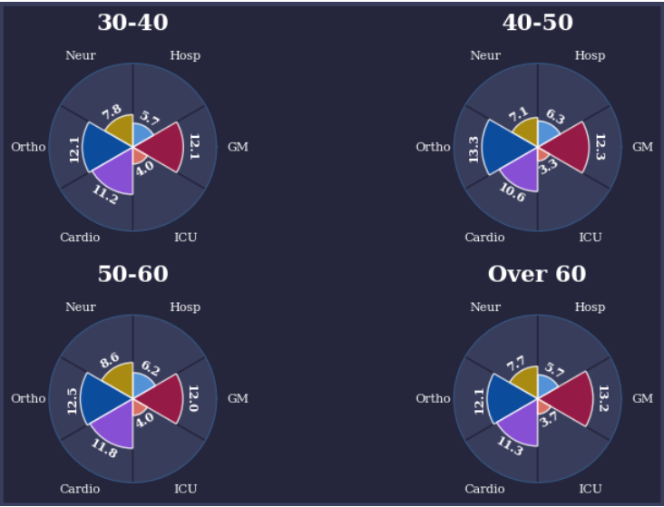

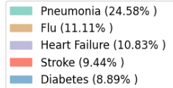
TIMELAPSE GIFS, NETWORK CHARTS, RADAR PLOTS, WAFFLE CHARTS AND MUCH MORE WITH MATPLOTLIB

