Slide 1
TEAM 5Py
Team Lead:
Prashanti T
-Team Members:
Jyotsna John
Syeda Nowreen
Hema S

Slide 2
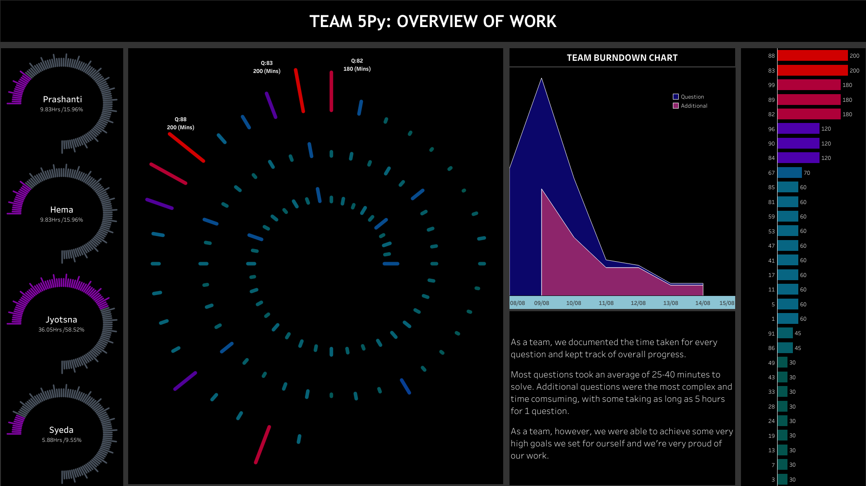

Slide 3
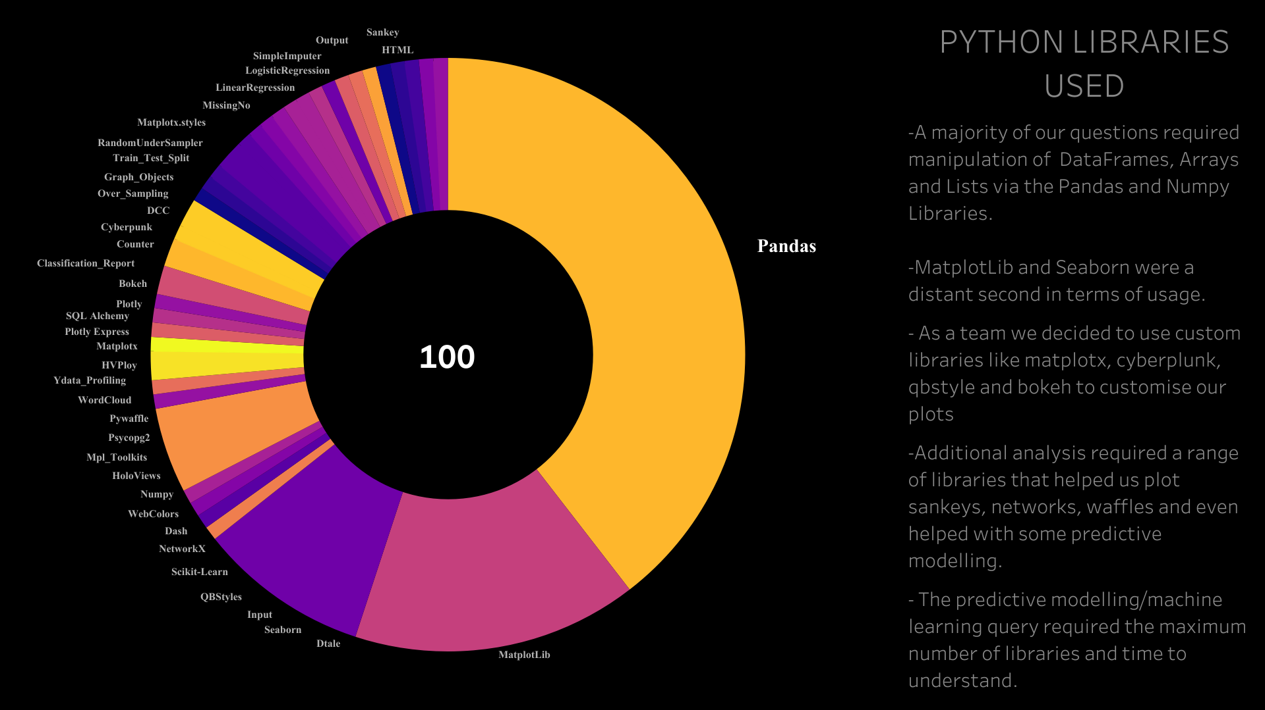

Slide 4
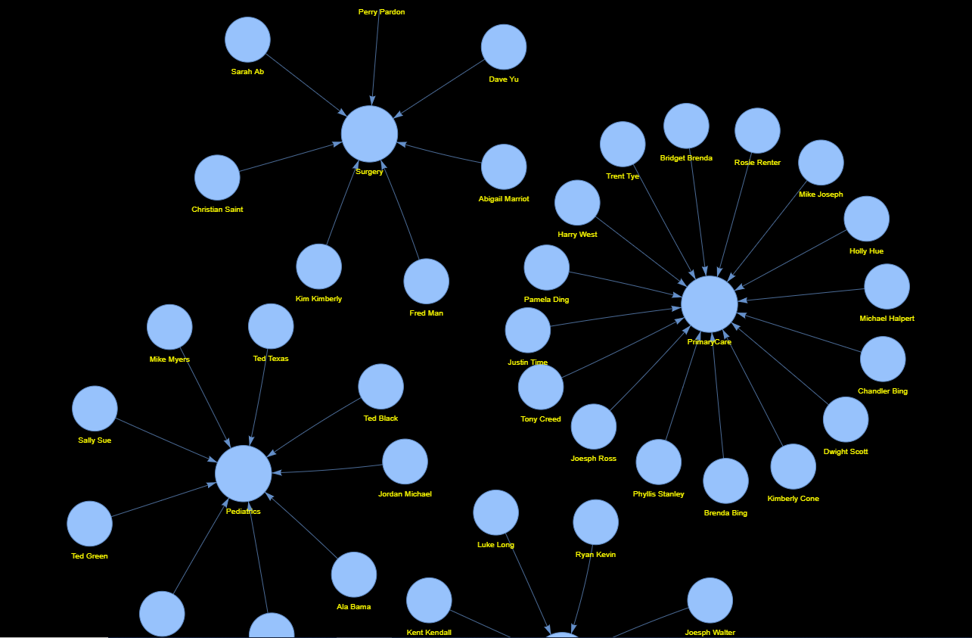
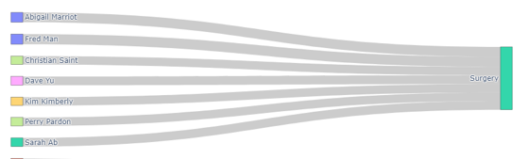
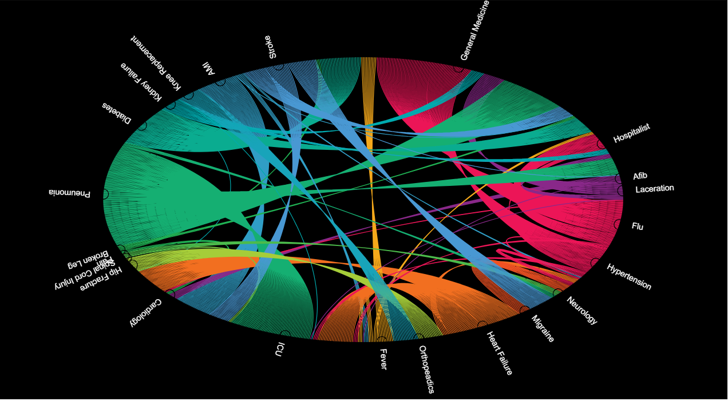
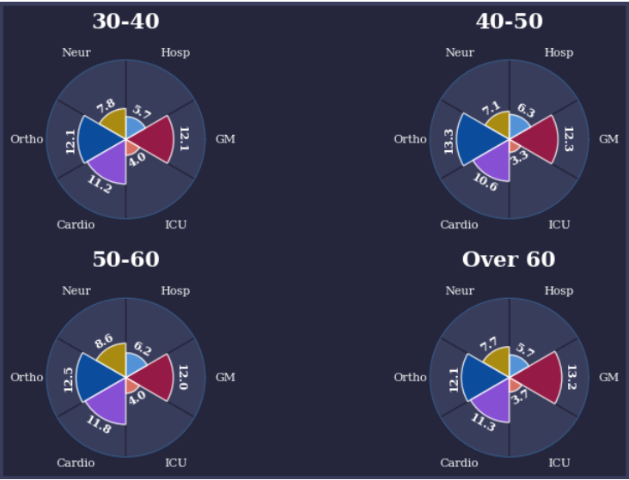
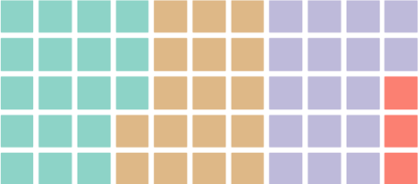
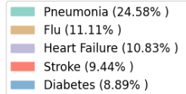
TIMELAPSE GIFS, NETWORK CHARTS, RADAR PLOTS, WAFFLE CHARTS,SANKEYS, CHORD DIAGRAMS…

Slide 5
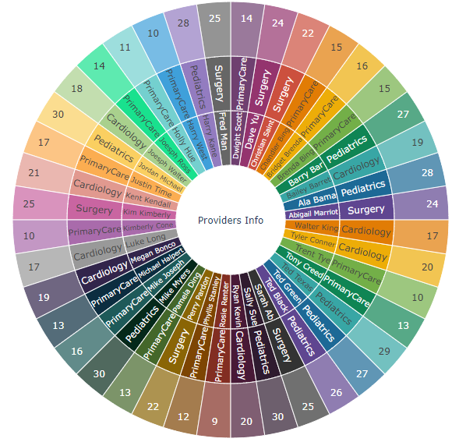
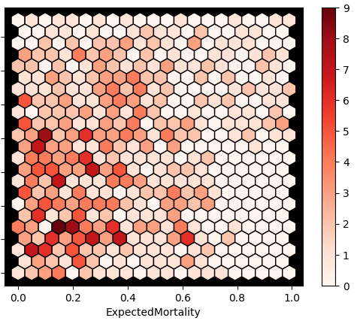
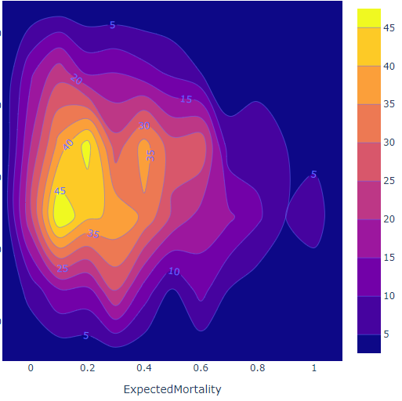
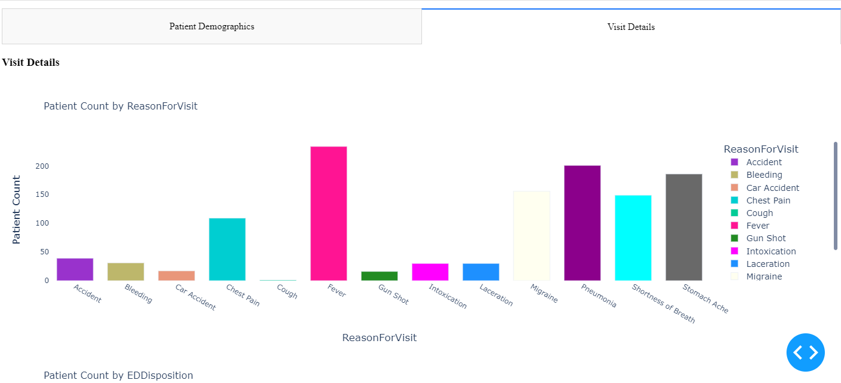
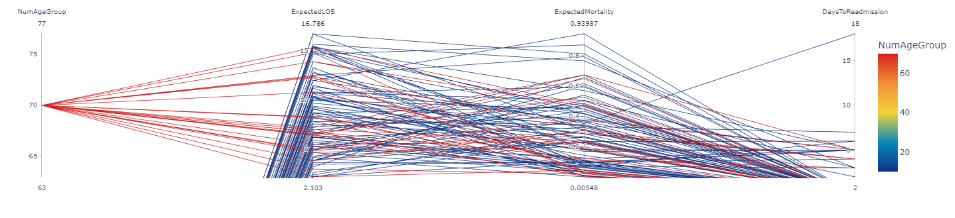
CLUSTERED HEAT MAPS, CONTOUR MAPS,PARALLEL COORDINATES AND EVEN A MINI-DASHBOARD APP ON HTML. PYTHON REALLY CAN DO ANYTHING

Slide 6
