Slide 1



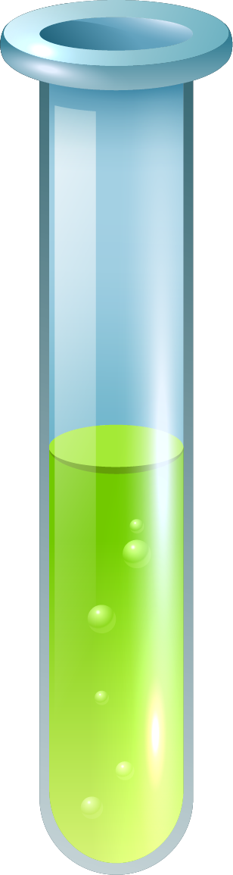
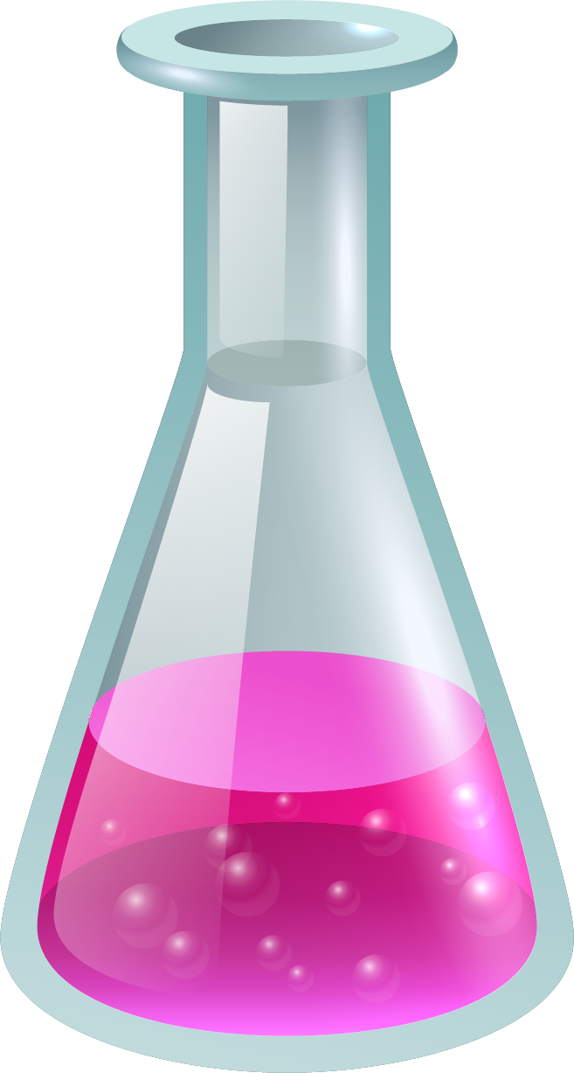
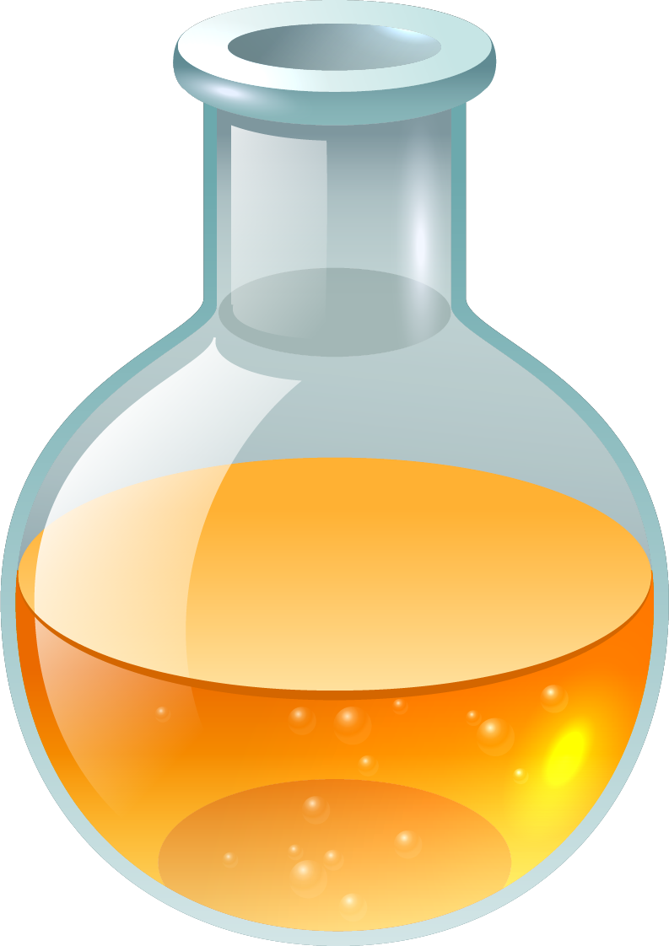
"Chemical Composition of Cleaning Products: Role of Acids and Bases in Stain Removal"
Presentation Topic:

Slide 2
.
.
Presented by:
Israt Jahan Tamanna
Student id: 2023-3-60-485
Course Name : Engineering Chemistry - I
Course Code : CHE109
Section : 08
Semester : Spring 2024
Submitted to:
Dr. Thamina Acter
Assistant Professor,
Department of Mathematical And Physical Science,
East West University.
.

Slide 3


TABLE OF CONTENTS
1
2
Introduction
Materials & Methods
.
.
3
4
Discussion
Conclusion
.
.

Slide 4

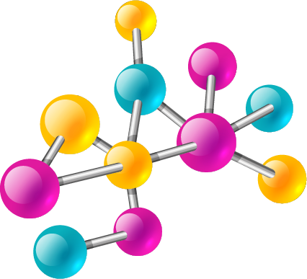
Introduction
1
What we need to know, acids and bases.

Slide 5
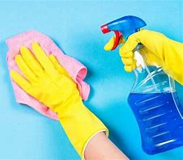
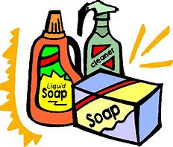

What we need to know about cleaning products
Global Reach: Household cleaning products are extensively used worldwide, incorporating widely-produced chemicals.
Health Considerations: Key ingredients in these products can pose health risks.
Essential Daily Use: Essential for routine cleaning and disinfection in both homes and offices.
Tailored Formulas: Various cleaning formulas are designed for specific tasks like removing grime, maintaining surfaces, and disinfecting.

Slide 6
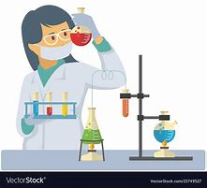

What we need to know about cleaning products...
Critical Ingredients: Active ingredients are crucial to the effectiveness of these cleaning products.
Effectiveness Measurement: The cleaning power is primarily evaluated by checking pH levels and the balance of acids and bases.
Precision Testing: Potentiometric titration is utilized to accurately assess the acidic or basic nature of cleaning agents.
Accurate Concentration Analysis: Acid-base titration methods determine the precise concentrations of acids or bases in cleaning products.

Slide 7
Use of Acids and Bases in home.
.
.
Acids:
Bases:
Vinegar: Contains acetic acid, effective for cleaning glass, removing mineral buildup, and cutting through grease.
Citrus Juices: Lemon and lime are rich in citric acid, useful for cleaning surfaces, enhancing flavors in foods, and tenderizing meats.
Carbonated Beverages: The carbonic acid in sodas adds a crisp taste to drinks but may contribute to tooth enamel erosion. ( and so on)
Baking Soda: A mild base that serves multiple purposes: used in baking, as a gentle cleaning agent, a deodorizer, and for heartburn relief.
Borax: Stronger than baking soda, Borax enhances laundry detergent performance, cleans effectively, and exterminates pests, but requires careful handling due to its potential skin irritant properties.
Ammonia: A potent base known for its effectiveness in degreasing tough stains, though it should be used with caution due to its strong odor and hazardous nature if mishandled. ( and so on)

Slide 8
Materials & Methods
2
"Chemical Analysis of Household Cleaning Products: Methods and Measurements"

Slide 9
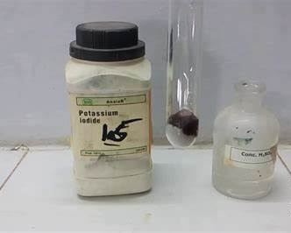
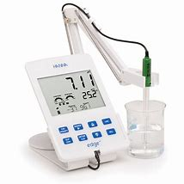
Chemical Analysis of Household Cleaning Products: Methods and Measurements
Chemical Ingredients: Utilizes analytical grade reagents such as sodium thiosulphate, potassium iodide, and hydrochloric acid for testing.
Equipment Used: Measurements taken using a pH-meter with a glass electrode and a density bottle for precision.
Product Samples: Analyzed a variety of cleaning products, including 28 household cleaners, five anti-scale cleaners, one kitchen cleaner, two drain cleaners, and twenty bleach products.

Slide 10
Chemical Analysis of Household Cleaning Products: Methods and Measurements
Sodium Hypochlorite Analysis: Employed the iodometric method to determine the sodium hypochlorite and active chlorine content in bleach cleaners.
Potentiometric Titration: Applied to measure the total acidity and alkalinity of cleaners using standard sodium hydroxide and hydrochloric acid solutions.
Measurement Technique: The pH and volume of neutralization are carefully recorded to calculate the cleaning products’ chemical properties.

Slide 11
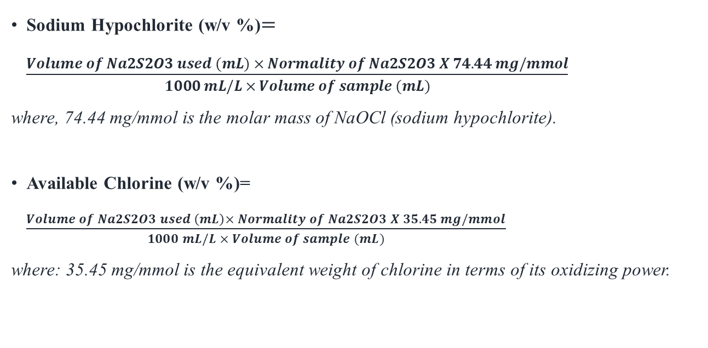
(formulas for determining the concentration of sodium hypochlorite and available chlorine through iodometric titration):
Sodium Hypochlorite (w/v %)$=\frac{Volume of Na2S2O3 used (mL) × Normality of Na2S2O3 X 74.44 mg/mmol}{1000 mL/L × Volume of sample (mL)}$
where, 74.44 mg/mmol is the molar mass of NaOCl (sodium hypochlorite).
Available Chlorine (w/v %)= $\frac{Volume of Na2S2O3 used \left(mL\right)× Normality of Na2S2O3 X 35.45 mg/mmol}{1000 mL/L × Volume of sample (mL)}$
where: 35.45 mg/mmol is the equivalent weight of chlorine in terms of its oxidizing power.

Slide 12
Discussion & Application.
3
"Chemical Analysis and Safety Considerations of Household Cleaning Products"

Slide 13
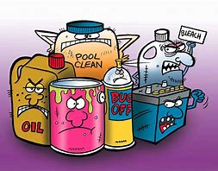
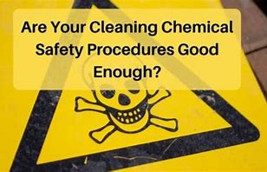
"Chemical Analysis and Safety Considerations of Household Cleaning Products"
Sample Selection: Analyzed 28 household cleaning products, including 20 bleach products, five toilet bowl cleaners, one kitchen cleaner, and two drain openers.
Analytical Methods: Measured pH values and determined the percentage of active ingredients in each product.
Safety Labeling: Emphasized the importance of accurate product labels for safe use and exposure prevention, as dictated by the Material Safety Data Sheet (MSDS) and Libyan National Standard Regulation.

Slide 14
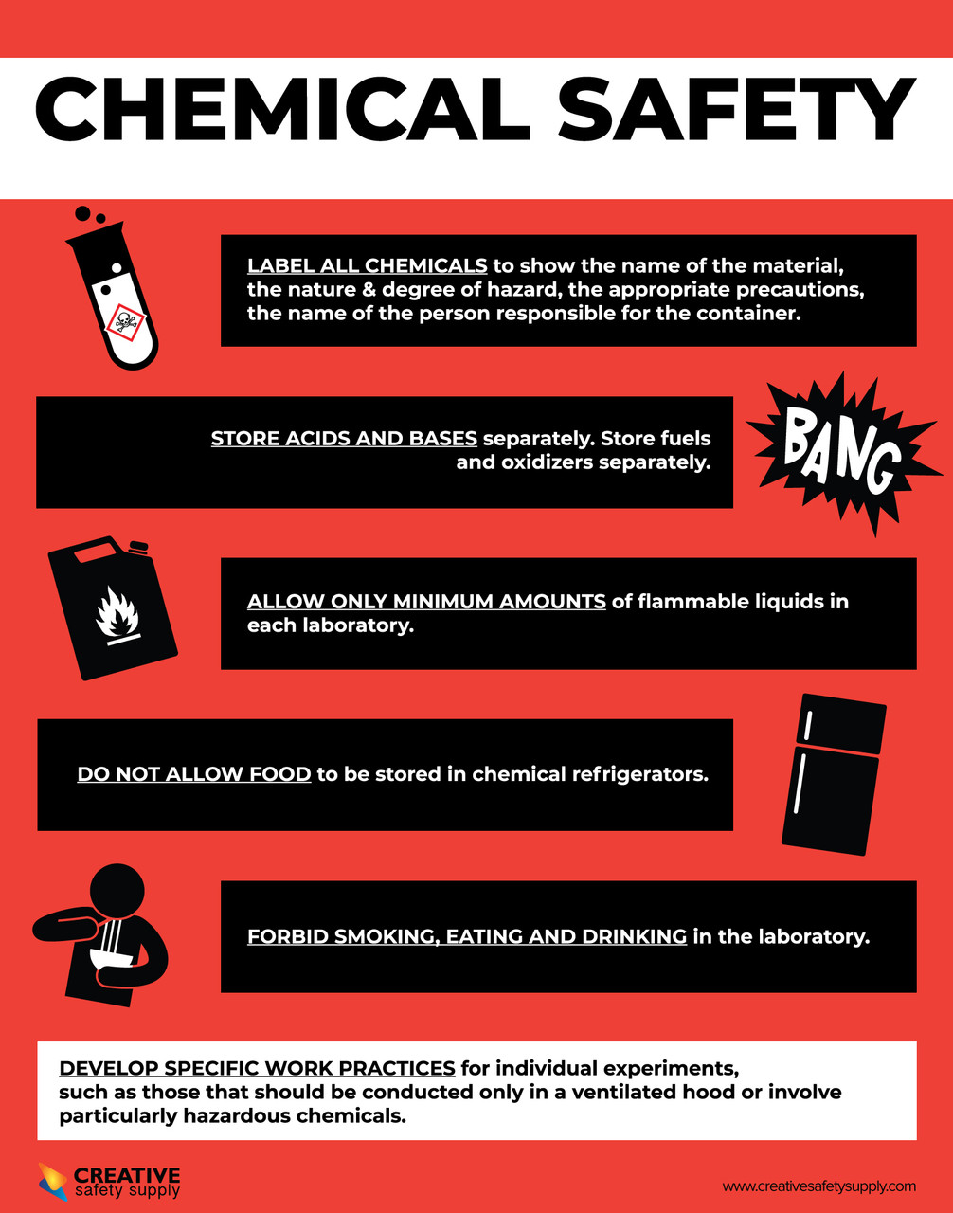
.
Packaging Requirements: Packaging must be durable, resistant to the product, and securely sealed to ensure safety.
Public Health Impact: Highlighted the potential environmental and health risks associated with the excessive use of cleaning products.

Slide 15
Conclusion
4
.

Slide 16
.
Analyzed pH and active ingredient content in 28 household cleaning products
( based on the assignment):
pH Results:
Anti-scale cleaners: pH 1.25 to 4.04.
Kitchen and drain openers: pH 11.19 to 12.59.
Bleach cleaners: pH 8.10 to 12.94.
Active Ingredients:
Sodium hypochlorite in bleach: Ranged from 0.0585% to 17.2541%.
Total acidity in anti-scale cleaners: 0.5067% to 8.331%.
Total alkalinity in kitchen and drain openers: 2.947% to 100.0%.
Safety Concerns: Concentrations of active ingredients in some products exceeded Libyan Standard Laws.

Slide 17

.
Thank you

