Slide 1
7-Series Architecture Overview
Artix-7
Vivado 2017.1 Version

Slide 2
Objectives
After completing this module, you will be able to:
Describe the basic slice resources available in 7-Series FPGAs
List memory hierarchy and various memory resources available
Identify the basic I/O resources available in 7-Series FPGAs
List some of the dedicated hardware features of 7-Series FPGAs
Identify latest members of Virtex-7 device family
Identify the MMCM, PLL, and clock routing resources included with these families
Describe the additional dedicated hardware for all the 7-series family members
Understand the Zynq-7000 SoC architecture

Slide 3
Outline
Introduction to 7-Series FPGA
Logic Resources
I/O Resources
Memory and DSP48 Resources
XADC
Clocking Resources
Zynq SoC
Summary

Slide 4
Introduction
All Xilinx FPGAs contain the same basic resources
Logic Resources
Slices (grouped into configurable logic blocks (CLB))
Containing combinatorial logic and register resources
Memory
Multipliers
Interconnect Resources
Programmable interconnect
IOBs
Interfaces between the FPGA and the outside world
Other resources
Global clock buffers
Boundary scan logic
Through various generations, Xilinx added new architectural resources to target various markets and application areas

Slide 5




7-Series FPGA+SoC Families
Maximum Capability
Lowest Power
and Cost
Industry’s Best Price/Performance
Industry’s Highest
Performance
All Programmable SoC
Logic Cells in K | 33 – 215 | 66 – 478 | 583 – 1,139 | 28 – 444
Block RAM in Mb | 2 – 12 | 4 – 34 | 28 – 68 | 2 - 27
DSP Slices | 90 – 740 | 240 – 1,920 | 1,260 – 3,360 | 80–2,020
Peak DSP Perf. (GMACs) | 929 | 2,845 | 5,335 | 2,622
Transceivers | Up to 16 | Up to 32 | Up to 88 | Up to 16
Transceiver Perf. (Gbps) | 6.6 | 12.5 | 12.5, 13.1 and 28 | 6.6, 12.5
Memory Perf. (Mbps) | 1066 | 1866 | 1866 | 1333
User I/O Pins | 106 – 500 | 285 – 500 | 350 – 1,100 | 54 – 400
I/O Voltages | 3.3V and below | 3.3V and below 1.8V and below | 3.3V and below 1.8V and below | 3.3V and below 1.8V and below
Notes:
The Xilinx 7-series FPGAs are a unified set of FPGA families. These families share the same underlying technology, construction, and implementation tools. The families are optimized for different price/performance points to meet all market needs. However, the unified architecture allows unprecedented migration capability from one family to another.
The Zynq®-7000 All Programmable SoC family series architecture contains an ARM®-based processing system that is tightly integrated to the programmable logic. The programmable logic portion of Zynq-7000 devices leverages the Xilinx 7-series programmable logic. This allows designers currently developing on the Xilinx 7-series to seamlessly port their FPGA designs to Zynq-7000 devices.

Slide 6
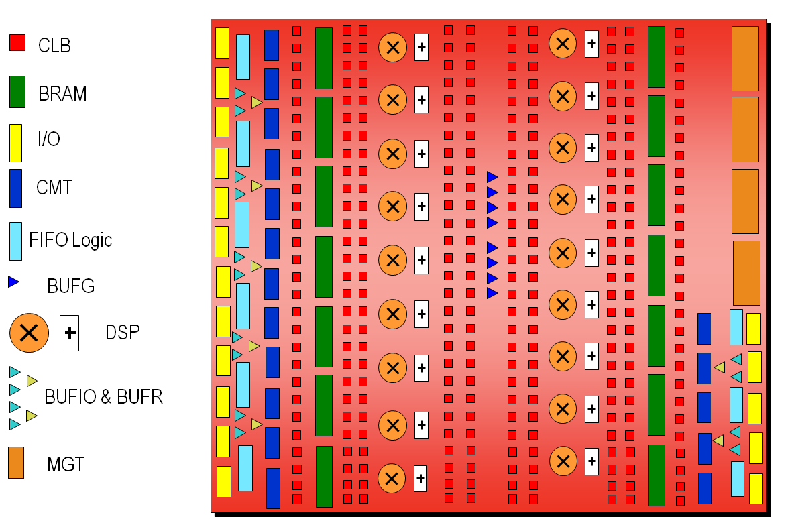

7-Series Architecture Alignment
Common elements enable easy IP reuse for quick design portability across all 7-series families
Design scalability from low-cost to high-performance
Expanded eco-system support
Quickest time to market
Artix-7 Architecture Overview
Notes:
All 7-series families share the same basic building blocks. The mixture and number of these resources varies across families.

Slide 7
Outline
Introduction to 7-Series FPGA
Logic Resources
I/O Resources
Memory and DSP48 Resources
XADC
Clocking Resources
Zynq SoC
Summary

Slide 8
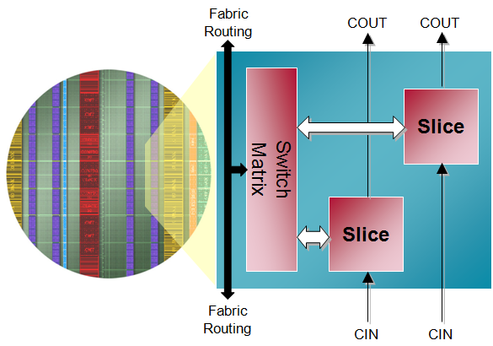
Configurable Logic Block (CLB) in 7-Series FPGAs
Primary resource for design in Xilinx FPGAs
Combinatorial functions
Flip-flops
CLB contains two slices
Connected to switch matrix for routing to other FPGA resources
Carry chain runs vertically in a column from one slice to the one above

Slide 9
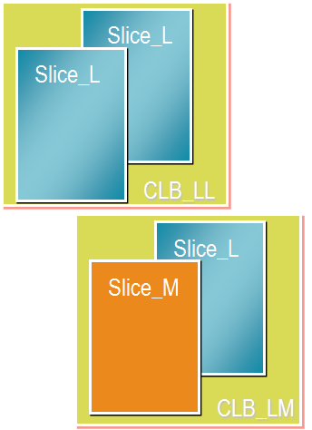
Two Types of CLB Slices
Two types of CLB slices
SLICEM: Full slice
LUT can be used for logic and memory/SRL
Has wide multiplexers and carry chain
SLICEL: Logic and arithmetic only
LUT can only be used for logic (not memory)
Has wide multiplexers and carry chain
Notes:
In the 7-series FPGAs, approximately ¼ of slices are SLICEM, the remainder are SLICEL. CLB columns on both sides of the block RAM columns have SLICEM/SLICEL CLBs, resulting in slightly more than ¼ of SLICEM.

Slide 10
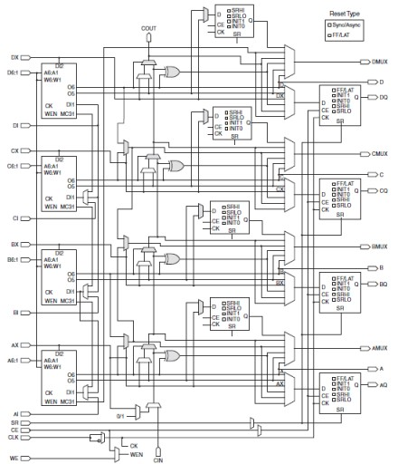
Slice Resource
Four six-input Look-Up Tables (LUT)
Multiplexers
Carry chains
SRL
Cascade path is not shown
Four flip-flops/latches
Four additional flip-flops
The implementation tool will pack multiple slices in the same CLB if certain rules are followed

Slide 11
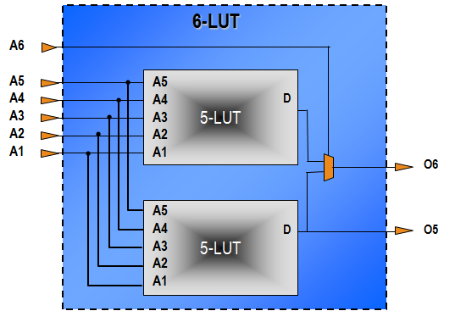
6-Input LUT with Dual Output
LUTs can be two 5-input LUTs with common input
Minimal speed impact to a 6-input LUT
One or two outputs
Any combinatorial function of six variables or two functions of five variables
Notes:
LUTs can perform any combinatorial function limited only by the number of inputs. It is your primary combinatorial logic resource and it is the industry standard.
The look-up table functionality is essentially a small memory containing the desired output value for each combination of input values.
The truth table for the desired function is stored in the memory.
The inputs of the function act as the address to be read from the memory (essentially a multiplexer controlled by the inputs).
The values for the storage elements are generated by the software tools, and downloaded to all LUTs at configuration time.
Each 6-input LUT can be configured as two 5-input LUTs. This gives the device a great deal of flexibility to build an efficient design.
Thus, the LUT can be used to build any function of six variables or two independent functions of the same five variables.
The synthesis and implementation tools use these resources to build combinatorial functions automatically.

Slide 12
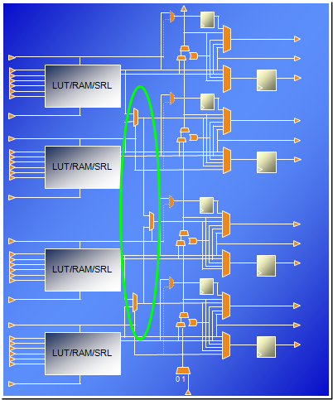
Wide Multiplexers
Each F7MUX combines the outputs of two LUTs together
Can implement an arbitrary 7-input function
Can implement an 8-1 multiplexer
The F8MUX combines the outputs of the two F7MUXes
Can implement an arbitrary 8-input function
Can implement a 16-1 multiplexer
MUX is controlled by the BX/CX/DX slice input
MUX output can drive out combinatorially or to the flip-flop/latch

Slide 13
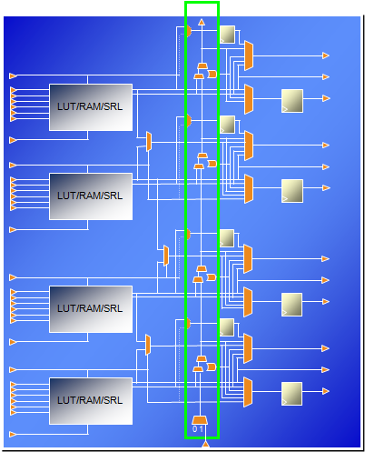
Carry Chain
Carry chain can implement fast arithmetic addition and subtraction
Carry out is propagated vertically through the four LUTs in a slice
The carry chain propagates from one slice to the slice in the same column in the CLB above
Carry look-ahead
Combinatorial carry look-ahead over the four LUTs in a slice
Implements faster carry cascading from slice to slice

Slide 14
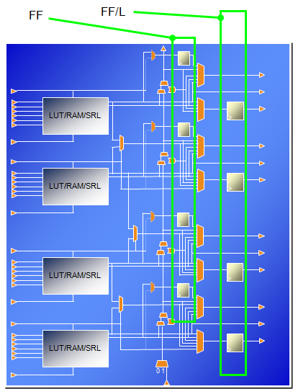
Slice Flip-Flops and Flip-Flop/Latches
Each slice has four flip-flop/latches (FF/L)
Can be configured as either flip-flops or latches
The D input can come from the O6 LUT output, the carry chain, the wide multiplexer, or the AX/BX/CX/DX slice input
Each slice also has four flip-flops (FF)
D input can come from O5 output or the AX/BX/CX/DX input
These don’t have access to the carry chain, wide multiplexers, or the slice inputs
If any of the FF/L are configured as latches, the four FFs are not available
Notes:
The four primary storage elements are referred to as “flip-flop/latch” elements. These correspond to the storage elements that existed in previous generations. They are named AFF/LATCH, BFF/LATCH, CFF/LATCH, and DFF/LATCH.
The four secondary storage elements are referred to simply as “flip-flop” elements. They are named AFF, BFF, CFF, and DFF.

Slide 15
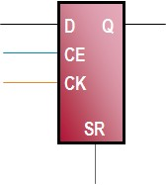
Slice Flip-Flop Capabilities
All flip-flops are D type
With Q output
All flip-flops have a single clock input (CK)
Clock can be inverted at the slice boundary
All flip-flops have an active high chip enable (CE)
All flip-flops have an active high SR input
Input can be synchronous or asynchronous as determined by the corresponding configuration bit
Sets the flip-flop value to a pre-determined state as determined by the corresponding configuration bit

Slide 16
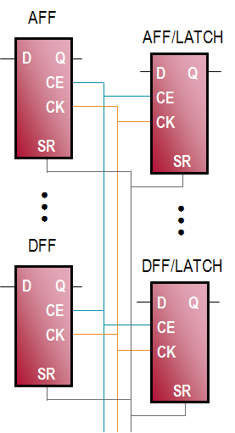
Control Sets
All flip-flops and flip-flop/latches share the same CK, SR, and CE signals
This is referred to as the "control set" of the flip-flops
CE and SR are active high
CK can be inverted at the slice boundary
If any one flip-flop uses a CE, all others must use the same CE
CE gates the clock at the slice boundary
Saves power
If any one flip-flop uses the SR, all others must use the same SR
The reset value used for each flip-flop is individually set by the SRVAL attribute

Slide 17
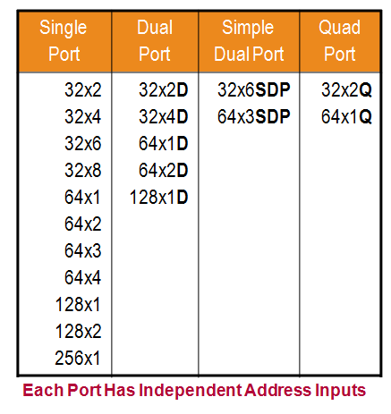
SLICEM Used as a Distributed SelectRAM Memory
SLICEM can be used for memory
Synchronous write, asynchronous read
Can be converted to synchronous read using the flip-flops available in the slice
Various configurations
Single port
One LUT6 = 64x1 or 32x2 RAM
Cascadable up to 256x1 RAM
Dual port (D)
1 read / write port + 1 read-only port
Simple dual port (SDP)
1 write-only port + 1 read-only port
Quad-port (Q)
1 read / write port + 3 read-only ports
Notes:
The look-up table functionality is essentially a small memory containing the desired output value for each combination of input values. These storage cells are programmed at configuration time, and the look-up itself is done by using the inputs as the control for a wide multiplexer.
By allowing these storage elements to be modified using FPGA fabric resources, the LUT can be used for the implementation of a small distributed memory.
Each LUT can be a single ported 64-bit RAM with synchronous write and asynchronous read. LUTs in slices can be combined to create small dual-port and multi-port RAMs.
Approximately one quarter of the slices in each 7-series device is a SLICEM, which has LUTs that can be used as distributed SelectRAMâ„¢ memory.

Slide 18
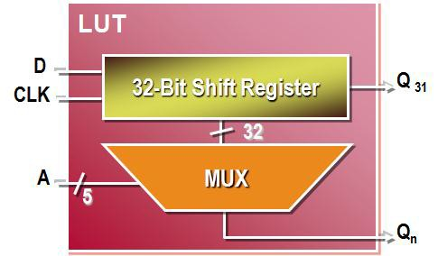
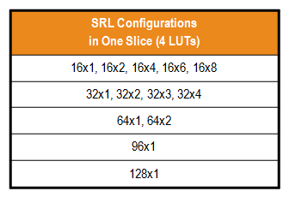
SLICEM Used as 32-bit Shift Register
SRL = Shift Register Lut
Versatile SRL-type shift registers
Variable-length shift register
Synchronous FIFOs
Content-Addressable Memory (CAM)
Pattern generator
Compensate for delay / latency
Shift register length is determined by the address
Constant value giving fixed delay line
Dynamic addressing for elastic buffer
Cascadable up to 128x1 shift register in one slice
Notes:
In the SLICEM slices, the LUT can also be configured as a dynamically addressable shift register. This component basically acts as a programmable pipeline delay element.
There are no set or reset capabilities, it is not loadable, and data can only be read serially. To ensure that software can map pipeline delays to the SRL, be sure to code them with these restrictions in mind.
Each LUT6 can implement a maximum delay of 32 clock cycles. The SRLs within a slice can be cascaded for longer shift registers (up to 128).
The shift register length can be changed asynchronously by changing the value applied to the address pins (A). This means that you can dynamically change the pipeline delay associated with an SRL.

Slide 19
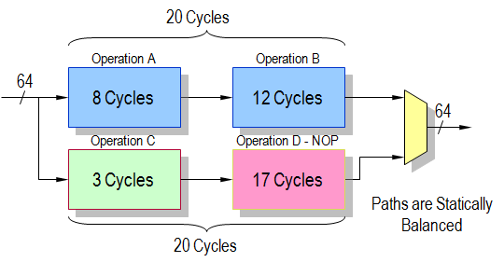
Shift Register LUT Example
Operation D - NOP must add 17 pipeline stages of 64 bits each
1,088 flip-flops (hence 136 slices) or
64 SRLs (hence 16 slices)
17-stage delay from SRL

Slide 20
Outline
Introduction to 7-Series FPGA
Logic Resources
I/O Resources
Memory and DSP48 Resources
XADC
Clocking Resources
Zynq SoC
Summary

Slide 21
I/O Interface Challenges
High-speed operation with maintained signal integrity
Source-synchronous operation (clock forwarding)
System-synchronous operation (common systems clock)
Terminate transmission lines to avoid signal reflections
Drive and receive data on wide parallel buses
Compensate for bus skew and clock timing errors
Conversion between serial and parallel data
Achieve very high bit rate (> 1 Gbps)
Single Data Rate (SDR) or Double Data Rate (DDR) interfaces
Interface to many different standards
Different voltages, drive strengths and protocols

Slide 22
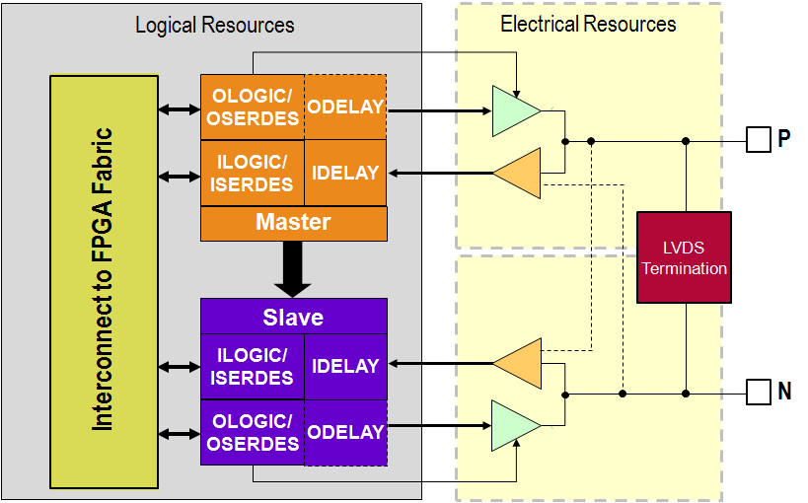
7-Series FPGA I/O
Wide range of voltages
1.2V to 3.3V operation
Wide I/O standards support
Single ended and differential
Referenced voltage inputs
3-state capability
Very high performance
Up to 1600 Mbps LVDS
Up to 1866 Mbps single-ended for DDR3
Easy memory interfacing
Hardware support for QDRII+ and DDR3
Digitally controlled impedance
Power reduction features

Slide 23
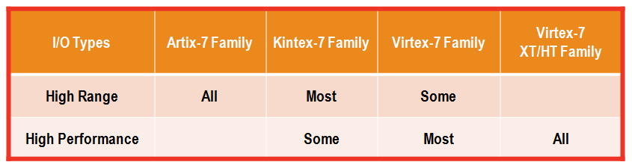
I/O Types
Two different types of I/O in 7-series FPGAs
High Range (HR)
Supports I/O standards with Vcco voltages up to 3.3V
High Performance (HP)
Supports I/O standards with Vcco voltages up to 1.8V only
Designed for the highest performance
Has ODELAY and DCI capability

Slide 24
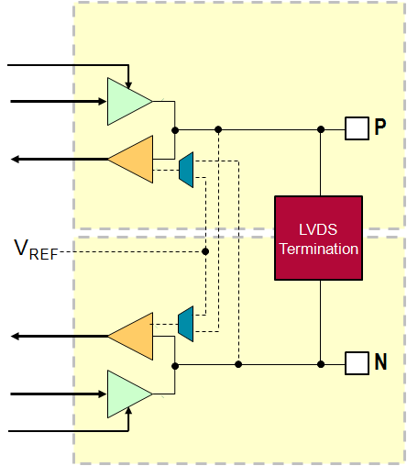
I/O Electrical Resources
P and N pins can be configured as
Individual single-ended signals or
Differential pair
Receiver can be standard CMOS or voltage comparator
When standard CMOS
Logic 0 when "near" ground
Logic 1 when "near" V_{CCO}
Referenced to V_{REF}
Logic 0 when below V_{REF}
Logic 1 when above V_{REF}
Differential
Logic 0 when V_{P} < V_{N}
Logic 1 when V_{P} > V_{N}
Notes:
The V_{REF} used for referenced protocols can either be provided from a pin or from an internally generated voltage.
If sourced externally, pins in the bank are used to provide the reference voltage.
The internally generated V_{REF} is derived from V_{CCAUX}, and must be set to the proper value using an attribute.
When the internally generated V_{REF} is used, the V_{REF} pins are available for user I/O.
There is a performance advantage to using an externally sourced V_{REF}

Slide 25
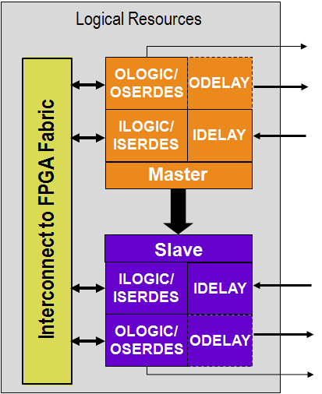
I/O Logical Resources
Two blocks of logic per I/O pair
Master and slave
Can operate independently or concatenated
Each block contains
ILOGIC/ISERDES
SDR, DDR, or high-speed serial input logic
OLOGIC/OSERDES
SDR, DDR, or high-speed serial output logic
IDELAY
Selectable fine-grained input delay
ODELAY
Selectable fine-grained output delay
Only available on High Performance I/O

Slide 26
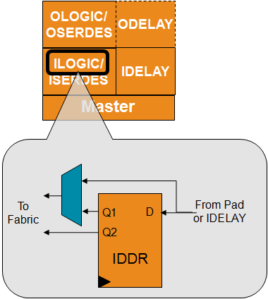
ILOGIC: Input SDR and DDR Logic
Two types of ILOGIC blocks
ILOGICE2 for High Performance banks
ILOGICE3 for High Range banks
Has zero hold delay capability
ILOGIC inputs come from the input receiver
Directly or via the IDELAY block
Outputs drive the FPGA fabric
Directly (no clocked logic) or
Via the IDDR
In SDR mode on rising or falling edge of clock
In DDR mode on both edges of clock
Can also use two clocks, 180° out of phase
Notes:
The ILOGICE3 (in High Range banks) supports the zero hold (ZHOLD) capability. When an IOB flip-flop is clocked directly from an input clock via a global buffer (with no MMCM or PLL for deskew), the tools will add the ZHOLD delay. This delay is internally balanced with the clock insertion delay to ensure that there is a zero or negative hold time requirement for the IOB flip-flop.

Slide 27
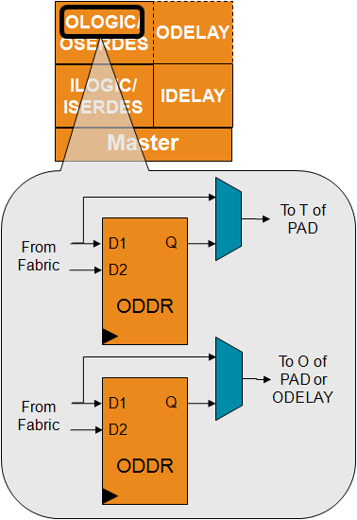
OLOGIC: Output SDR and DDR Logic
OLOGICE2 for HP banks, OLOGICE3 for HR banks
Output of OLOGIC connects to the output driver directly, or via the ODELAY
ODELAY is available in HP banks only
Output is driven directly from the fabric
Directly, through an SDR flip-flop or via the ODDR using both edges of clock
Each OLOGIC block contains two ODDR
One for controlling the data to the output driver
One for controlling the 3-state enable
Both ODDR are driven by same clock and reset
SAME_EDGE or OPPOSITE_EDGE only

Slide 28
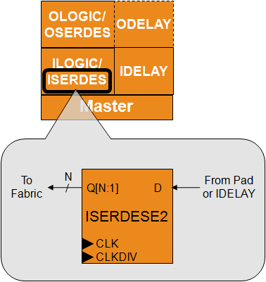
ISERDES: Input Serial-to-Parallel Converter
Clocks in data from input pad or IDELAY
D is clocked on high speed clock (CLK)
Can be SDR or DDR
Sends de-serialized data to fabric
Q is clocked on low speed clock (CLKDIV)
CLK and CLKDIV must be in phase
De-serializes data
Single data rate: 2, 3, 4, 5, 6, 7, 8
Double data rate: 4, 6, 8
Cascade with slave for wider ratios
Double data rate: 10, 14
Has BITSLIP logic for framing parallel data
Notes:
When used in NETWORK mode, the ISERDESE2 provides a powerful mechanism to interface to high-speed, clock-forwarded interfaces.
The ISERDESE2 also supports modes of MEMORY, MEMORY_QDR, and MEMORY_DDR3. In these modes, different clocking options, including support for direct clocking by the data strobe from the memories, is supported. These modes should only be used through the Memory Interface Generator (MIG) interface.
The final mode, OVERSAMPLE, allows the data to be sampled on four phases of the low speed clock, each separated by 90°; no high-speed clock is necessary.
The top-most and bottom-most IOB in each bank do not have an associated slave IOB. Therefore, these pins only support de-serialization rates up to 1:8.
ISERDES has a bitslip mechanism which allows the application to control the framing of the received data.

Slide 29
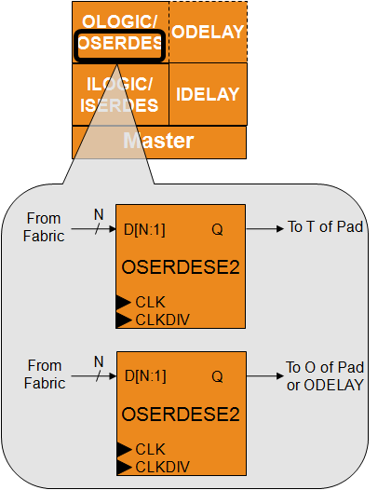
OSERDES: Output Parallel-to-Serial Converter
Serializes out data to output pad or ODELAY
Q is clocked on high speed clock (CLK)
Can be SDR or DDR
Parallel data comes from fabric
D is synchronous to low speed clock (CLKDIV)
CLK and CLKDIV must be in phase
Serializes data
Single data rate: 2, 3, 4, 5, 6, 7, 8
Double data rate: 4, 6, 8
Cascade with slave for wider ratios
Double data rate: 10, 14
When using 3-state serializer, both the data and 3-state width must be 4
Clocks are shared between both serializers
Notes:
The OSERDES is conceptually the opposite of the ISERDES. It accepts up to 8 bits of data on one OSERDES, or 14 bits when the master and slave are cascaded, and serializes them out on a high speed clock (SDR or DDR).
There are two output serializers, one for data and one for the 3-state control. They share the same set of clocks (CLK and CLKDIV); hence, they must have the same serialization. The 3-state serializer can only do 4:1 serialization, so it can only be used when the data serializer is also doing 4:1 serialization.
The top-most and bottom-most IOB in each bank do not have an associated slave IOB. Therefore, these pins only support serialization rates up to 8:1.

Slide 30
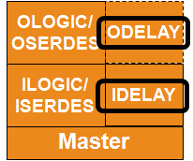
IDELAY and ODELAY
Separate IDELAY and ODELAY delay lines
IDELAY is available in both HR and HP banks
ODELAY is only available in HP banks
Delay line elements are calibrated using the IDELAYCTRL cell
Delay is process, temperature, and voltage independent
IDELAY and ODELAY have almost identical capabilities
IDELAY can also be accessed from the fabric
Tap counter value can be accessed via FPGA fabric
Monitor, increment, decrement, or set the tap value; tap value can be from 0 to 31
Reference frequency can be 200 MHz in all speed grades; 300 MHz is also allowed in fastest speed grade
Results in 78 ps or 52 ps per tap
Notes:
In previous generations, each IOB had a single delay chain that could be used as a variable input delay or a fixed output delay. The delay could be “turned around” using the 3-state enable.
In 7-series devices, the IODELAY is no longer shared; HP banks have a separate IDELAY and ODELAY, each of which can be fixed or variable.
HR banks only have an IDELAY, which cannot be shared between the input and output.
The IDELAY is also accessible for internal delays.

Slide 31
Outline
Introduction to 7-Series FPGA
Logic Resources
I/O Resources
Memory and DSP48 Resources
XADC
Clocking Resources
Zynq SoC
Summary

Slide 32
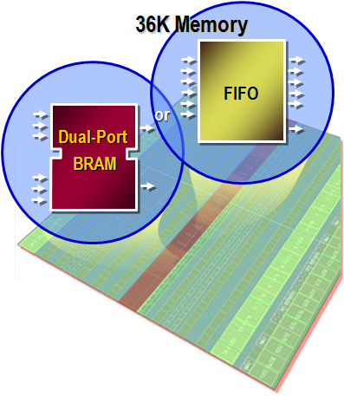
7-Series Block RAM and FIFO
All members of the 7-series families have the same Block RAM/FIFO
Fully synchronous operation
All operations are synchronous; all outputs are latched
Optional internal pipeline register for higher frequency operation
Two independent ports access common data
Individual address, clock, write enable, clock enable
Independent data widths for each port

Slide 33
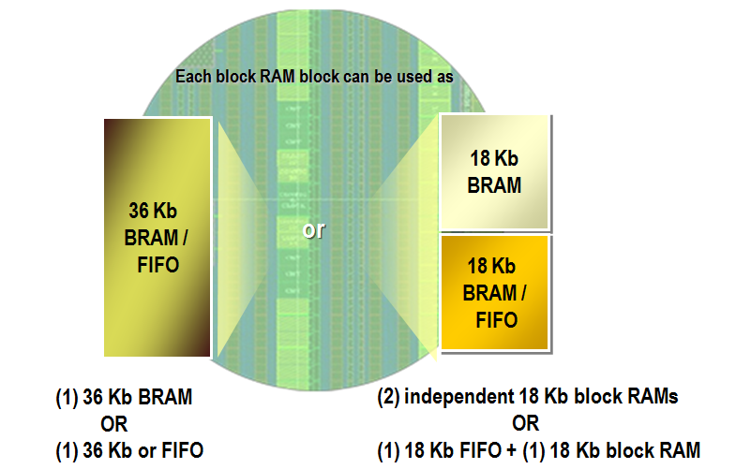
7-Series Block RAM and FIFO
Multiple configuration options
True dual-port, simple dual-port, single-port
Integrated cascade logic
Byte-write enable in wider configurations
Integrated control for fast and efficient FIFOs
Integrated 64 / 72-bit Hamming error correction
Separate Vbram voltage supply rail to ensure block memory functionality in -1L

Slide 34
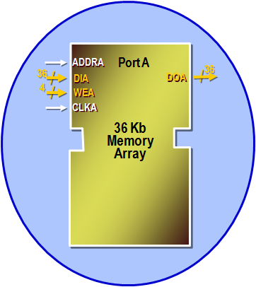
Single-Port Block RAM
Single read/write port
Clock: CLKA, Address: ADDRA, Write enable: WEA
Write data: DIA, Read data: DOA
36-kbit configurations
32k x 1, 16k x 2, 8k x 4, 4k x 9, 2k x 18, 1k x 36
18-kbit configurations
16k x 1, 8k x 2, 4k x 4, 2k x 9, 1k x 18, 512 x 36
Configurable write mode
WRITE_FIRST: Data written on DIA is available on DOA
READ_FIRST: Old contents of RAM at ADDRA is presented on DOA
NO_CHANGE: The DOA holds its previous value (saves power)
Optional output register for maximum performance (DOA_REG=1)
Notes:
In addition to the signals shown above, the RAM port also has:
RAM enable: ENA
Output latch reset: RSTRAMA
Output register reset: RSTREGA
Output register chip enable: REGCEA
The optional output register adds one clock of read latency, but enables the highest clock frequencies
For simplicity, the DIA and DOA busses are shown as including the parity bits, which are actually on separate buses, DIPA and DOPA.
The polarity of the RST, CE, and CLK signals are programmable. The RST signals are synchronous.
The priority of REGCEA over RSTREGA is programmable via the RSTREG_PRIORITY attribute.
It is important to ensure that no timing violations occur on the address pins of the RAM, even if the write enable is not asserted. Violating address timing (even during a read operation) can corrupt the RAM contents.

Slide 35
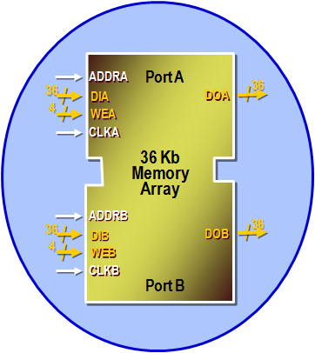
Dual-Port Block RAM
Two separate read/write ports
Each port has separate clock, address, data in, data out, write enable…
Clocks can be asynchronous to each other
The two ports can have different widths
Same configurations as when single ported
The two ports can have different write modes
No contention avoidance when both ports access the same address, except
If clocked by the same clock, and the write port is READ_FIRST, the read port gets the old data
Notes:
Because the two ports can operate on independent clocks, it is up to the user to avoid contention. If both ports attempt to write to the same location “too close together”, the contents of that RAM location can be corrupted. If one port attempts to read from an address that is being written from the other port, the read result will be unpredictable.
In the special case where both ports are clocked by the same clock signal (that is, the two ports are synchronous), and the write port is in READ_FIRST mode, then the other port can read the old contents of a RAM location while the new value is being written.

Slide 36
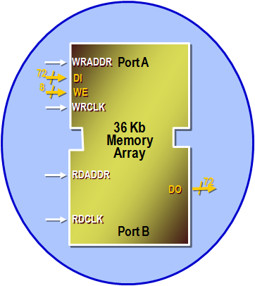
Simple Dual-Port Block RAM
One read port and one write port
Each port has separate clock and address
In 36-kbit configuration, one of the two ports must be 72 bits wide
The other port can be x1, x2, x4, x9, x18, x36, or x72
In 18-kbit configuration, one of the two ports must be 36 bits wide
The other port can be x1, x2, x4, x9, x18, or x36

Slide 37
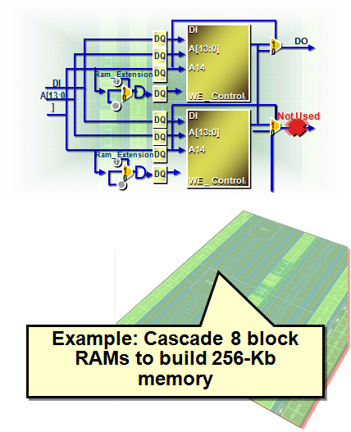
Block RAM Cascading
Built-in cascade logic for 64Kx1
Cascade two vertically adjacent 32Kx1 block RAMs without using external CLB logic or compromising performance
Saves resources and improves speed of larger memories
Cascade option for larger arrays
128Kb, 256Kb, 512Kb, 1 Mb, …
Using external CLB logic for depth expansion
Not quite as fast as cascaded block RAMs
Width expansion uses parallel block RAMs
Notes:
The address and cascade connections do not cross onto the silicon interposer for devices that use stacked silicon interconnect technology. When cascading adjacent RAMs, ensure that the two RAMs do not straddle an SLR boundary.

Slide 38
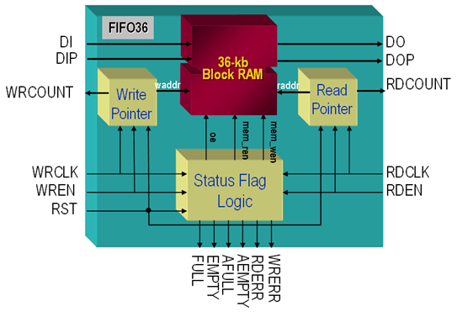
FIFO
Full featured
Synchronous or asynchronous read and write clocks
Four flags
Full, empty, programmable almost-full/empty
Optional first-word-fall-through
FIFO configurations
Any 36-Kb block RAM: 8Kx4, 4Kx9, 2Kx18, 1Kx36, 512x72
Any 18-Kb block RAM: 4Kx4, 2Kx9, 1Kx18, 512x36
Write and read width must be equal
Can use the integrated error correction when used in the x72 width

Slide 39
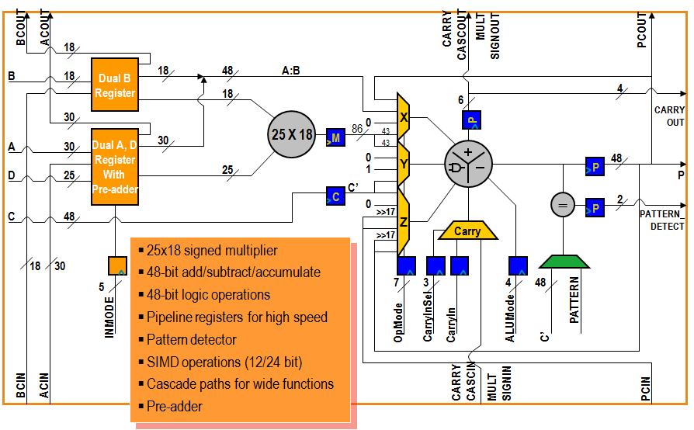
7-Series DSP48E1 Slice
Notes:
All 7-series FPGAs contain the same DSP48E1 slice. Only the number of slices and maximum frequency vary from family to family.
C’ denotes the output of the optional C pipeline register. This bus is one input of the pattern detect multiplexer; the other input is the 48-bit PATTERN attribute.
In order to implement most DSP functions, certain features are required of a DSP slice:
Input conditioning – including pre-addition and pipeline control.
Pipelining – for maximum performance and the implementation of sample delays (Z-1).
Multiplication – the basis of most DSP functions.
Operation control – to support different operations.
Addition – for multiply-accumulation.
Product register – for performance, sample delays, and accumulation.
Cascade paths (not shown) – for chaining together DSP slices.

Slide 40
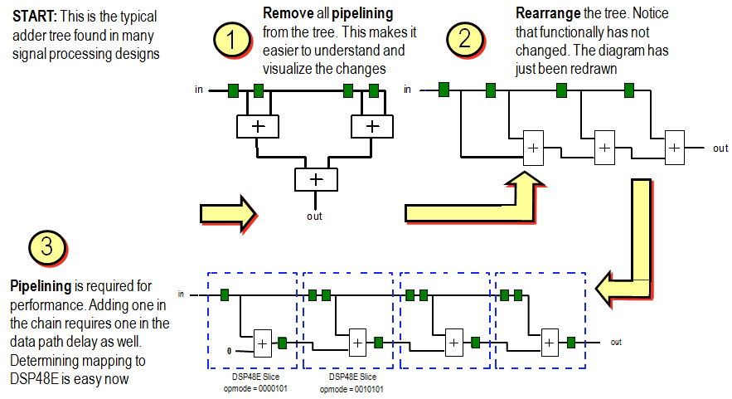
Using DSP48 for Non-DSP Function
Notes:
The DSP slice is not only useful for DSP operations—many other operations can be implemented using this structure:
Multiplication
Wide adders/accumulators
Pipelined adders
Wide multiplexers
This example illustrates how to rearrange a multi-input pipelined adder tree for implementation as an adder chain implementation, which is better suited for DSP48 slices.

Slide 41
Outline
Introduction to 7-Series FPGA
Logic Resources
I/O Resources
Memory and DSP48 Resources
XADC
Clocking Resources
Zynq SoC
Summary

Slide 42
XADC and AMS
XADC is a high quality and flexible analog interface new to the 7-series
Dual 12-bit 1Msps ADCs, on-chip sensors, 17 flexible analog inputs, and track & holds with programmable signal conditioning
1V input range
16-bit resolution conversion
Built in digital gain and offset calibration
Analog Mixed Signal (AMS)
Using the FPGA programmable logic to customize the XADC and replace other external analog functions; for example, linearization, calibration, filtering, and DC balancing to improve data conversion resolution
Notes:
The integration of the XADC block now allows FPGAs to support a general-purpose analog interface that can address a wide range of applications.
More importantly with the combination of the XADC with the programmable logic and resources in the FPGA, a highly customized analog interface can be implemented.
AMS is the combination of analog and programmable logic (WP398: Agile Mixed Signal Addresses Analog Design Challenges).

Slide 43
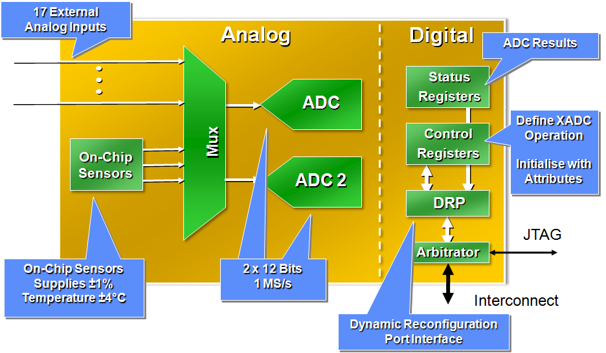
XADC Block Diagram
Fast sampling
Conversion time of 1 us with support for simultaneous sampling
Flexible timing modes (self and externally triggered sampling modes)
Separate track/hold amplifier for each ADC ensures maximum throughput using multiplexed analog input channels
Flexible analog inputs
Differential analog inputs with high common mode noise rejection
Support for unipolar, bipolar, and true differential input signal types

Slide 44
XADC’s Other Features
Internal and external multiplexing and sampling
Can sample internal power supplies and temperature
Multiplexes internal sources and 17 external analog inputs
Can control an external analog multiplexer to reduce pin count
Flexible triggering
Conversion data is stored in internal status registers
Internal control registers control source selection, sampling, and alarms
Registers can be accessed internally via the dynamic reconfiguration port (DRP)
Register can be accessed via JTAG
Available on power up, before configuration
Operates over a wide temperature range (–40°C to +125°C)

Slide 45
Outline
Introduction to 7-Series FPGA
Logic Resources
I/O Resources
Memory and DSP48 Resources
XADC
Clocking Resources
Zynq SoC
Summary

Slide 46
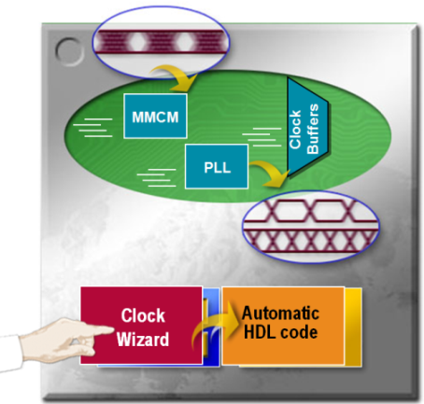
7-Series FPGAs Clock Management
Global clock buffers
High fanout clock distribution buffer
Low-skew clock distribution
Regional clock routing
Clock regions
Each clock region is 50 CLBs high and spans half the device
Clock management tile (CMT)
One Mixed-Mode Clock Managers (MMCMs) and one Phase Locked Loop (PLL) in each Clock
Performs frequency synthesis, clock de-skew, and jitter-filtering
High input frequency range
Simple design creation through the Clocking Wizard

Slide 47
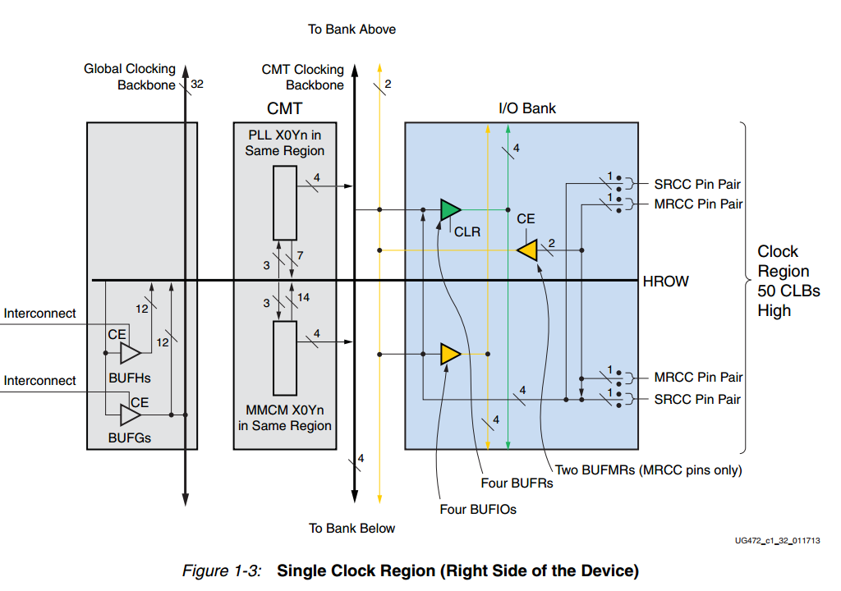
Clock-Capable Inputs
All synchronous designs need at least one external clock reference
These clocks need to be brought into the FPGA
Every 7-series FPGA has clock-capable inputs in every I/O bank
These inputs are regular I/O pins with dedicated connections to internal clock resources
Each I/O bank has 4 clock capable pins
2x Multi-Region Clock Capable (MRCC)
2x Single Region Clock Capable (SRCC)
Each clock input can be used as a single-ended clock input, or can be paired with an adjacent pin to form a differential clock input
Each bank can therefore have four single-ended or four differential clock inputs
Notes:
Clock-capable pins will have the identifier “CC” in their pin name.
An IBUFG or IBUFGDS primitive can be used in your HDL code to indicate that an input must be mapped to a clock-capable pin

Slide 48
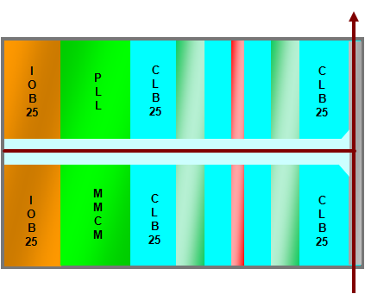
7-Series FPGA Clock Regions
Larger clock region than previous families
50 CLBs high, 50 I/Os high
Same size as I/O bank
Half width of device
2–24 regions per device for 7-Series
Resources per clock region
12 global clock networks
Driven by BUFH
4 regional clock networks
Driven by BUFR
4 I/O clock networks
Driven by BUFIO

Slide 49
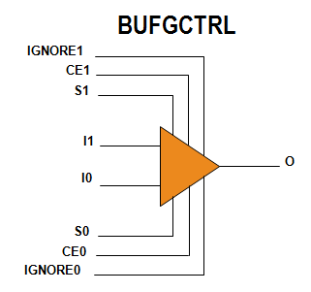
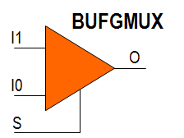
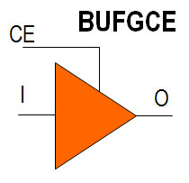
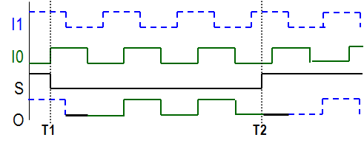
Global Clock Buffer (BUFGCTRL)
BUFGCTRLs (or BUFG) reside in the center of the device
BUFGCTRLs can be driven by
Clock-capable I/O (CCIO) in the same half
CMT outputs in the same half
Gigabit transceiver clocks in the same half
Other BUFG, interconnect, or BUFR
BUFGCTRL outputs drive the vertical global clock spine
BUFGCTRL component implements
Simple clock buffer (BUFG)
Clock buffer with clock switching (BUFGMUX or BUFGMUX_CTRL)
Clock buffer with clock enable (BUFGCE)

Slide 50
Outline
Introduction to 7-Series FPGA
Logic Resources
I/O Resources
Memory and DSP48 Resources
XADC
Clocking Resources
Zynq SoC
Summary

Slide 51
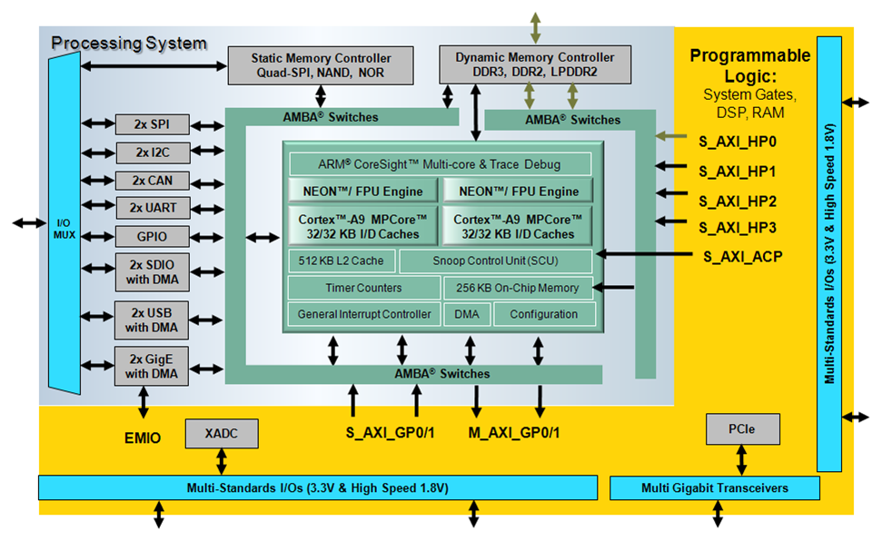
Zynq-7000 Family Highlights
Complete ARM®-based processing system
Application Processor Unit (APU)
Dual ARM Cortex™-A9 processors
Caches and support blocks
Fully integrated memory controllers
I/O peripherals
Tightly integrated programmable logic
Used to extend the processing system
Scalable density and performance
Flexible array of I/O
Wide range of external multi-standard I/O
High-performance integrated serial transceivers
Analog-to-digital converter inputs

Slide 52
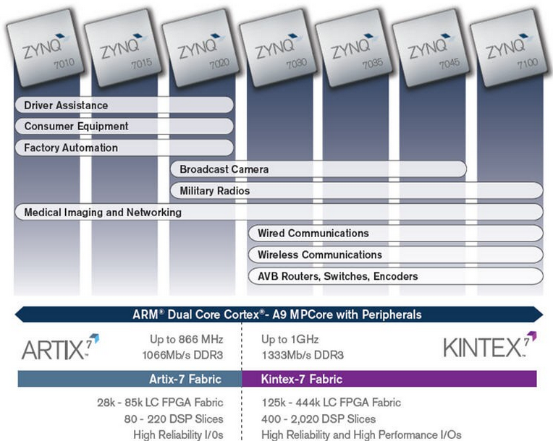
The PS and the PL
The Zynq-7000 AP SoC architecture consists of two major sections
PS: Processing system
Dual ARM Cortex-A9 processor based
Multiple peripherals
Hard silicon core
PL: Programmable logic
Shares the same 7-series programmable logic as
Artix™-based devices: Z-7010, Z-7015 and Z-7020 (high-range I/O banks only)
Kintex™-based devices: Z-7030, Z-7035, Z-7045 and Z-7100 (mix of high-range and high-performance I/O banks)

Slide 53
Outline
Introduction to 7-Series FPGA
Logic Resources
I/O Resources
Memory and DSP48 Resources
XADC
Clocking Resources
Zynq SoC
Summary

Slide 54
Summary
The 7-series FPGA slices contain four 6-input LUTs, eight registers, and carry logic
LUTs can perform any combinatorial function of up to six inputs
LUTs are connected with dedicated multiplexers and carry logic
Some LUTs can be configured as shift registers or memories
Slices also contain carry logic and the MUXF7 and MUXF8 multiplexers
The MUXF7 multiplexers combine LUT outputs to create 7-input functions or 8-input multiplexers
The MUXF8 multiplexers combine the MUXF7 outputs to create 8-input functions or 16-input multiplexers
The carry logic can be used to implement fast addition, subtraction, and comparison operations
The 7-series FPGA IOBs contain DDR registers as well as SERDES resources
The SelectIO™ interfaces enable direct connection to multiple I/O standards

Slide 55
Summary
The 7-series FPGA includes dedicated block RAM and DSP slice resources
The 7-series FPGAs includes dedicated MMCMs, PLLs, and routing resources to improve your system clock performance and generation capability
The 7-series FPGAs include other dedicated hardware such as XADC
The Zynq-7000 processing platform is a system on a chip (SoC) processor with embedded programmable logic fabric of either Artix or Kintex 7-series FPGA

